Slide 1
Future of Grid in India & Renewables Integration
a PTC India presentation
Sanjeev Mehra
Executive Vice President

Slide 2
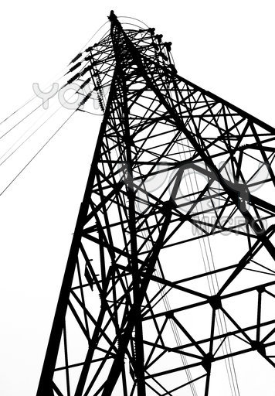
The Grid
Largest Machine in India
- 2,93,972 ckm of transmission lines
11,23,906 ckm of distribution lines
26,25,36,597 kVA of distribution transformers
4,28,000 transmission substations
Few outages are enough to bleed Indians of at least 15000 Cr/- annually

Slide 3
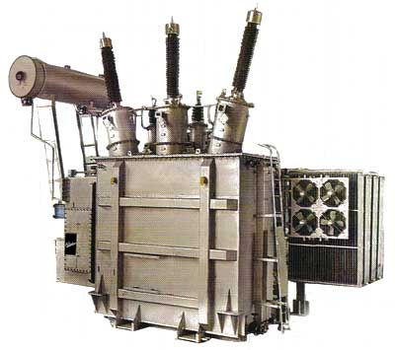
The largest machine is also one of the weakest in the world
· Poorly planned distribution networks
· Overloading of system components
· Lack of reactive power support and regulation services
· Low metering efficiency and bill collection
· Power theft

Slide 4
Power Outages
Transmission & Distribution Losses
Thefts & Illegal Siphoning
Security Threats
Supply Shortfalls
Peak Load Management
Renewable Energy Sources
Juggling Power

Slide 5
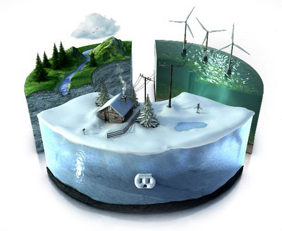
If you find yourself dropping balls while juggling, either quit juggling or become a better juggler
Smart Grid
Lets Juggle Better

Slide 6
Smart Grid
Smart Grid is a from our current centralized, unidirectional producer-controlled network to one that is less centralized and more consumer-interactive, using (i)two way digital communications and (ii)monitoring and (iii)control systems, saving energy and reducing costs making the system more reliable and transparent.
transition
Smart Grid involves :-
- connecting millions of embedded and distributed intelligent agents sensors, switches, meters, and other devices) to various devices on the electricity grid
- collecting, analyzing & auditing information on a real-time /defined-time basis

Slide 7
Potential Benefits
AT&C Loss reduction
Seamless Power Trading
Energy Accounting
Smart Grid
Alternate Energy integration
Peak Load & Demand Side Management
Power Quality
Asset Management
Outage Management
& Reliability
Notes:
Peak load reduction. TOD price signals has unique potential for India.
AT& C loss reduction. This is a major commercial and regulatory consideration. Discoms
may consider communication technology.
Self-healing. A smart grid automatically detects and responds to routine problems and
quickly recovers, minimizing downtime and financial loss.
Consumer motivation. Smart grids give consumers visibility into pricing offers an
opportunity to control usage
Attack resistance. Smart grids have security built-in from the ground up.
Improved power quality. A smart grid helps provide power free of sags, spikes,
disturbances and interruptions.
Accommodation of all generation and storage options. Enables interconnection to
distributed sources of power and storage
Enabled markets. Supports investment and innovation.
Optimized assets and operating efficiently. Lowers need for construction of new
infrastructure and enables sale of more power through existing system.

Slide 8
Smart Grid Deliverables
AT&C Loss detection, alert and control
Accurate measurements using smart metering
100% 3Φ & 1Φ consumer-wise real time monitoring for theft, tampering, leakages
Detection of major and minor losses (I²R, Reactive power, THD,…)
Asset Management
Asset mapping on GIS
Asset tracking
Preventive maintenance thru real time transformer health monitoring (Temp, Voltage, Current, Oil)
Asset theft (optional, in high theft-prone areas) real time alert and tracking
Scientific network planning
(using smart grid data provided on Load, GIS, consumer’s consumption pattern, etc)
for feeder realignment to lower losses
for feeder reconfiguration to deliver higher reliability using automated switchover
capacity planning
Islanding for reliability and security

Slide 9
Smart Grid Deliverables
Load Management
Load Capping
Rolling Shutdown
Curtailment by select consumer class for social, commercial, other objectives
Off-peak power drawn above “load sanctioned”
Outage Management
Real time event alerts to utility via SMS and email
Event location with GIS map, nature of event, prompt for action response, resolution log
Interactive web-based GUI at control offices
Increases manpower productivity and reduces time to resolution
Energy Accounting & Data Management
Real time measurement of per phase KW, KWHr, KVA, KVAh, V, I; hourly energy cost, energy rate, time and date, power factor & frequency using smart metering & AMI
Daily/Weekly/Monthly/Annual upto-date reporting(data/charts/…) as required by utility
Load forecasting

Slide 10
Smart Grid Deliverables
Improved Reliability
Lower interruptions in energy availability
Reports on utility indices (CAIDI, SAIFI,….) as needed for utility’s requirements
Improved Power Quality
Real time voltage and power factor improvements
Alerts for various deviations
Billing
Accurate billing with shorter cycles
Real time up-to-date bill value On-demand thru SMS / web
SMS reminders (on bill generation, near due date, on overdue, on payment)
Pre paid billing for all consumers, dynamically when required.
Ready for TOU billing
KVA billing for all consumer classes possible
Payment Gateways

Slide 11
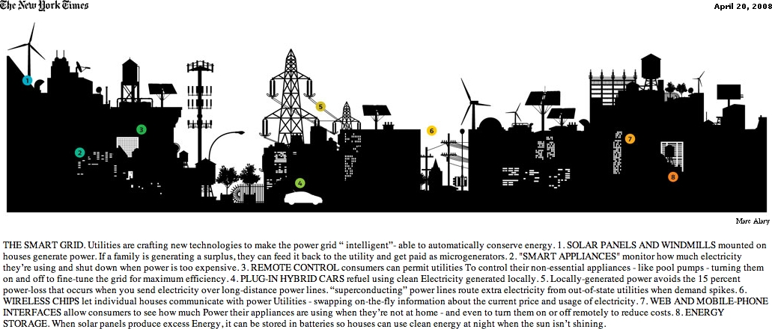
Smart Technologies
Demand response
Capacitor control
Islanding
Time-of-use tariffs
Distributed, standby and off-grid generation
Renewable energy
DSM and LM (Security )
Mini-SCADA
Outage monitoring and evaluation
Remote disconnection and reconnection
Automated Meter Reading

Slide 12
Everything is difficult until easy
Challenges
Indian Perspective

Slide 13
Business Model
The business model adapted for implementation of Smart Grids will determine the execution of the projects.
1. Public Private Partnerships (PPP)
- Technology providers will share technology and processes
- Utility will implement the project
2. Grants/Incentives (Government financing)
- Provide Policy and Programmatic Leadership
- Technical Support
- Capacity Building
3. Utility Financing
- Manage the Process
- Establish Technical Group
- Implement the Project
4. Energy Savings Model (ESCO)
-Implementing agency to arrange for funding
- Monetization of savings for returns
- Financial / Technical Risk with implementing agency

Slide 14
The Challenge
Renewable Energy Integration
There are a number of potential challenges inherent in integrating renewable energy into the existing grid—due in large part to its infirm and distributed nature—that utilities will need to address in order to capitalize on the renewables opportunity. The lack of an effective electricity storage system means utilities must deal with unwanted supply during low-demand hours and insufficient supply during peak-demand times.
Thanks to technology, alternate/renewable energy integration is one of the most important benefit Smart Grid serves.
But, there are few issues one needs to consider even after renewable integration.

Slide 15
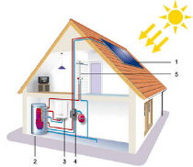
Renewable Sources
Solar energy can be harnessed by installing even solar cells on rooftops. This can as well be integrated to Smart Grids enabling a consumer to inject electricity into the grid. As a result, certain issues and regulations should revolve around such a benefit.
Whether user generation will comply to grid code?
Whether user generation will synchronize with existing grid?
Will user injected power (reverse flow) be feasible?
Can user injected power be blocked?
What tariff regulations may exist for user injected power?
Will injected power affect transmission loads?
Will solar cells installed need standardization?
-For achieving benefits of Smart Grid efficiently, such issues should be addressed through regulations and standardizations. Systemized, standardized Smart Grids can be replicated effectively.

Slide 16
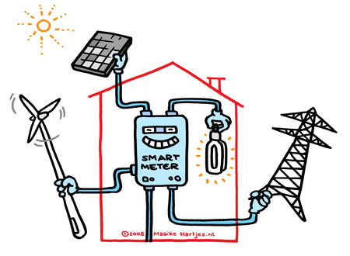
Generic Concerns
Establishment of Smart Grid Code.
Control and monitoring regulations, laws and by-rules
Risk management
Safeguarding and securing Smart Grid architecture
Reverse flow regulations

Slide 17
Regulatory Perspective
1. Provide new business and investment regulations.
2. Provide flexibility to utility for offering to consumer different options of
retail tariff.
3. Innovative tariff design to flatten the load curve
4. Policies to encourage generation of renewable energy and integration of
distributed renewable and captive generation with system
Notes:
Shift from traditional investment approval procedure 2.Provide flexibility to utility for offering to consumer different options of retail tariff.3.Innovative tariff design to flatten the load curve4.Policies to encourage integration of Distributed generation with system –RE and Captive.5.Involve societal stakeholders such as environment, health conscious to bear the partial cost for the smart grids6.Involve communication authorities for creating infrastructure to meet the communication needs of power sectorRealization

Slide 18
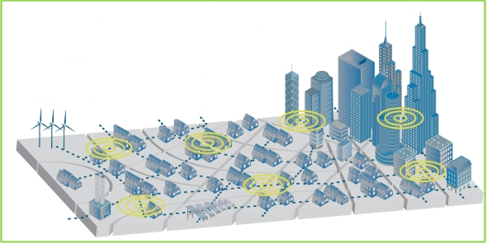
Technology Perspective
Identification of right technology and scope
Limited availability of proven technology for Indian Environment
Capacity building of consumer to adopt to smart grid technology
Phase-wise implementation of Smart Grids
Increased interaction of utility beyond meters
Safety and privacy of consumer and data
Standardization of architecture and devices
Obsolete natures of technology

Slide 19
The Road Ahead
I. Identify opportunities for your utility
- Establish targets / goals for the future.
Assess the present condition
Identify what needs to be done to fill the gap
II. Develop and record understandings
Is the project economically justifiable? If not, what is the compelling case to do the project?
Test the technology; conduct pilot projects.
Lessons learned before scaling up.
Equipment and vendor qualification
Expand the implementation

Slide 20
Bringing life to power since 12 years of innovation and services
PTC India Ltd.
Thank You

