Slide 1



E-Mobility and Charging Infrastructure
14 January 2021
N. Mohan
Dy. General Manager, EESL
(Head, Electric Vehicle Charging Infrastructure)
Email – nmohan@eesl.co.in.

Slide 2







About Energy Efficiency Services Limited
Joint venture of four Central Public Sector Undertakings under Ministry of Power, Government of India
Convergence Energy Services Limited – A wholly owned subsidiary of EESL
Interventions have created access to innovative and future-ready energy efficiency technologies for domestic consumers, including households, commercial establishments, industries & public facilities
Growth-oriented organization founded in 2010, has become a leader in transforming markets for energy efficiency in India and abroad. Programs operational in UK, Malaysia, Thailand, Saudi Arabia, Ireland, Canada, Vietnam and Myanmar

Slide 3
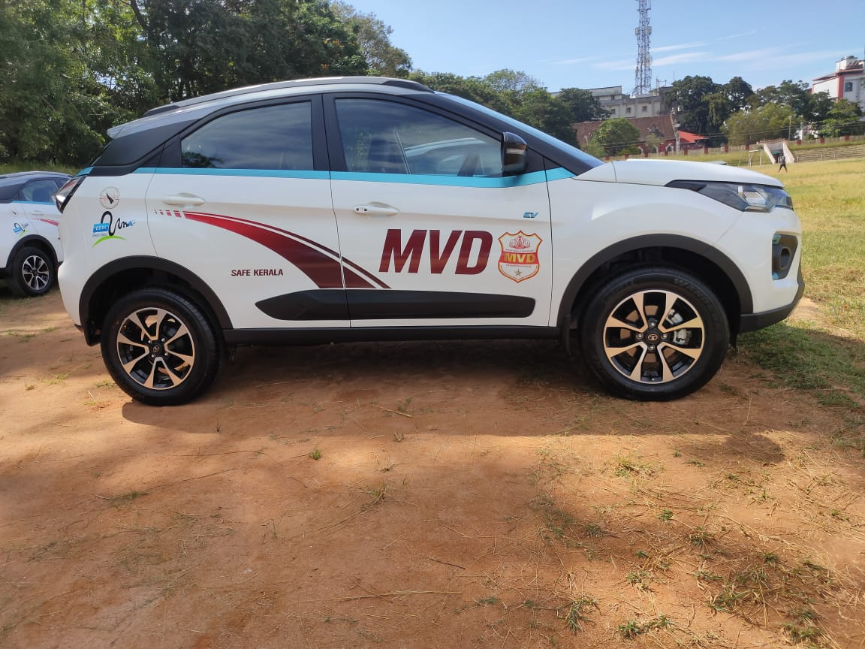
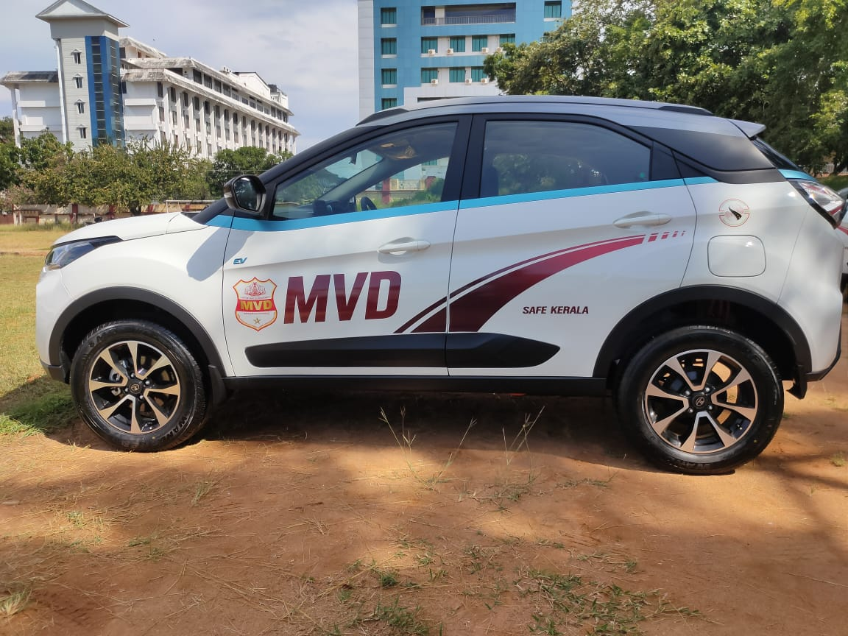
National e-mobility Programme of EESL
National e-mobility Programme of EESL
Launched in March 2018
Goal: Provide an impetus for Indian EV manufacturers, charging infrastructure companies, fleet operators, service providers, etc. to gain efficiencies of scale and drive down costs, create local manufacturing facilities, and grow technical competencies for the long-term growth of the EV industry in India
EESL has aggregated demand of EVs and chargers from various government departments such as the Prime Minister’s Office, Fifteenth Finance Commission, MoP, NITI Aayog, UN Environment, NDMC, SDMC, GMDA, NTPC, PGCIL, PFC, among others
EESL has already deployed around 1,500+ EVs and 1225+ captive points across Government offices in the country
70 Long Range EV’s deployed by EESL to Kerala Motor Vehicle Department (MVD) through ANERT in Kerala State .
*ANERT; Agency for Non-conventional Energy and Rural Technology

Slide 4
EESL’s National Electric Mobility Dashboard
https://ev.eeslindia.org/evdashboard/#/

Slide 5
EV Ecosystem Challenges
Lack of charging infrastructure
High upfront cost
FAME II expected to lower the upfront cost for EV’s and Chargers
$
Viability of public charging infrastructure a key challenge – key variables
Upfront costs*
Utilization
Operational cost **
Provision of Land
Limited EV models
No. of OEMs in process of launching new EV models (in view of the policy direction)
*Cost of EV Supply Equipment and related infrastructure such as canopy structure, barricading, meter and meter box, and accessories such as canopy, LED screens, CCTV camera
** Gateway charges, parking charges, insurance premium

Slide 6
To enable ecosystem for charging infrastructure

Slide 7
Approach for installation of Public Charging Stations
1
2
3
4
5
Approach and Design
Location Assessment
Operation
Sustainability of business operation
Implementation
Categorizing city into a grid of 3km x 3km
Secondary assessment of potential focus areas
Stakeholder mapping and business model blueprint
List of sites for assessment
Formation of joint survey team
Site visit and assessment on pre-defined parameters
Agreement signing with the land partners
Application for power connection with DISCOM
Procurement of charger
Installation of charger
Operation and maintenance of chargers
Monitoring and Evaluation
Customer service
Cost recovery
Tie ups with OEMs and fleet operators
Other sources of revenue
Innovative pricing and periodic review

Slide 8
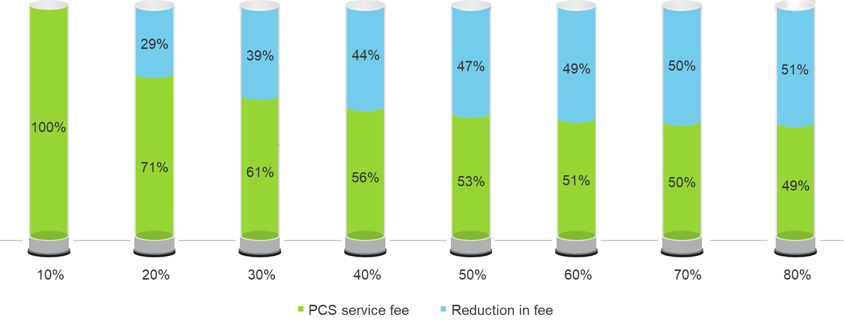
Need for location assessment
Utilization impacts the viability
Ensuring high utilization of PCS is essential for viability of a PCS business
To ensure higher utilization, location assessment is required to assess the footfall / popularity of a particular location
Optimize the costs
Another factor that impacts the business viability is costs
Apart from the cost of EVSE, grid infrastructure costs form a significant part of CAPEX
To ensure a lower installation cost, location assessment is required to estimate the cost of civil works and cost of power connection

Slide 9
Business Model Design for PCS
EESL ties-up with land partners to install PCS
EESL owns and operates PCS over their life-time (~10 years)
Win-win value proposition for EV users
Load sanction Application
Service Agreement
Unique mechanism of land leasing from local municipality
EESL
Land Partners
Procure, Install, Operate and maintain
Demand aggregation by EESL enabling bulk procurement
Land / Park space
Power Utility
Land rental
Power tariff
Power connection
Low cost financing used by EESL
EVSE
EV charging tariff
Charging service
Co-ordination
Delivery
Land rental on energy basis
Affordable PCS services for the end-consumers
User
Cash flow

Slide 10
Deployment of EV Chargers under DHI - FAME India Scheme Phase II
Sr. No. | Name of the state | Name of the city | No. of charging station | Type of EV Charging Stations | No. of EV chargers at each charging station |  | Total no. of EV chargers
 |  |  |  |  | DC 001 (15 KW) | CCS2 + CHAdeMO+ Type 2 AC (122 KW)
1 | Maharashtra | Mumbai | 33 | Fast | 33 | 66 | 99
 |  | Nagpur | 38 | Fast | 38 | 76 | 114
2 | Tamil Nadu | Chennai | 26 | Fast | 26 | 52 | 78
3 | Telangana | Hyderabad | 49 | Fast | 49 | 98 | 147
4 | Gujarat | Ahmedabad | 82 | Fast | 82 | 164 | 246
5 | West Bengal | Kolkata | 23 | Fast | 23 | 46 | 69
6 | Rajasthan | Jaipur | 7 | Fast | 7 | 14 | 21
7 | Chandigarh | Chandigarh | 15 | Fast | 15 | 30 | 45
8 | Karnataka | Bengaluru | 12 | Fast | 12 | 24 | 36
9 | Noida | Noida | 54 | Fast | 54 | 108 | 162
10 | Delhi | Delhi | 32 | Fast | 96 | 32 | 128
Total |  |  | 371 |  | 435 | 710 | 1145
EESL has been allocated a total of 1145 chargers under the DHI
EESL plans to complete the installation of the above chargers by June 2021

Slide 11
Key outcomes of EESL Charging Business
1226 +
Captive Charging Points
200+ EV Chargers
375+ Charging Points
3,17,000+
1.9 million+
Captive All India
PCS All India
Units of electricity consumed
kms supported
(May 2019 -Dec 2020)
(May 2019 - Dec 2020)*
*Assuming mileage of 6 km/kWh
Lockdown impact

Slide 12
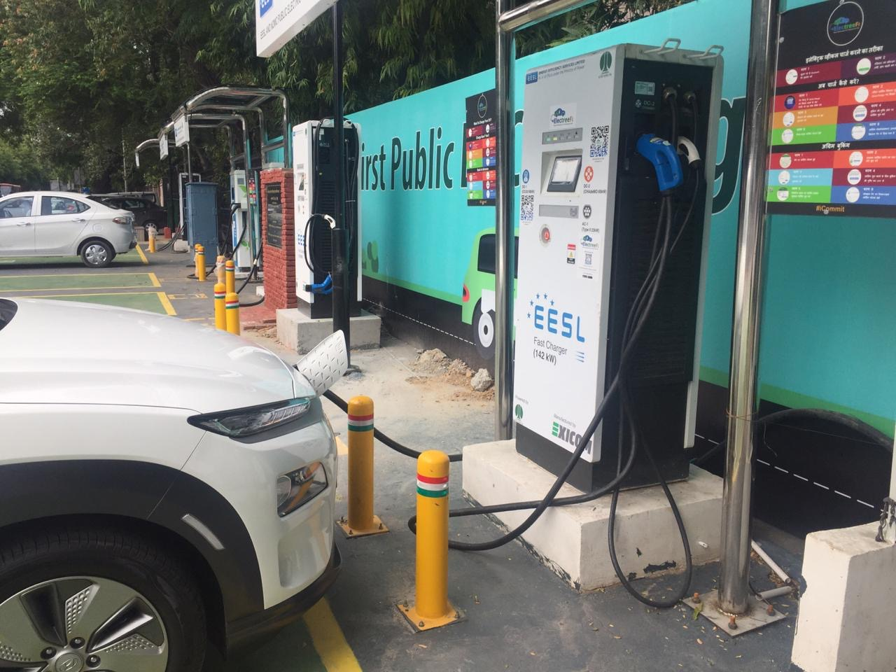
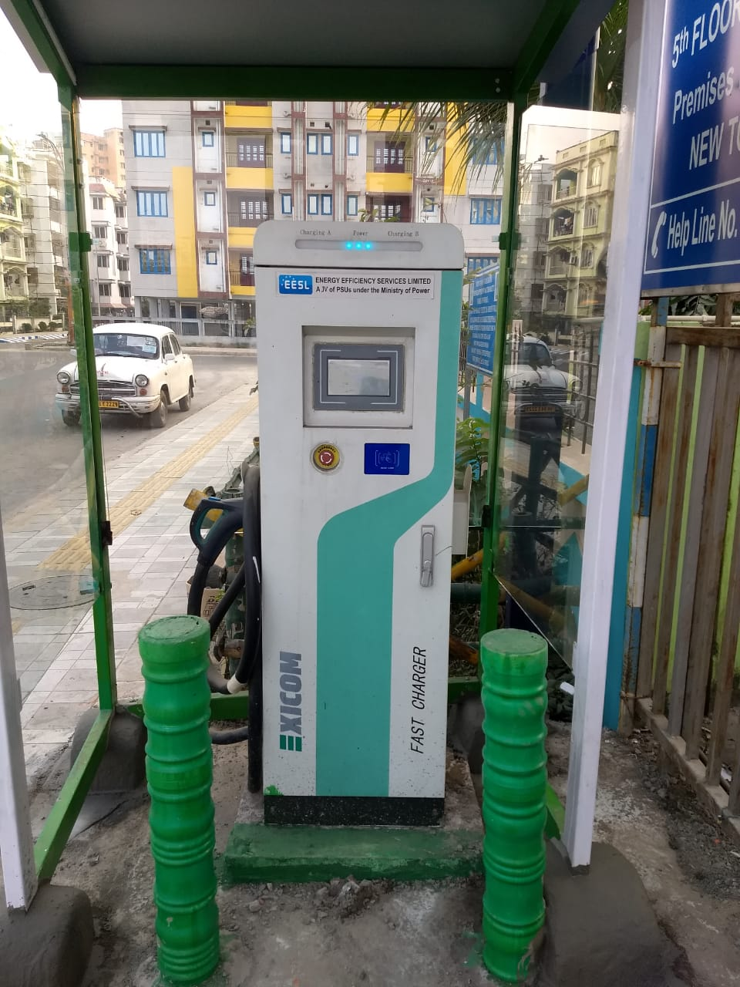
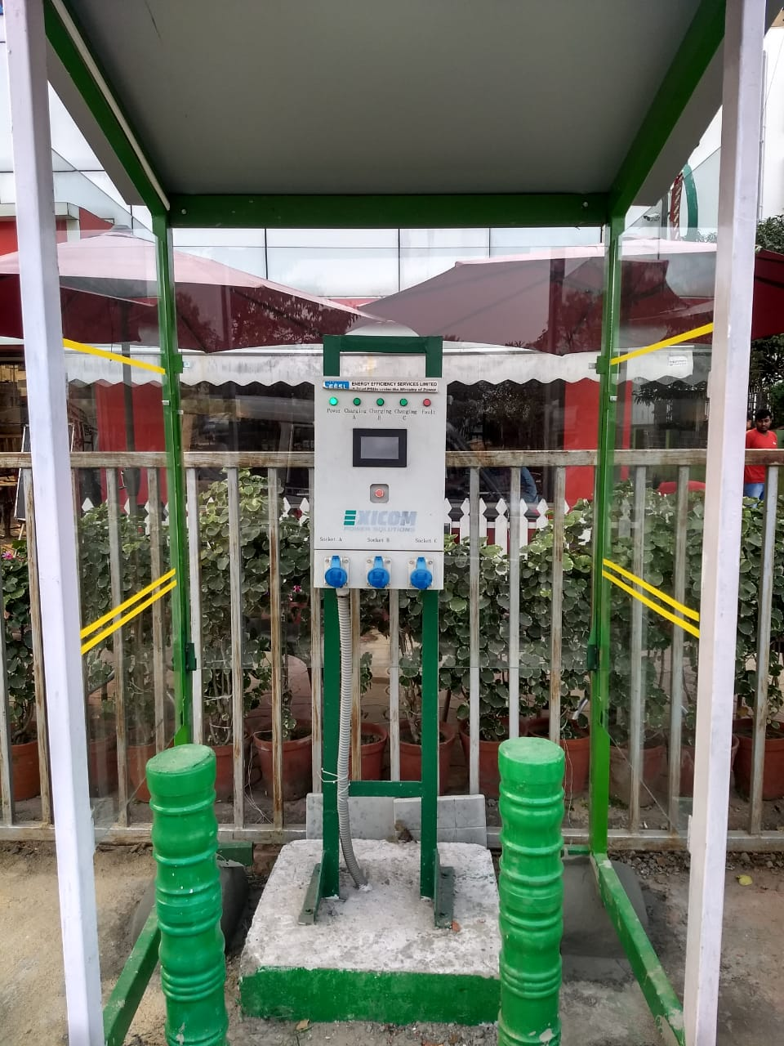
Installation of PCS
First EV Charging Station at Kolkata City with NKDA
EV Charging Plaza at Rafi Marg, New Delhi

Slide 13
Policy Interventions and Support
Introducing preferential EV Charging tariff for the operations of Public Electric Vehicle Charging Stations (PCS) in the West Bengal.
Exempt fixed/demand charges for EV Charging Stations for at least a period of 5 years (2021-2025)
Enabling EV Charging Infrastructure for all segments of electric 2/3/4 wheelers and buses.

Slide 14
Thank You
N. Mohan,
Dy. General Manager, EESL
(Head, Electric Vehicle Charging Infrastructure)
Email – nmohan@eesl.co.in.

