Slide 1
Infrastructure Creation & Business Readiness Strategies
Electric Mobility
Sanjoy Mukherjee
VP (Dist. Tech)

Slide 2
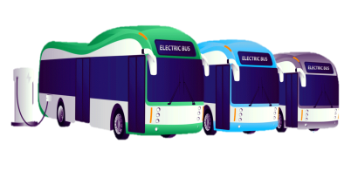
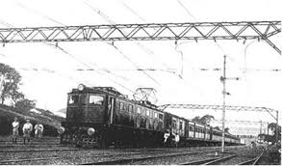
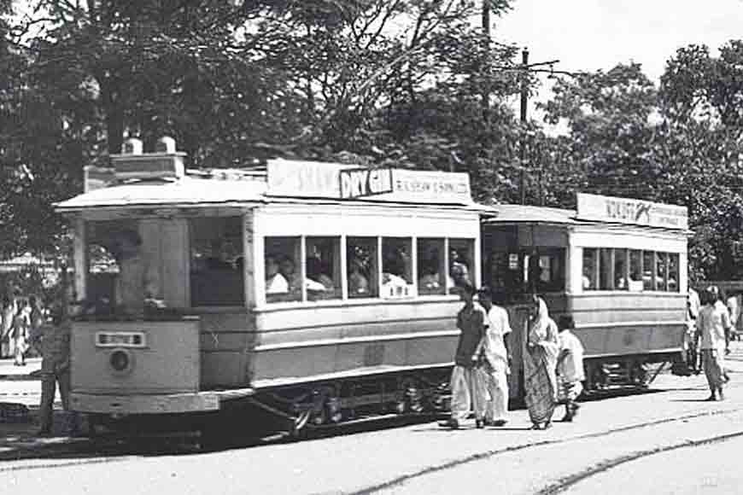
E-Mobility in India…….was always there
Electric Vehicle
Battery electric vehicles (BEV), Hybrid electric vehicles (HEV) & Plug-in hybrid electric vehicles (PHEV) are on road in many parts of the country.
Metro Rail
The first metro line in India was completed on 24th October 1984, a stretch of about 3.4 km between Esplanade and Bhowanipur (Netaji Bhavan), thrown open for the Public.
Electric Train
Indian Railways began using electric mobility in as early as 1925 through electric locomotives. These locomotives drew electricity from the overhead electrical lines.
Electric Tram
The first electric tramcar in Calcutta ran from Esplanade to Kidderpore on 27 March 1902
Still in operation
1902
1925
1984
Today

Slide 3
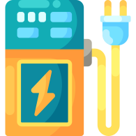
Key challenges for EV Adoption…….as perceived
Travel Range
Limited Vehicle
Options
Charging
Infrastructure
Battery Technology
Maintenance &
Battery Life
₹
₹
₹
High Upfront Cost

Slide 4
EV on road
Charging Station

Slide 5
EV Deployment Scheme
Vehicle Segment
Charging Infrastructure
Supply chain
Technology Upgrade
(Battery and components)

Slide 7
Different aspects of EV adoption: DISCOMs’ Perspective
01
02
03
Technical/
Operational aspects
Commercial Aspects
Regulatory and Policy-related Aspects

Slide 8
Technical/Operational aspects
Identification of suitable nodes for Electric Vehicle Charging Station (EVCS).
Importance of communication infrastructure and grid interactive EV Charging Infrastructure (EVCI)
Connection agreements/ connectivity regulations for providing connectivity to home charging, or a public charging station
Technical challenges in the grid due to current/future EV penetration
Grid infrastructure augmentation in-order to accommodate increased load due to EVCS
Clean energy integration

Slide 10
Regulatory and Policy-related Aspects
Increased power-procurement during peak-hours for EV charging-load
Costs anticipated in augmenting distribution network to accommodate rising EV charging load
₹
₹
Alternative revenue and business models for supporting development of EVCI
₹
Standard guidelines and Single-window clearance for approvals from Municipal Authorities and other statutory bodies for operation of charging stations

Slide 11
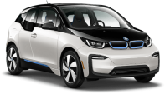
Segment
Battery Size
Charging Type
Typical Charging Behaviour
Level Of Flexibility
Considerations For Discoms
2
WHEELERS
—
Private
2–3 kWh
Day and night
High
Not a challenge
Range: 35-70 kM
Commercial
3
WHEELERS
—
Day and night
High
Not a Challenge
Commercial
3-8 kWh
Range: 50-80 kM
Limited daytime flexibility due to business needs. Fleet operators are a natural aggregation of many vehicles and may be receptive to demand response programs
4
WHEELERS
—
Private
(15 -80 kWh)
Slow Charging at night
Fast Charging during the day
Low
Range: 110-450 kM
Commercial
Buses offer a big opportunity for managed charging and have a great deal of load predictability. Discoms should prioritize working with bus depots to ensure managed charging practices are taken.
+
BUSES
—
Commercial
100–400 kWh
Slow Charging at night
Fast Charging during the day
Medium
Range: 190-280 kM
Charging at Bus Depot
Personalized charging
Public charging
LEVEL 1 DC charger: Power Output:10 kW–15 kW; Output voltage of 48 V/72 V
LEVEL 2 DC charger: Power outputs: 30 kW–150 kW; Output voltage up to 1000 V
Battery swapping
Three-pin 15 amp connector

Slide 12
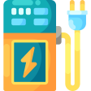
We too are ready…
EV charging facility at CESC House
13
nos Supply to WBTC’s Electric bus charging station
One of our EVs being charged
3
nos new Public Charging Stations in collaboration with KMC
Park Circus (Below MAA flyover)
Beckbagan (Beneath AJC Rd Flyover)
Dhakuria ( Near Lake PS)
Charging Socket
Charging Panel
Notes:
Photo By: UNSPLASH Anders Jildén@andersjilden

Slide 13
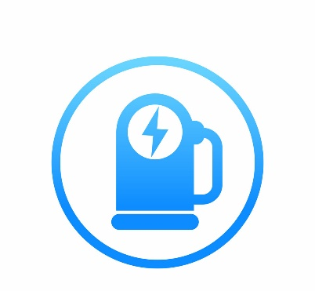
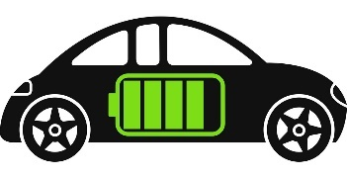
Some more Initiatives
Installation of EVCS at
petrol pumps
Advocating changes in building rules and favourable policies
#LiveFreeBreatheFree
Engaging with EV manufacturer for in house fleet change-over
Promoting EV at various events and fora like CREDAI and Book Fair

Slide 14
…And The Journey Continues
Notes:
Image source: https://pixabay.com/photos/jogging-run-sport-jog-sporty-race-2343558/

Slide 15
Future is Electric!!
Thank You

