Slide 1
Powered by Data Driven Cutting-Edge Technology
BY ARJUN DUTTA

Slide 2
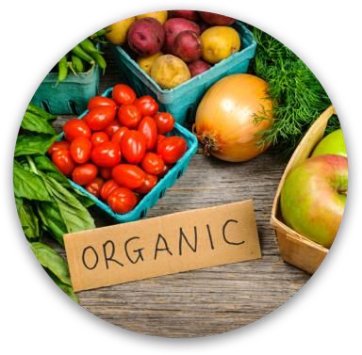
THE PROBLEM
Traditional Farming ~ Inefficient Practices
Insufficient supply of exotic veggies at affordable rates.
Disrupting Factors ~ Global Warming.
~Food Crisis & Supply-Chain
~Depleting Rural Workforce

Slide 3
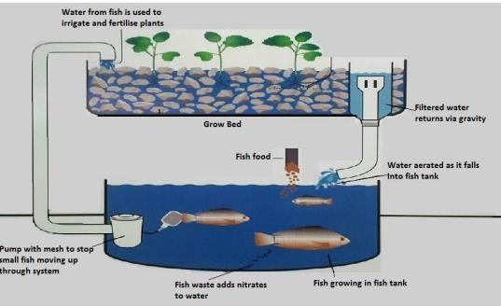
GREENLIFE IQPONICS AGRITECH FUNNEL

Slide 4
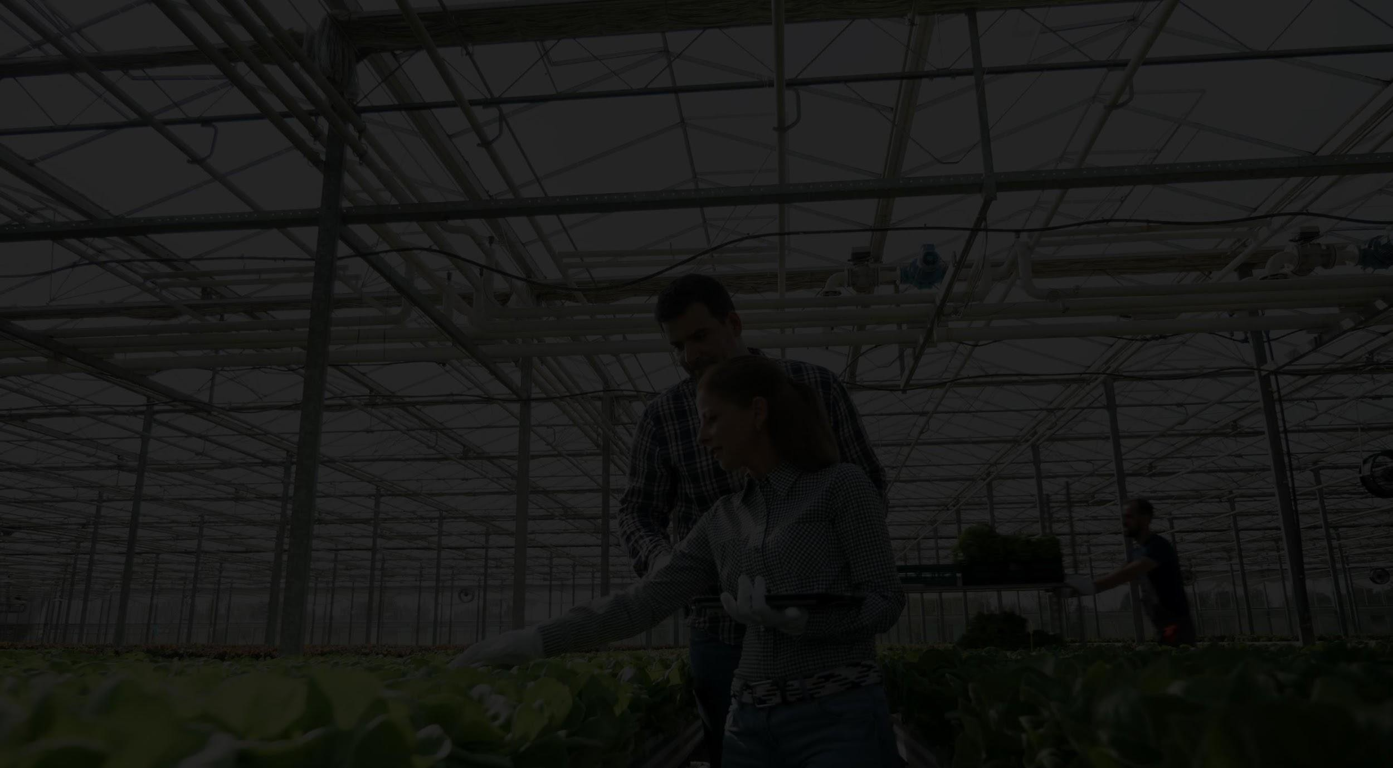
WHO ARE WE?
We are the passionate Next Generation Farmers.
Our primary goal is to provide healthy organic food at an economical rate & developing a healthy living across the country..
Visualization with the help of cutting edge technology IIoT & Cloud.
AI-driven ‘Smart Aquaponics’ can determine optimum growth of plant and fishes.
Insights are generated from data obtained by sensors in the hardware.

Slide 5
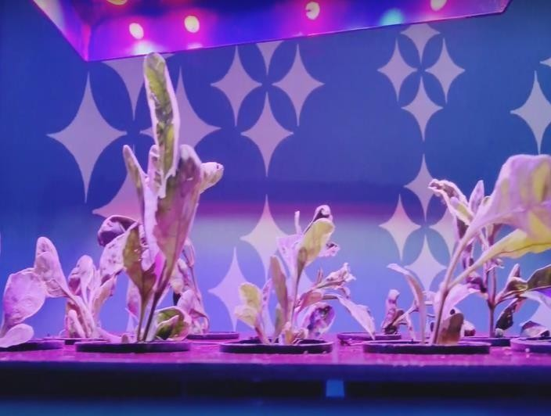
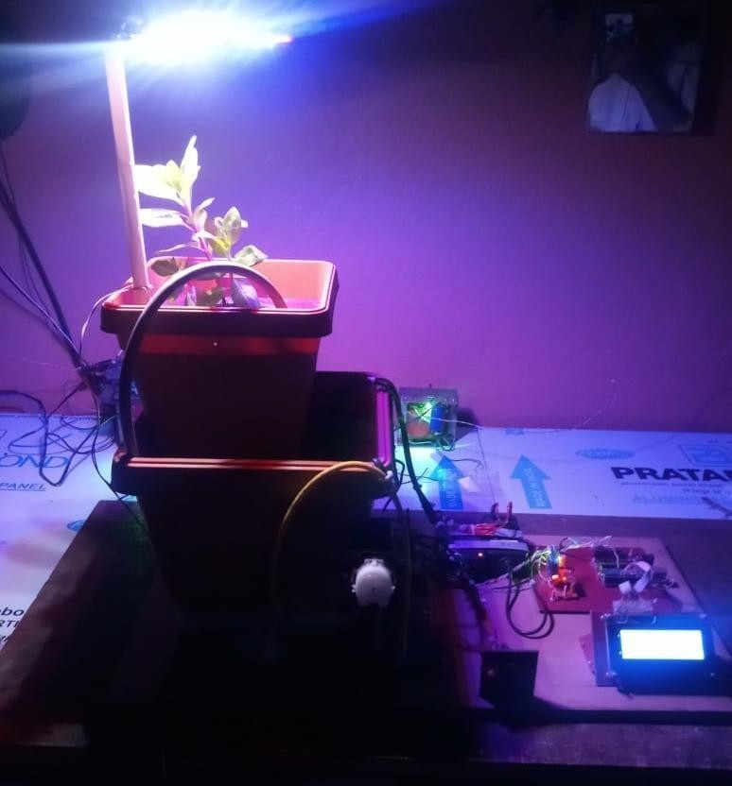
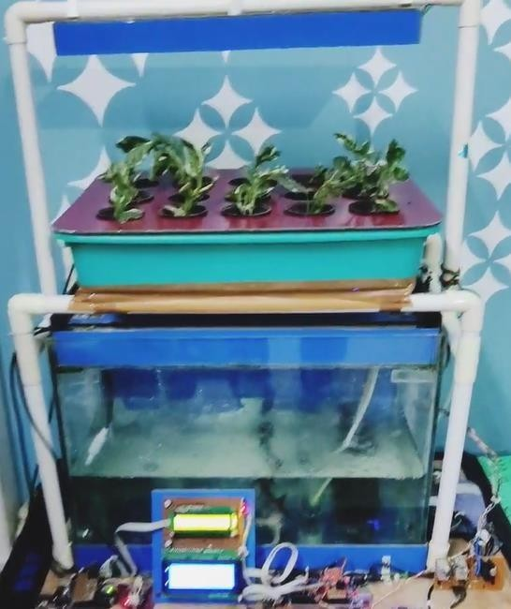
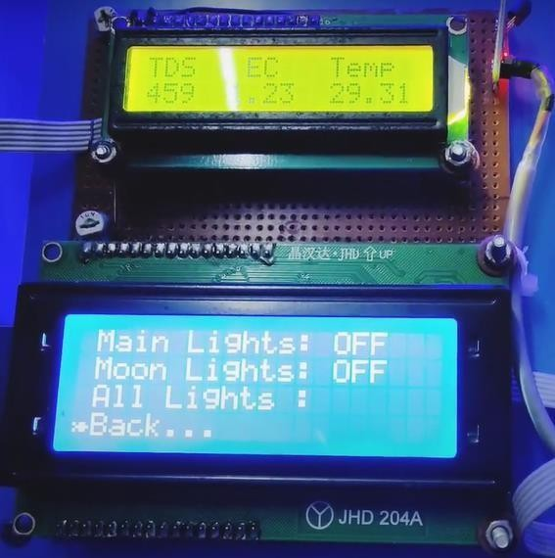
TESTED INDOOR SETUP
Data Collection Hydroponic Setup Aquaponic Setup
https://greenlifeiqponics.com/

Slide 6
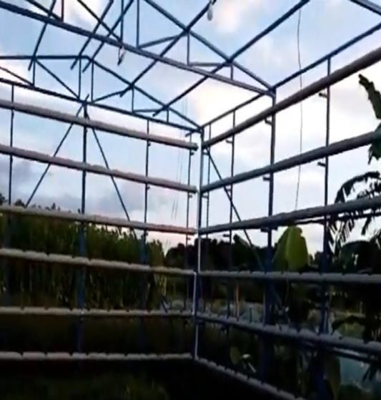
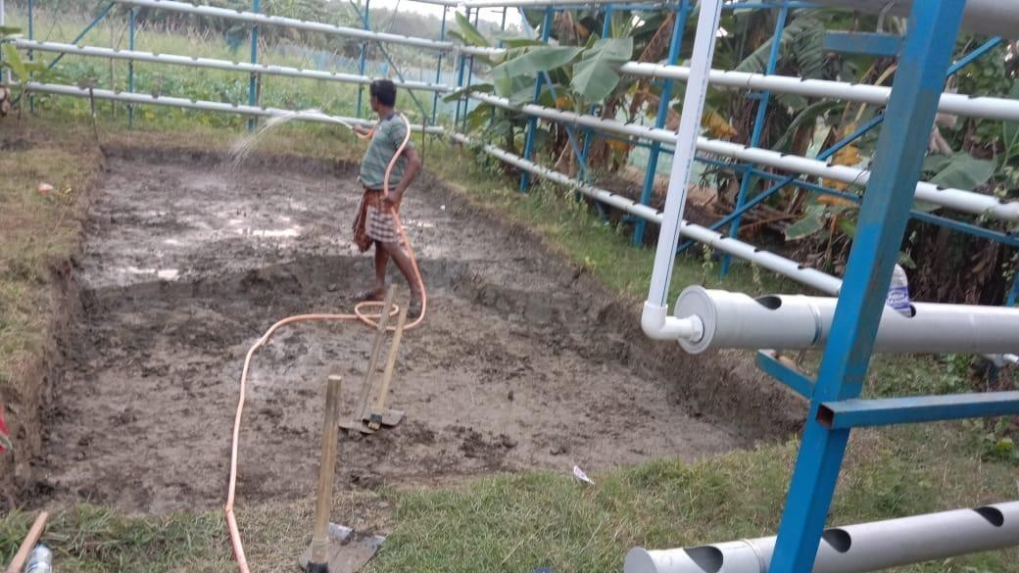
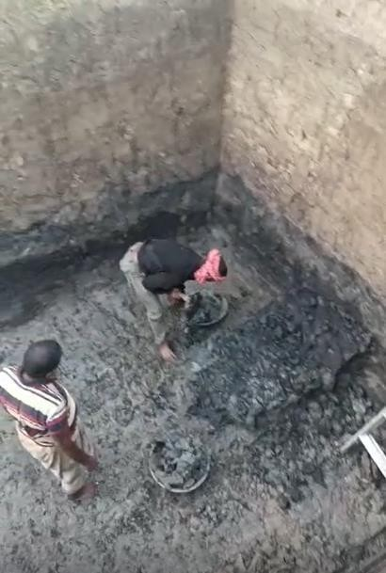
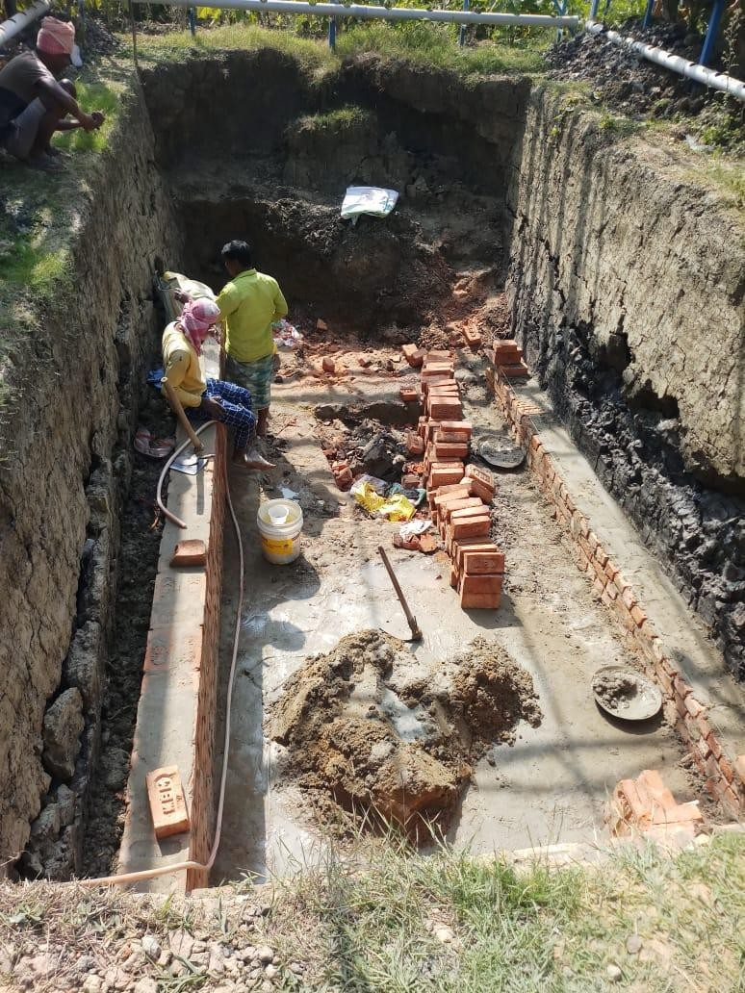
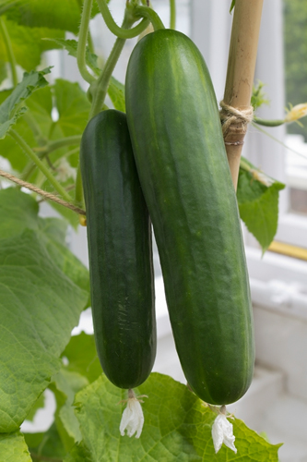
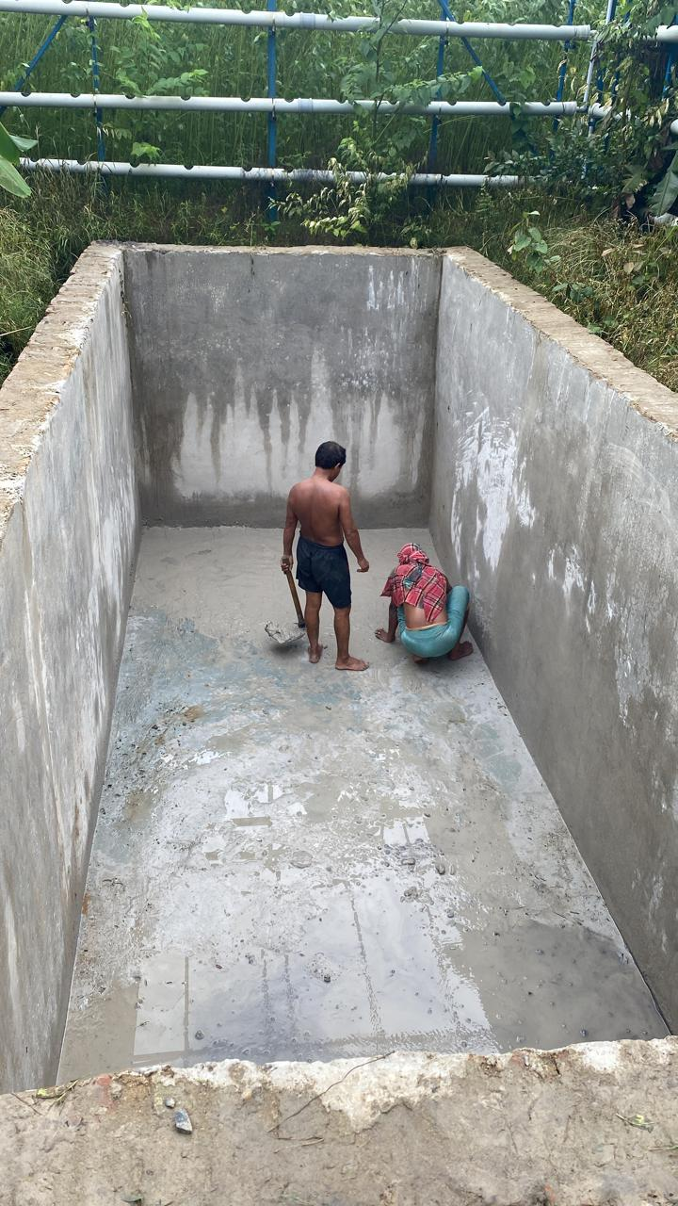
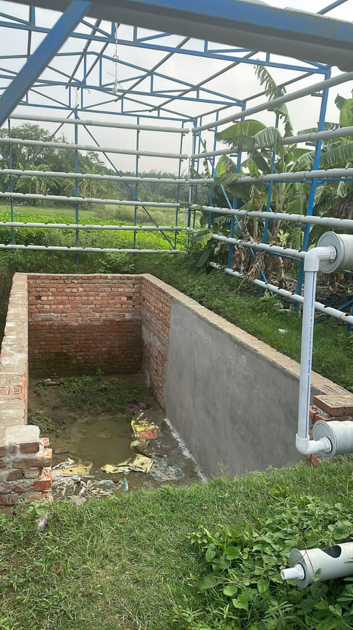
TESTED OUTDOOR AQUAPONICS WORK
STEP 1 STEP 2 STEP 3 STEP 4
STEP 7 STEP 6 STEP 5
Cucumber & Fishes Harvested
https://greenlifeiqponics.com/

Slide 7
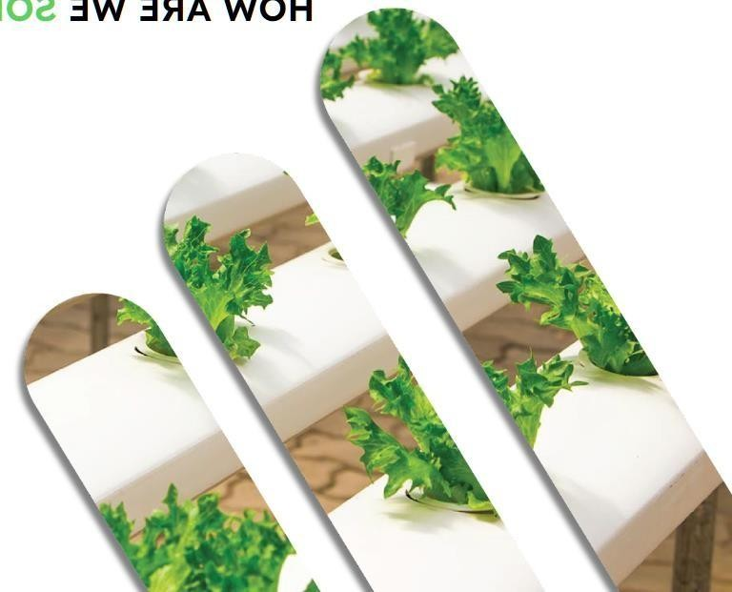
UNIQUENESS WE ARE GOING TO BRING IN THE MARKET
Monitors growth through (IIoT) for shortest possible growth cycle.
Deliver curated fresh production as per diet requirement of the customer & demand based through franchises.
Nature assisted scalable models & restoring uncultivated/waste land.
Providing weekly nutrition at doorstep across Kolkata.
AI driven ‘ Smart Aquaponics ‘ can determine optimum growth of veggies/fishes
Implementation of Solar for electricity consumption of sensor setups.
Social Impact & Tax-benefits for the Franchise Owners and Investors

Slide 8
Source : Google Scholar
https://greenlifeiqponics.com/

Slide 9
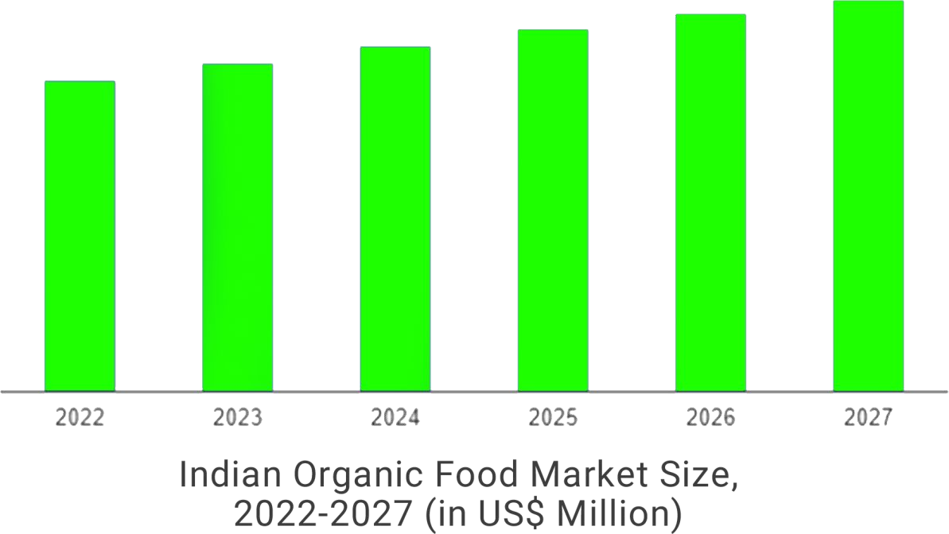
(Source: NATIONAL CENTRE FOR ORGANIC AND NATURAL FARMING)
KEY INDUSTRY HIGHLIGHTS
According to FiBL survey 2021 India holds a unique position among 187 countries practicing organic agriculture. India is home to 30% of total organic producers in the world having 2.30 million.
Survey 2022, places India in 6th position in Agricultural land & 1st Pos.for production as per 2021 data.

Slide 10
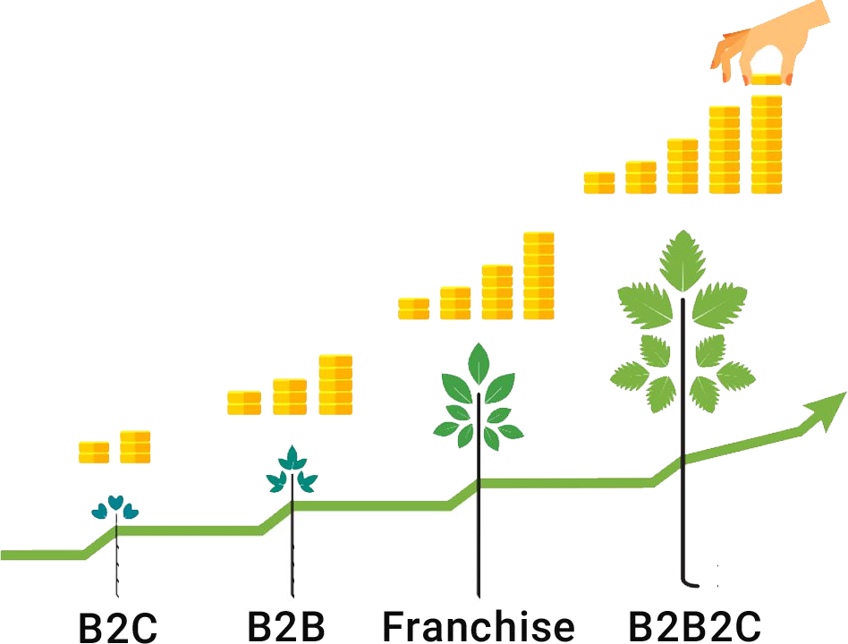
GTM
https://greenlifeiqponics.com/
Through franchise chains.
A hybrid approach combining ground and digital channels is planned which will increase by at least 10X in the following 24 months.
To accelerate our growth, we will also concentrate on B2B channels.
Next 1 year, we can activate channels with 100 retailers
and 2000 buyers in Kolkata.

Slide 11
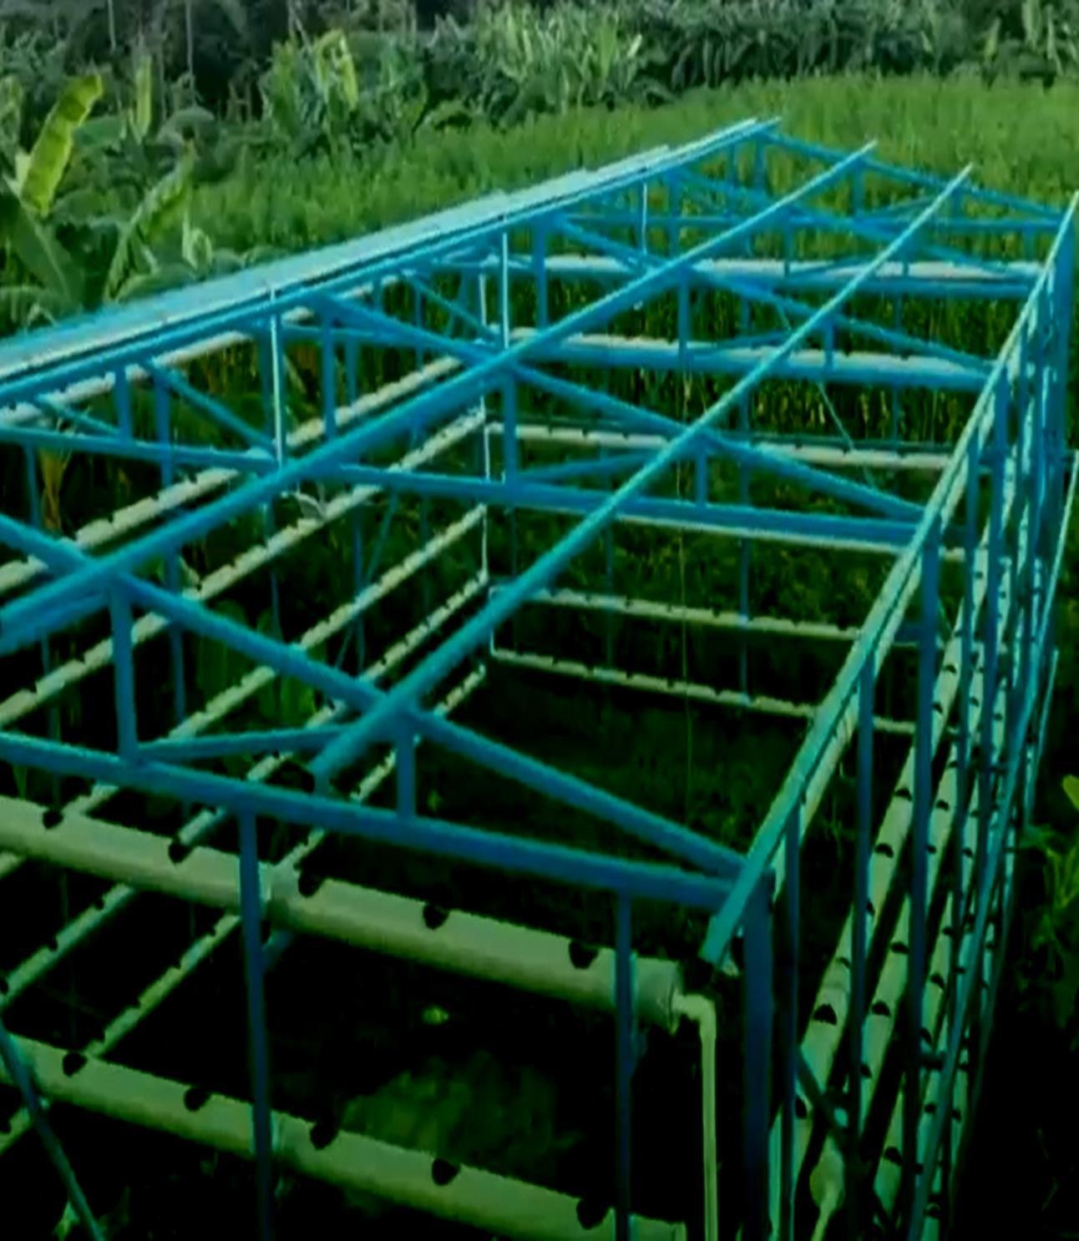
CURRENT STATUS OF IQPONICS
IDEATION
PROTOTYPE MAKING
INDOOR / OUTDOOR SYSTEMS
COPYRIGHT, INDUSTRIAL DESIGN
AI DRIVEN APPLICATION
MASS SCALE INTEGRATION
https://greenlifeiqponics.com/

Slide 12
WHAT WE HAVE ACHIEVED YET
Contracts | Total
LOI Received from Gym & Restaurant Owners, Kol-India | 3
Franchise, Kol-Assam, India | 3
Land & Waterbody in Bangladesh | 100 Bigha ( in process )

Slide 13
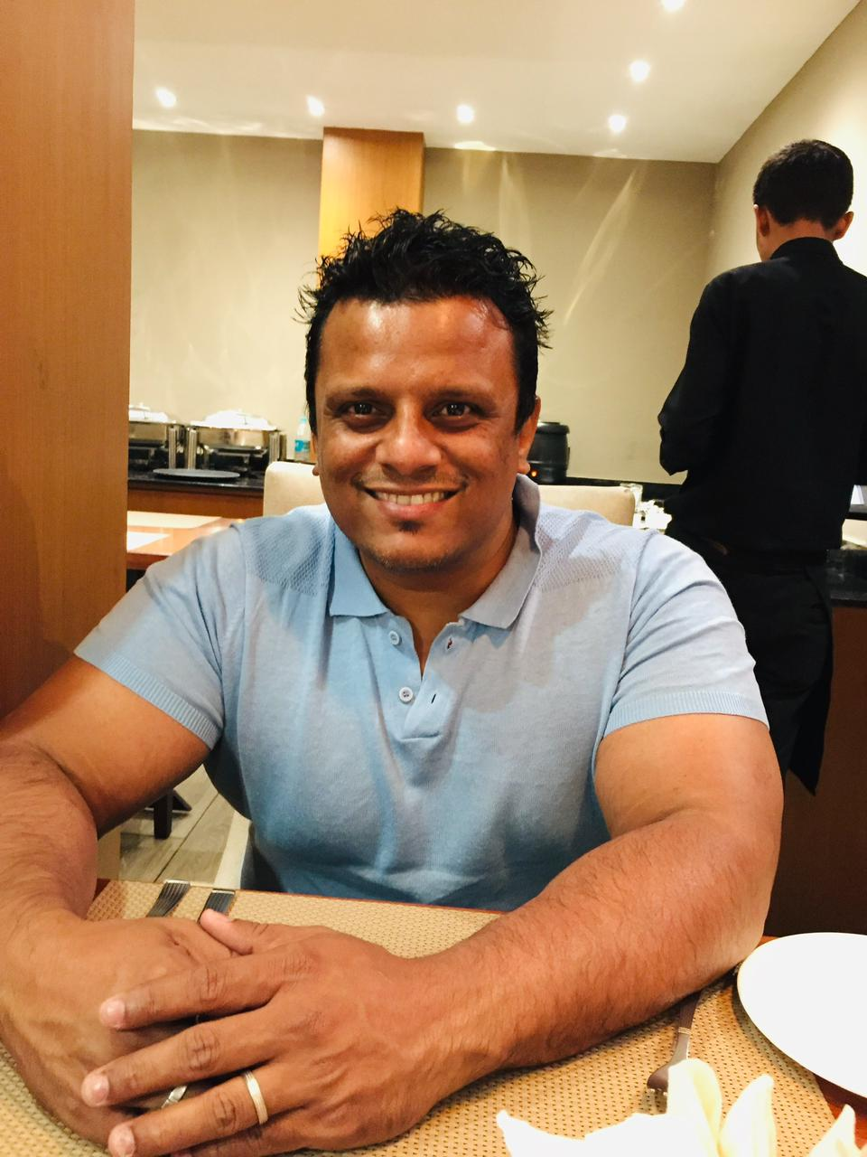
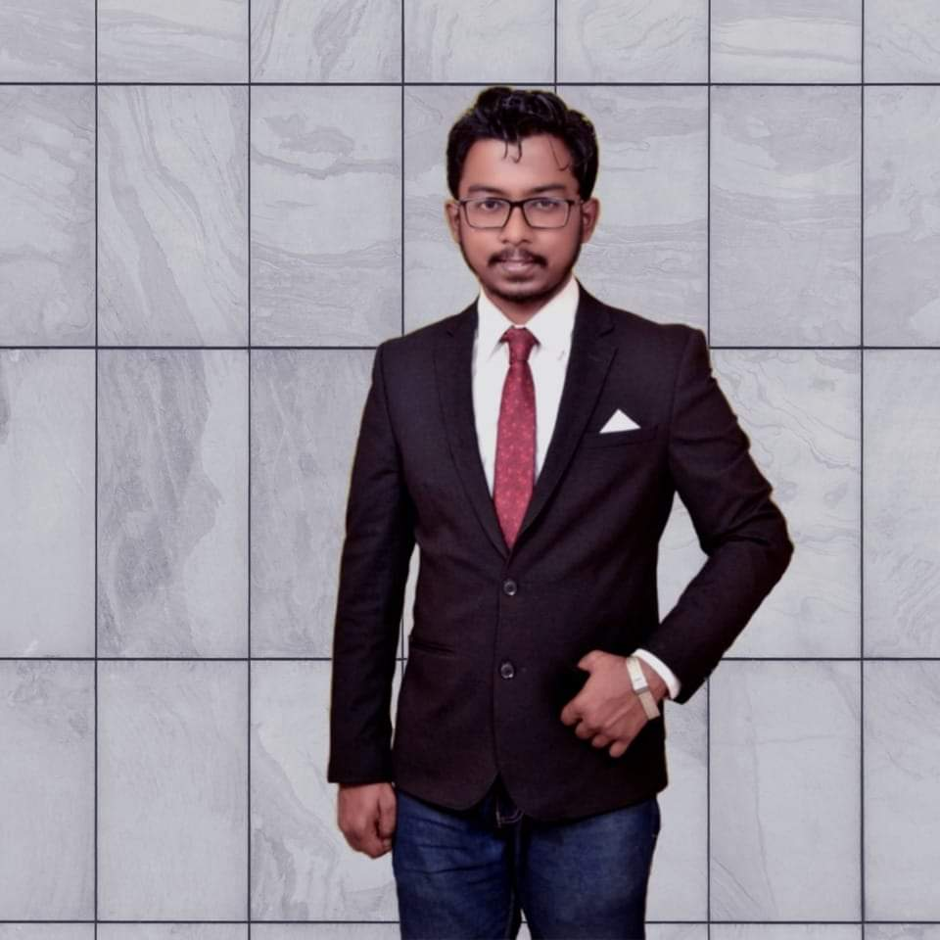
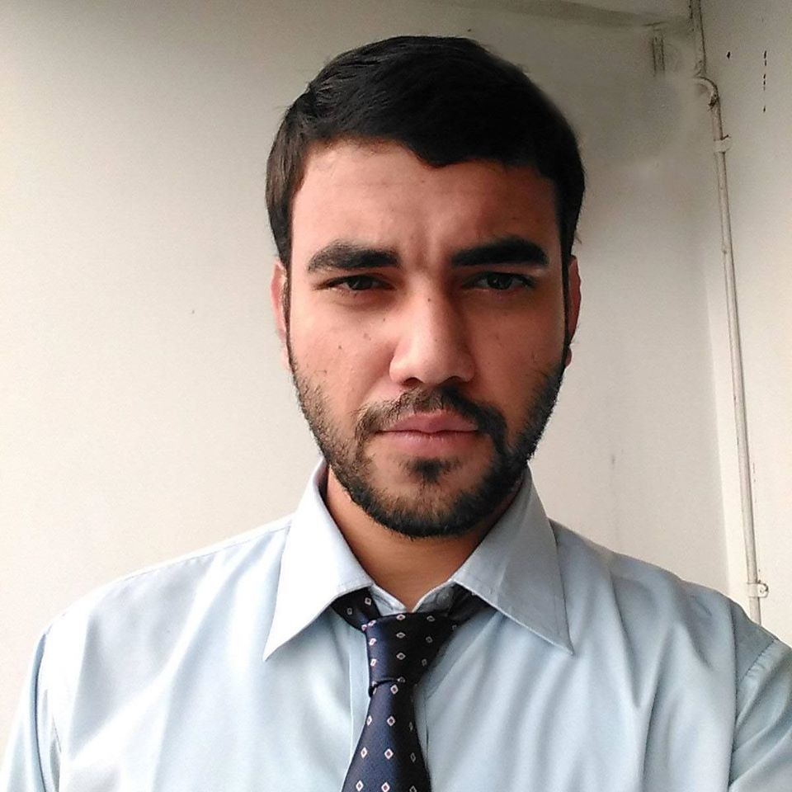
TEAM
Zakir Hossain Arjun Dutta Indrajit Adhikary Linkon Hossain
(Co-Founder & CSO) ( Founder & CEO ) Technology Consultant (Co-Founder & Operations)
Full-Stack Blockchain Developer 3+ years work exp 15 yrs work exp 5 years work exp in Import/Export
15 years Work Exp-Middle East

Slide 14
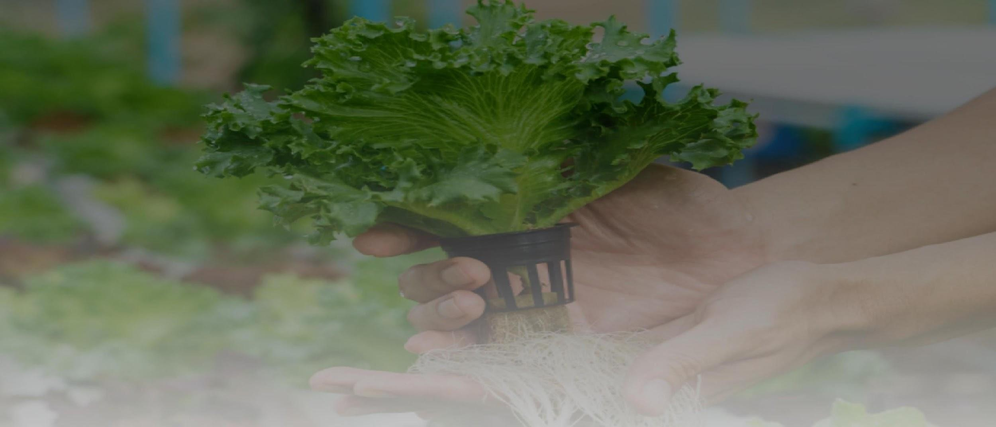
THANK YOU!
“ Investment in agriculture are the best weapons against
hunger and poverty, and they have made life better for
billions of people ”
Email : contact.greenlifeiqponics@gmail.com Contact : +91 8777765809

Slide 15
Annexure
All the Income accrued by Investor from Farming Land is Tax Free creating a social & global impact.
Investors get the beneﬁt of multiplying the proﬁts based on the investments made by breaking even in next 3 ﬁnancial years with Easy Exit Options.
All the Farms are located in High-Growth Corridors and well connected to heart of Kolkata covering the areas like Rajarhat, Airport Area, Bidhannagar.
Every Investor gets the opportunity to grow their own choice of plants in our farm.
Every Investor gets a LIFETIME MEMBERSHIP to get a Discount of 10% Buying any IQPONICS Products.
https://greenlifeiqponics.com/

