Slide 1
“ Once in a while we need a Doctor, Lawyer, or an Engineer
But three times a day we need a Farmer “

Slide 2
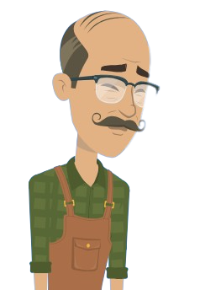
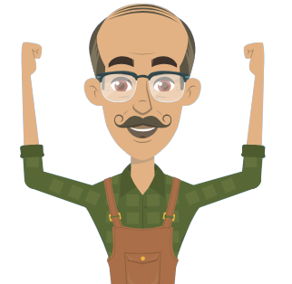
Traditional
Farmer
Profitable
Farmer
The Problem:
Traditional Farming –
Inefficient practices
Unsustainable
Unpredictable
Disrupting Factors
Raising food demand
Global warming
Depleting Rural Workforce
Assumptions
Hope
Action
Knowledge
Planning

Slide 3
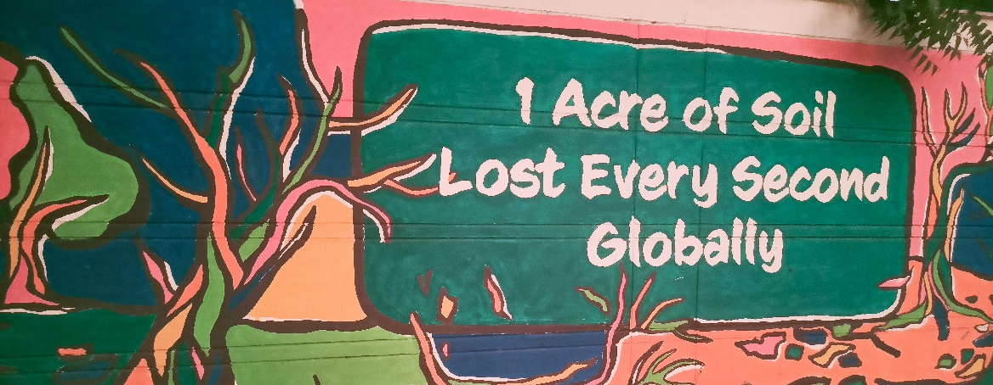
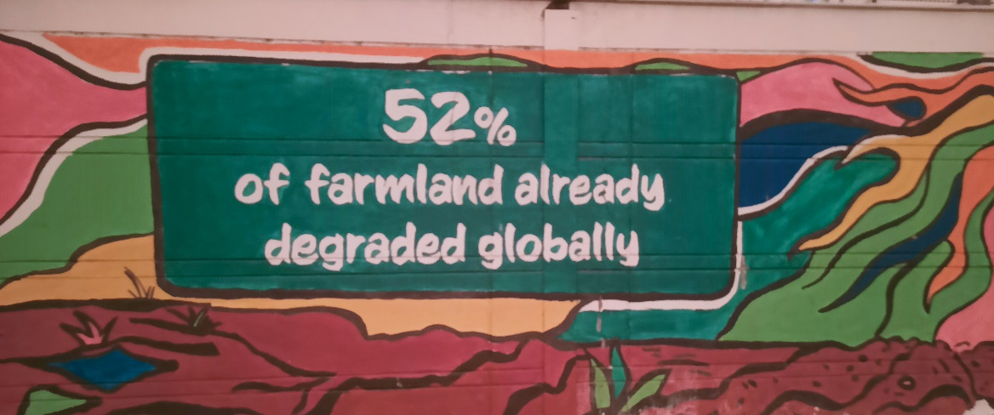
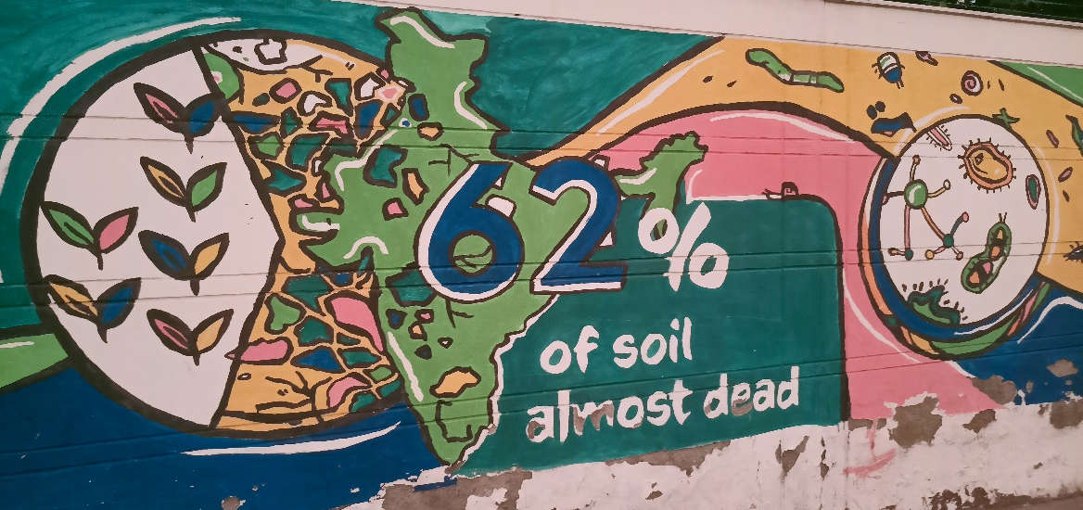
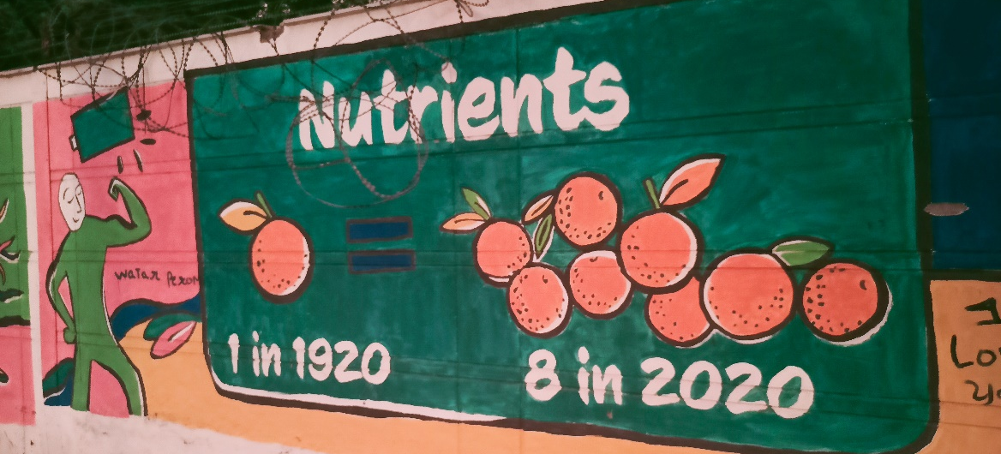
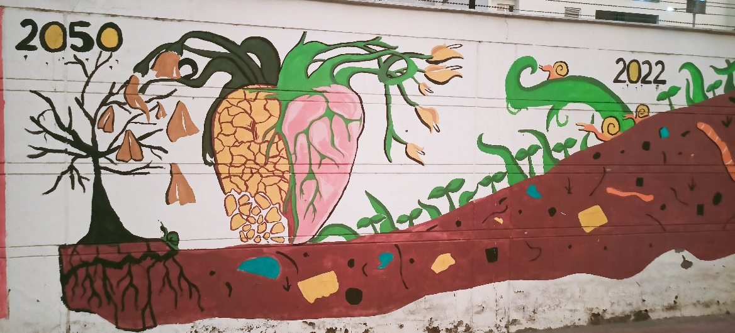
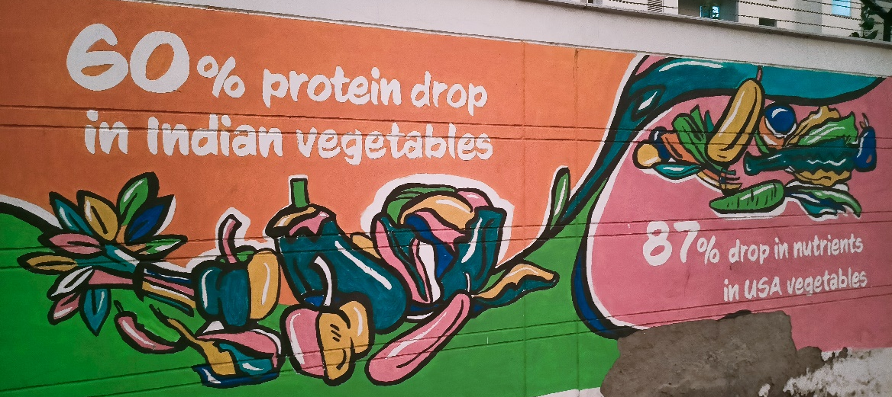

Slide 4
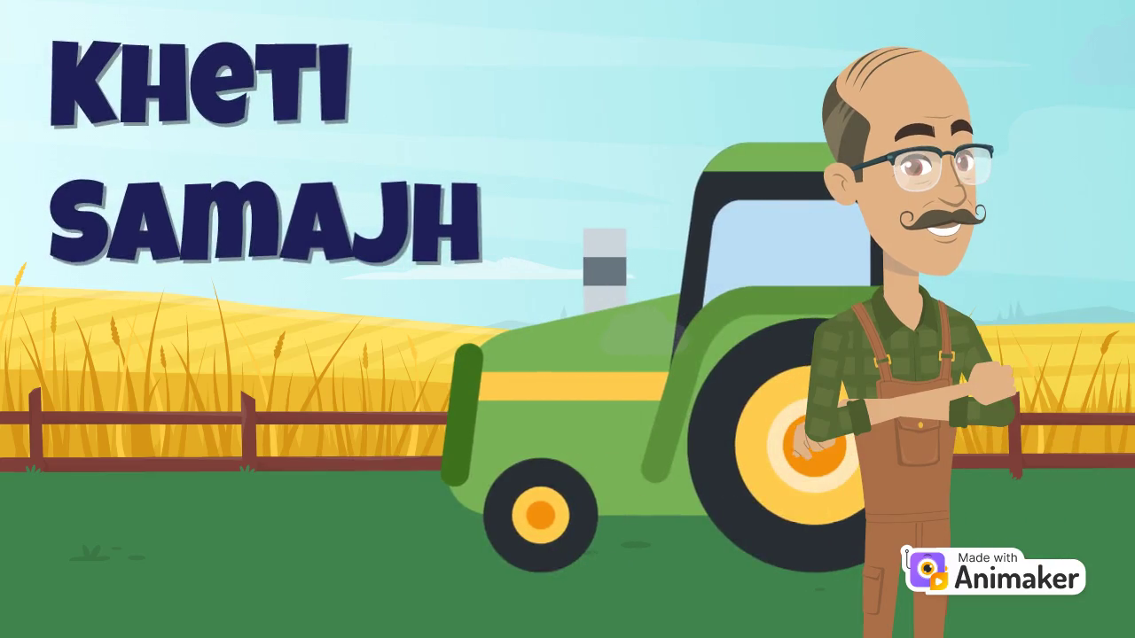
Sustainable way of farming

Slide 5
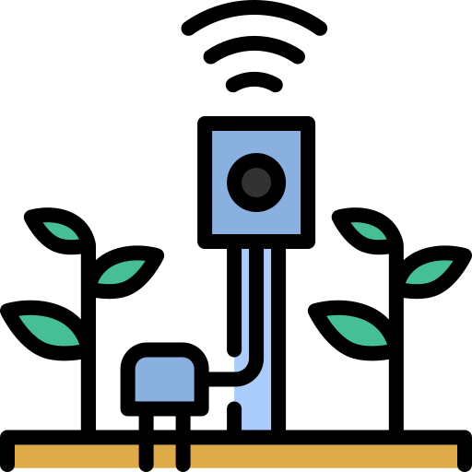
Our Solution
An end to end IoT Platform that utilizes live agricultural data to help farmers further improve productivity & sustainability of farmlands
Decision Support
Data Collection
Analysis

Slide 6
Benefits:
Track farm activities.
Increased Per acre revenue.
Reduced expenditure over agro-inputs.
Easier market connect.
Environmental Impact:
Avoids soil degradation
Reduces pollution caused by farming
Reduction of Water usage for Irrigation

Slide 7
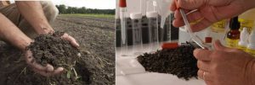
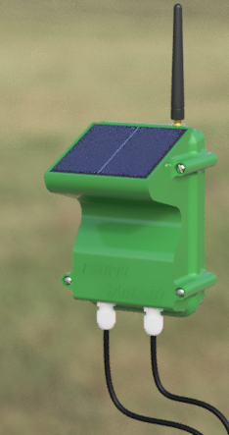
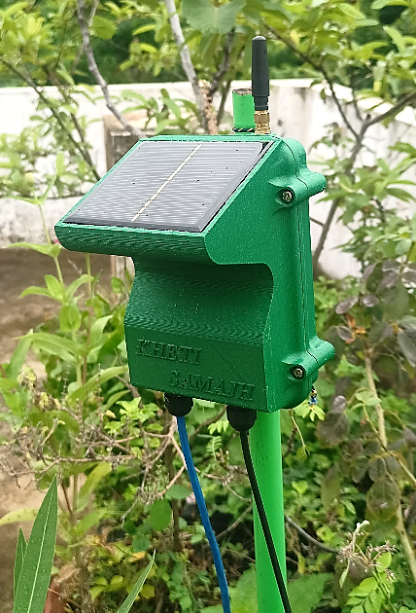
Kheti Samajh’s Data Collection Module
Manual Soil Testing
3-Days Soil Moisture data
collected remotely

Slide 8
Potential Customers
Farmers
Agro-Companies
Other key Customers
NGOs
FPOs & FPCs
Agricultural & Research Institutes.
Agro-input Companies
Machinery Providers

Slide 9
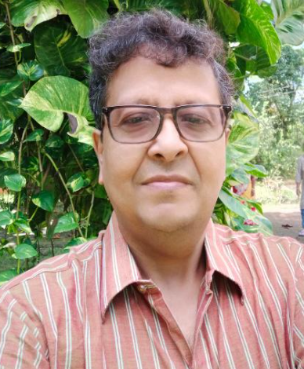
Team
Muralidhar S
Graduate in Electrical & Electronics Engineering
7+ years of Industrial Experience
Experience in 3D printing, Industrial IoT & Embedded Systems
Shantanu Das Gupta
Entrepreneur & Industry Expert
35+ years of Expertise in Instrumentation, Energy Management

Slide 10
Let’s make farming more efficient, profitable, sustainable & pollution free.

