Slide 1
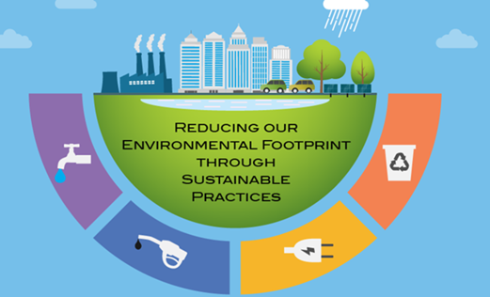
Sustainable Journey – Indorama India
30.11.2021

Slide 2
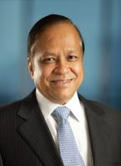
ASIA’S LEADING CHEMICAL HOLDING COMPANY
Indorama Corporation
(IRC)
Singapore
Synthetic Gloves
Fertilizers
Olefins
Textiles
Polyester
Indorama Eleme Petrochemicals Ltd.
(Nigeria)
YTY Group
(Multi Location)
Industries Chimiques Du Senegal
Indorama Synthetics
(Multi Location)
Indorama Ventures PCL
(Multi Location)
100%
78%
65%
59%
32%
Indorama India Pvt Ltd (India)
Indorama Industries Ltd.
(India)
100%
100%
Indorama Eleme Fertilizers & Chemicals
(Nigeria)
76%
Indorama Corporation global foot print : 87 sites , 33 countries
Public Company

Slide 3
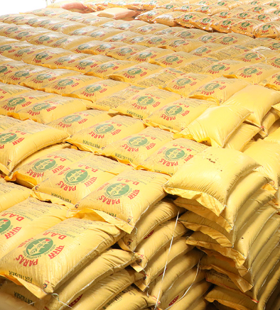
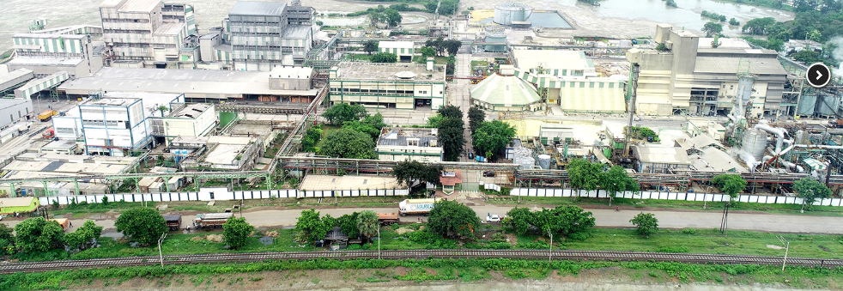
Indorama India– Phosphatic Fertilizers Plant at Haldia
O v e r v i e w
  Indorama acquired Tata Chemical’s Phosphatic Fertilizers Business on 1st June 2018.
  Haldia plant is one of the largest DAP/NPK Plant in Eastern India.
  Production capacities of Haldia Plant is as below:
    DAP – 594,000 TPA or NPK -1.0 million TPA
    Sulphuric acid – 247,500 TPA
    SSP – 198,000 TPA
  PARAS Brand is one of the preferred brand in India by farmers.
  Import and sale additional 0.5 million TPA DAP/NPK/Potash India

Slide 4
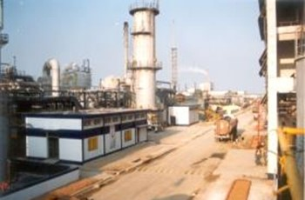
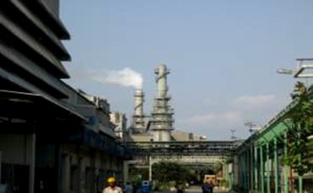
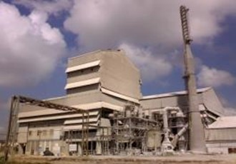
Indorama India - Product Portfolio
RAW MATERIALS MFG PLANTS PRODUCTS
Sulphur
Rock Phosphate
Phosphoric acid
Ammonia
MOP
Sulphuric Acid I & II
SSP
DAP / NPK I & II
Sulphuric Acid
SSP
DAP / NPK

Slide 5
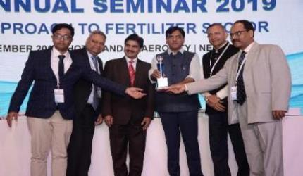
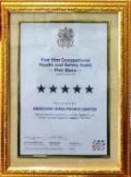
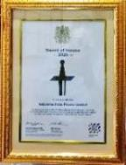
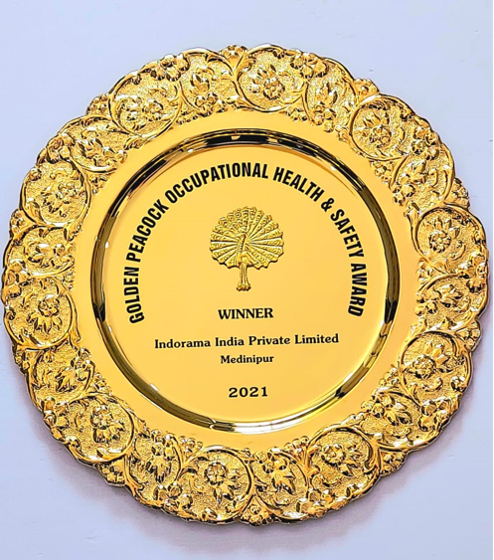
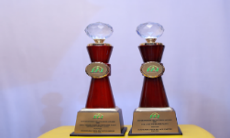
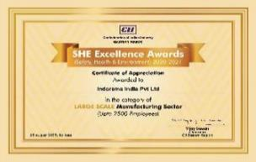
Certification & Awards - Safety & Environment
FAI Annual Seminar 18-19
5 Star rating in BSC Five star audit by British safety Council for Health and safety Management System and “Sword of Honour” for outstanding commitment towards Health and Safety in 2020-21.
Environment Protection Award for DAP/NPK without Captive acid in 18-19 , 19-20 and SSP (Single Super Phosphate) category in 18-19, 19-20 & 20-21 from FAI ( Fertiliser association of India)
Golden peacock award for occupational health and safety in 20-21
Certificate of appreciation in SHE from CII in 2020-21

Slide 6

Reducing Environment foot print from Fertiliser Production
Going beyond Regulatory Compliance
Improving Energy Efficiency in fertilizer complex
Reduction in GHG Emission
Improving raw materials recovery efficiency
Reduction in Raw water Consumption

Slide 7
Green Manufacturing – Haldia Operations Approach
Water Footprint
Element – Fresh water Consumption Measure- KL/MT of Products
Element – Recycle of waste water Measure- KL/ MT of products
Element-Treated effluent discharge Measure- KL/MT of products
Carbon footprint
Element -GHG emissions Measure- CO2 e Ton /MT of products
Land foot print
Element- Solid Waste Disposal
Measure- MT of solid waste dry basis/MT of products
Element – Green Cover Measure – No of trees planted inside and outside plant area
Green
Manufacturing

Slide 8
Carbon foot print
Good
Increase in capacity of Captive power generation from waste heat has reduced grid power requirement resulting into reduction of carbon footprint.
Currently Scope 1 and Scope 2 emission is considered .

Slide 9
Energy Conservation
Conservation measure update :
Certification of ISO 50001 (energy management system) Standard from Beureveritas in 2018
Installation and commissioning of 8.3 MW Steam turbo generator completed to utilise vent steam (13-14 Ton/Hr) in the month of Nov 20. This has increased captive power generation from 1.8 MW to 5.4 MW at current sulphuric acid plant capacity
Replacement of all conventional lights replaced by LED ( 90% Completion)
Procurement of high energy efficient motors (IE3 types)
Good
Energy consumption due to electricity, fuels used for all purposes all are considered .
Use of Renewable energy ( as biomass in DAP 2 HAG) till Oct 21 : 18.80 % of total energy used

Slide 10
Water Foot print
Water intensity high in 21 -22 .
Higher production of sulphuric acid and less production of fertilizer.
To improve the water intensity and reduce the effluent discharge, installation of effluent recycling plant of 40m3/Hr - project taken in Capex 21-22, which is under execution.
Target for water intensity after installation of effluent recycling plant: 0.70 KL/MT of production
Good
Year | Total water withdrawal (KL) | Source of water%
 |  | Deep tube well | PHE water
FY19-20 | 819381 | 26 % | 66%
FY 20-21 | 834982 | 17% | 75%
FY 21-22 (till date) | 535295 | 31% | 69%
Key Challenges :-
- During summer season poor PHE water quality (more than1500 ppm Choride)
- Interrupted supply of water

Slide 11
Challenges : Water quality and Interruptions in supply PHE water
PHE water quality poor from March – June 21 . Deep tube well water required for plant operations during that period.
PHE supply interruption in last 6 months is ~4 hrs daily

Slide 12
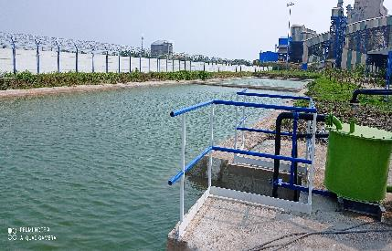
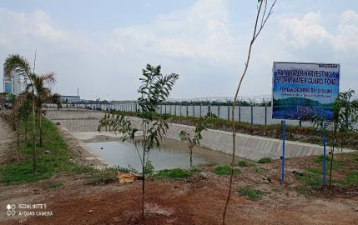
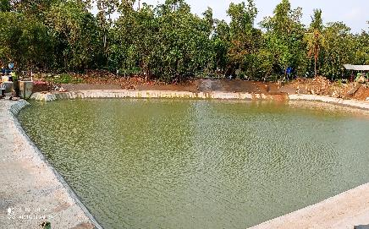
Rain Water Harvesting
Rain water storage pond – Fertilizer section
Rain water collection through valley gutter from roof top
Rainwater utilised in SSP and DAP process from existing rain water storage pond ( Total 3 nos , Total capacity -7000 m3 ) .
Rain water storage pond near Administration building

Slide 13
Waste to Wealth
ETP sludge in DAP/NPK product :
Proposed to CPCB for grant of permission to add ETP sludge in DAP/NPK process as a filler in substitute of clay filler .Trial run conducted in presence of CPCB & WBPCB. Report submitted to CPCB. Waiting for their recommendation to develop SOP. This will provide the opportunity to all phosphatic fertiliser industry use the ETP sludge in DAP/NPK process
Sulphur Sludge in SSP product :
Sulphur sludge is generated from filtration of molten sulphur. Sulphur sludge is a hazardous waste . Proposal submitted to CPCB for utilisation of sludge in SSP as a filler ..
SO2 scrbbing using ammonia :
For adoption of cleaner technology, in sulphuric acid plant, ammonia is used for scrubbing of SO2, which generates ammonium sulphate . The ammonium sulphate solution generated is recycled as supplemental feed to the DAP/NPK process.There is no generation of waste in this scrubbing process.
Challanges – Single vendor , Waste Management Agency for disposal of Industrial hazardous waste

Slide 14
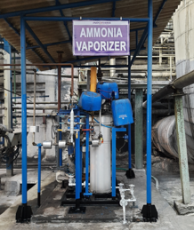
SO2 Scrubbing using NH3 in Sulphuric acid plant
Project “Scrubbing of SO2 gas in Sulphuric acid plant using NH3 instead of Soda solution” has been successfully commissioned in Aug 2020.
We are the only fertiliser industry who implemented this technology.
Benefits:
No waste disposal. Use of soda solution generates sodium sulphide which needs disposal whereas use of NH3 generates ammonium sulphate which is consumed in DAP plant.

Slide 15
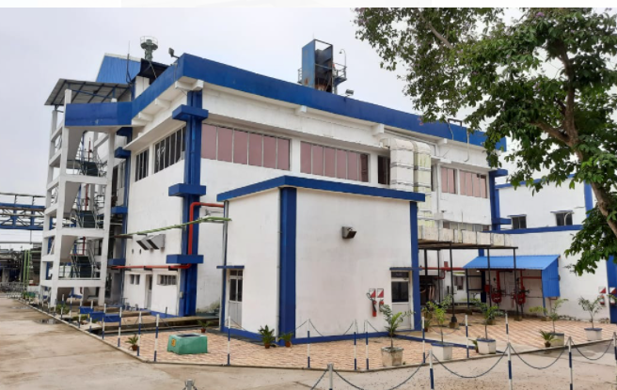
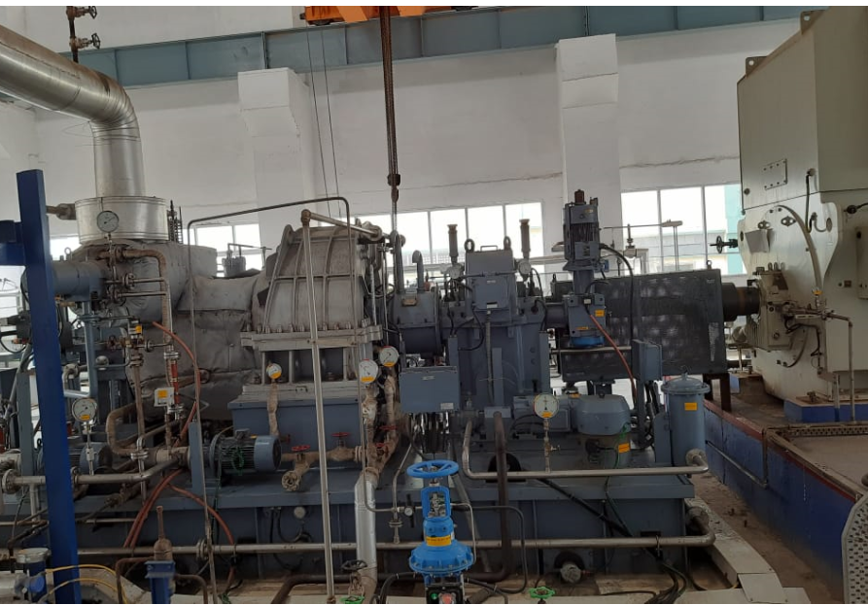
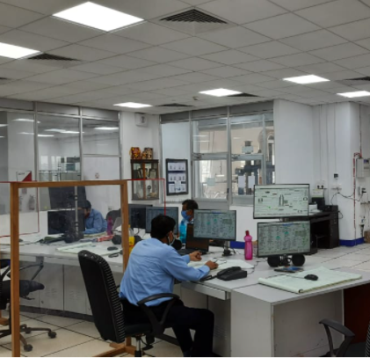
Carbon foot print reduction by installation of steam turbo Generator
Installation and commissioning of 8.3 MW Steam turbo generator completed to utilise vent steam (13-14 Ton/Hr) in the month of Nov 20. Due to Additional captive power generation minus some equipment motor driven added in STG project , shall reduce the carbon emission of approx. 24000 MT of Co2 /Annum.

Slide 16
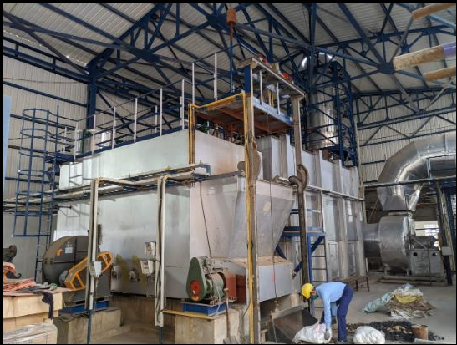
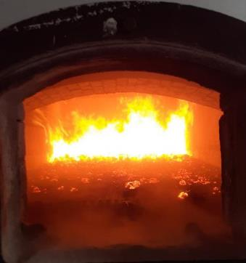
Use of carbon neutral fuel and replacement of Fossil fuel
Furnace Outside
Furnace inside with normal briquette firing
New biomass Hot air generator installation in DAP2 plant commissioned in 2020 Dec. This will eliminate the usage of Furnace oil in plant (5-6 MT/day) .

Slide 17
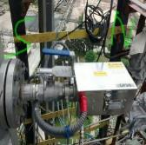
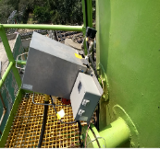
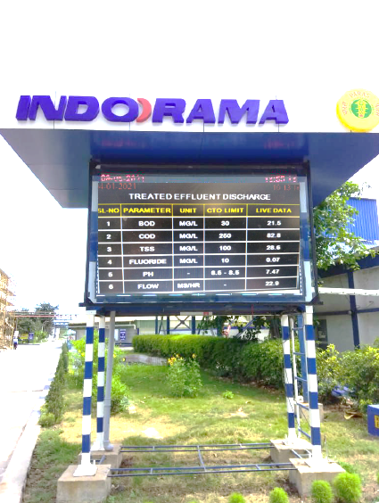
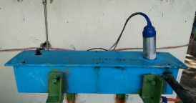
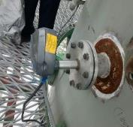
Air Pollution Control devices & Online analysers
Stack No. | Stack Attached | Stack Height | Air Pollution Control Device | Online analyser parameter details
S-3 | DAP/NPK -I | 42 m | Multistage Scrubbers & Cyclone | HF, NH3 & PM
S-4 | DAP/NPK-II | 42 m | Multistage scrubbers & Cyclone | HF, NH3 & PM
S-5 | SSP ball Mill | 30 m | Bag filter and Cyclone | PM
S-6 | SSP | 40 m | Four stage Fluoride Scrubber | HF & PM
S-7 | SAP-I | 40 m | Alkali Scrubber | SO2
S-8 | SAP-II | 40 m | Alkali Scrubber | SO2
NH3, HF analyser
BOD, COD, TSS, Fluoride analyser
Online display board – Safety & Environment
SO2 analyser
PM Analyser

Slide 18
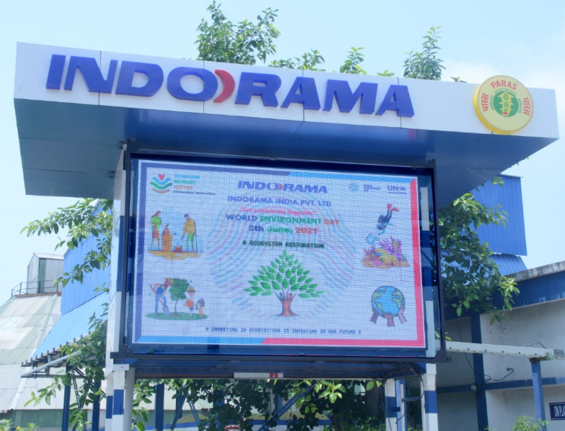
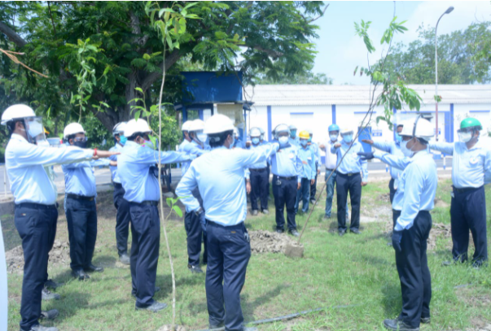
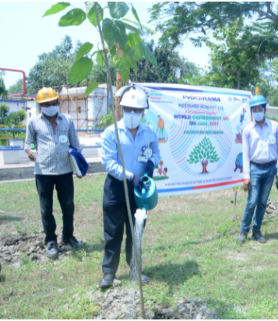
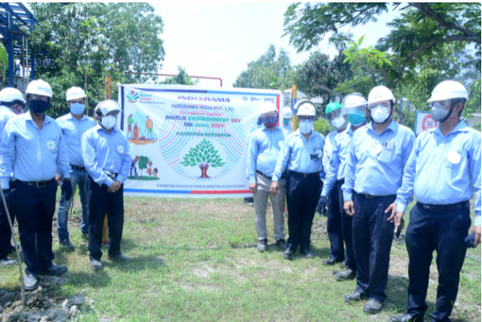
Environment Day celebration at factory
Env day theme at Display board
Pledge for zero harm and eco-friendly workplace
Tree plantation programme

Slide 19
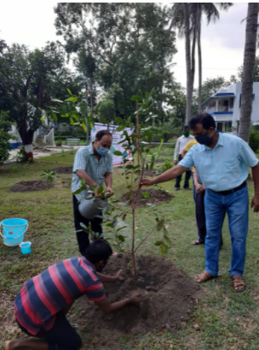
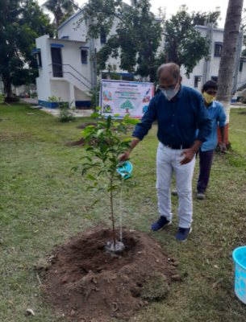
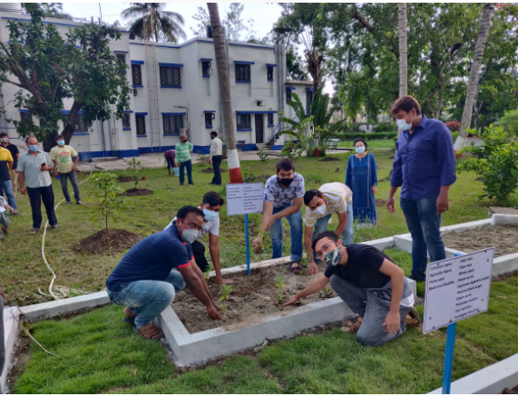
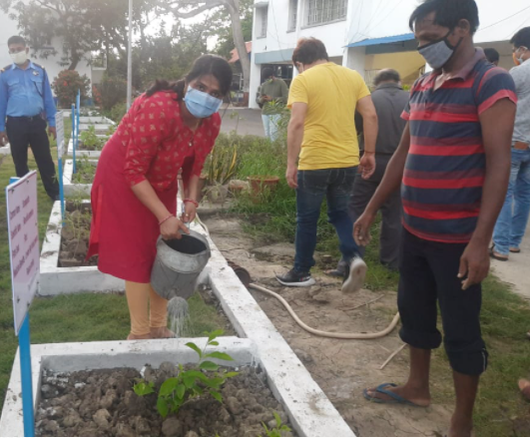
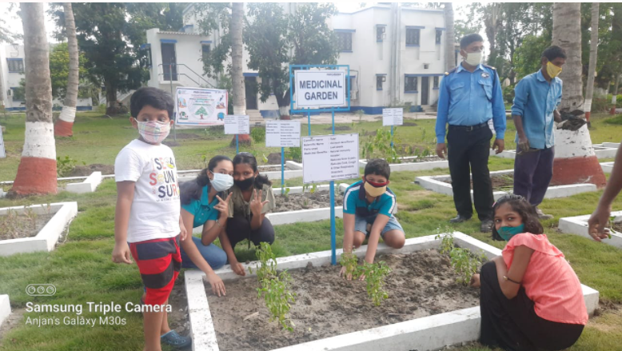
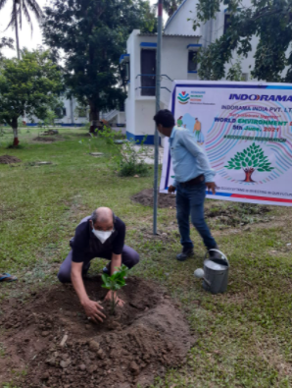
Environment Day celebration at township
Tree plantation programme
Saplings plantation at medicinal Garden

Slide 20
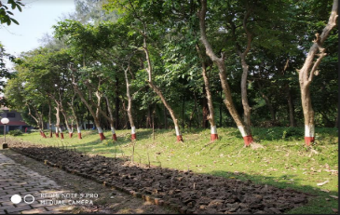
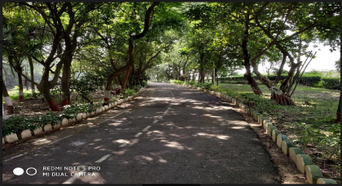
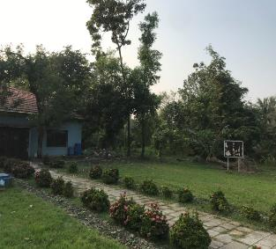
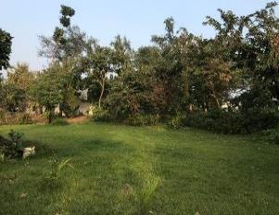
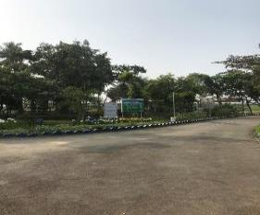
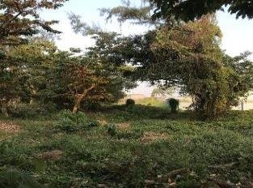
Green Belt Picture

Slide 21
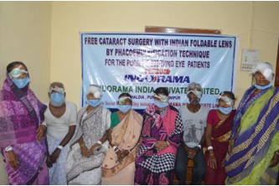
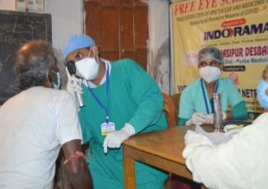
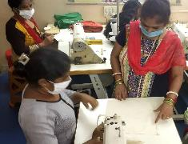
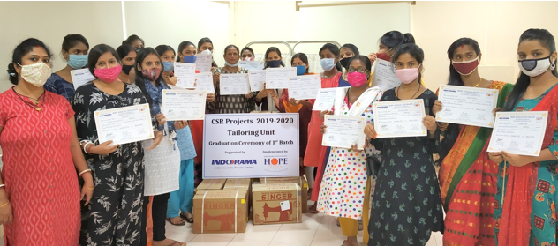
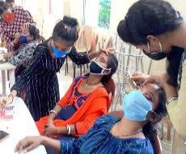
CSR Activities
This year organised two eye screening camps . Total 1126 nos people treated , 420 nos got free spectacle, 94 nos received free medicine.
Sponsored 140 people from marginalised community free cataract surgery.
Eye Camp through Vivekananda Mission
Asram Netra Niramay Niketan
40 underprivileged youth and women, aged 18-35 years from marginalized communities of South Kolkata, successfully completed the beautician and tailoring training .
To promote women empowerment tailoring training provided . As a part of the kit the tailoring trainees received tailoring machine.
Enhancing employment opportunities for
underserved women in Kolkata through Hope Kolkata Foundation ( Beauty Unit and Tailoring Unit)

Slide 22
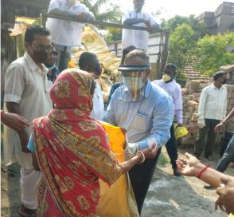
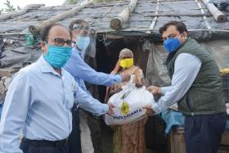


Relief Food packet distribution during Covid
Ration & Hygiene Kit Donation Drive was undertaken at villages nearby Haldia plant by Indorama India Private Limited (IIPL) in collaboration with Mukul Madhav Foundation and Indorama Charitable Trust to aid 8850 nos marginalized families during Covid-19 pandemic.
Relief material includes rice, pulses, mustard oil, wheat flour, salt, sugar, soap, tea and sanitary napkin

Slide 23





Assistance to Local Administration during Covid
Hand gloves distribution to local police station
Sodium hypochlorite handover to local police station
Kent sanitizer distribution to Railway
233 LPM Oxygen generator unit installation job under progress at Digha Sub divisional Hospital

Slide 24
Future Plan
Installation of 40 m3/Hr Effluent recycling plant in FY 21-22.
Installation of bio gas plant in factory to generate cooking gas from food waste in FY 21-22.
Implementation of EPR (Extended Producer Responsibility) as per Plastic Waste Management rule 2016 & as amended.

Slide 25
THANK YOU

