Slide 1
Indian grid and the way forward
Bengal Chamber 27_08_11

Slide 2
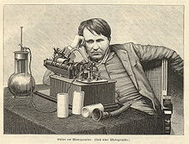
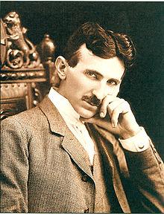
Smart wars? From war of currents to IT wars
IT wars
Bill Gates – Steve Hobs
PC – Apple
Operating systems
Open systems
Dot net – Java
Browser war
SAP – Oracle
...
Thomas Edison
American inventor and businessman, known as "The Wizard of Menlo Park", pushed for the development of a DC power network.
Nikola Tesla
Inventor, physicist, and electro-mechanical engineer, was known as "The Wizard of the West" and was instrumental in developing AC networks

Slide 3
Technology should be looked at in totality
Digital Technology
Information Technology
+
Information Technology
Communication
Automation and Control
Communication
Convergence
+
Automation and Control
IT, Communication, Automation/Control must be planned and implemented in synergy to achieve optimal results
3
Notes:
Digital Technology - Convergence of IT, Communication and Automation & Control
3

Slide 4
Current state of the Indian power sector
Total estimated cost of electricity sold is. Rs. 2,05,000 Crores in the year 2008-09
Gross subsidy on sale of electricity is in the range of Rs. 46000 Crore
The total commercial loss of the state power sector (excluding subsidy) is around Rs. 26,000 crore
The billing and collection efficiencies are in the range of 71% and 94% respectively (National average)
The Aggregate Technical and Commercial (AT&C) losses in various states are in the range of 18% - 62% with an average national-level figure estimated at around 33.07% primarily on account of power theft and inefficient billing and collection.
The rate of return of the state power sector is around (-) 18 %.
Source: Union Budget & Economic Survey 2007-08 (Ministry of Finance); Ministry of Power; CEA and other institutions of Govt. of India

Slide 5
Various Smart Grid solution areas and benefits
Transmission & Distribution Enterprise
End Consumers
Various Smart Grid
solution areas for
Utility Enterprises
and end consumers
Grid Reliability
Energy Efficiency
Asset Optimization
Delivery Efficiency
Demand Response, Renewable Integration
SG Solution Area | Expected Benefits
Grid Reliability | Increased network performance and reliability (key for overall economy)
Asset optimization | Utility industry’s primary performance indicator is RoA. Better asset maintenance leads to deferred capex investments as well as overall reliability of power delivery.
Delivery Efficiency | Reduction of overall technical and commercial losses through measurement and controls. In India, an average of 33% AT&C losses - current focus of RAPDRP.
Demand Response | Deferred capex for new generation. Every kWH saved is equivalent to 1.5 kWH generated. Savings to end consumers (due to Time of Use tariff and other such incentive mechanisms)
Renewable integration | CO2 reduction Renewable Portfolio Standards (RPS) targets mandated for generators and large consumers
Energy Efficiency | Reduction of energy consumption and expenses for end consumers by as much as 30% through measurement and controls

Slide 6
Synchrophasor System – An introduction
Phasor Measurement Units (PMU) as building blocks
Precisely time-synchronized, high resolution measurements
  measured with respect to a common reference, Universal Time Clock (GPS clock), hence, generating comparable Synchronous Phasors
  10 to 60 measurements per second
Configured as stand-alone PMUs or as embedded devices in relays, meters and other IEDs
Governed by the IEEE C37.118-2005 “ Standard for Synchrophasors for Power Systems”
GPS receiver
Phase-locked
Oscillator
Analog Filter (anti-aliasing)
A/D converters
DSP calculator
Transformers and transducers
Communication System
Power System
Functional block diagram of PMU
Synchrophasors provide ‘MRI ‘of the grid as against currently available ‘X-Ray’

Slide 7
Data generated from Synchrophasor system can be used by various applications for grid management
Synchrophasor
Applications
Planning
Validating and improving State Estimations
Fine-tuning of existing planning and estimation models
Optimizing new infrastructure investments
Monitoring
Real-time wide-area system operating conditions
Angular separation for assessing stress on the grid
Long‐duration, low frequency, inter‐area oscillations
Voltage and frequency stability
Analyzing
Post-mortem analysis of outages like a black-box
Pre-events and post-event analysis
Analyzing and triggering system restoration activities
Controlling
Dynamic rating
Congestion management
Wide‐area adaptive protection and system integrity protection
Predictive Grid control
7

Slide 8

Architecture View
Business Analytics Portal
Smart Customer Portal
Extranet Portal (Market, Suppliers, Partners etc)
Business Applications
Customer Service
Power Procurement and Market Ops
Billing
CIS
Call Center
Planning &
Forecasting
Bidding &
Scheduling
Trading &
Contracts
DSM/ Demand Response
MDMS
AMI
Resource
Dispatch
Settlements
Real-Time Systems
Planning and Engineering
Enterprise Integration
Power Quality and Reliability
Systems
Planning
Maintenance
Mgmt
Asset Mgmt
EMS
DMS
OMS
GIS
MWM
Operation
Planning
SCADA
Protocols, Standards and Security
Communication Infrastructure
Protocols, Standards and Security
Power Infrastructure
Generators
Transmission System
Sub-Stations
Distribution System
Smart Meters/ Smart Homes
Distributed Energy Sources
Energy Storage

Slide 9
R-APDRP SCADA/DMS – Overall scope
Business Applications
Control Centre Apps
Electrical Infrastructure
Communication
Measuring Sensors
Integration of SCADA with
existing R-APDRP business apps
MEASURE ANALYZE
CONTROL FEEDBACK
SCADA / DMS software, Front End processors, HMI
Media for reliable information exchange between Field and System level components (Fiber Optic / GPRS)
RTUs , Input/output racks, Transducer & interposing relay panels
FRTUs located at First switching stations & RMUs
Overall scope of work

Slide 10
R-APDRP SCADA/DMS – Overall scope
SCADA for
Distribution network
Centralized Data acquisition and control
DMS applications
Network power flow
Switching procedure arrangement
Fault isolation and service restoration
Volt/VAR control
Communications & Network
LANs and WANs – Network Equipments
Network Management System
Integration with other business processes
With IT Systems, GIS,AMR , Legacy systems etc.
Historian
Alarm and event handling
Energy balance
Intelligent load shedding

Slide 11
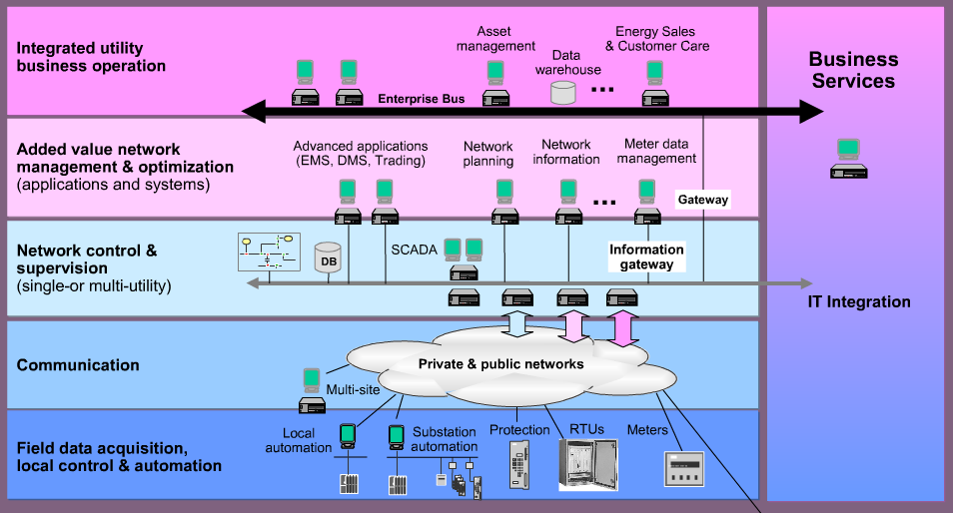
Beyond SCADA - Integrated data flow in the future

Slide 12
Architecture Reference Model
61970 / 61968
EMS Apps
DMS Apps
OMS Apps
Metering Apps
ERP application
Market Mgmt System
CIM
Market management System
AMM application
ERP application
CIM
CIM
CIM
CIM
CIM
ESB
    ESB
ESB
CIM
TASE
Generating Mgmt System Apps
CIM
CIM
CIM
Distribution, Transmission Remote control system
SCADA
Inter Control Center Link
ESB
AMM System
SCADA
Generating management System
61850
61850
61850
61850
61850
61850
61850
61850
61850
61850
61850
Substation Field Device
Substation Automation System
Substation Field Device n
61850
Distributed Energy Resources
Concentrator
61850
Nuclear Power Plant
DLMS-COSEM
Protection, Control, Metering
Hydro Power Plant
WIND Farms
61850
WIND Generating Unit
Thermal Power Plant
Residential Meters
Switchgear, Transformers, Instrumental Transformer

Slide 13
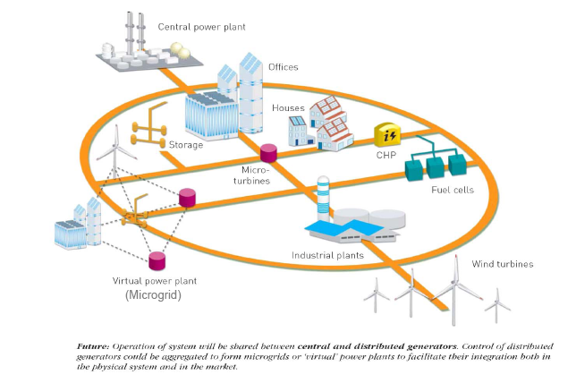
Micro Grids – bringing it all together…
Notes:
13

Slide 14
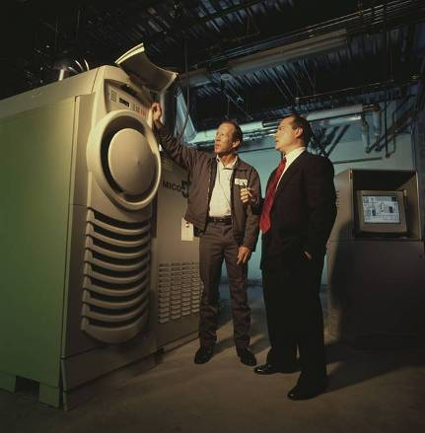
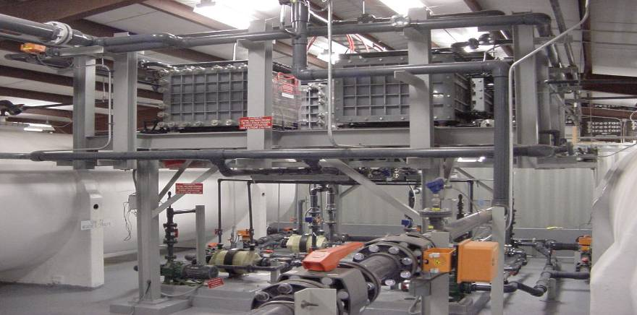
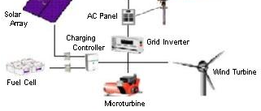
New MicroGrid Controller
Circuit Parameters
+
~
-
Electricity Storage
& Distributed Energy Resources
Smart
Line
Devices
Source
Transformer
Load Tap
Changer &
Regulators
MicroGrid Control
Advanced DMS
Consumer Loads
& beyond-the-meter
energy technologies
Notes:
14

Slide 15
MicroGrid Core Functionality
Safety and Reliability priority
Automated Field Devices
Model and Manage MicroGrid resources
  Economically, Reliably, and Securely (including charge/discharge storage)
Normal & Islanded Operations
Real-Time integration with
  OMS/DMS
  SCADA
  Demand Response/Load Mgt
  Field Devices
OMS/DMS
SCADA
Microgrid
Master
Controller
Historian
Microgrid
Master
Controller
Microgrid
Master
Controller
Microgrid
Master
Controller
Field
SCADA
Devices
Field
SCADA
Devices
Field
SCADA
Devices
Distributed
Energy
Resources
Field
SCADA
Devices
Distributed
Energy
Resources
Distributed
Energy
Resources
Distributed
Energy
Resources
Customer
Demand
Response

Slide 16






Industrial automation footprint spreads across engineering and business layers.
Business Logistics [ERP/SCM/CRM/MRP]
Plant Production Scheduling, Shipping, Receiving, Inventory, etc
Middleware Adapters [Level 3-Level 4]
Level 4
Enterprise-wide/plant-wide network
TCP/IP, Ethernet
BUSINESS GROUP
Manufacturing Operations Management [MES/LIMS]
Dispatching, Detailed Production, Scheduling, Recipe Management, Production Tracking
Workflow modeling
Package Implementation
Interface Adapters
[Level 3-Level 2]
Level 3
Operation Information Network
TCP/IP, Ethernet
Supervisory/Advanced Control & Optimization (Real-time)
[Model-based, Fuzzy, Expert Systems, Neural Network, Statistical process control]
HMI, SCADA, RTU
[Acquisition, Monitoring, Trending]
Advanced Process Control
Soft-sensors
Real-time Optimization
Monitoring & diagnostics
Scheduling
Level 2
Automation Networks
Ethernet, Modbus, DeviceNet, TCP/IP
PLC, DCS
ENGINEERING GROUP
Ethernet IP, HART, Profibus, FF protocols
Control Systems
Device Configuration
Discrete/Process Device Comm Networks
Level 1
Device Managers
[Diagnostics/Configuration]
Field Devices
[I/O, Controller, Sensors]
Embedded Systems Development
Wireless (PDA)

Slide 17
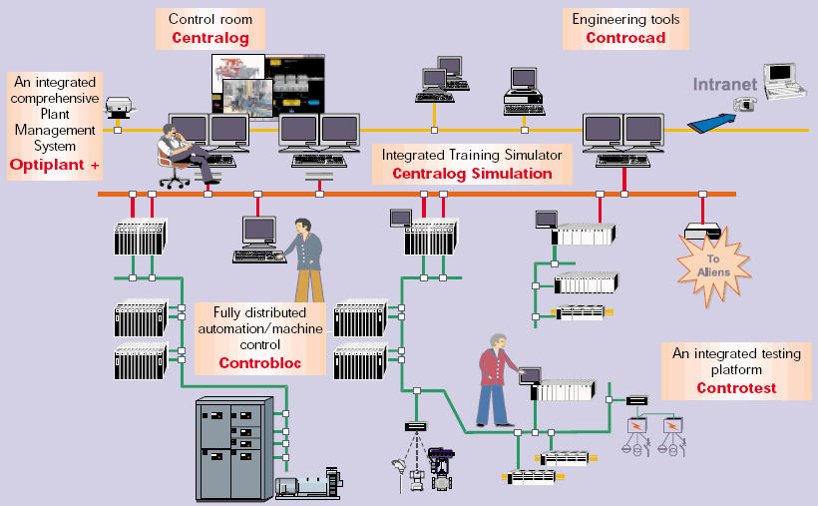
OPTIPLANT

Slide 18
Plant Management System : Layered Architecture
Portal UI
Asset Manager
Energy Optimizer
Configurator
Security
Logging
Configuration
Alarms and Events viewer
KPI Viewer
Reports builder and viewer
Mimics Viewer
Condition Monitoring
Plant Scheduler
Plant Simulator
Energy trading
SAP
Framework
OPC UA Client Framework
UI Framework
OPC UA based Enterprise Service Bus
SAP Connector
OPC UA
Existing Business(IS) application
Business Layer
Access Control Manager
Report Generation
Smart Calculation Engine
Data Access Layer
Data Access
Services
Entity
Framework
SSIS
SSAS
SSRS
CIM Model
Unit #1 control system
Unit #n control system
SQL 2008

Slide 19
Gradual but with end-vision in sight:
Smart Grid adoption in Indian power distribution context
Step 1
Step 2
Step 3
R-APDRP and beyond
Smart Grid
Part of R-APDRP
A system for:
Operational efficiency
Customer service excellence
Automated control
A system for :
Curtailing AT&C losses
Driving transparency
Driving accountability
A system that is:
Self-healing
Adaptive
Interactive
Secure from attacks
Accommodates all generation and storage options
Supports bi-directional energy flow
Distributed across geographies and organizational boundaries
1 to 3 years
3 to 5 years
5 to 15 years

Slide 20
No one-size fit-all solution ...Customization is the key to Smart Grid
Very advanced
Very advanced IT
Initial
Minimal IT
Advanced
Advanced IT
Bare Minimum
Minimal IT
Reliance and Tata in Mumbai
North eastern states, Bihar, Chattisgarh, Andaman and Nicobar etc.
Discoms in Maharashtra, Karnataka, Rajasthan, Andhra Pradesh etc.
BSES and NDPL in Delhi
Bare Balance Discoms
Geography
Metros
City
Town
Rural
IT adoption level
Consumers
Industrial
Commercial
Residential
Agricultural
Others

Slide 21
THANK YOU
www.infosys.com
The contents of this document are proprietary and confidential to Infosys Limited and may not be disclosed in whole or in part at any time, to any third party without the prior written consent of Infosys Limited.
© 2011 Infosys Limited. All rights reserved. Copyright in the whole and any part of this document belongs to Infosys Limited. This work may not be used, sold, transferred, adapted, abridged, copied or reproduced in whole or in part, in any manner or form, or in any media, without the prior written consent of Infosys Limited.
Notes:
To reproduce this slide simply create a new slide, right click and select layout and apply the Notes&Disclaimer layout.

