Slide 1
Energy Efficiency Movement India – Challenges & Opportunities for ESCOs
26 August 2011
ENVIRONMENT & ENERGY CONCLAVE 2011
Sustainable Development - Driving Technology Advances
in Future Energy
The Bengal Chamber
T: +9111-43027344
E: info @ aeee.in
www.aeee.in
Notes:
© Confidential 1996-2008 Copyright Conzerv Systems Pvt Ltd
1

Slide 2
Alliance for an
Energy Efficient Economy
AEEE is a member-driven industry association providing a common platform for energy efficiency stakeholders to collaborate with the Bureau of Energy Efficiency for implementing the Energy Conservation Act, and National Mission on Enhanced Energy Efficiency (NMEEE)
Vision
An Energy Efficient India
2

Slide 3
AEEE Mission
AEEE addresses barriers to EE implementation through policy research; facilitating market transformation; fostering technology innovations; capacity building of energy professionals and stimulating financial investments
3

Slide 4





































AEEE Members
Large Corporate Members
Members
SEE-Tech
BEBLEC
Cosmos Ignite
CMAI
Alternative Futures
Specific Project Partners:
4
Notes:
© Confidential 1996-2008 Copyright Conzerv Systems Pvt Ltd
4

Slide 5
AEEE Membership base
Leading equipment manufacturers & integrated EE solution providers Contributed to the Corpus Fund of AEEE
Schneider Electric (India) Ltd
Thermax Limited
Conzerv Systems Pvt Ltd (Now acquired by Schneider Electric)
Grundfos Pumps India Pvt Ltd
Present Large Corporate Members include
Johnson Controls India
SKF India Limited
Specific Projects or Training Partners
Honeywell & CISCO, Infosys, Wipro, Tata Pwr, Reliance Infra/ REMI (M&V Training/ CMVP Certification)
Forbes Marshall, FL Smidth, Bharat Bijlee – Event Partners
5
5
Notes:
© Confidential 1996-2008 Copyright Conzerv Systems Pvt Ltd
5

Slide 6
AEEE 40 Members – August 2011
  Utilities and DisComs
    North Delhi Power Ltd, New Delhi
    Bangalore Electricity Supply Co (BESCOM), Bangalore
  EE Companies & Consultants
Dalkia Energy Services Limited
SEE-Tech Energy Solutions
A.T.E. Enterprises Pvt Ltd
CEPT University
Alien Energy Pvt Ltd
Beblec (India) Pvt Ltd
Invensys India Pvt Ltd
IRG Systems South Asia
KLG Systel Ltd
Wipro Eco Energy
Customised Energy Solutions
Paharpur Business Centre
Spectral Services Consults Pvt Ltd
Ecofirst Advisory Services
Marc Eco Lighting Pvt Ltd
Tide Technocrats Pvt Ltd
Data Matrix Infotech Pvt Ltd
Aqua MW
6
6

Slide 7







Our Partners
7

Slide 8

Partnerships & Alliances
USAID ECO-III Project Team & Partners
      International Resources Group (AEEE Policy Framework)
      Alliance to Save Energy – Charter, Vision & Mission
Affiliate of Efficiency Valuation Organization – M&V Training, CMVP Certification
Lawrence Berkeley National Laboratory (LBNL) - (1)Capacity Building for Implementation of DSM Programmes. (2) Data Centers
Institute of Sustainable Communities in partnership with ORNL in capacity building of Energy Auditors in India
Climate Work-SSEF support for Report on State of Energy Efficiency in India
ASSIST Asia – working with AEEE to take M&V Capacity Building to Philippines
8
8
Notes:
© Confidential 1996-2008 Copyright Conzerv Systems Pvt Ltd
8

Slide 9
Current Energy Scenario
India’s Economic Growth – around 7-8 % annual in recent years
Need to meet economic and environmental goals – through Clean Energy and Energy Efficiency
Quality & Access are key challenges
Demand supply gap as reported by CEA for 2009-10 was 84 TWh 10% of total requirement
Peak demand deficit was more that 15 GW – a shortage of 12.7%
To meet the anticipated demand in 2017, we need to double the current capacity to 300 GW
Oil demand for Transportation by 2015 would be 40% higher than that of 2007 and 150% higher for 2030
Need to broaden Energy Mix, and extend present energy supplies through improved Efficiency
9
9
Notes:
9
9
© Confidential 1996-2008 Copyright Conzerv Systems Pvt Ltd
9

Slide 10
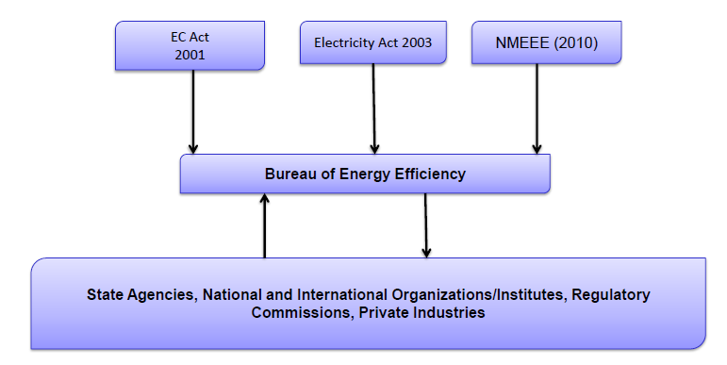
Current Policy Scenario

Slide 11

AEEE Integrates EE in all Sectors
“Mainstreaming energy efficiency in investment operations by systematically integrating energy efficiency operations within the core energy practice by replicating the business-as-usual and proven energy sector project designs and instruments” - WB EE Action Plan for Sustainable Development (2007)
R&D
Innovations
AEEE’s Support
Interface on EE Policies & Regulations
Participate & partner in EE implementation
Identify Grants & Funding supports
Access & dialogue with EE financing community (Banks & FIs)
Interface between Start-ups & VC / Donors
Startups in
CleanTech & Carbon Management
EE Equipment
Mfrs & Vendors
ESCOs & Consultants
END USERS
Industry, Buildings, Commercial Residential Sectors
Key Stakeholder for Clean Energy Integration
11
Notes:
11

Slide 12
Energy Service Companies (ESCOs) to Scale Up Energy Efficiency in India
USAID ECO-1 & 2 Projects helped create the first ESCOs in India
ESCO implementation through Performance Contracting
BEE has accredited 89 ESCOs, evolving an EE Financing platform
Capacity building of ESCOs to address diverse EE demands (Building, Municipal EE, Agri. EE, SMEs, Designate Consumers)
The Energy Efficiency Services Limited (EESL) was formed by INR 1.9 billion in 2010 by the Government
EESL to serve as a super ESCO for the public sector (including municipalities, government buildings, etc.)
12

Slide 13
Why ESCOs
ESCOs could open up huge market for clean energy technologies & business solutions, that could reduce GHG emissions - creating energy savings
Nearly 80% of the India’s industrial establishments are Small & Medium Enterprises, which may need to replace outdated equipment & improve efficiencies
ESCO business should be an attractive solution, as successful implementation of energy savings with short payback (about 2 to 3 years), with minimal investment from the clients
13

Slide 14
Accreditation of ESCOs
In 2008 the Bureau of Energy Efficiency (BEE) initiated an accreditation system for ESCOs, around 34 ESCOs were accredited
By 2010, the number of BEE accredited ESCOs more than doubled to 89, as opportunities arose in Agri. DSM and Municipal DSM projects (Street lighting upgrades)
ESCO market potential in India is estimated at around $ 10 billion in 2008 by ADB
The Ministry of Power estimates energy savings potential in Municipalities alone amounting to 3.7 billion kWh
14

Slide 15
ESCO Opportunities
Buildings are the prime target of ESCO markets
Other Target Sectors:
  Municipal sector, Agriculture Sector, SMEs, Designated Consumers (NMEEE)
  In 2011-12 India will have 20 million pumps; replacing 45-50% by EE pumps will give 62.1 billion units savings annually
  Industrial Sector (large private sector), pursuing energy efficiency through ESCO & non-ESCO route could be leverage to provide examples & expertise
15

Slide 16
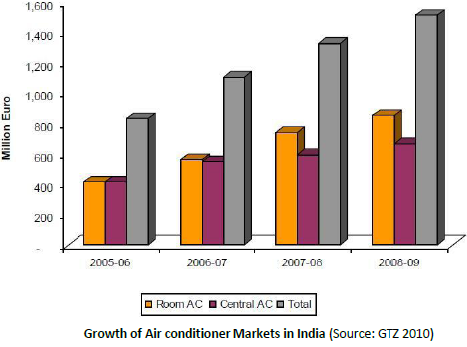
Energy Efficiency in Buildings
By 2011, 1000 registered green building projects
India has the third largest green building footprint in the world (56 million sq m)
LEED India, GRIHA, Star Rating of Buildings
Surge in demand for Building Management Solutions
16

Slide 17
ESCO Opportunities: Public Sector
Examples of Public Sector Programs via ESCO partnership
Gujarat Urban Development Company (GUDC) to replace street lighting and water pumping systems in 150 municipalities
  (Program mandates energy savings of 20% for both projects)
Tamil Nadu municipal EE program across 29 cities
BEE Municipal DSM program targets 175 municipalities in the country by conducting energy audits for which Detailed Project Reports (DPRs) are prepared
(The DPRs indicate an investment of around Rs 3 to 5 crore is required with a simple pay-back period ranging from 2 to 3 years)
17

Slide 18
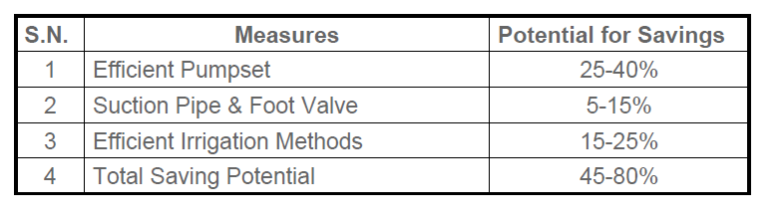
ESCOs in Agriculture DSM
Agriculture consumes 23% of power at national level and in many states it accounts for 40% of power
USAID’s Water Energy Nexus (WENEXA) project involved Bangalore Electricity Supply Company (BESCOM) and the ESCO - Enzen Global Solutions, Bangalore
BESCOM provided the preconditions for the project:
  One Distribution Transformer for each pump, Meters on all Distribution transformer, NGO working and educating farmers for four years, Detailed data available on pumps and pump efficiency, Farmers get a new branded energy efficient pump-set free with a 18 month warranty
ESCO implements the pump-set replacement as a part of the Ag DSM program and finances the investment required
  Provides ongoing O&M support to farmers and establishes a site office
  ESCO recoups investments through sharing of the energy served
18

Slide 19
State of ESCO Market in India
Despite the emergence of various energy service providers and equipment manufacturers, and Government initiatives towards the ESCO market, ESCOs business model not taken root in India
Larger presence of vendor ESCOs
  Vendor ESCOs are advantageously placed as t product-driven;
  Smaller ESCOs have to look for investments, need collaterals.
Absence of a framework of law to support ESCO practice.
  Investors face a huge risk, and loss of revenue, in the event of disputes between client and the ESCO.
Difficulties in accessing finance for investing in ESCO projects
  Banks, financial institutions insist on lending against collaterals.
No standards for identification and quantification of energy savings, before, during and after the project
  Lack of widely accepted M&V protocol
  High transaction costs to conclude ESCO contracts
19

Slide 20
Initiatives to Strengthen ESCOs
Energy Efficiency Services Limited (EESL) - set up by BEE and the Ministry of Power in 2010
  EESL is a joint venture of 4 public sector undertakings, NTPC, PFC, REC and POWERGRID with a share capital of Rs 190.00 crore
  EESL aims to play a larger role as a 'Super ESCO'
BEE is launching two funds as part of NMEEE – the Partial Risk Guarantee (PRG) fund and the Venture Capital (VC) fund:
The PRG Fund will address debt part of EE investment
  If an FI is not comfortable the PRG will do a back-to-back arrangement i.e., up to 50% of non-repayment is met by the PRG Fund – to enhance the comfort of the FIs to invest in EE
The Venture Capital (VC) fund aims to increase borrowing capacity and reduce risk by enhancing Equity
  Aimed at manufacturers of EE equipment, and EE Service providers such as ESCOs
  BEE expects that such financial instruments can be replicated and attract private investments into the ESCO industry
20

Slide 21
Lessons from forerunners: USA
US in early stages, 20% ESCOs were law-firms selling contracts. However , this muddled up the ESCO model
Subsequently the states invested in resources to create conducive environment for ESCOs
Regulators mandated DSM and benefits had to be calculated and reported to allow Annual Revenue Requirement (ARR) for the utilities’ EE expenditure
This gave rise to utility-driven ESCOs.
Today USA has two types of markets for ESCOs:
  the Utility driven DSM and
  the Super ESCO (the public facility market for federal, state and municipalities)
21

Slide 22
Lessons from China
In 2001, Chinaʼs State Economic and Trade Commission (SETC) established an Energy Management Company (EMC) to support ESCOs in the country which later converted into a legal entity – an Association today known as EMCA
Over 900 registered ESCOs in, with more than half registered at EMCA EMCA EPC concept, researches key problems and promoting solutions, and assists its members to expand business
EMCAʼs membership increased to 560 members by the end of 2010, of which 428 have implemented energy performance contracting projects
About half of EMCA’s ESCOs have capital less than USD 730,00, while 18 of them had a registered capital of USD 14.6 million
Industrial enterprises are the dominant clients for EPC projects, followed by the building sector dominated by commercial clients
EPC Projects by Sector in 2007-09: Industry-50%, Buildings 49%, other 1%
22

Slide 23
China: Policy support for ESCOs
In April 2010, China’s State Council issued a major national government policy support and favourable taxation:
US$ 36 / tonne coal equivalent (tce) of annual energy savings capacity created by qualified EPC investments. Additional award from local governments at USD 9 per tce
Annual energy savings capacity generated per project must be under 10,000 tce, energy savings capacity generated per project must also be at least 100 tce/yr and min 500 tce/yr for industries \EPC business that pay turnover tax, including equipment sales that pay value-added tax are temporarily exempted from tax
First 3 years of income from EPC project is now exempt from corporate income tax, and income tax is applicable to only 50% of project income during the fourth through sixth years
To improve focus on public sector entities like central government, provincial and municipal government, university, hospital and schools
23

Slide 24
AEEE: Activities to Support ESCOs
AEEE has created a platform for policy and advocacy and market transformation and collaborations
AEEE is committed to working with BEE, the industry and financial community to mitigate the barriers to ESCO development
Identified and supports the need for effective Measurement and Verification (M&V) of to assess savings and avoid disputes
AEEE is an Affiliate of the Efficiency Valuation Organization (EVO), the international non-governmental organization that developed the IPMVP
AEEE’s M&V capacity building programmes are attended by energy professionals in industries, municipalities, ESCOs, energy consultants, auditors, equipment manufacturers, vendors and facility managers
24

Slide 25
AEEE Concept of EE Expertise
Implementation & Financing
Energy Efficiency: “From Boiler Room to Board Room”
(Enhance the pool of Energy Auditors & M&V professionals)
Level 1 - Energy Audit – Certified Energy Auditors / Managers
  Identifies opportunities, does not achieve Energy Efficiency per se
Level 2 - Investment Grade Audits & develops projects/ DPRs that can attract Banks/ Institutional funding
Level 3 – Certified M&V Professional (CMVP) – India has 65 now
  Equipped to use reliable, International M&V protocols to COMPUTE energy savings
  Expertise in EE Financing to ensure/ keep track of payback, strengthen ESCO business model by validating savings
Level 4 – Carbon Reduction Manager, E.M.V. Expertise for DSM programme evaluation
25
Notes:
© Confidential 1996-2008 Copyright Conzerv Systems Pvt Ltd
25

Slide 26
M&V Training & CMVP Certification
First M&V Seminar Delhi 2005, PCRA hosted for EVO
M&V Fundamentals trainings in Delhi-Apr’08, Mumbai-May’09 and Bangalore Nov’09 & M&V Familiarisation Workshops in Delhi & Chennai - Mar’11 and Pune April ‘11
CMVP Certification Training & Exams in Delhi Nov 2009, July 2010, Bangalore March 2011, July 2011
EVO has Certified 5 Indian Trainers as CMVP Trainers
AEEE invited under USAID/ SARI/Energy to train & certify CMVPs in South Asian countries (excluding India)
AEEE to conduct M&V Training in Manila, October 2011
26
Notes:
26
26
© Confidential 1996-2008 Copyright Conzerv Systems Pvt Ltd
26

Slide 27
India has 65 CMVPs
Out of 1065 worldwide
Global Distribution of CMVPs
Country | No-s
USA | 406
Canada | 275
China | 93
South Africa | 73
Spain | 57
INDIA | 65
Taiwan (28), Hong Kong | 39
France | 19
Belgium (11), Swiss, UK | 21
Portugal | 16
Others | 11
TOTAL | 1075
27
Notes:
27
27
© Confidential 1996-2008 Copyright Conzerv Systems Pvt Ltd
27

Slide 28
Company-wise Distribution of 65 CMVPs
Sectors | Companies | No-s
B E E & Utilities | BEE, Tata Power, Reliance Infra, MSEDCL (1 each) | 4
Energy Managemt Solutions | Schneider-Electric(9), Johnson Controls(2), Honeywell(4) | 15
IT Enabled Solutions | Cisco Systems(3),Infosys(2), Wipro Eco Energy(2), Intel(2) | 9
Investment & Risk Management, CDM | Aditya Birla Mngt Services (2) \PWC(2), Darashaw &Co(4), Morgan Stanley Capital Intl(1) | 9
Energy Service Consultants | SeeTech, AlienEnrgy, Invensys, Custmsd Energy Solutns, SGS India, KLG, UVKA (1 each) | 9
Building Services | Paharpur BusnsCentre, BlueStar, GreenTree, Spectral/M&V Svs | 6
Associations/ NGOs | IRG, ASE & AEEE | 3
28
Notes:
28
28
© Confidential 1996-2008 Copyright Conzerv Systems Pvt Ltd
28

Slide 29
AEEE Activities Reflect India’s Clean Energy & EE Priorities
Support the implementation of PAT Scheme
M&V Training & CMVP Certification – to strengthen EE project implementation
Energy Efficiency in Rotating Equipments (motors, pumps, fans). Launched 21 April 2011, National Workshop on 5 Aug. 2011
Partnering with Forum of Regulators, Utilities & DisComs to support DSM & EE programmes
DSM programme parterns – North Delhi Power Ltd and BESCom, Bangalore (as members) and MERC, MSCDCL, Tata Power, Reliance Infra
29
29
Notes:
29
29
© Confidential 1996-2008 Copyright Conzerv Systems Pvt Ltd
29

Slide 30

Energy Efficiency Milestones in India
History & Overview
Chapter I: History of Energy Efficiency in India
1947 – 1970: Post Independence Surge in Energy Demand
The 1970s: Energy Conservation to Address Energy Access Crisis
The 1980s: Energy Productivity & Energy Management
The 1990s: Energy Demands of Unregulated Economy
Ch II: EE for Sustaining Economic Growth
a. The Energy Conservation Act 2001
b. The Electricity Act 2003
c. National Mission for Enhanced Energy Efficiency
d. The Bureau of Energy Efficiency
e. Barriers to Energy Efficiency
Ch IV: Energy Efficiency in Industries
Ch V: Energy Efficiency in Micro Small and Medium Enterprises
Ch VI: Energy Efficiency in Agriculture
Ch VII: Municipal Energy Efficiency
Ch VIII: Market Transformation towards EE in India
Ch IX: The Way Forward
30

Slide 31
Information & Resources
Integrate Resources and Reports on Energy Efficiency
Status Report on Energy Efficiency in India – in print
USAID ECO-III project reports and documents: Projects, Workshops, Surveys and Benchmarking of various sectors
Fortnightly AEEE Webinars – knowledge sharing platforms on policies, technologies, regulatory measures, markets and international EE developments
Technology updates and reports on Low Carbon Technologies
A dynamic Website for updates with resources for Members and non-members and Newsletters
Workshops & Reports on EE in Hospitals, Waste Heat Recovery and Energy Efficiency in Rotating Equipment
31
Notes:
31

Slide 32
Thank you
Large Corporate Members
Members
SEE-Tech
BEBLEC
Cosmos Ignite
CMAI
Alternative Futures
Specific Project Partners:
32
Notes:
© Confidential 1996-2008 Copyright Conzerv Systems Pvt Ltd
32

