Slide 1
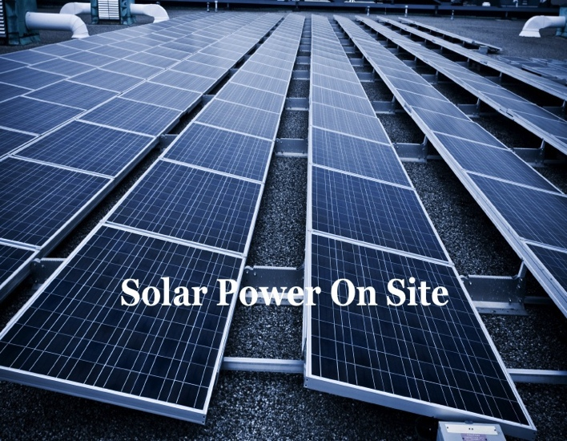
Opportunities for India to Lead in Distributed Solar Energy Generation
2011 Environment and Energy Conclave
Bengal Chamber of Commerce, Kolkata
Sanjay Dani
CEO, Serra Power Solutions, Inc.
sanjay@serrapower.com
Notes:
RAIN: Good morning, Kolkata. I’m really glad (a little disappointed) it’s sunny (or not today) as we discuss the future of Solar Power.
DEFINE: Thank you for being here. My topic, as you can see.. I’ll briefly describe distributed solar (vs. centralized/utility scale, off-grid, lanterns, street lighting). 100KW-500KW. Captive. Commercial. In this session, we will
Global perspective solar industry leaders see Distr Sol solar as biggest opportunity.
India’s goals for Distr Sol should be higher. Much, much higher.
Benefits, many already know, of Distr Sol solar and it’s a reality in India. Today.
Serra Power’s belief India is a natural fit for Distr Sol and emerge as a global leader. Acting on that belief, like to partner with all of you to make it happen.

Slide 2
global perspective
Centralized Solar Power plans will soon place California among world leaders in installed capacity
Not resting on these laurels, Governor Brown has challenged California’s solar industry to “Install 12GW of Distributed Solar by 2020”
    “harder to become the leader in distributed solar power”
    “Distributed Solar is resilient & secure because it is distributed”
    “Distributed Solar is a great breakthrough technology for energy security and to keep California among the world’s leading innovators.”
  Centralized Solar leaders see Distributed Solar as next challenge
Notes:
. Just in from Silicon Valley; Share the challenge Governor of California set for CA’s solar industry.
--SLIDE LOOK—
1GW installed capacity. 33% RPS renewable portfolio mandate. 20% already met.
California >5 GW (10% demand) of centralized solar projects in the pipeline. 2/3 or US’s 17GW PIPELINE.
. Why Distr Sol is harder? Diverse challenges. Adoption requires market acceptance of Solar’s true value; not just a top-down policy mandate. That is the beauty of it!
. Global leadership => Faster innovation. Most important innovation at this stage of industry is business-model innovation.

Slide 3
global perspective a comparison…
2010 | CALIFORNIA | INDIA
Peak Power Demand | 50,000 MW | 125,000 MW
Peak Power Met | 50,000 MW | 112,000 MW 10% Short
Grid Losses | 7% | 30% or more
GDP | $1.9 Trillion | $1.53 Trillion $4.06 Trillion @ PPP
GDP Growth | 1.8% | 8.5%
2020 Distributed Solar Target | 12,000 MW | 2,000 MW
UNDERSTATED!!
  India’s Distributed Solar Opportunity is Substantially Understated
Notes:
Let’s compare power needs &distributed solar targets of the state of California and India.
Despite the obvious differences, one a state, another country with 40 times population size, I still think it’s an interesting comparison from the energy use perspective.
--SLIDE LOOK--

Slide 4
Why aim higher in Distributed Solar?
India’s steep growth rate, large population and its growing aspirations means accelerating per-capita power usage
India needs all the power it can produce, now!
    India Inc. lost Rs. 43,000 Crores in 2009 to power outages
    Peak shortage as high as 30% in some regions
Centralized Solar takes too long, witness JNNSM Phase I closures
No “Economies of Scale” in Solar Power Generation: Good!
    PV Solar installation costs scale linearly from MW to KW
    Distributed Solar makes unstable grids more resilient
Distributed Solar strengthens JNNSM objectives by providing an impetus for broadening of the solar industry
  India’s 2020 Potential Far Exceeds California’s at 12,000 MW
Notes:
Talk about grid inefficiency and its impact on centralized projects

Slide 5
Distributed solar: Natural fit for India
Indian businesses are highly entrepreneurial and prefer control
    Accustomed to owning on-site diesel generators & real estate
    Willing to invest in project equity and share technology risks
Diesel price has quadrupled over 12 years.. and…..?
India is not China! Mega projects don’t happen overnight
Tremendous creativity, resourcefulness and innovation “at the edges”
Distributed Solar empowers businesses and heals inefficient grid
  India is naturally suited for deploying Distributed Solar rapidly
Notes:
Show of hands for executives, business owners: whose premises have diesel gensets for power failures?
Business owners have evolved to beat friction: resourceful, prefer more control on their real estate and power needs unlike in developed economies
Show of hands (if response earlier), on annual price rises in diesel in next few years? 10% -- higher or lower?
The cost of “lost opportunity” far exceeds costs of power generation; Enables entrepreneurs to access untapped resources

Slide 6
IMAGINE, what if ?!
35% of your energy was generated on-site
    Reliable as sunshine. Zero fuel cost. No bills for 20+ years
    Payoff from Renewable Energy Certificates (REC), Ministry of New and Renewable Energy (MNRE) investment credit and depreciation
  Diesel and electric bill savings exceed annual payments from year one
  The “most important part of the energy value chain” (Secretary MK De), the consumer who pays for the power, validates energy price.
  Locally installed & maintained using best-of-breed solar technologies from Silicon Valley, Germany and China
    Modest equity participation from you or a “tax investor”
    Rest financed by global, reputed, infrastructure-focused capita
    Decision to Installation takes 3-4 months
  Businesses enjoy reduced energy costs and increased reliability. On-site Distributed Solar is now a reality in India.

Slide 7
India’s time to lead
Unmet needs call for ambitious goals
More clarity on policies for Distributed Solar will help:
    Do MNRE financing incentives for off-grid, residential-scale solar extend to Distributed Solar at commercial scale?
    Can MNRE, REC and NABARD-loan incentives be streamlined?
    Do Domestic Content requirements apply? Why impose them?
Free flow of foreign financing of Solar Projects will attract global talent and allow business model innovation – key to India’s future leadership
    Let a Thousand Flowers Bloom!
    Allow the ecosystem of developers, financiers, engineering, construction and supply chain to form, grow and create jobs locally
  Distributed Solar taps into India’s entrepreneurial resourcefulness
Notes:
. If I may, I wish to challenge this august audience to set higher goals for ourselves
. We are continuously seeking clarity on policies and incentives – I’ll be grateful for pointers, suggestions and comments
.
. I’m partial to the silicon valley model of continuously seeking business-model innovations. It seems they come from attracting talent that seeks opportunities and removing constraints on funding

Slide 8
A policy Wish list: please “Do NOT”…
…Set a blanket, national “Feed-in Tariff”. India 2011 is NOT Germany 2001!
    Let markets discover energy price by seeking efficiencies in varying grid losses, generation costs, electricity tariffs, sources of financing and reliability premiums
…Treat Distributed Solar as a step-sister of Centralized by imposing artificial caps
…Dictate Domestic Content. Or even origin of funding
    Let markets decide to stock up on global surplus of PV Solar capacity or use spot pricing or manufacture locally based on global supply-demand trends
    Insularity will encourage inefficiencies and dampen the opportunity
    Let reputed, global capital find worthy projects; allow free in and outflow
…Dictate technology choices, such as 50% PV vs. 50% thermal.
  Let the Indian Solar Industry emerge as a global leader based on its Core Competencies
Notes:
. Blanket Feed-in-Tariffs focus solely on the production side, helping make a technology viable.
. Nascent Indian solar industry will not move the global market
. Further distorting “unintended consequences” in the form of transmission tariff that Mr De mentioned.
. We are doing away with entire discipline of comparative economics
. They entirely miss the point on pricing driven by market conditions.
. FiT is an artificial crutch. Industry comes to a standstill if it disappears.
. This is more important when consumers of power pay for the power directly and also to make the technology self-sustainable in the long run. The long run here is on India’s side.
.03ind360
. Few months ago, solar veterans didn’t foresee per-watt price of crystalline solar will quickly close the gap with thin film

Slide 9
About Serra POWER SOLUTIONS
Founded by IIT, Stanford Business alumni with the mission to “Address Energy Pain-Points with On-site, Clean Energy Solutions”
    50 years management experience in India, US, Germany and twenty countries
    Power Plants, Systems, Internet Infrastructure, and Environment background
    Robust on-the-ground presence in India backed by Silicon Valley roots
Commissioning projects across the nation for various Hospitals, Cold-Storage Facilities, Schools and Industrial Zones
  Serra Power is here to partner with you.
Notes:
. Talk about the markets and vertical segments we are serving

Slide 10
summary
A global perspective on why solar industry leaders see Distributed Solar as the next biggest opportunity in solar power.
India’s Distributed Solar target for 2020 can be higher. Much, much higher.
Distributed Solar offers many benefits. And it’s a reality in India. Today.
Serra Power shares the belief that India is naturally suited for accelerated adoption of Distributed Solar and can, very well, emerge as a global leader.
We are excited about opportunities in West Bengal
    Please visit serrapower.com. Contact sanjay@serrapower.com
    THANK YOU Bengal Chamber of Commerce, Sponsors and Delegates!
  Let’s build India’s Distributed Solar industry together!
Notes:
To summarize, today,
We have taken a global perspective on how solar industry leaders see distributed solar view as the next, biggest opportunity.
Then we saw, given that perspective, why India should set her goals for distribute solar higher. Much, much higher.
We revisited the benefits of distributed solar, which many of you already know, and more importantly how it’s a reality in India. Today.
Lastly, thank you all for the opportunity to share our belief at Serra Power Solutions why India is the most natural fit for distributed solar. We believe that India can and will emerge as a global leader in distributed solar. We are acting on that belief today. That is why I’m honored to be here and invite you all to partner with all of you to make it happen.
Thank you Bengal Chamber of Commerce.

