Slide 1
Sustainable Cities
Making the world more sustainable through innovation
Krishna Kumar
Vice Chairman and Managing Director, Philips India Limited
29th August 2014

Slide 2
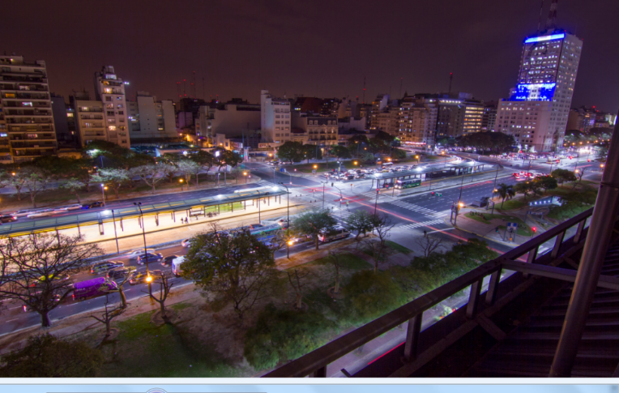
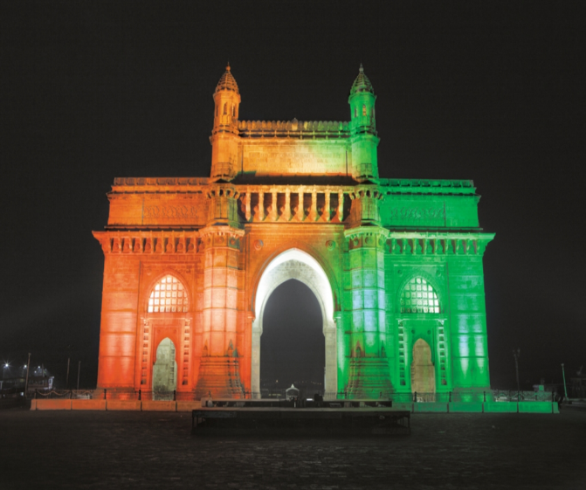
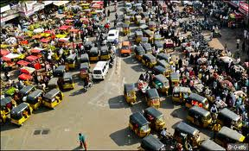
Can we imagine India in 2030?
1.6 B People;
~650 M in Cities
91 M middle class
urban households (~22M today)
~70 cities with
population > 1M
(42 today)
270 M increase
in working age
population

Slide 3
Can we imagine India in 2030?
>4x GDP
2.5 B Sq Mtrs of
Roads to be Paved (20x last decade)
700-900 Sq Mtrs
of commercial &
residential space
3rd Largest
Consumer of Energy
in the World
7,400 KMs of metros to be
constructed

Slide 4
Are we ready for India in 2030?
3rd Largest Energy Consumer in the World
5x growth in demand for Power
700 TWh in 2005
3,870 TWh by 2030
5.7 B tonnes CO₂e
Power sector >50% of emissions

Slide 5
Big challenges in energy today
Existing gap (BU)
Infrastructure constraints
80M households without access to electricity^
Peak 2013 demand at ~135GW
Inter state and inter regional transmission constraints (Southern grid not connected to NEW)
Average AT&C losses ~24%
Declining Plant Load factor - PLF of coal based power plants was ~70% in ’13
‘15 Planned Supply
CEA est. Demand
1,049
Estimated Gap
54
Unmeasured peak
Est at 15% demand*
157
Un-electrified parts
Est at 30% demand*
315
Total gap
525
1.5x - 2x demand supply gap
Source: CEA’s Load Generation balance report 2014-2015
^ http://www.censusindia.gov.in/2011census/hlo/hlo_highlights.html
* To be validated
BU = Terra-Watt Hour = 10⁹ kWh
MU = Giga-Watt Hour = 10⁶ kWh

Slide 6
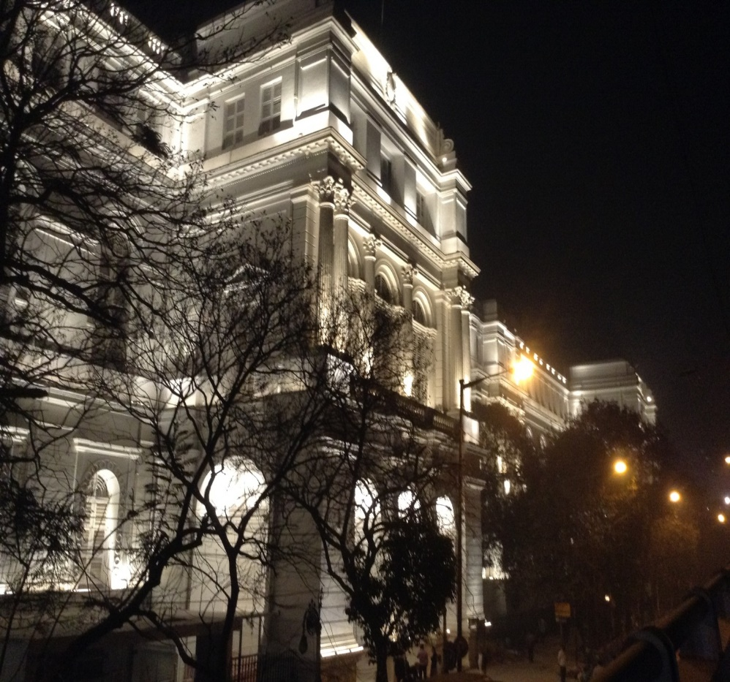
West Bengal: A top 10 state in power consumption
Guj
13%
66%
Mah
26%
58%
TN
25%
53%
AP
23%
43%
UP
37%
44%
Kar
18%
41%
Pun
23%
42%
Raj
17%
46%
MP
21%
47%
WB
32%
59%
Ori
18%
81%
Har
20%
36%
Dlh
61%
24%
Others
27%
65%
Agri
Dom.
The Indian Museum, Kolkata: Lit with LED;
40% reduction in power consumed
Comm
Industry
Munis

Slide 7
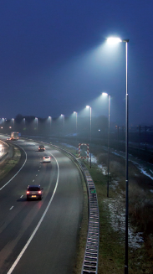
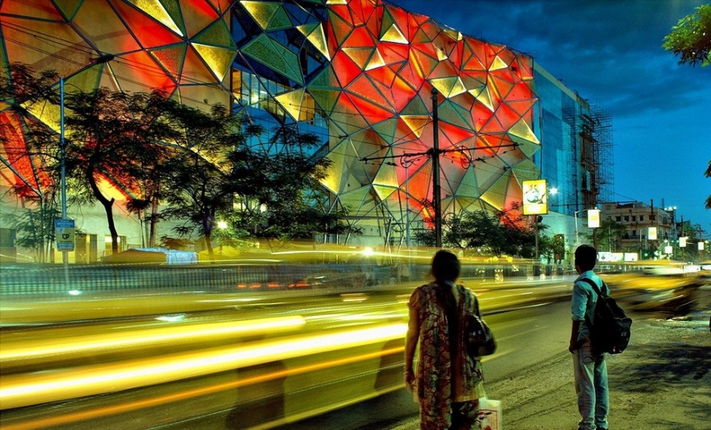
Lighting responsible for ~20% of India’s electricity consumption

Slide 8
Lighting: ~40% of municipal consumption
Muni (Public Lighting)
Municipalities Consumption in the top 8 deficit states
~40% of total municipal electricity consumption estimated to be for Lighting
995 BU: Total supply in ’15
25 BU: Muni load (2.5% of supply)
10 BU: LI load (40% of load)
AP
67.0%
0.7
UP
34.0%
1.1
MAH
34.0%
2.2
KAR
72.0%
2.2
TN
43.0%
0.6
Ker
66.0%
0.0
Raj
13.0%
1.4
J&K
14.0%
0.3
Water & Sewage
LI

Slide 9
Lighting: ~25% of residential consumption
Households
Urban Household Consumption in the top 8 deficit states
In Urban segment LI& Fans account for 24% to 25% of load across the states
In Rural/Semi Urban, LI is the main load (~70%)
995 BU: Total supply in ’15
239 BU: Domestic load (24% of supply)
60 BU: LI load (25% of load)
AP
19.2%
10.7
UP
19.2%
13.7
MAH
22.4%
15.4
KAR
24.0%
6.2
TN
22.4%
13.0
Ker
20.8%
5.6
Raj
19.2%
4.5
J&K
28.0%
1.4
Others
LI
Source: NPC report for BEE on Electricity
Consumption for FY ‘08

Slide 10
Lighting: ~10% of industry consumption
Industries (SME & Large)
Industries Consumption in the top 8 deficit states
~10% of load in industries is Lighting
995 BU: Total supply in ’15
526 BU: Muni load (53% of supply)
26 BU: LI load (5% of load)
AP
UP
MAH
KAR
TN
Ker
Raj
J&K
Source: NPC report for BEE on Electricity
Consumption for FY ‘08

Slide 11
Energy Efficiency holds the key to our Growth, Security & Sustainability
Energy Efficient Lighting has a big role to play

Slide 12
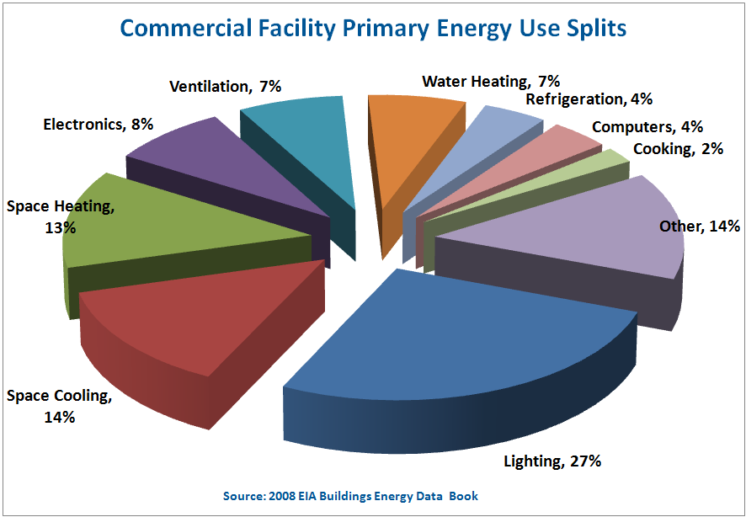
Sustainable Cities: Energy Efficient Lighting
Street Lighting
Heritage/Commercial Buildings
Power consumption expected to grow @ CAGR of 5.6% to 14901 MU by FY 22 (18th EPS)
Savings Potential of 20-25% (BEE) by shifting to energy efficiency lighting technologies
Contribute to 50% of World’s air pollution,42% of emission of Green house Gases
Savings potential 30-40% by shifting to energy efficient lighting technologies

Slide 13
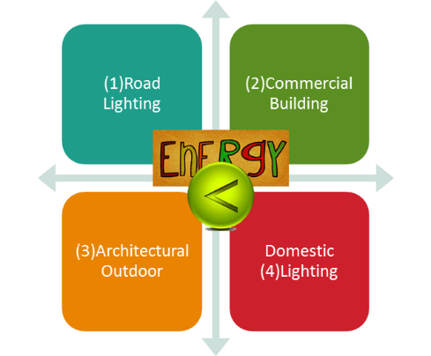
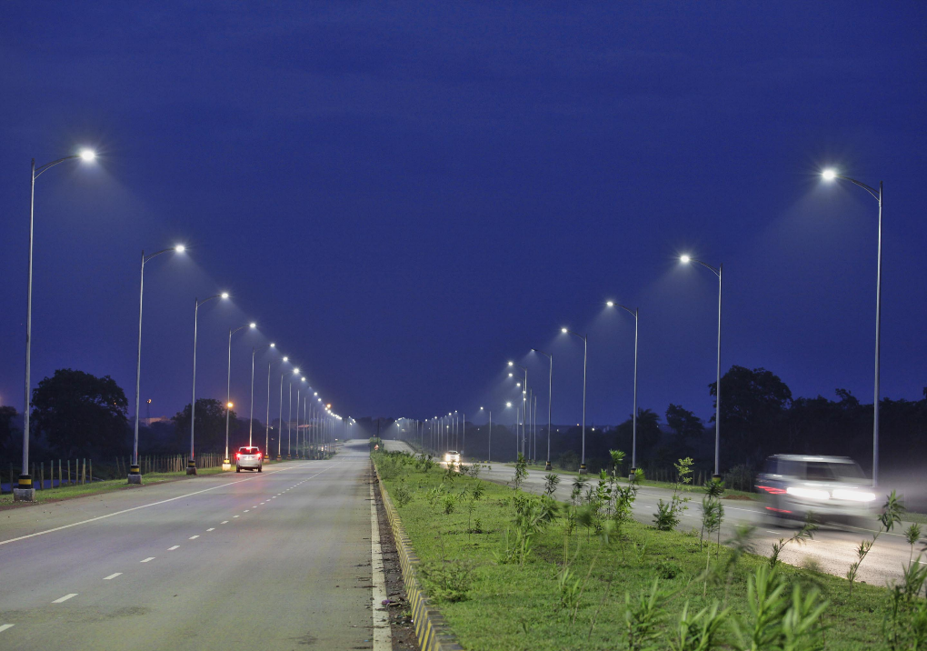
What can West Bengal & Other States Do?
1. Need an integrated master lighting plan
4. Stipulate / incentivize energy efficient
lighting for commercial & residential
2. Switch to efficient Lighting (LED + Controls & Solar)
3. Infrastructure status for energy efficient lighting

Slide 14
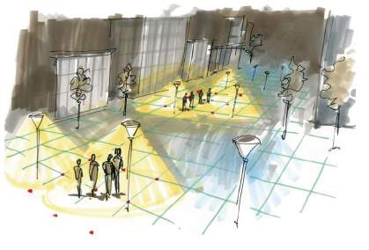
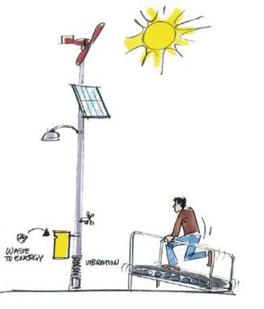
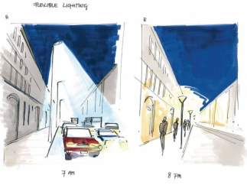
What will the future look like?
Intelligent Lighting
Renewable energy sources
Flexible Lighting

Slide 15
Impact of Energy Efficient Lighting: Examples from the ‘City of Joy’
Old lighting with conventional system ~ 70kW (2 sides lit)
Upgraded to LED lighting ~ 40 kW (4 sides lit)
Indian Museum

Slide 16
Impact of Energy Efficient Lighting: Examples from the ‘City of Joy’
27kW at Full Intensity with Color Kinetics Lighting
RPG Quest Mall

Slide 17
Impact of Energy Efficient Lighting: Other Examples
Naya Raipur LED + Control
66% reduction in power consumed by Lighting

Slide 18
The Savings Potential for India with Switching to LED (Excluding Solar)
18 Billion Euros
95 million tons of CO₂e
Equivalent of 91 power plants

Slide 19
Philips: Building sustainable partnerships with Governments & Private Sector for Energy Efficiency
Notes:
Description of each of the awards :
At Philips we set high performance targets for ourselves and we believe it is critical to report on our progress- in this slide you can see the results of our performance.
We use the benchmark information and research of external indexes to help us strengthen our management systems and sustainability reporting. We are proud of the recognition we have earned for our performance over the years. Please see the website for latest awards: http://www.philips.com/about/sustainability/awardsandrecognition/index.page
2014 Top 50 Best Global Green Brand by Interbrand – Philips is fastest riser amongst technology brands in the annual ranking of the top 50 Best Global Green Brands by leading brand consultancy, Interbrand. Advancing nine places, Philips has the second largest increase of all brands and now holds the 14th position, up from 23rd last year.
Practice Greenhealth Champion for Change - Philips received the 2014 “Champion for Change” Award for delivering resource-efficient healthcare solutions to our clients and assisting them in improving their environmental performance.
Energy Star Partner of the year - With 370 new ENERGY STAR-qualified products, for the second year in a row, Philips continues to earn praise for our work protecting the environment through manufacturing of energy-efficient products.
2013 Dow Jones Sustainability Index – Philips achieves a score of 90/100 – Best in Class score in Environmental Dimensions. Philips has maintained its membership in the Industrial Conglomerates category.
CDP – Philips is one of the highest scoring companies on disclosure and performance (100 points and A-rating)
Global 100 Most Sustainable Corporations in the World – Philips has been ranked number 7 on the annual list of ‘Global 100 Most Sustainable Corporations in the World’ by Corporate Knights– up 6 places from 2012.

Slide 20
www.philips.com/sustainability

