Slide 1
Moving Towards Sustainable Power: Nudging Users and Suppliers with Policies, Technologies & Tariffs
Ajay Mathur
Bureau of Energy Efficiency Government of India

Slide 2
Sustainable Electricity Future - Key Challenges
Enhanced access & energy services: Energy consumption needs to be enhanced so as to provide more energy services
Enhanced supply: Greater availability of energy is essential to enable increased energy services
Manage imports: Increasing imports enhance energy prices and increase vulnerability to disruption in supply
Reduce emissions intensity: Decrease the carbon intensity of energy consumption
Reduce losses: Increase coal-to-electricity conversion efficiency, and decrease T&D losses
Affordability: Ensures that consumers are able and willing to pay energy prices

Slide 3
Directions of change
Universal access to electricity
Enhanced efficiency in energy generation, supply and end use
Increased share of renewables

Slide 4
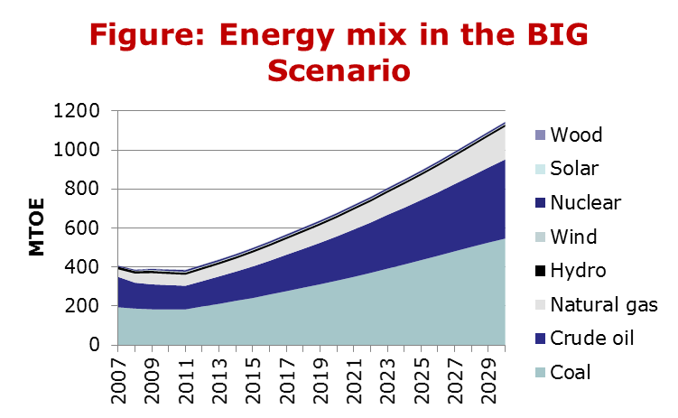
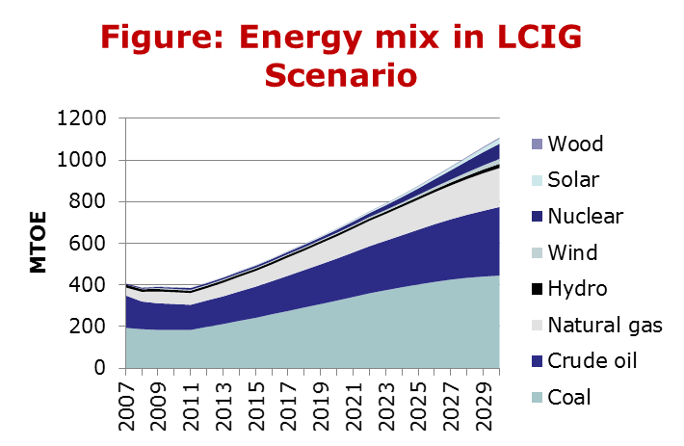
Future Energy Supply estimates- Baseline Inclusive Growth (BIG) & Low Carbon Inclusive Growth (LCIG) Scenario
The Low Carbon Growth Committee developed projections based on demand side growth estimates
The total energy requirement rises from 407 mtoe in 2007 to 1,146 mtoe in the BIG scenario and 1,108 mtoe in the LCIG scenario in 2029.
While the difference in total energy requirement is moderate, the energy mix changes significantly

Slide 5
Key nudges
Public Investment – infrastructure for access (Grameen Vidyutikaran Yojana)
Regulations & standards (new power plant requirements, appliance standards, energy conservation building code, industry PAT requirements, renewable purchase obligations)
Taxes (accelerated depreciation, import duty reduction)
Financial incentives (feed-in tariffs, lower-interest loans)
Rationalized tariff structure (progressive tariffs which meet costs)
Innovation - Technology development, deployment & price reduction, Innovative business models based on performance guarantees

Slide 6
Outline
Key sustainability issues in the Indian electricity sector
Challenges in moving towards sustainability
Tools to enable sustainability

Slide 7
Energy demand in India will increase by a factor of 1.5 to 2.5 by 2030
Energy supply in India was 819 million toe, and consumption was about 493 million toe in 2011
Per capita supply was about 0.6 toe
Per capita con- sumption was 0.4 toe
Supply is estimated to grow to 1146 million toe (Low Carbon Growth Report), 1200 million toe (IEA) or 1700 million toe (India Integrated Energy Policy) by 2030

Slide 8
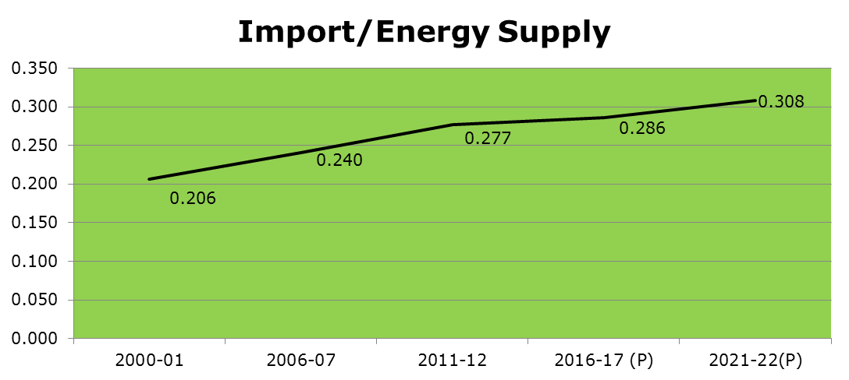
India is increasingly dependent on energy imports
External energy dependence is increasing, and is expected to continue to increase
Currently, 70% of petroleum requirements are based on imports; expected to increase to >80% by 2027.
Coal is also now being imported; currently import dependence is 10% and is expected to increase to 30% by 2027.
Key issue: More imports will be needed in future

Slide 9
Energy Consumption in India is very low compared to other countries
Energy Consumption per capita, toe/capita
Energy Consumption Per Capita Vs
Human development Index (HDI)
India
India
Energy Consumption per capita, toe/capita
Compared to other countries, per capita consumption in India is very low
A minimum energy consumption of 2.3 toe/year/cap is needed today to achieve HDI of 0.9
Countries which “develop” later achieve transition at lower levels
Probable that transition may occur at 1.5 toe per capita in the future
Key issue: Energy Supply is low and needs to be enhanced

Slide 10
Energy losses between supply and consumption are very high
The high share of coal based electricity generation implies that 65% of coal input is lost during coal to electricity conversion
India’s T&D losses are amongst the highest in the world, averaging 25% of total electricity generation
Key issue: High conversion losses, especially in coal based generation and electricity T&D , need to be reduced

Slide 11
Energy prices are already very high compared to incomes
Price of 1 million Kwh / per capita GDP
Electricity (and Petrol) prices in India are quite high compared to people’s incomes - there is limited willingness and ability to pay more
Energy prices for industry and commercial buildings are comparatively much higher (in absolute terms ) than other countries in the world
Key issue: Supply of electricity at affordable cost

Slide 12
CO2 emission growth needs to be minimized
Global climate change mitigation requirements suggests that global CO2 emissions should be less than 3 tCO2/capita in the 2030-50 timeframe
India’s per capita CO2 emissions should attempt to be less-than-double by 2030, though energy consumption needs to increase by more than 4 times in that period.
Key issue: Enhancing energy supply while minimizing increase in CO2 emissions

