Slide 1
Environment Management seen as Opportunity
Principal business of industry projected rightly or wrongly, as production/mktg not sustainability nor Energy efficiency>Underlying reason why market forces alone will not achieve S on a global basis, “price signals” notwithstanding.
It will initiate attempt to secure energy at lowest possible price but only price will not build awareness within the corporate culture of the potential saving, benefits on all fronts.
Tectonic shifts occurring in economy, geo-politics indl behaviour, technology, emission reguln etc>

Slide 2
poses significant threats, opportunities
One paradigm shift>>key words, energy effy, conservation changed to Resource effy, produc- tivity, words familiar to industry>>
This is protection of life of orgn, yours & earth’s !
Energy is invisible, raw matl is not, product is on hand, seen by all, how many see the electric bill
Cost of profit>imp issue for industry, handling PCB, contaminated oil etc, double benefit but may need changes in processes.
Importance of KPI’s in the industry

Slide 3
BT sustainable development index (BTSDI) is an assessment of business performance in India, a survey of senior opinion leaders to measure performance of business & progression towards SD over time.
The last one reveals> corp perf in India—strongest on ensuring long term econ growth(73%), but other critical ones are health-care(also 73%), climate change(71%). Water resource mgmt >>urgent attn.
The jury is still out whether the Indian Industry is truly committed or just “green-washing”(!) but more +ve steps towards SD forthcoming. The overall perf

Slide 4
of the Corporate sector needs to be more/better developed.
71% of India’s opinion leaders surveyed points to lack of political will, 55% lack of awareness for SD
Note—study reflects perception, not actual performance
Lower marks than previous year but also remarks on increased CSR, increased sustainability(for Cos) with heightened sense of urgency. Same in various other countries, gap betn expectation & perceived perf.
Overall genl perception<< both govt & Industry are taking more actions towards SD & anticipate more

Slide 5
activities in this arena, CSR & CSS within the organisations in the next 1/2 years
However, negative views on progress of SD in India still persist about past and present but anticipations are better for the near and distant future
4 Steps for the Industry :
Lead publicly, Empower employees to be your champions, Expand stakeholder collaboration for strengthening, Make the business case to the investors

Slide 6
Industry investor community not normally concerned with saving the world but have fiduciary responsibility for ROI. This is now endangered.
WEF survey>>700 industry leaders identify water, energy, CC as top global business risks not just envmtl concern>>risk “hotspots”, specially in stressed areas
Also Cos now operate in a global fish-bowl, all flaws on global display, thanks to advanced

Slide 7
Technologies, proliferation of social media, more enquiring minds and so on.
Enlightened investors may not be many today but the nos are increasing.
Change from doing good issue to a must do consideration>>Change assuredly happening but with a slower pace
Nelson Mandela>>”It is always impossible until it is done”

Slide 8
Indian Industry>>exciting stage for sustainability, opportunities in water/wastewater, treatment, re-use, RE to bridge the peak load gap, also to provide in remote areas, Land-based solar, Rooftop solar, huge no. of accessories like inverters etc.
Ballard power system in Vancouver supplying metha- nol fuel cells to Idea cellular, India, in combn with solar energy at 5 celluar base station towers, Another 30 in the offing.
500,000 wireless base station towers in the country will replace diesel generator, Pb-acid cells. Mandate> 50% rural, 30% urban towers to be powered by clean energy by 2015. Supply chain needed for smaller,

Slide 9
quieter, more efficient, low emissions back-up supply system.
Reducing or totally removing Polychlorinated biphenyle, contaminated oil will add to profit as huge cost of disposal would be avoided—re-examine production process, reduce even raw matl requirment, double savings
Purchase of waste-water for re-use---one Co’s waste is another one’s raw material
Soft issues>>>On line monitoring systems for EE particularly, data collection & confidentiality.

Slide 10
Green Project for the largest bank in India :
Eco&power friendly 10,000 new ATM’s>power cost & C-credit !!! +right example to emulate
Green channel counter>paperless, no deposit slip, no withdrawal form, no cheques,no paper transactions.+ Wind energy, 15 MW spread
Largest hotel chain>>organic bed linen, E/E bus, rooms, bio-gas plant, all green-tech
Large paint maker>Removal of all heavy metals (Hg, Cr, As, Sb, Pb).
Largest oil Co.>fuel compliance,Rs.120 bn investment

Slide 11
in green fuel projects
Q improvement, petrol/diesel, all impurities green projects, R&D centre> formulation of eco-friendly bio-degradable lube formulation
CNG,LPG, ethanol blended petrol, bio-diesel, H2…
First green stadium in Delhi.
Large IT Cos>desktop, laptop, servers, very little toxic matl, low power
E-rickshaw for CW games, green city in Agartala, auto co. making green show-room, factory buildings
Green sewage plants, solids by microbe, low water, under-serviced, low water environment

Slide 12
Large Auto Company :
Making pioneering effort in control technology/ emi- ssion control lab, fuel effy in 4/6 cylinder vehicles, alternative fuel like CNG, Bio-fuel etc.,
Treated water lakes, planted trees attracting new species of birds.
Wood being gradually withdrawn as a packing medium, whole supply chain informed.
Reducing, avoiding use of hazardous/toxic material like extended life lubricants, fluids, Ozone friendly refrigerants etc.

Slide 13
Cement industry matl balance is negative with 1.45 ton of raw material for 1 ton of cement produced.324 mtpa cap, globally 2nd largest
Today one of the world’s most energy-efficient cement producers, good blending using wastes. But it has been indicted for bad mining practice. The mining of this resource is leading to huge environmental problems.
P&P industry challenge double fibre requirement by 2020, today half from recovered paper, half of that imported. Tree planting between rice fields
Textile>>largest industry polluter, saving of water

Slide 14
energy & chemicals. Even growth of this industry affected by limited freshwater availability
In water starved Delhi NCR, 85 projects, ROI 765%, payback 11 days, water consmpn down by 6.6%, 84.5 tons/yr, electricity by 3.4%, fuel by 4%, chem by 14%, 35 mills cost redn by ~2%>> millions. Treatment, reuse, heating cycles etc
Steel 6.6 Gcal/ton, ^50%, water 3.5m cube/ton, land 200ha/ton
Auto, logistics cost quite high, being brought down

Slide 15
Steel>6.6 Gcal/ton, Resource conservation, effy major focus
Only process water 3.5 M³/ton, a few times more than global practice. Land required 1200 ha per MT, global bench mark slightly higher than 200. Up to 300 MT no more land should be required.
In Auto industry which is six largest in the world, huge cost difference in logistic. In India 14% , global base 10 – 11%. In India 2% tied up in inventory.
Supply chain concepts improved radically but sill much more could be done.

Slide 16
“IF YOU WANT THINGS TO
STAY AS THEY ARE,
THINGS WILL HAVE TO CHANGE”
==Lampedusa==

Slide 17
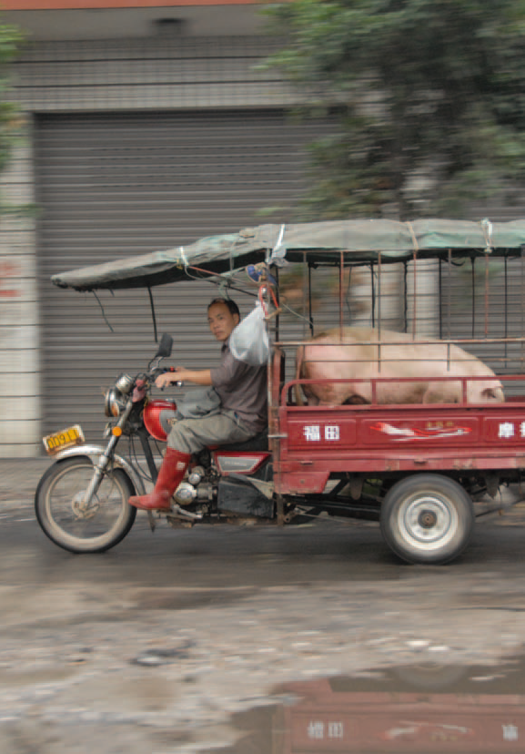
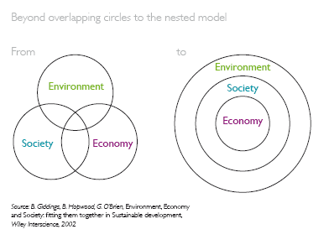
The fundamentals for
sustainable innovation
Emerging need to shift from the model where sustainability is seen as trade-off amongst ‘society’, ‘environment’ and ‘economy’ or ‘people-planet-profit’ to an ‘interdependent existence’ model of sustainability.

Slide 18
Modern Science & Technology
Has given mankind enormous power &
access to still more power
BUT HAS BEEN ACCUSED OF IT BEING
Misdirected
Unequitably Distributed and
Undermining Societal Confidence

Slide 19
“SOCIAL, INDUSTRIAL & ECONOMIC PROGRESS - TECHNOLOGY DRIVEN?”
Welfare of society
Widely dispersed economic growth
Quality of life
NOT NECESSARILY GUARANTEED
By
More (and more) Scientific and technological work
unless specifically directed towards the same
spread required in fruits of such development
Use of technical development -
mostly carried out by Industry
vis-à-vis
Welfare, satisfaction, happiness of the society

Slide 20
“A new lifestyle, new methods of production, new patterns of consumption……….
A lifestyle designed for sustainable performance”
==E F Schumaker==

Slide 21
“KNOWLEDGE WILL GIVE US A WAY
TO LIVE OUR LIFE
IT IS WISDOM WHICH WILL BRING TO US
THE QUALITY OF LIFE”

