Slide 1
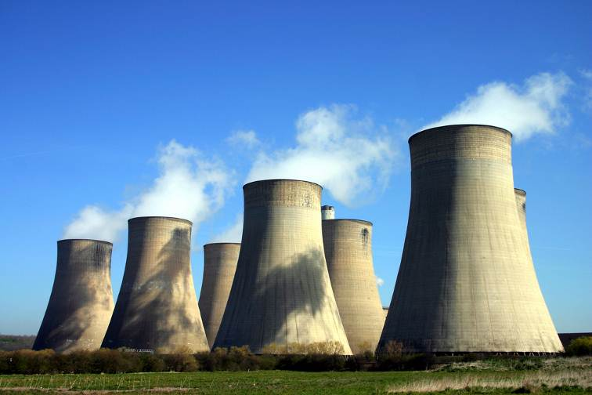
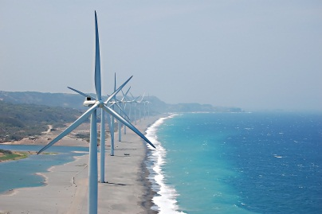
Sustainable Power – Unpacking the Buzz Word
Bengal Chamber of Commerce & Industry
August 30, 2014
The world’s leading sustainability consultancy

Slide 2
India’s Growth & Energy Needs – Some Perspectives
3rd Largest Economy in terms of PPP
Primary Energy consumption doubled from 1990 to 2012
4th largest energy consumer in the world
Centre for energy demand shifting from OCED to Asia (India & China)
For 9% GDP growth, energy supply needs to grow 4 – 5 times and generation capacity; 6-7 times
Critical need to promote energy security
Ensuring sustainability in energy supply & use
Addressing soc. Dev.; H,S & E needs of the people
Notes:
EIA, 2014
From 441 KwH to 673 KwH (IEA, 2013)
No Ref
No Ref
Integrated Energy Policy, 2006

Slide 3
India’s Power Sector – An Overview
Installed capacity stands at 2,28,721.73 MW in 2013 (Central Electricity Authority) - 77 times growth from 1st Five Year Plan period
Contribution in Installed capacity – State sector 40%; Private Sector 32%; Central 28% (Ministry of Power, 2013)
Notes:
Mode wise distribution of installed capacity – Points: (1) Coal is the largest, and growing rapidly; (2) Hydro has also grown but at a slower rate. Almost stagnant between 11th and 12th plan; (3) Renewables growing from 10th Plan Period.
Source: Ministry of Power, 2014

Slide 4
India’s Power Sector – An Overview contd.
India: Power Generation by Fuel Source
BRICS: Power Generation by Fuel Source
Notes:
Key Takeaways:
Coal is overwhelmingly large as a source of power
Followed by Hydro
Other renewables catching up
Each country’s primary fuel source dependent on availability of the source in-country.

Slide 5
India’s Power Sector – An Overview contd.
Distribution of Installed Capacity (Renewables)
Average Energy Deficit
Notes:
Key Takeaways:
Wind – largest source of renewables
Bio-gas & small hydro equally split
Solar, lowest but growing.
Average energy deficit (supply minus demand) is 9.84% and peak energy deficit (13.3%); Planning Commission, 2012

Slide 6
Sustainable Power in the Indian Context
International focus equates sustainable power with renewable energy
Drivers – (i) reduce dependency on conventional hydrocarbons; (ii) promote “cleaner” fuel based energy sources
In the Indian context, such a simplistic view may not be the best option. Why?
Source | Capital Cost* (million/MW) | Gestation Period (Years) | Availability (Maximum capacity factor) | Cost of Generation (INR/Kwh) | Land Area (sq. m/MW)
Coal | INR 50/MW USD 1/MW | 5 | 92% | INR 3/kWh | 2000
Gas | INR 40/MW USD 0.8/MW | 3 | 95% | INR 3.5-4/kWh | NA
Nuclear | INR 70/MW USD 1.4/MW | 7 | 80% | INR 4/kWh | 1200-4700
Hydro | INR 60/MW USD 1.2/MW | 6 | 50-60% | INR 2.5-3.5/kWh | 222,000
Solar PV | INR 120/MW USD 2.4/MW | 1 | 25% | INR 10/kWh | 12,000
Solar Thermal | INR 150/MW USD 3/MW | 2 | 26% | INR 15/kWh | 20,000
Wind | INR 60/MW USD 1.2/MW | 1-2 | 30% | INR 4-6/kWh | 100
Notes:
Higher comparative availability
Reliability of production
Lower capital costs
More assured
Wind and solar dependent on overall climatic conditions

Slide 7
Sustainable Power in the Indian Context contd.
Therefore, in the Indian context, to be more than merely a buzz word sustainable power will perforce have to:
Be consciously de-linked from the preoccupation with the type of fuel source
Encompass a judicious mix of conventional sources and renewables
Understand and address the major challenges linked to each source
Lead to the meeting of India’s energy security needs

Slide 8
Sustainable Power in the Indian Context - Challenges
Land acquisition, resettlement and rehabilitation – the ‘curse of resources’
Social, environmental, health and safety issues
Regulatory impediments and weak governance
Infrastructure needs
Financial health of state power utilities

Slide 9
Sustainable Power in the Indian Context – Way Forward
Land acquisition, resettlement and rehabilitation
Free, prior, informed consent
Market valuation and payment of compensation as per LA Act at the minimum
Respect for customary rights, communal lands, religious and cultural heritage; especially of tribal and vulnerable communities
Innovative mechanisms to include impacted stakeholders as partners in projects
Addressing regulatory hurdles and governance issues
Streamline regulatory processes and ensure time bound clearances
Automatic approvals in case of failure by state to provide verdict on time
Transparency & fairness in decision making and availability of information

Slide 10
Sustainable Power in the Indian Context – Way Forward contd.
Social, Environmental, Health & Safety Issues
Compulsory EIAs and SIAs; preferably Cumulative Impact Assessment (CIAs) for all power development projects – draft separate guidelines if required for renewables
Create and enforce guidelines for phasing out and disposal of out dated equipment
Link community interventions and investments to mitigate project impacts (via CSR)
Creation of a nation wide database of large power projects, identified impacts and mitigation of the same

Slide 11
Thank You

