Slide 1
Energy Efficiency and Lighting
Making the world healthier
and more sustainable
through innovation
Lalit Puri
Vice President & Business Head
Professional Lighting Solutions
Philips Lighting
30th Aug 2014

Slide 2

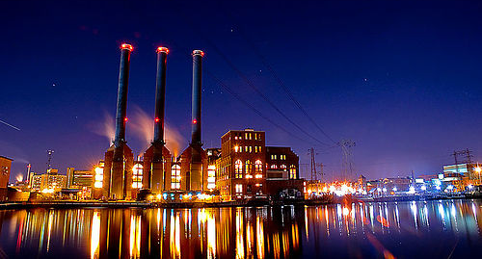


We are living in a time where Energy and Climate Challenges are increasingly capturing the world’s attention.

Slide 3
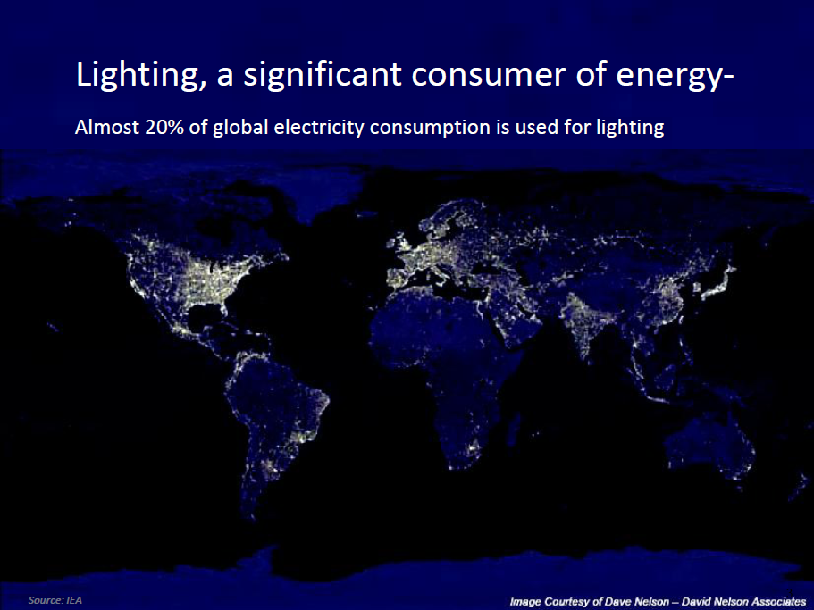

Slide 4

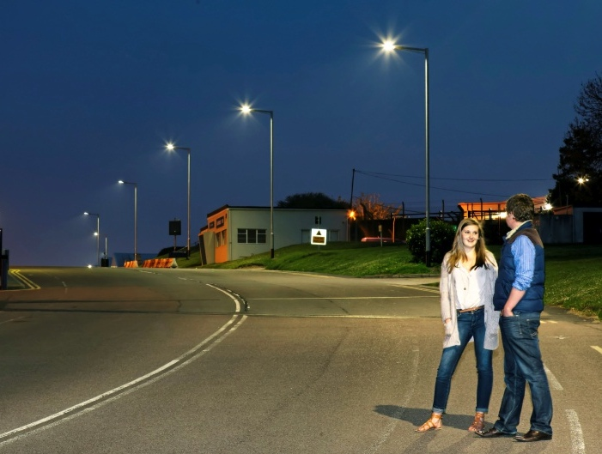
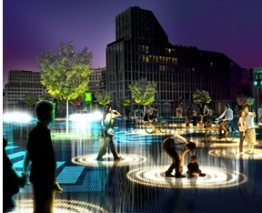
The world needs….
more light
more energy-efficient light
digital light
…and Philips Lighting is changing the game

Slide 5
Technology is advancing at an unprecedented pace and the LED Revolution provides triple win solutions for consumers, environment and economy

Slide 6

The LED Lighting revolution
Traditional lighting
LED lighting
*Source: Philips Lighting global market study 2009, updated for 2010
Oliveira Bridge, Sao Paulo, Brazil
6
Notes:
Slide intent:
Expose the magnitude of LED lighting on the market. Set Philips up as an expert in understanding the nature of, and potential for, the impact on the market.
Speaker notes:
LED lighting innovations will fundamentally change the dynamics of our business. It is as simple as that. We conservatively expect 50% LED penetration in the market by as early as 2015. This has tremendous implications for us!
New ideas for the future are critical, but meaningful innovations that address the systems we already have in place today will also offer excellent value in the near term. For example, ways of quickly renovating the current installed base and providing new solutions are critical to address the needs of people today.
Already, customers are becoming increasingly aware of the benefits LED solutions have to offer in terms of energy savings and sustainability. And, related to this, governments all over the world are driving for sustainable energy solutions; examples include the phase-out of incandescent lamps and stimulus packages for energy-efficient solutions.
llustrated: Oliveira Bridge, Sao Paulo, Brazil, Luminous 3 magazine

Slide 7




Creating Greener Possibilities
Strategy 1:
Lamp Upgrade
The easiest way to save energy is to upgrade your light source. Switch from using a conventional light source to LED technology. Philips LED retrofit solutions allow you to save up to 80% on energy.
Strategy 2:
Luminaire Upgrade
To achieve significant energy savings, upgrade to LED technology and retrofit Philips luminaires in your facility. Philips LED products are RoHS compliant and offer a maintenance-free lifetime of up to 50,000 hours.
Strategy 3:
Lighting Control Plus
Cutting down on usage is the best way to save energy. This can now be achieved by using lighting controls that enables auto on and off switches depending on area occupancy or even sunlight.
Strategy 4:
Ambient Setting Plus
Integrate special controls into the workspace to maximize comfort while minimizing energy use. From mood or scene setting to personalized controls that help create a more pleasant environment conducive for productivity.
Notes:
STRATEGY 1: LAMP UPGRADE
The easiest way to save energy is to upgrade your light
source. Switch from using a conventional light source to
LED technology. Even if initial cost is a factor, the 10 - 35%
energy savings are justified in the long run. Philips LED retrofit
solutions allow you to save up to 80% on energy.
STRATEGY 2: LUMINAIRE UPGRADE
To achieve significant energy savings, upgrade to LED
technology and retrofit Philips luminaires in your facility.
Philips LED products are RoHS compliant, and offer a
maintenance-free lifetime of up to 50,000 hours. Philips
recessed luminaires saves you an additional 10 - 20% on top of
the lamp upgrade without compromising on the quality of light.
And with digital technology, savings from LED office luminaires
can be further enhanced when complemented with the latest
lighting controls.
STRATEGY 3: LIGHTING CONTROL PLUS
Cutting down on usage is the best way to save energy. This
can now be achieved by using lighting controls that will make
‘lighting energy waste’ a thing of the past. Philips offers a
comprehensive range of lighting control solutions that will make
a significant impact on your energy savings: Philips occupancy
sensor which automatically switch lights on and off depending
on the occupancy rate of the work area; and Philips Daylight
which maximizes light from the sun as it adjusts lighting levels to
give off just the right amount of light.
Other lighting control solutions include; time-clock controls
and auto-dimming with Philips Occuswitch Dali. These lighting
solutions can also be integrated into other building systems to
enhance the overall performance of your facility.
STRATEGY 4: AMBIENT SETTING PLUS
Integrate special controls into the workspace to maximize
comfort while minimizing energy use. From mood or scene
setting to personalized controls that provide the staff with the
flexibility to adjust his work area lighting, Philips provides the
perfect lighting control solutions that will help create a more
pleasant work environment conducive for productivity.

Slide 8
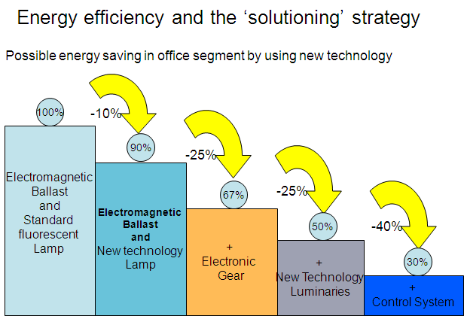
Potential Lighting energy reduction

Slide 9
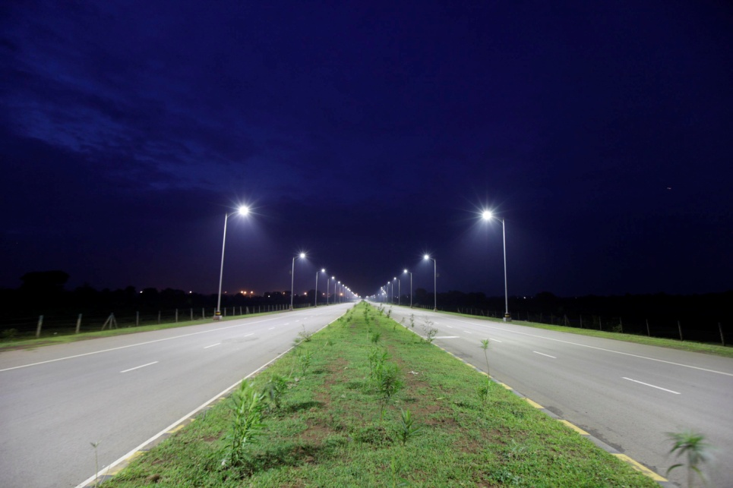
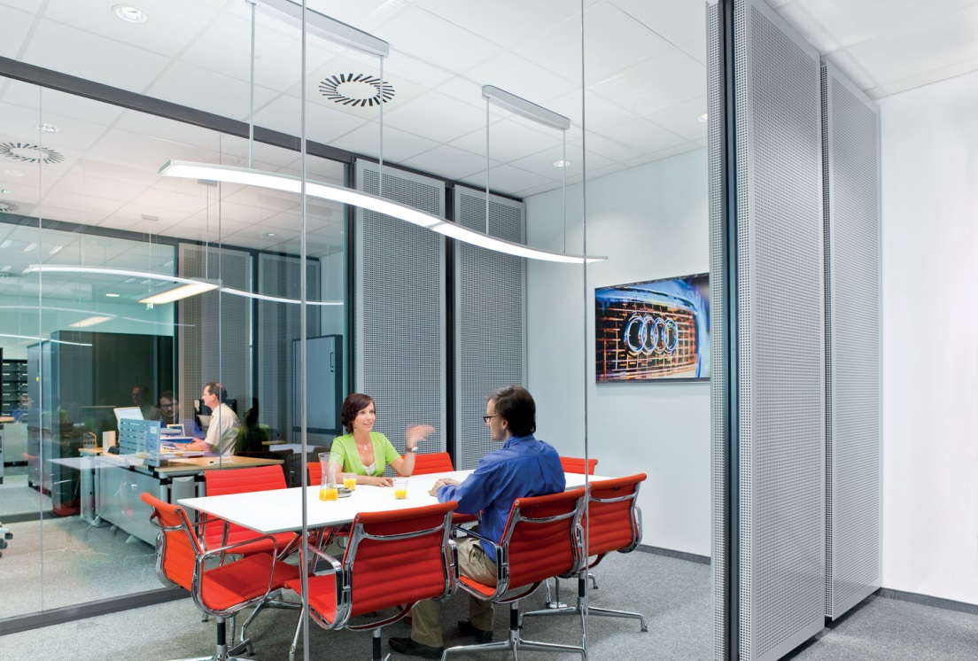
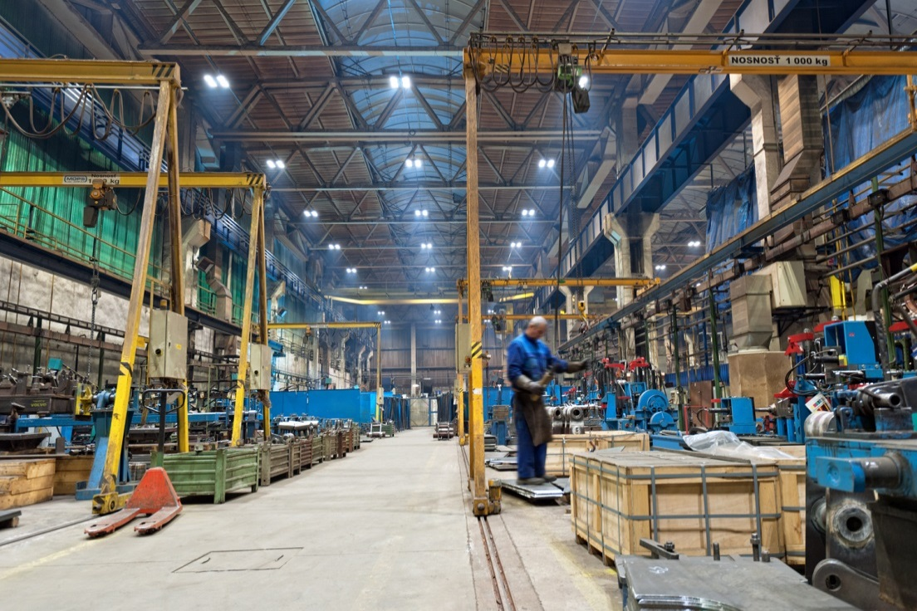
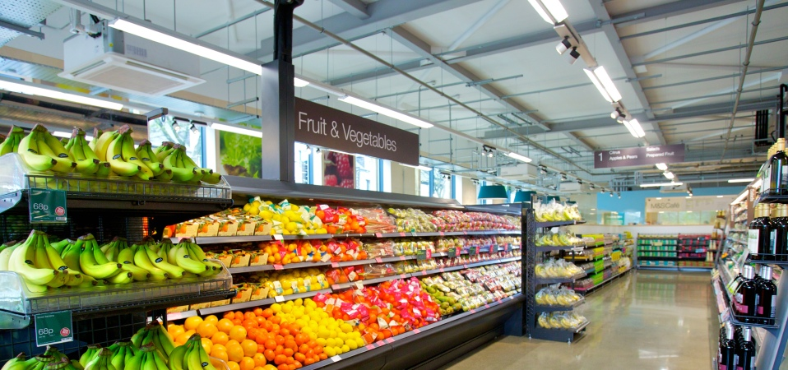
Some examples

Slide 10

Available Financing Solutions
Basic propositions
Including a payment solution in the customer offering
enables the customer to spread the investment costs in time
Eventually, it boils down to the following 2 propositions:
New lighting without additional costs
monthly energy savings are equal or in excess of the monthly project payments
Buy now and pay in installments
spreading the payment over a number of years

Slide 11


Financing – No need to wait
Lighting retrofitting existing Cities & Buildings:
  Lower lifecycle cost (CapEx/Opex)
  Latest innovative solutions
  Productivity improvements
  Value increase (buildings)
The Philips retrofitting toolbox:
  Energy benchmark
  Lighting design proposal
  Financing Mechanisms
From lowest initial cost focus, to performance based decisions, adding value to your project
Notes:
So my invitation to you is – join the team today!
Lighting can play a big role in energy efficiency. We have the technologies. We have the expertise and the commercial solutions. The legislation is in place. So what we are waiting for?
Let’s get the teamwork going. There are massive opportunities in our cities and non-residential buildings. So let’s make the switch together, now.

Slide 12

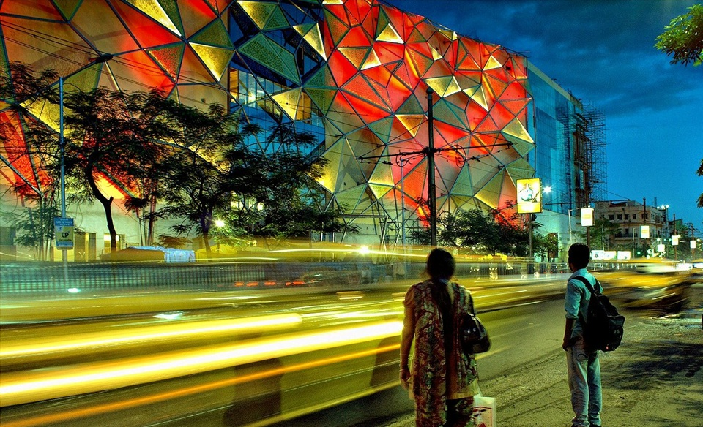
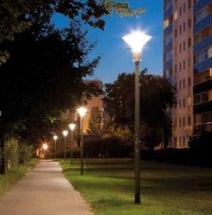
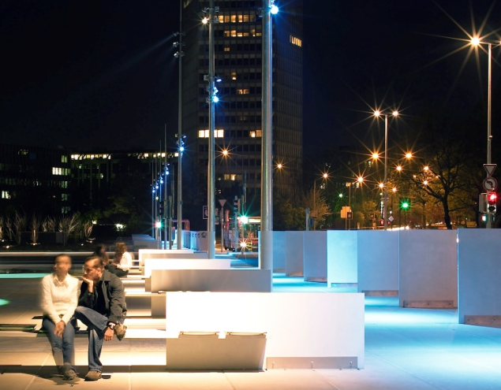

Next steps: Need to Accelerate!
Technology exists: no need to delay adoption
Policy frameworks: renovation & green public procurement
Unleash Public-Private Financing Mechanisms
Communicate tangible benefits: voting & buying behaviour
Confidential

Slide 13
We will create more momentum for sustainable development by focusing on communication of tangible social benefits beyond economic and ecological gains alone

Slide 15

Public benefits of LED City Lighting confirmed in The Climate Group’s report
City dwellers prefer LED lights, and around 90% based in 3 major cities over the world, would support a full rollout of LEDs across city street lights and 70-80% felt safer with LEDs.
Source:
The Climate Group, LED report 2012

