Slide 1
Equity in Environmental Sustainability and Climate Change
Prodipto Ghosh, Ph.D
August 2014

Slide 2
Coverage
Inter-generational equity:
Costs of GHG mitigation for India
Social Discount Rates in the inter-generational context
Historical responsibility for climate change
Intra-generational equity:
“Contraction and convergence”: Aubrey Meyer
Presentation to UNFCCC on behalf of India
“Greenhouse Development Rights”: Stockholm Environment Institute

Slide 3
Costs of GHG Mitigation for India
Results of energy-economic modeling studies carried out by TERI and NCAER

Slide 4
Undiscounted Incremental Energy System Cost for CO2 reductions from Illustrative Scenario (2011-31)
10% reduction: ~ US$ 240 Billion
20% reduction: ~ US$ 499 Billion
30% reduction: ~ US$ 1062 Billion

Slide 5
Undiscounted Cummulative GDP Loss
US $ billion (constant 2005)

Slide 6
Inter-generational Equity
Source: Stern review

Slide 7
Inter-generational equity
Impacts of sustainability/climate change on future generations and other nations raise very firmly questions of rights. Protection from harm done by others lies at the heart of many philosophical approaches to liberty, freedom and justice.
Protection from harm is also expressed in many legal structures round the world in terms of legal responsibility for damage to the property or well-being of others.

Slide 8
Inter-generational equity…
Many would argue that future generations have the right to enjoy a world whose climate has not been transformed in a way that makes human life much more difficult.
A concept related to the idea of the rights of future generations is that of sustainable development: future generations should have a right to a standard of living no lower than the current one.
This principle need not imply that the whole natural environment and endowment of resources should be preserved by this generation for the next generation in a form exactly as received from the previous generation.

Slide 9
Inter-generational equity…
On the other hand, it seems quite clear that, at a basic level, the global environmental and ecological system, which provides us with life support functions such as stable and tolerable climatic conditions, cannot be substituted.
In this approach each generation has the responsibility of stewardship. Some would see the climate in this way, since it shapes so much of all the natural environment and is not straightforwardly substitutable with other capital.

Slide 10
The Social Discount Rate
The effects of GHGs emitted today will be felt for a very long time. That makes some form of evaluation or aggregation across generations unavoidable. The ethical decisions on, and approaches to, this issue have major consequences for the assessment of policy.
Typically, in project and policy appraisal, an increment in future consumption is held to be worth less than an increment in present consumption, for two reasons.

Slide 11
Social Discount Rate…
Assessing impacts over a very long time period raises the problem that future generations are not represented in current decision-making.
Stern’s Approach: If a future generation will be present, we suppose that it has the same claim on our ethical attention as the current one.

Slide 12
Social Discount Rate…
Combining these considerations with the assumption of isoelastic (constant elasticity of utility wrt consumption) utility functions, Stern arrives at a very low inter-generational discount rate, which drives his conclusion that the present value of future climate change impacts is very high in relation to future GDP (upto 20% of GDP).
Formal mathematical treatment of these concepts is given in The Stern Review, Part I, Technical Appendix.
The Stern approach has been criticized by several scholars, in particular, Nordhaus, 2007.

Slide 13
Historical responsibility for climate change
Source: Country presentations at the AWG-LCA Workshop, Bonn: June 2009: www.unfccc.int and TERI studies

Slide 14
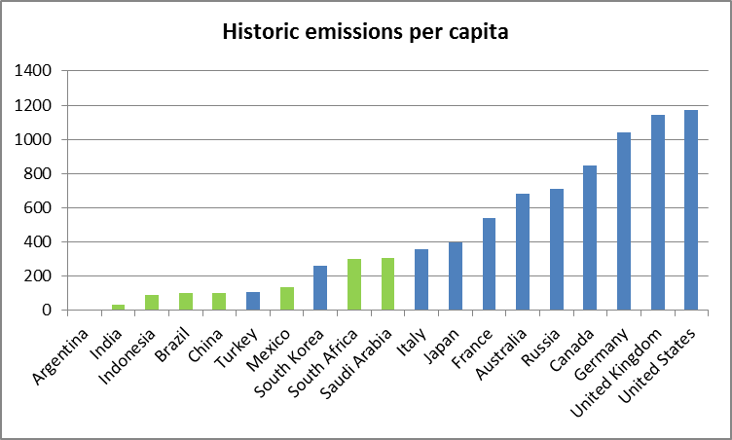
Historical responsibility for climate change – G 20 members (1850-2011)
Source: TERI analysis based on World Bank PPP and population data and WRI-CAIT GHG emissions data

Slide 15
GHG Emissions per capita –G 20 members
MtCO₂ per capita
Data source:
Total CO₂ Excluding Land-Use Change and Forestry (MtCO₂), WRI, CAIT 2.0. 2014. Climate Analysis Indicators Tool: WRI’s Climate Data Explorer. Washington, DC: World Resources Institute
Population (Millions), World Bank, 2013, Measuring the Real Size of the World Economy: The Framework, Methodology, and Results of the International Comparison Program. Washington, DC: World Bank,
Developed Countries
Developing Countries
Missing Data
Source: TERI analysis based on World Bank PPP and population data and WRI-CAIT GHG emissions data

Slide 16
MtCO₂ /billion US $
Data source:
Total CO₂ Excluding Land-Use Change and Forestry (MtCO₂), WRI, CAIT 2.0. 2014. Climate Analysis Indicators Tool: WRI’s Climate Data Explorer. Washington, DC: World Resources Institute
GDP on PPP (billion US $), World Bank, 2013, Measuring the Real Size of the World Economy: The Framework, Methodology, and Results of the International Comparison Program. Washington, DC: World Bank,
Developed Countries
Developing Countries
Missing Data
Source: TERI analysis based on World Bank PPP and population data and WRI-CAIT GHG emissions data

Slide 17
UNFCC Provisions
UNFCCC affirms that the largest share of historical and current emissions are due to developed countries.
It also lays down the fundamental principle underlying the global climate change regime: all countries are expected to contribute to protection of the global environment, on the basis of “common but differentiated responsibility and respective capability”
The debate on equity in the climate change negotiations are essentially about an agreed detailing of the CBDR principle.

Slide 18
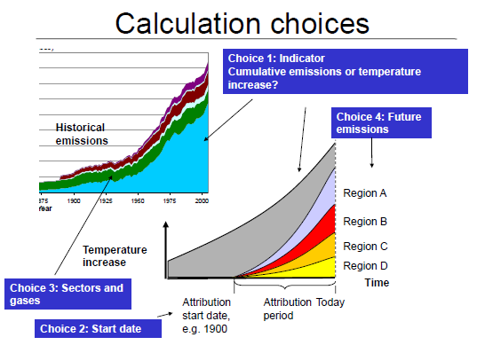
Source: Laila Gohar , UK Met Office, Hadley Centre: Presentation at the AWG-LCA workshop on Historical Responsibility, UNFCCC, Bonn, June 2009.

Slide 19
North-South divide on elements of calculation choices:
Cumulative emissions or temperature change:
North: Temperature change is what drives climate change, not emissions per-se.
South:
Scientific uncertainty of linkage between GHG concentrations and temperature change.
Earlier emissions count for less than later emissions, and this distinction is inequitious.

Slide 20
Calculation choices…
Start date:
North: Countries were innocent of knowledge that GHG emissions would cause climate change, till recently, and so they cannot be held to account for cumulative emissions prior to (say) 1990.
South: Scientific knowledge of climate change was available in 19th century (Arrhenius). In any event prior knowledge of likely harm from an action, or intent to cause harm (mens-rea) is relevant in the arena of criminal liability, and we are not in that arena but in that of determination of historical responsibility. Civil liability laws typically consider the consequences of harmful actions and not the intent behind them.

Slide 21
Calculation choices…
Sectors and gases:
North: Count gases and sectors depending upon reliability of data.
South: This would leave out CO2 from deforestation for earlier periods (when major deforestation occurred in the North) but include it for later periods (when it is happening primarily in the South). This creates an ad-hoc asymmetry between North and South.

Slide 22
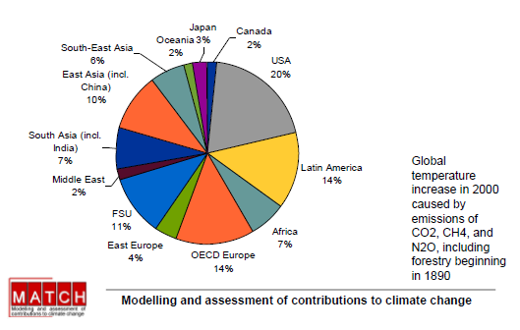
Example 1: Contributions by regions to temperature increase since 1890
Source: Laila Gohar , UK Met Office, Hadley Centre: Presentation at the AWG-LCA workshop on Historical Responsibility, UNFCCC, Bonn, June 2009

Slide 23
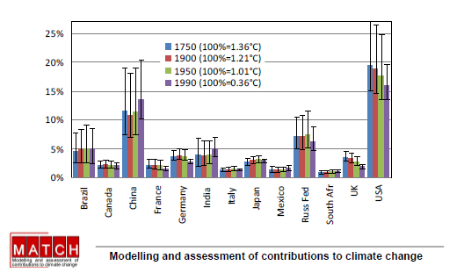
Example 2: Contributions by country for different start dates
Source: Laila Gohar , UK Met Office, Hadley Centre: Presentation at the AWG-LCA workshop on Historical Responsibility, UNFCCC, Bonn, June 2009

Slide 24
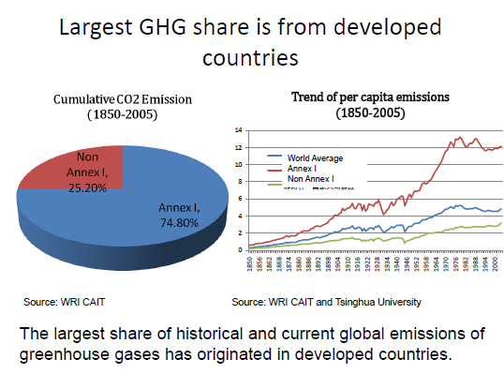
Two Approaches: China
Source: Presentation by China at the AWG-LCA workshop, Bonn, June 2009

Slide 25
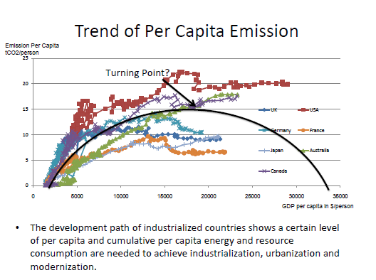
China…

Slide 26
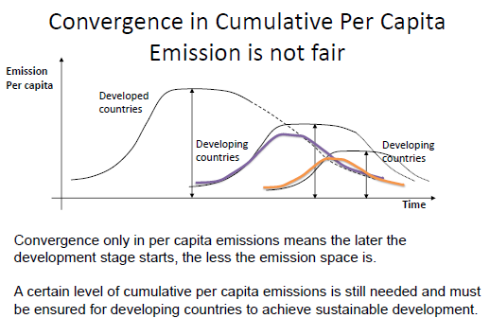
China…

Slide 27
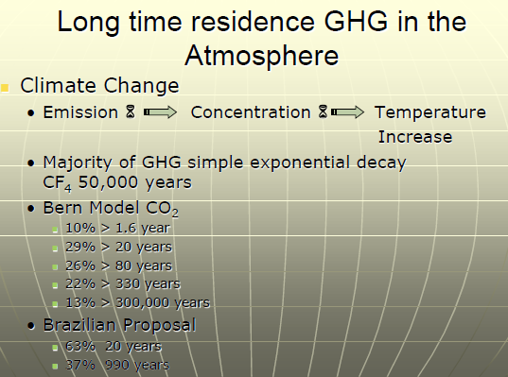
Brazil’s Approach
Source: Presentation by Brazil at the AWG-LCA workshop, Bonn, June 2009

Slide 28
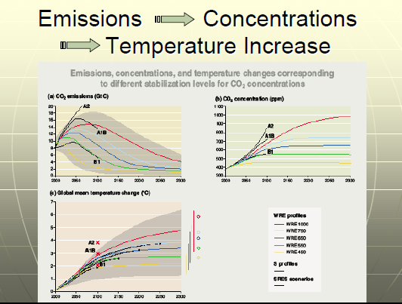
Brazil…

Slide 29
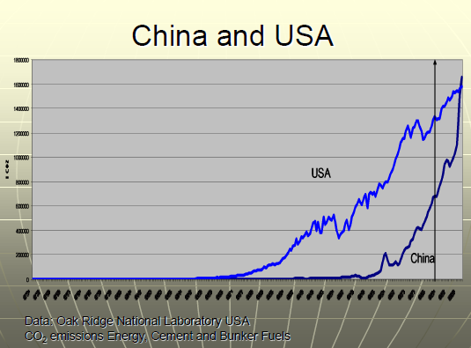
Brazil…

Slide 30
Intra-generational Equity

Slide 31
Contraction and Convergence
Source: Contraction and Convergence, Aubrey Meyer
Aubrey Meyer’s methodology is based on equal per-capita entitlements to carbon space. “Since the world’s atmosphere belongs equally to everyone if it belongs to anyone at all, the only basis on which such an agreement seems possible is that there must – eventually at least – be an equal allocation to everyone in the world.”

Slide 32
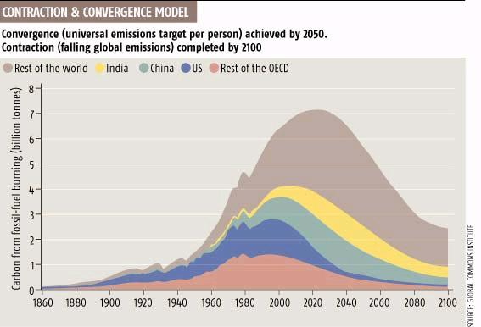

Slide 33
Developing country critiques of “Contraction and Convergence”:
Aubrey Meyer’s formulation does not take historical responsibility into account – the remaining carbon space is proposed to be divided, but responsibility for the accumulated emissions which have reduced the available carbon space is forgiven. This imposes an unfair burden on those countries which have had historically low emissions, but whose current emissions are relatively high (e.g. South Africa).

Slide 34
Stern’s critique of equal per-capita:
Source: Stern Review
One is that the right of equal entitlements to the atmosphere for all humans, while it might seem natural to some, is essentially asserted. It is not clear why a common humanity in a shared world automatically implies that there are equal rights to emit GHGs.
Equality of rights, for example to basic education and health, or to common treatment in voting, can be related to notions of capabilities, empowerment, or the ability to participate in a society.
How does the ‘right to emit’ stand in relation to these rights? Rights are of great importance in ethics but they should be argued rather than merely asserted.
More pragmatically, action on climate change requires international agreement and this is not a proposition likely to gain the approval necessary for it to be widely adopted.

Slide 35
Developing country critique of Stern’s critique of equal per capita
It is not true that formal defence of equal per capita does not exist in the published literature, Stern’s research has neglected such literature (e.g. Ghosh, 1993).
Stern himself has simply asserted (not argued) welfare maximization as the appropriate ethical norm for inter-generational equity.
An application of Stern’s principles to intra-generational equity would result in in less than equal per-capita allocations to the North as compared to the South. Since we are in the space of assigning endowments of GHG emissions rights (in both inter- and intra-generational contexts), there is no valid reason for not treating inter- and intra-generational equity through identical principles.

Slide 36
Presentation on behalf of India to the UNFCCC
(Prodipto Ghosh, June 2012)

Slide 37
The Terrain of Equity in Climate Change
Securing the interest (and involvement of) future generations
Obligations of Parties in relation to GHG mitigation,
Obligations of Parties in relation to Adaptation to impacts of climate change
Obligations of Parties wrt loss of livelihoods owing to GHG mitigation actions by others
Obligations and entitlements of Parties wrt transfer of finances and technology
Climate change obligations need to be realized on the basis of equity, if the arrangements are to have wide political acceptability, and hence sustainability in practice.

Slide 38
The imperative of formal justification of proposed equity principles
In “The Economics of Climate Change”, Nick Stern asserted that advocates of equity norms, must do more than simply assert the norm – they must provide justification.
We accept this prescription and subject our proposed equity norm to a test of validation paralleling the scientific method. The referenced paper provides the full discussion.

Slide 39
Proposed equity norm
Proposition 1: All humans should cooperate in securing the Ultimate Objective in respect of the global climate (furnished in Art 2 of the UNFCCC), the terms of such cooperation being as follows:
Proposition 2: In respect of persons of low capability, in order to remedy the residual damage of climate change impacts (i.e. when the Ultimate Objective is met), persons of high capability should provide resources and technology in proportion to their respective capabilities.
Note: The “residual damage” may be within or external to a given country. The point is that the obligation of a country to remedy the damage depends only upon its respective capability. Thus, a poor country, with little capability, but high climate damage would be entitled to transfer of resources from others with high capability.

Slide 40
Equity norm…
Proposition 3: In respect of persons of low capability, in order to enable such persons to remain within their assigned entitlements to the global environmental resources while continuing to develop unfettered, persons of high capability should provide resources and technology in proportion to their respective capabilities.
Proposition 4: In respect of harm to persons of low capability beyond residual damage i.e. when the Ultimate Objective is not met, persons who have exceeded their respective shares of the global environmental resource and have high capability must remedy such excess harm in proportion to the extent to which they have exceeded their respective entitlements.

Slide 41
Equity norm…
Proposition 5: In respect of those with low capability whose livelihoods are adversely affected by the actions of others to mitigate GHG emissions, assistance towards alternative livelihoods must be provided by those with high capability in proportion to their respective capabilities..
Proposition 6: All human beings have equal entitlements to global environmental resources. Each person is the legatee of her parents, and carries their undischarged obligations as well as their unused entitlements. They may exchange these entitlements/obligations by mutual, prior, informed consent. These entitlements/obligations, in the aggregate are limited by the Ultimate Objective of the Climate Change Convention.
The context, of course, is global society comprised of sovereign states, in turn comprised of, and representing human beings. Thus the actual locus of the Propositions will be sovereign states, rather than individuals.

Slide 42
Methodology: Test of invalidation
The methodology derives from Karl Popper’s (1968) critical rationalist philosophy of science which holds that the growth of scientific knowledge occurs through deliberate attempts to falsify, rather than confirm, proposed hypotheses.
A “ hypothesis” proceeds to the status of a “theory” after surviving repeated tests of falsification.
Details of the methodology are provided in referenced paper

Slide 43
Greenhouse Development Rights
Source: Greenhouse Development Rights, Stockholm Environment Institute, 2008
An approach to intra-generational equity formulated by EcoEquity and the Stockholm Environmental Institute (SEI).
Overall perspective:
“An emergency climate stabilization program is needed, that such a program is only possible if the international effort-sharing impasse is decisively broken, and that this impasse arises from a severe, but nevertheless surmountable, conflict between the climate crisis and the development crisis.”
Addresses the concern in the North that the “rich” in the South should also share the burden of GHG mitigation.

Slide 44
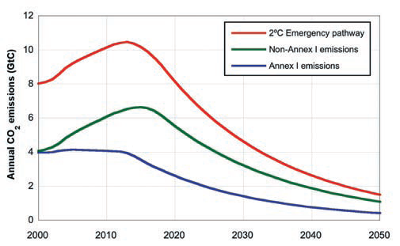
GDR: Emissions Pathways:
The South’s Dilemma. The red line shows the 2°C Emergency Pathway, in which global CO2 emissions peak in 2013 and fall to 80 percent below 1990 levels in 2050. The blue line shows Annex I emissions declining to 90 percent below 1990 levels in 2050. The green line shows, by subtraction, the emissions space that would remain for the developing countries.

Slide 45
GDR: “Development Threshold”
Development Threshold: a level of welfare below which people are not expected to share the costs of the climate transition.
Threshold set at $ 20 per day per capita consumption, i.e. 25% above $ 20 per day (or $ 7,500 per capita per year PPP) – a level at which malnutrition, high infant mortality, low educational attainment, high relative food expenditures – begin to disappear.
Authors accept that setting the level of threshold could be debated.

Slide 46
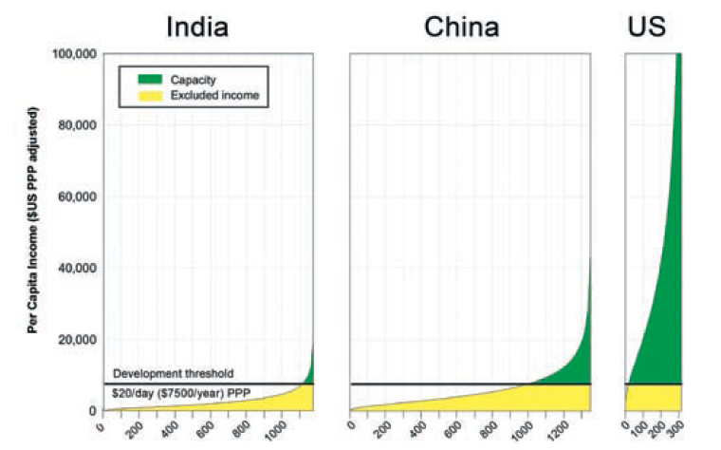
Capacity: Income above the development threshold. These curves approximate income distributions within India, China, and the United States. Thus, the green areas represent national incomes above the ($20 per person per day, PPP) development threshold .Chart widths are scaled to population, so these capacity areas are correctly sized in relation to each other. Based on projected 2010 data.

Slide 47
Capability (“capacity”) and Responsibility
Capability (capacity): A nation’s aggregate capacity is defined as the sum of all individual incomes, excluding income below the threshold.
Responsibility: is contribution to the climate problem, defined as cumulative emissions since 1990, excluding emissions that correspond to consumption below the development threshold.
These measures of capacity and responsibility can then be combined into a single indicator of obligation, in a “Responsibility Capacity Index” (RCI). This calculation is done for all Parties to the UNFCCC, based on country-specific income, income distribution, and emissions data.
Authors concede that the start date of 1990 could also be debated.

Slide 48
Critiques of GDR:
Relies on internal income distributions of countries for determination of “capability”. This is difficult to justify as it penalizes more equitable societies at the cost of the less equitable (e.g. Japan vs US)
Does not address historical responsibility
Empirically problematic: internal distributions of income (esp. developing countries), purchasing power parity (not wholly objective)

Slide 49
References:
The Economics of Climate Change: Stern Review, 2006, Government of the United Kingdom:
http://www.webarchive.nationalarchives.gov.uk
Country presentations at the AWG-LCA Workshop, Bonn: June 2009: http://www.unfccc.int
“Contraction and Convergence”: Aubrey Meyer: Green Books, 2001: ISBN 13: 9781870098946
“Greenhouse Development Rights”: Stockholm Environment Institute, 2008: http://www.GreenHouseRights.org
“Equity in Climate Change – A suggested approach”: Prodipto Ghosh, Economic and Political Weekly, Vol. XLVIII, No. 12, March 2013
Other Readings:
Comment on the Stern Review: William Nordhaus, May 2007 (pdf copy sent by email).
Structuring the equity Issue in Climate Change: Prodipto Ghosh, in Climate Change, An Indian Perspective: Amrita Achanta (Ed), Tata Energy Research Institute, 1993. (Scan copy on request).

Slide 50

Notes:
50

