Slide 1
Conceptualizing India’s EV ambition
Incorporating targets and mandates as the cornerstone of the EV adoption strategy –
How businesses can deliver for India’s climate goals

Slide 2
REmobility: Regional coalition in India
Accelerating business or fleet-led adoption of EVs in India
Project partners
Manufacturing
Charging infrastructure
Mobility Services
Corporate customers
Funding partners
OEMs
Charging equipment & operations
Mobility service companies
Corporations
Organizational partners
Other tech provider
Utilities
Government endorsement
Start-up accelerator

Slide 3
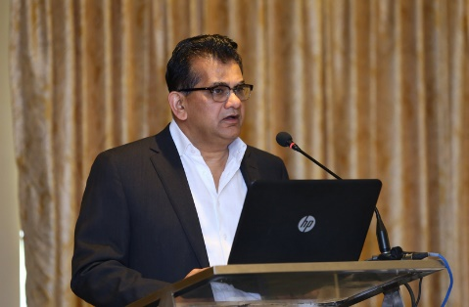
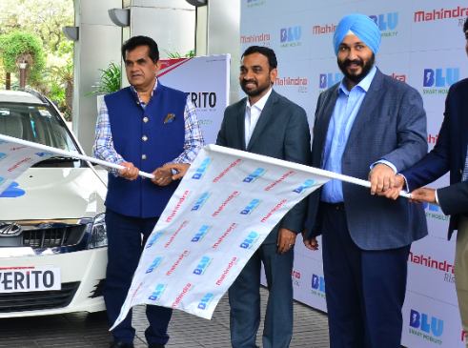
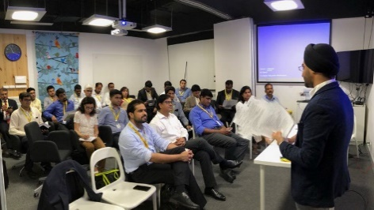
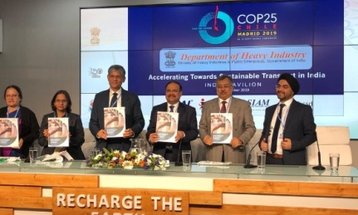
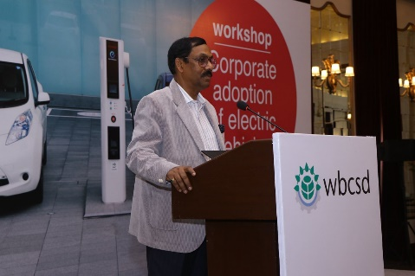
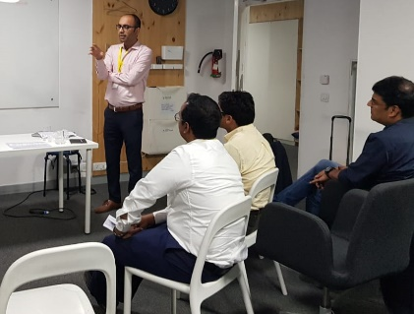
REmobility members collaborate to build knowledge, lead through own actions and advocate for right policies – to help accelerate EV adoption in India
Project Deliverables
REmobility coalition – Over 50 business come together to set ambition, lead through own action, share knowledge and advocate for policy initiatives that help accelerate fleet-led EV adoption in India
India Business Guide to EV Adoption – A ready reckoner for fleet adoption across use-cases such as ride-hailing, employee transport and urban freight created by business for business (launched by Indian government at COP 25)
Demonstration projects – Supported and documented learning from India’s first all-electric ride hailing service (BluSmart) to showcase viability of transitioning ride-hailing to all electric in India. A similar demonstration project under progress with India’s largest e-commerce company
Policy recommendations – Developed policy recommendations for various government departments and ministries to support faster adoption of EVs by fleets and attract private investments in charging. Recommendations shared with senior government officials.
Ambition statement – CEO backed ambition statement, in partnership with UK Government, to be launched in the run up to COP26 to support Indian government to enhance its transport related NDCs

Slide 4
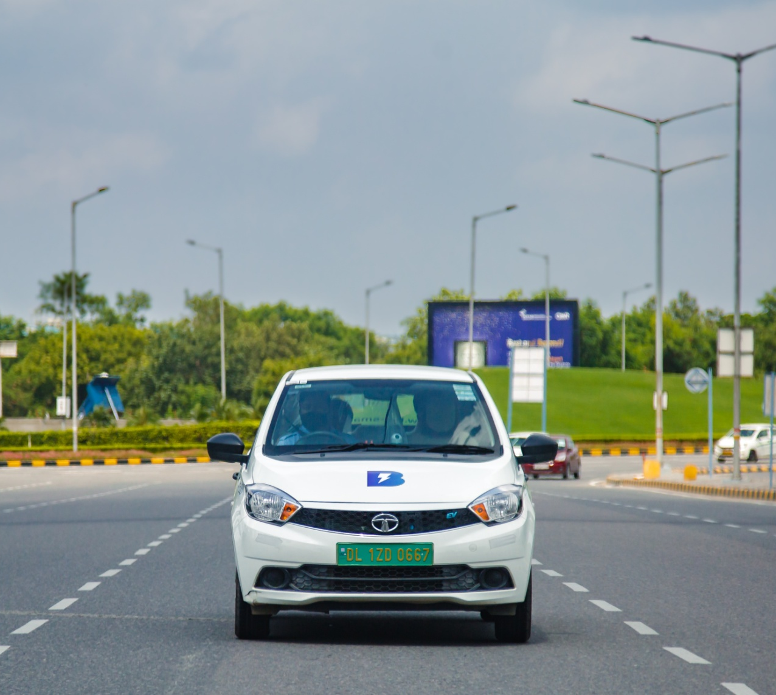
Need for an ambition
Develop confidence and clarity among businesses
Defining the RATE of EV transition

Slide 5
Global EV ambition timeline
Portugal
France
Spain
Canada
Sri Lanka
2025
Norway
2032
2040
Scotland
UK
Iceland
Ireland
Sweden
Netherlands
Slovenia
2030
2035
Denmark
Cabo Verde
Germany
Costa Rica
2050
EV sales / stocks target
ICE phase-out target

Slide 6
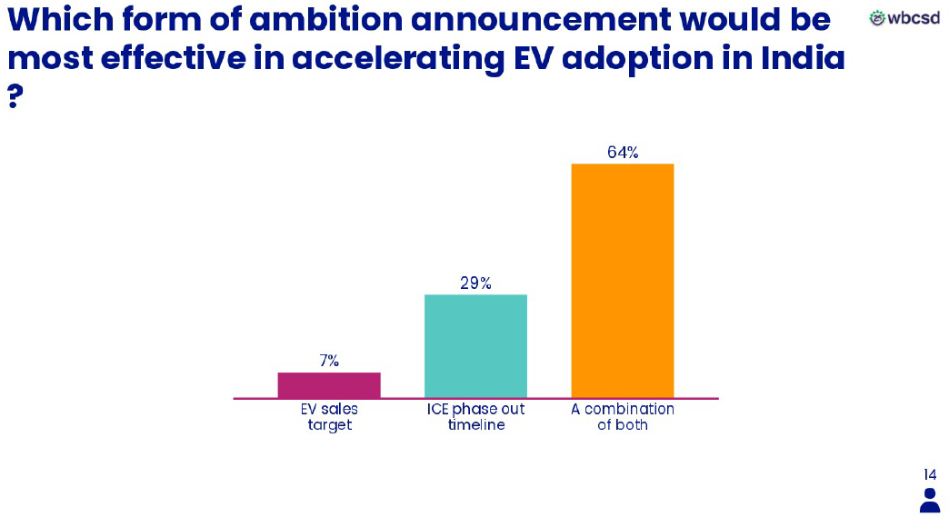
Consensus shaping up

Slide 7
Our contact details
Appurva Appan
Associate, REmobility
WBCSD India
4th Floor, WorldMark 2, Aerocity
New Delhi, 110037, India
Email: appan@wbcsd.org

