Slide 1
A Presentation by Azad Foundation
Job Creation For Resource Poor Women
In India
In the Session On
E- Mobility - Infrastructure Creation and Business Readiness Strategies and Green job creation
Organized by
The Bengal Chamber Of Commerce and Industry
&
British Deputy High Commission, Kolkata
14th January 2021

Slide 2
CONTEXT
01
In India, women’s workforce participation rate is declining.
According to World Bank in 1990 the women’s labour force participation rate was 30% which came down to 20.5% in 2019. According to SDG review report, 2019, this rate is even lower, i.e. -18.5%
93% of women in workforce are in the informal sector
This decline has happened at a time when country's GDP has doubled and when the proportion of women in the working age have increased by 25%.
While the men’s labor force participation rate slightly decreased over time, too, it is four times that of women at 76.08 percent in 2019

Slide 3
CONTEXT
Effect of Pandemic
02
Since lockdown
Female-dominated sectors such as arts and entertainment, domestic work and other services have been heavily impacted.
61% of female workers impacted.
As per ILO report:
“Those who are most likely to lose their work and income are casual workers”.
118 million workers in India are casually employed.
Higher number of women are in casual work than men.
Therefore, women are likely to experience greater loss of employment than men.

Slide 4
SKILL TRAINING
Need to be more inclusive
03
2.74%
Of working-age population (15-59) formally trained in Technical and vocational training
90%
Of youth between 15–30 years of age who are unemployed have had no vocational training
7.2%
Youth had vocational training - not resulted in employment
42%
of youth are NEET (Not in Employment, Education or Training) segment. 96.2% of this segment comprises women
504 M
Internet users- 65% male (IAMAI-Nielsen 2020)
SOURCE- Periodic Labour Force Survey [PLFS], 2020

Slide 5
ACTIONS
To Create Employment for Women
04
SKILL
ENABLING ECOSYSTEM
Skills need to match Industry Standards
Gendered social norms need to be changed to create an enabling ecosystem for women to Join Non-traditional professions.
SKILL BUILDING
Skill building approach should be Skill++
SUPPORT IN CARE WORK
Engaging men in care work Crèches for child care
SKILL BUILDING
Skill building opportunities need to be expanded for women : Non-traditional skills
EQUAL PAY
Equal pay for equal work
FREE OF VIOLENCE
REMOVE DIGITAL DIVIDE
Violence and fear of violence free lives Legal, shelter, health and psychosocial counseling support for survivor
Access to smartphone, computer, internet connection
GENDER SENSITIVITY
Gender sensitive infrastructure, such as washroom

Slide 6
AZAD FOUNDATION’S MISSION & WORK
05
We engage urban resource-poor women in non-traditional livelihood, i.e. we impart four wheelers and two wheelers training to women and our strategic partner Sakha Consulting Wings engages them with the market which has been traditionally closed to women.
MISSION
Azad Foundation’s mission is to equip resource-poor women so that they excel as professionals and/or entrepreneurs, and earn a “livelihood with dignity” in jobs and markets that had traditionally been closed to them.
02
In more than a decade we have been able to make more than 2500 women employable and 1000+ women are now working as drivers in the roads of different cities in India.
Azad started its operation in 2008 in Delhi and is presently working in 8 cities in India –
- 4 cities directly
- 4 with partners.
01
03
OUR WORK

Slide 7
AZAD’S APPROACH
06
In our work, GJSE means:
Gender Just Skill Education
Framework
Rights to GJSE
These relate to factors that affect “access” which means
ENGAGE
WITH
MARGINALIZED
COMMUNITIES
Access to information
Increase negotiation power with families & communities
Sharing unpaid care work by men of the family
Couselling to change patriarchal norms
RETAIN
CREATE GENDER SENSITIVE MARKETS
TRANSFORM
THROUGH RIGHTS-BASED AND TECHNICAL SKILLS
Rights within GJSE
EMPLOY
WOMEN IN DECENT REMUNERATIVE LIVELIHOODS
Making gender sensitive market
Rights Through GJSE
Making gender sensitive market
Advocacy for a supportive ecosystem such as hygienic washrooms, crèche etc

Slide 8
GREEN MOBILITY
AZAD’S EXPERIENCE
07
We aspire to make our planet sustainable
Committed to SDG goals
(goal 13)
Training women to drive E-vehicles
Our strategy has been to include women in E-commerce Industry

Slide 9
CHALLENGES
WE FACED
08
Reluctance by companies
Speed of E-Bikes
No Loan Support
E-commerce companies are not ready to accept green vehicles as a tool for business
Banks don’t provide loans saying e-vehicles are not registered vehicles
Speed of E-bikes while carrying load need to be increased
Limited
E-Bike
vendors
Re-sale Value
Charging station
Mechanical Support
No charging stations in cities and in companies where women work.
Capacity of E-bikes
Mechanical support need to be made available
Weight carrying capacity of E-bikes need to be standardized

Slide 10
RECOMMENDATIONS
09
Comprehensive policy intervention from government is needed to promote E-mobility
Infrastructural support, such as charging stations, need to be in place.
Industries, government and financial institutions need to work in synergy.
Awareness generation among stakeholders, citizens about Green Mobility and ‘Smart City Scheme’ is required.
Since the West Bengal government has introduced E-buses and announced to switch public transportation to electric mode by 2030, the plan need to more inclusive to make it effective.

Slide 11
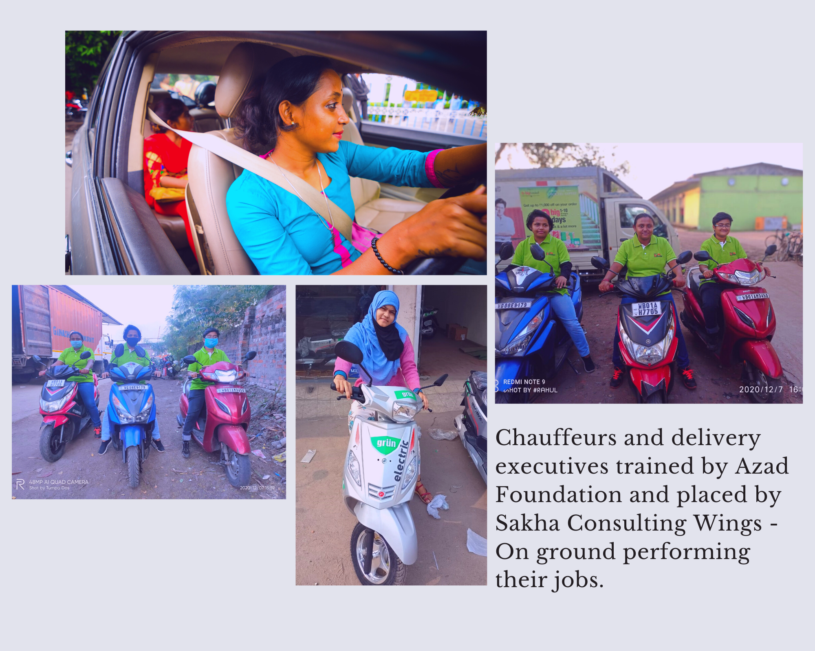
PHOTOS
10

Slide 12
THANK YOU

