Slide 1
Green Transport- Innovation and Strategies for Decarbonization
Bengal Chamber Energy Conclave, Aug 2021
Presented by:
Ira Gupta, Advisory Lead India (Introduction)
Liani B Castellares (Case Studies)
27 August 2021

Slide 2
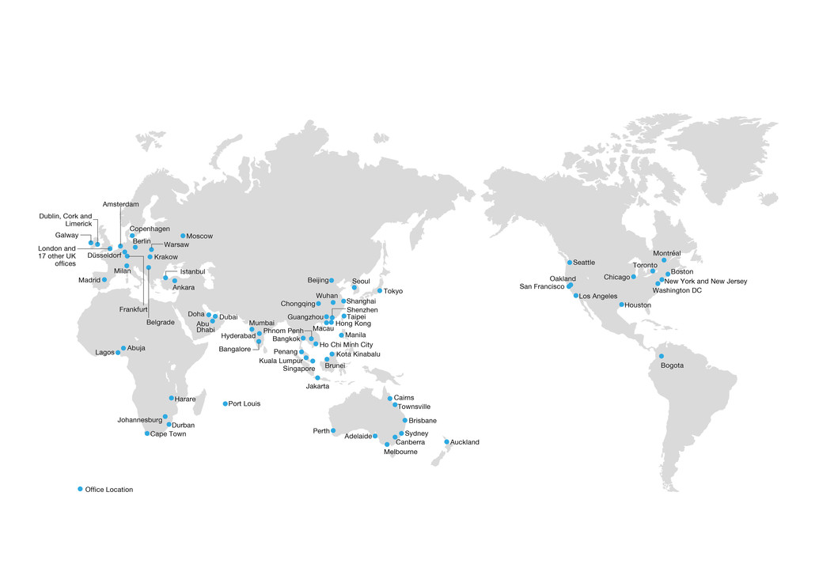
About Arup
Arup was founded by Sir Ove Arup in London in 1946. We are a multi-disciplinary consulting firm with more than 15,000 specialists, working on projects in over 140 countries.

Slide 3
Arup in India
Arup India Limited
Arup has had an India presence since 2008. We are headquartered in Mumbai and have presence in Delhi, Hyderabad, Bangalore and Pune.
The India office, with over 80 staff, works closely our global specialists worldwide to ensure the best team is available to you.
We are an ISO 9001, ISO 14001 and OHSAS 18001 accredited firm.
Business Strategy and Transformation
Regulatory Review
Asset Management
Buy-side and Vendor Due Diligence
Operational Efficiencies
Life Cycle Modelling
Health, Safety, Environment (HSE)
Digital Solutions
Threat, Risk, Vulnerability Assessment
TRANSPORT
E-MOBILITY
ENERGY
SMART CITIES

Slide 4
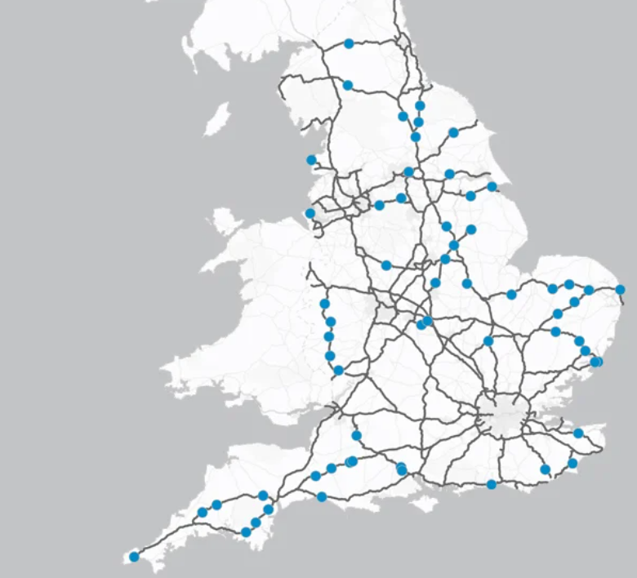
Major EV charging strategies
Other projects
Highways England EV Charging Points Programme Support
Assessing electric vehicle charging needs at UK Motorway Service Areas
Arup helped inform the Highways England 2050 strategy which helped develop the Road's Investment Strategy (RIS). The RIS sets that: "95% of the Strategic Road Network will have a charging point every 20 miles".
Arup is now supporting in the implementation by:
Helping define the new criteria: able to reach full charge in 30 minutes, to be accessible within a five-minute drive of the SRN and to be available 24/7.
Development of a GIS model and gap identification
Developing a direct procurement strategy. Arup supported the appointment and administration require to appoint two EV charging infrastructure suppliers.
Further modelling work identifying where additional electric vehicle charging capacity is required. This work combines transport, energy and socio-economic data to provide a detailed picture of EV charging demand across the network during the day and as EV ownership rises.
Helping various UK Gov depts. to understand gaps in grid infrastructure at UK motorway service stations, with our analysis feeding into a policy paper setting out the UK gov’s vision for rapid charging in England.
66 new charge points have been installed and commissioned
The project considers the demand requirements with the grid availability for electricity distribution and transmission. It also estimates the potential costs for connecting the charging hubs to the grid as a high-level feasibility study for the sites
Welsh Government Electric Vehicle Charging Strategy
Developing an EV charging strategy for the whole country
Notes:
Highways England:
- Creating new criteria for EV charging
Arup worked closely with Highways England to develop and define essential criteria that newly proposed EV charge point sites must meet; to be rapid and able to reach full charge in 30 minutes, to be accessible within a five-minute drive of the SRN and to be available 24/7 to the public. This provided a framework for the project to ensure the following decisions enabled a full network coverage that is always open, secure and accessible for road users.
- Connecting the 'gaps' in the network
Many locations throughout the SRN are challenging and remote. The difficulty in identifying and securing financially viable sites, with access to adequate electrical power provision has created gaps across the network. Using GIS mapping techniques, we have undertaken a route analysis to identify all existing charge point locations within a 2.5-mile driving distance of a major road network. This meant we could accurately calculate the coverage provided by these points, how many extra charge points were required and where to locate them.
- Developing two EU-compliant procurement models
Arup developed a bespoke contract to facilitate an open competition which resulted in two suppliers, Swarco and BPChargemaster, being awarded contracts to install, maintain and operate charge points for a minimum period of seven years. The collaborative approach of our dedicated and responsive team has led to the installation and commissioning of 66 rapid charge points, resulting in a 20% increase of coverage across the network. Surpassing DfT’s original aim, 97.4% of the SRN will now be within 20 miles of a rapid charge point. The provision of these additional rapid EV charging facilities throughout the SRN will help to alleviate concerns over electric vehicle range restrictions and thus encourage the wider use of EVs for long journeys.
- Visualising usage of EV Charge points
Highways England has been provided with access to the EV charge point operator’s online dashboards to monitor the usage of the charge points. This will allow environmental statistics to be measured and quantified across all charge point sites, including CO2 savings, equivalent trees saved and power consumption.

Slide 5
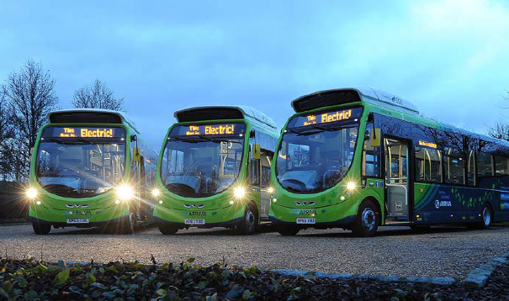
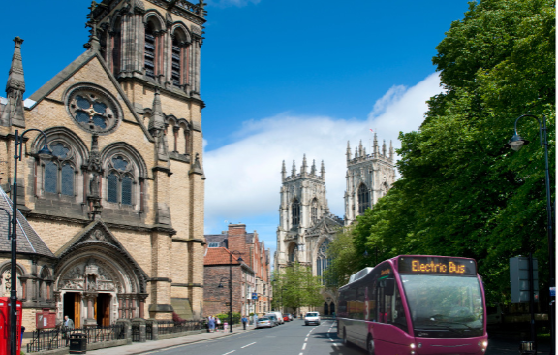
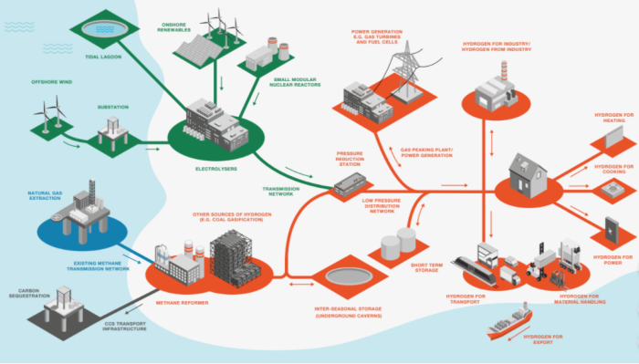
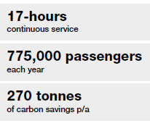
Bus Strategies
Other projects
Electric Bus Feasibility Study, Doncaster and Sheffield, UK
Award-winning project involved developing a bespoke, digital tool to test the feasibility of electrifying bus routes that operate in South Yorkshire.
Electric Vehicle Feasibility Study, Manchester, UK
Wireless charging electric bus trial, Milton Keynes
Electric Bus Feasibility Study, York
Hydrogen Bus Network and Future Zero-Emission Routemap, Liverpool
Helping Manchester Metropolitan University (MMU) identify vehicles that were viable to replace based on cost effectiveness and duty cycle. We also calculated the amount of CO2 that would be saved by making this change. This information allowed our client to assess the business case for making the switch to electric vehicles.
Five-year wireless charging Electric Bus trial to assess the technical and commercial feasibility of an all-electric bus fleet. Matching the reliability and cost of a conventional diesel bus fleet.
York has a historic city centre with a highly constrained highway network, which creates issues for bus operation in the city.
Arup produced a full technology review study outlining which services would need to be converted to which technology in order to achieve the city’s ambitious targets for bus fleet decarbonisation and how the strategy should be delivered. Arup helped to deliver a successful bid to the Green Bus Fund for a number of electric buses for the city.
Supporting Merseytravel, the public transport authority for Liverpool, in developing an innovative pilot to introduce a fleet of Hydrogen buses across the City Region. When operational, by the end of 2021, they will be the first buses in the region to utilise the new, clean and sustainable technology.
Notes:
Milton Keynes:
Fast and efficient: Rather than plugging into the mains, the eight electric vehicles have their batteries recharged wirelessly. A ten-minute boost approximately every hour is sufficient to enable them to operate all day. This is done during scheduled driver breaks.
Matching existing capability: The speed with which the buses can recharge, thanks to the innovative wireless charging system that uses induction power transfer, makes it possible for them to match the capabilities of their diesel counterparts.
A business model to mitigate risk: To overcome the inherent financial risk that comes with new technology, MASP (a Mitsui-Arup joint venture) set up an enabling company, eFleet Integrated Service, to purchase the electric fleet and charging equipment and lease them back to the operator.
Liverpool: The project aims to demonstrate the commercial viability of hydrogen and act as a catalyst to develop a future network of hydrogen refuelling stations for use by both public and private vehicles. It will also put Liverpool at the forefront of a transformational technology, developing new skills, jobs, and business export opportunities. A multidisciplinary and multi-office Arup team are providing Merseytravel with specialist technical advice throughout the procurement, business case, manufacture, delivery, and approvals phases of the project, which is scheduled to bring buses into service by the end of 2021. In addition to the above, Merseytravel asked Arup to undertake a strategic study of all 400 bus routes across the City Region, utilising digital bus planning planforms combined with energy network and costing analysis to set out the routes most suited to either Hydrogen or Electric operation. This will set a routemap for the authority in planning for a zero-emission network
Doncaster and Sheffield:
Arup supported South Yorkshire Passenger Transport Executive (SYPTE) to work towards cleaner public transport in Sheffield and Doncaster. The electric bus study responded to priorities in clean air, digital and future mobility to deliver a bespoke toolkit that assessed the feasibility of electric buses in the two districts.
The toolkit combines three different software to indicate which bus routes could be serviced by electric buses, and considers bus operational patterns, topography and different charging strategies. It has been instrumental in engaging with bus operators in a deregulated market, and the confidence provided by this analysis resulted in the two major operators expressing interest in trialling electric buses in Sheffield.
Arup also developed implementation plans for the electrification of two route options, which considered the strategic, economic, commercial, financial and management cases for investment. A further piece of work that considered the potential for hydrogen as an alternative technology was also developed.
SYPTE requested funding from Government to support this trial, and if successful, will see electric buses operating in South Yorkshire by 2021 for the first time.
York: City of York Council wanted to improve air quality in York by reducing emissions from the city’s bus fleet. With this in mind the Council set an ambitious target that by the end of 2017 80% of bus traffic in the city will have zero carbon emissions.
York has a historic city centre with a highly constrained highway network, which creates issues for bus operation in the city. Arup was appointed to produce a roadmap to identify how their challenging target could be achieved. A full technology review was produced providing a snapshot of the technology currently available. The study outlined which services would need to be converted to which technology in order to achieve the objective and how the strategy should be delivered. Arup helped to deliver a successful bid to the Green Bus Fund for a number of electric buses for the city.
Key services provided:
Advanced technology
Transport economics
Transport planning
UPDATE: As of June 2020 York Council has applied for more funding from the Department of Transport to make all their buses electric and be the first all electric bus city in the UK.

Slide 6
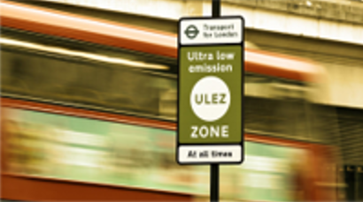
Airports
Heathrow Ultra Low Emissions Zone & Expansion
Arup worked with Heathrow Airport Limited (HAL) to develop the Surface Access Strategy. A key aspect of this was the management of private vehicle journeys to and from the airport.
We developed a road user charging policy for the airport, which included the Heathrow Vehicle Access Charge (HVAC) and Heathrow Ultra-Low Emission Zone (HULEZ). These policies supported a reduction in carbon emissions by encouraging modal shift to public transport. It plans to reduce vehicle mileage and encourage the uptake of more carbon efficient vehicles.
The development of the policy included:
Assessing impacts (mode-shift, air quality, costs and revenue)
Guiding external communications
Guiding discussions with stakeholders
Developing technical details for implementation
Arup also advises other leading airports internationally, to provide decarbonisation strategies using renewable energy sources. We have developed carbon emission models, carbon forecasting and interventions assessment.
Notes:
Heathrow: Arup provided advice to Heathrow Airport Limited (HAL) across all aspects of developing the Surface Access Strategy of which a key aspect was the approach to managing vehicle journeys to and from the airport, particularly by private vehicle to meet targets set by government for expanding the airport.
This approach included developing a road user charging policy for the airport, which included the Heathrow Vehicle Access Charge (HVAC) and Heathrow Ultra-Low Emission Zone (HULEZ). These policies supported a reduction in carbon emissions from surface access by encouraging modal shift to public transport, reducing vehicle mileage and encouraging the uptake of more carbon efficient vehicles.
Arup’s role extended from developing the road user charging policy, assessing potential impacts of the scheme (e.g. mode-shift, air quality, costs, and revenue), guiding external communications and major press releases, leading discussions with key internal and external stakeholders including the airport’s airlines, Transport for London and other local authorities; to developing the technical details for delivery and implementation for the scheme by working with various teams within HAL.​
Arup advises airports across the U.K and within transport we work closely with the aviation and buildings teams to give comprehensive advice to airports on how they can improve carbon efficiency and as we move towards carbon zero. Within surface access we have developed carbon emission models, carbon forecasting and interventions assessment.

Slide 7
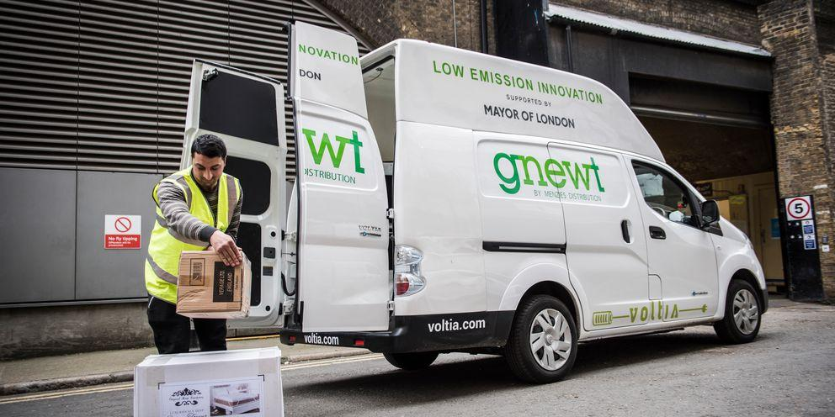
Logistics
Broadgate
Other projects
Broadgate is 2-acre neighbourhood that bridges the City of London financial hub and the upcoming tech hubs in the city.
Working with current occupiers and key stakeholders, Arup helped set up a Sustainable Logistics Strategy which included:
Bespoke vehicle trip generation rate and demand profile
Retiming of deliveries – to smooth the peak demand
Use of local suppliers
Promotion of supply chain consolidated deliveries
Promotion of preferred suppliers
Vehicle booking system
Delivery and Servicing Management Plan (DSMP)
Consolidation / vehicle reduction required and design for cargo bikes
Bespoke Sustainable Logistics Strategies also developed for:
King’s Cross
67 acre site comprising approximately 486,000 sqm commercial space, 2,550 residential units and 100,000 sqm of other uses including retail, leisure, hotel, food and beverage, bars, galleries and a university.
Stratford
East Village: Residential and leisure development of the former Athletes village and new accommodation providing 2,800 new homes (including 1,370 affordable).
Here East: Redevelopment for the provision of an innovation and technology campus.
Marshgate 1: 35,000 sqm of academic space, plus café, retail and exhibition space within the UCL campus. Designed to BREEAM Excellent standards
GLA Gnewt EV trial (2017 -2019)
EV Trial Partnership between The Mayor of London and Gnewt Cargo, testing light goods vehicles delivery and logistics in London.
Telematics data
Vehicle and delivery performance info.
Charger types
Route optimisation
Daily charger power demand patterns
Potential for grid technology
BBC Television Centre
Consolidated Receiving and Distribution Center, Portland

Slide 8
Thank you
Ira Gupta
Stephen Bennet
Liani Baglietto C
Advisory Services Lead, India
ira.gupta@arup.com
Director, Transport Consulting London
stephen.bennett@arup.com
Transport Planner, London
liani.bagliettocastellares@arup.com

Slide 10
Active Travel
Greener Grangetown
Other projects
Multi-award winning scheme delivering a Sustainable Urban Drainage System whilst enhancing the environment for pedestrians and cyclists in Cardiff.
Green Infrastructure
Removing more than 40,000m³ of rainwater each year from entering the combined sewer network.
Rain gardens are planted areas that mimic the natural environment, providing a more sustainable method for catching and cleaning rainwater. When it rains, water flows into the rain gardens where hardy plants and trees soak it up and filter it, capturing and breaking down some pollutants along the way. During heavy storms, water that cannot be absorbed by soil and vegetation travels through pipes at the base of each rain garden and is conveyed to the nearby River Taff.
Active Travel Improvements
Creating Wales' first bicycle street (555m ‘bicycle street’ along Taff Embankment), installation of new crossings, attractive planting that moves parking away from junctions, and a central textured strip in the road that prompts drivers to take extra care have transformed the street. A better-quality street environment for users and residents has been created, reducing motorists’ speeds and improving the visibility of cyclists and pedestrians. The result is a residential street where bicycles take priority.
Ankara Cycle Masterplan, Turkey​
Masterplan being developed with gender equality and social inclusion at the forefront of the planning and decision-making process. Ankara currently has a mode share of cycling of less than 1% of all trips.
Connswater Community Greenway, Belfast, North. Ireland
Visionary urban regeneration project transforming East Belfast by combining improved flood protection with the creation of public spaces and pedestrian/ cycle routes that connect communities.
Public Realm and Movement Strategy, Jersey
SESTRAN Strategic Network, South East Scotland
Transport for Wales Carbon Savings. Active Travel and Remote Working (2020/21)

