Slide 1
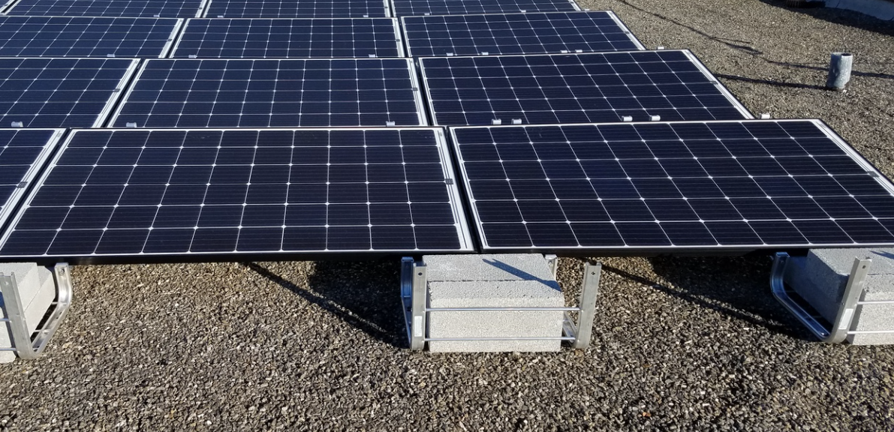
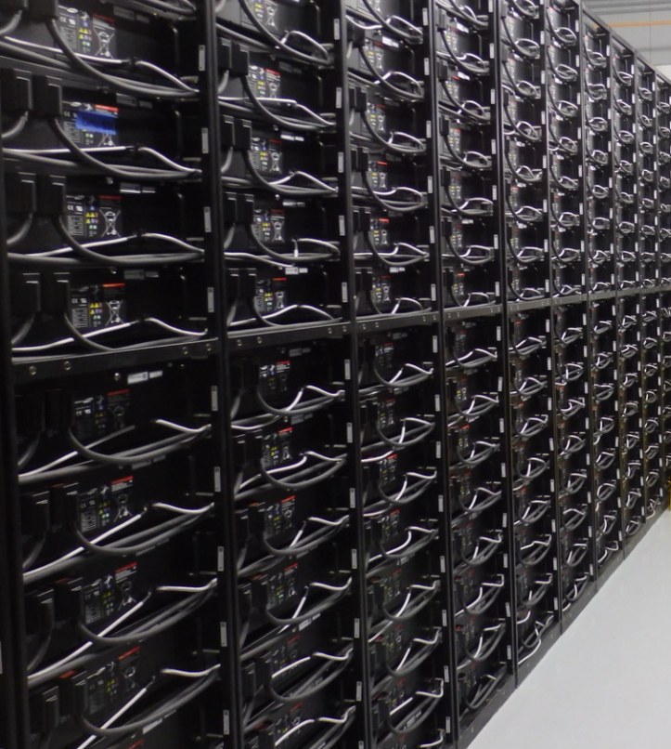

Next Generation Power Grid
August 27, 2021
Presented by: Jason Marenda, P.E.
Notes:
I work for POWER engineers as a PM focused on DER and renewables
Based in Hailey, ID which is a mountain town in the south central part of Idaho
My background is in POWER Delivery or T&D work, and I lead our DER team at POWER which is a multi-discipline effort that are working in many areas including microgrids and how to integrate renewables into the existing grid.
We are a US based company but have also done work around the world in India, Asia and beyond
Much of the international work that we do is feasibility studies and road mapping where we are trying to figure out how to get from where we are today to where we want to be tomorrow, while dealing with many different obstacles along the way
So, we do engineering that helps people figure out how to deal with the changing grid.

Slide 2
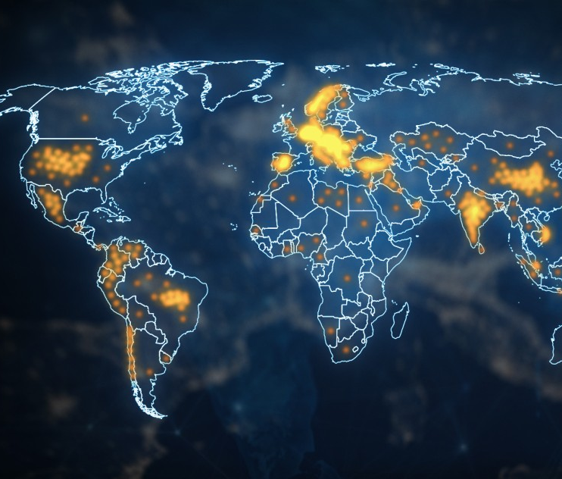
Changing Grid
Renewables
Electrification
Distributed Generation
Aging/Growth
Expectations
Notes:
I think we all know that the grid is changing
Renewables are being installed all over the place
In 2020, it is estimated that 260 Gigawatts of renewables were installed, which is a 50% increase over the prior year. And that was with COVID.
260 GW is such a big number that it may be hard to imagine how big that actually is.
Installing 260GW requires installing 8kW of renewables every second.
The difference between a Gig or a billion and a Meg or a million is quite significant. A million seconds is a little less about 11.5 days. But a billion seconds is almost 32 years.
Electrification
In an attempt to combat climate change we are electrifying everything
While transportation get the most press, they aren’t the only thing.
There is a big push to electrify gas heating, gas fired industrial processes, and many other things
Distributed Generation
Where our grid has traditionally been made up of large generators that pass through transmission lines to substations and onto distribution lines and then onto houses, we are seeing more and more distributed smaller generation.
This means that power used to flow in only one direction but now is flowing in both directions
And then you have the standard drivers, like aging of systems that were installed many years ago and the rapid growth in some areas of the world
Finally, we are seeing our customers expectations change
People are reliant on energy to power their lives and not having it is a big deal
Multi day outages while once may have just been an inconvenience, today are a big dead with the potential for becoming a humanitarian crisis

Slide 3
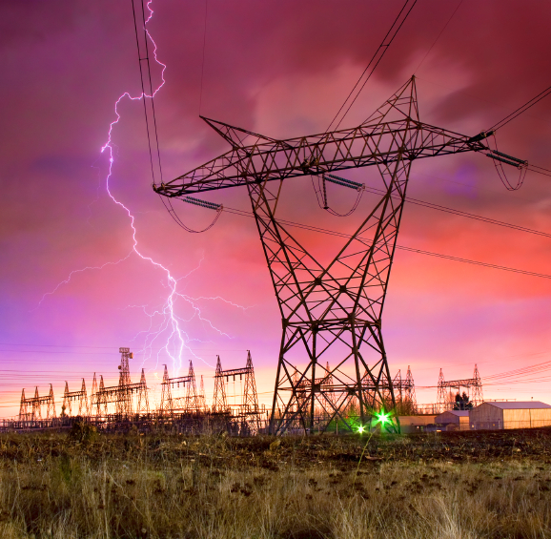
Resilience and Sustainability
Notes:
So the main thing this new grid of the future needs to be is resilient.
How do I define resilience?
Well, the easy answer is to just quote the dictionary. Resilience is defined as "the capacity to recover quickly from difficulties, toughness"
So Resiliency is the ability of the grid to withstand something bad, like below zero temps in traditionally warm climate or wildfires in dry climates, happening to it and keep providing power for us to carry on with our lives.
But we also need a sustainable grid
Sustainable so that we are not destroying what we have been given and are creating something that can be used for many generations to come
Is there a conflict between resiliency and sustainability though?
Today, I really think that there is.
I think that the #1 thing that is standing in our way is an affordable and sustainable form of long duration storage.
That isn't to say that there aren't options and that there aren't people doing research in the area. There are and many people are, I just don't think that we are able to say that there are affordable options that can be deployed in a widespread manner just yet.
Li-ion technology is really only affordable up to 4 hours and beyond that we need some more option
Maybe that is Hydrogen, maybe it is battery technology that isn't Li-ion, maybe it is stacking block technology, I am not sure.
But we have to find a way to provide affordable long term storage to balance out the supply when intermittent renewables are not available

Slide 4
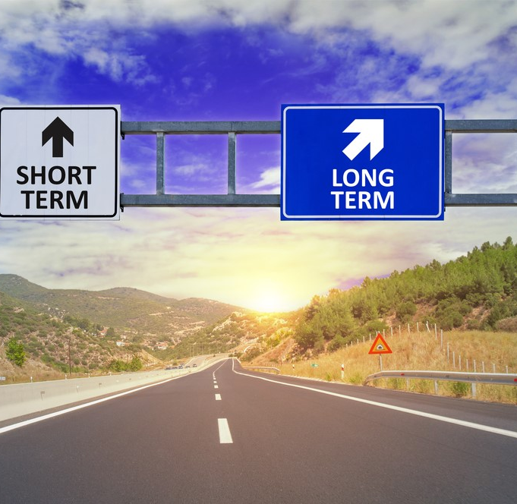
Where do We Go from Here?
Notes:
I think that the potential impacts to our society from a widespread long term power outage are pretty significant and I think that most people's appetite for intermediate fossil fuel based solutions will change once it is their power that won't turn on in the middle of the summer heat or the middle of the winter cold.
However, I don't think that this is a mutually exclusive situation.
So, what do we do today? What are the Arguments against putting more renewables onto the grid:
The first is that renewables are intermittent
For temporary reductions in power the technology that we have today is able to replace peakers. Whether that is with demand reduction or with replacing peakers with batteries we can do that affordably today
So, if I just said that long-term storage was the missing piece for the balance between resiliency and sustainability, how can we deal with longer term renewable power intermittency?
Continuing with the assumption that there aren't affordable clean long duration storage options available today, what are our options?
Well, the key is to keep funding R&D into the technologies and the deployment of long duration project pilots. I know that companies like, Form Energy, are putting together 150hour batteries in a pilot project and that is just one there are others too. Like wind, solar, and Li-ion batteries though we need to be patient as it will take a bit for the number of installations to increase enough to get the costs down in line with other technologies. So no matter what we do, we have to keep funding things like this.
The other argument against more renewables is the lack of inertia on the grid
Why is inertia important?
Mainly because it provides frequency support to the grid
But if you have a grid full of fast acting power electronics in inverters then you don’t need as much inertia
What this means is that adding more inverter based resources lower the need for inertia at the same time that it reduces the amount of inertia
There are other options like synchronous condensers and hydrogen that provide carbon free ways to provide grid inertia
For grids that are already built out, I want to stress the importance of the demand side of the equation.
There is a saying that the greenest kWh is the one that you don't use.
There is some demand response and energy efficiency programs in place but we need more; including asset based demand response programs
Another thing that I want to mention that is tangentially related to DR is how we shut down portions of our grid when they are under stress.
With all of the smart meters, AMI, AMR, and other technologies available, I am amazed that we are, in the case of many very developed and sophisticated grids, still shedding load by opening breakers in a high voltage transmission substation.
We have the technology to do better, and we need to do a better job of implementing it.

