Slide 1

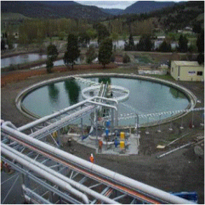


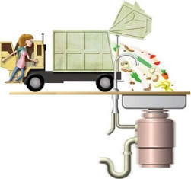
Innovative Financing Models for Developing 24x7 Water and Waste Water Infrastructure utility under PPP basis
By
Mr. Rudranarayan Kumar,
Chief Manager – Business Development
&
Mr. Akshan Gupta
Manager – Finance & Accounts
Swach Environment Pvt. Ltd.
at
BCC&I 14th Edition of Environment and Energy Conclave
26th August, 2021

Slide 2

“The next war will be fought over water, not politics”
Boutros Boutros Ghali, UN Secretary General, 1985
So lets talk about water!

Slide 3
PPP Water Projects & Challenges
Type of projects
  Water intake, treatment & supply
  Sewage collection, treatment & disposal / recycling.
  Desalination for drinking and industrial purpose.
  Augmentation / rehabilitation of existing infrastructure and improve efficiency.
  Arsenic, fluoride and iron contaminated zones water treatment & supply
Challenges
  Water does not generate revenue in the rural area / setting up of tariff.
  Financial constraints
  Poor water supply service
  Proper design and effective execution
  Restructuring and strengthening existing infrastructure for better service delivery and resource sustainability
Significant initiatives in DBO model in water infrastructure
Smart Cities with large population >100,000-250,000 population ideally placed for Hybrid Annuity Scheme
Opportunity for SMART METERS under Hybrid or Annuity Schemes under OWN YOUR METER
Multiple revenue stream model better placed for successful Annuity schemes.
Smart City to have technology driven initiative and based on Two stage selection process with RFQ and RFP , this will have better quality output.
The success of this model will hinge on the Government’s ability to institute well defined Concessional Agreement and make timely payments against its capital cost and annuity commitments.

Slide 4
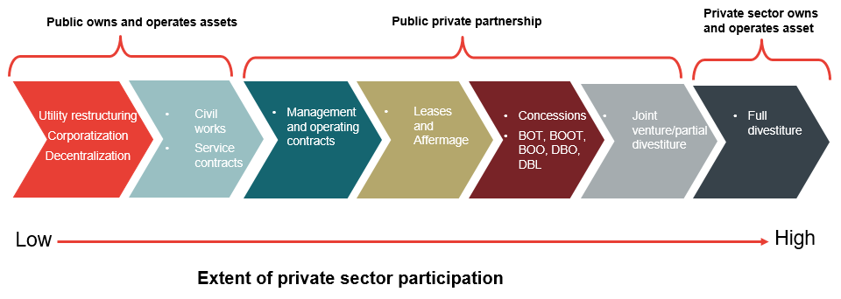
PPP Models in Water Sector
Design, Build, Operate Model (DBO) – In this model, the ULB or parastatal meets the capital costs for the project, and uses the private sector to bring in technology and managerial skills to operate and maintain the assets. The construction, technology and operating risks are borne by the private sector operator while the financing risk is borne by the government counterpart.
Build, Operate and Transfer Model (BOT) – A model in which the end user or consumer itself is the private operator, hence owns and takes responsibility for the project. Also called as End User PPP. The construction, technology and operating risks are borne by the private sector operator while the financing risk is borne by the government counterpart.
Design Build, Finance, Operate and Transfer Model (DBFOT)- A model in which the Private operator brings in the design criteria, build and Finance the asset capex in full and operates the asset over the concessional period against an agreed annuity paid by the ULB/Client/Government counterpart.

Slide 5
Risk Allocation while framing Tender Documents
Type of Risk | Private Sector | Public Sector
Pre Construction Risk
Delay in Land Acquisition
Delay in Statutory and Environment Clearances
Financing Risk
Planning Risk
Technical and Construction Phase Risk
Design Risk
Construction Risk
Approvals

Slide 6
Risk Allocation while framing Tender Documents
Type of Risk | Private Sector | Public Sector
Operation Phase Risk
Technology Risk
O&M Risk (Quality , Quantity and Performance)
Demand Risk
Billing and Collection Risk
Other Risk
Change in Law
Change in Interest Rates
Force Majeure (Political and Non –Political)
Concessionaire Event of Default
Government Event of Default

Slide 7
Risk Mitigation
Revenue Risk Mitigation Strategy: It is recommended that a three-level payment security mechanism be adopted, which involves ring fencing of water/sewage revenues at the local government/state utility level followed by funding support from the state government through a separate State water/Sanitation Fund, back-stopped by a guarantee facility from the Government of India.
Moving to a regime where Water/sewerage charges at least cover O&M expenses: This approach is in line with international experience with PPPs, where the revenue risk is borne by the concession granting authority (CGA) or the government counter-party which collects the Water/sewerage charges from the end-users but pays contractually agreed amount to the private sector.
Data Quality and Project Scoping can be improved considerably through extensive public consultations and detailed technical surveys and audits to determine the base line values.
Bidding Risks: Further, it is important to recognize that the PPP project preparation and bidding takes time and rushing through this process leads to poor quality bids and unsatisfactory project outcomes. Therefore adequate time for data collection, stakeholder consultation and project preparation is non-negotiable.
Rigid Contracts: Moreover, contracts should be flexible enough to allow revision in Key Performance Indicators (KPIs) and costs should the initial contours of the project change significantly with the passage of time. It is recommended that KPIs should be progressively tightened as the project progresses instead of stating excessively high threshold values at the time of signing the contract.

Slide 8
Hybrid Annuity – Risk Mitigation Model
Another approach to address revenue risk concerns of the private sector and Government’s own desire to ensure that the private sector has some “skin in the game” to ensure commitment and performance
Combination of the BOT Annuity and the DBO models
In this hybrid model about 30 – 40% of the capital investment may be paid by the Government through milestones linked to construction progress and the balance may be paid through annuities over the remaining life of the concession.
This will ensure that the private sector puts in some equity in the project unlike the DBO model where the complete capital costs are borne by the Government agencies.
In this model, the private sector will have to finance 70 – 60 % of the capital cost and recover this capital cost and O&M expenditure from annuities spread over the contractual / operations period.
The success of this model will hinge on the Government’s ability to make timely payments against its capital cost and annuity commitments.
Investment by Government
30-40%
Paid as per contract milestone during construction
Paid as Annuity payments during O&M with Interest
Investment by Bidder
70-60%

Slide 9
Project Concession Agreement – NMCG Project Reference
Term | 15 Years post Commercial Operation Date (COD)
Project Payment | 40% of the bid project cost would be paid by NMCG in 4 installments during the construction period The remaining 60% of the bid project cost would be funded as a part of project cost by the Concessionaire and reimbursed by NMCG in the form of Capex Annuity payments during the project operation period
Tariff Payments – To be paid by NMCG | Capex Annuity Payments for 60% of the Project Cost Interest payable on the reducing balance of 60% of the Bid Project Cost, at the rate of the SBI MCLR plus 3% p.a. O&M charges Electricity Charges based on actual consumption up to the guaranteed energy consumption level, as estimated in the bid.
Payment Guarantee | Payments to the Concessionaire would be secured by the means of an Escrow Account which would be opened and maintained with the Minimum Escrow Balance by NMCG The Escrow Account shall comprise of an amount equivalent to the next milestone payment during the construction period and 2 years of Tariff Payments during the operation period at any point of time
STP Site | The Jal Nigam shall grant the Concessionaire a license over the Site, along with all necessary rights of way, to enter upon, access and occupy the Site The full ownership and title over the Site shall vest with the Jal Nigam for the entire Term
Supporting Infrastructure | The Supporting Infrastructure facilities required for the operation of the Facilities will be provided, operated and maintained by the Jal Nigam during the Term
Arbitration | The venue of the arbitration shall be New Delhi and the language of the arbitration shall be English. The arbitration shall be governed by the laws of India

Slide 10
Financing of Water Infrastructure – NMCG Project Reference
Developer Consortium
COMPANY A – [51]%
COMPANY B– [49]%
Capex investment 60% to be funded by SPV during construction phase
Project
equity
30%
To be Subcontracted by SPV
EPC Contract
O&M
Contract
SPV
SPV: STP for the Varanasi and Haridwar STPs
Principal Executing and Bidding Authority
Insurance Contract
Payment Guarantee through Escrow Account
Jal Nigam
Allotment of Project Site
Debt
Insurers
70%
Capex Payment (40%) Based on Milestones
O&M Payments Annuity Based (60%) over 15 years period
National Mission for Clean Ganga
(NMCG)
Lenders

Slide 11
Viability Gap Funding
The scheme provides VGF grants to PPP projects in specific sectors, sponsored by any level of administration – Central/State/Local Government
The concession /or contract for development and/or implementation of the project shall be awarded to a company in which a private entity control 51% of more of the paid-up equity
The project is awarded through an international /or national competitive bidding process The private sector company shall be responsible for financing, development, operation & maintenance of the project
The VGF support may be capped at 20% of the project cost.
An additional VGF grant, capped at 20%, can be given by the government agency sponsoring the project
The project shall involve provision of a service against a pre-determined tariff or user charge
The VGF support is issued only after the other options of enhancing viability are exhausted or are not possible in the case of a specific project.
The approved amount of VGF grant for a project is released in its entirety to the Lead Financial Institution (lead member of the consortium financing the project).
The Lead Financial Entity releases the grant after the equity of the private partner is exhausted. The release of the grant to the project is in the ratio of release of the debt.

Slide 12
Viability Gap Support Requirement for PPP Project
AMRUT & SBM have VGF Funding structure both State and Central Components

Slide 13





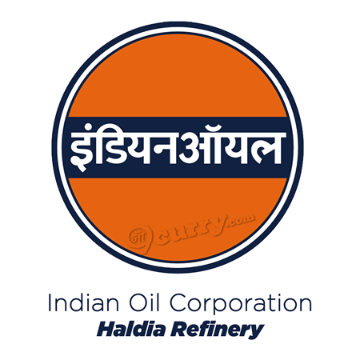




Haldia Water Services – Case Study
Haldia is an important industrial town in Eastern India with a residential population of 200,762 as per 2011 census and with presence of several important industries
Haldia Development Authority (“H.D.A”) is the nodal agency for providing water supply to various categories of customers like industrial, commercial, domestic and municipal in Haldia.
H.D.A. had set up a water treatment facility of 20 MGD capacity at Geonkhali in 1992, which was augmented to 25 MGD in 2005-06. Further, in 2008 a new 25 MGD water treatment plant was constructed.
Key Industries account for ~86% of water supply
In July 2019 the project for Repair, Up-gradation, Operation & Maintenance and Management of the 50 MGD WTP under PPP model for a period of 15 years was awarded to Haldia Water Services Private Limited, the Consortium of Shristi Infrastructure Development Corp. Ltd. (51%) , Swach Environment Pvt. Ltd. (38%) and Ion Exchange (I) Ltd. (11%)
The key responsibilities of the HWSPL would be repair, up-gradation, operation and maintenance, and management of the Haldia Water Supply System including billing and collection of water charges from the customers, with water supply from Hooghly river, with all pumping stations, electrical installations, existing and new WTPs, connecting pipelines and distribution system including cost of all materials, power and labour at Haldia, Purba Medinipur;
13

Slide 14
Key Highlights of the Concession Agreement (1 of 3)
Key Highlights of the Concession Agreement
HWSPL entered the Concession Agreement (“CA”) with HDA on August 16, 2019 after payment of an upfront one time non-refundable and non-adjustable license fee of Rs. 8 crore to HDA.
HWSPL then took over the Project on November 1, 2019 for a period of 15 years. HWSPL shall continue to be the exclusive and dedicated operator as there is no other perennial source of water in Haldia,.
Fees Payable to HDA:
  Upfront one-time non-refundable and non-adjustable fee of Rs. 8.00 Cr payable on signing of Concession Agreement towards the right of the concession, refundable in case of termination due to a force majeure event, HDA event of default;
  Performance Security of Rs. 20 Cr in the form of guarantee of Scheduled Bank/ PFI to be issued before takeover / compliance date ;
  Fixed Annual License Fee of Rs. 24 Crores payable in equated monthly instalments;
  65.50% sharing of incremental revenue for water sales beyond 4.47 Cr kl p.a. payable at the weighted average water tariff at the end of each concession year;
  50% sharing of incremental revenue due to increase in water tariff for Industrial and Commercial incremental revenue beyond Minimum Water Tariff (5% increase p.a.) defined in the CA.
  50% sharing of savings on power cost due to decrease in power tariff below the Base Tariff (4% increase p.a.) defined in the CA.
14

Slide 15
Key Highlights of the Concession Agreement
Take or Pay Clause: Contracts entered into by HDA with customers have “take or pay” clause, wherein, the customers are required to pay for minimum 50% of the contractual volume, at the prevailing water tariff, irrespective of the water consumed.
Revenue Collection: Revenue collection is significantly high (>95%). However, in case of default in water payments for period of more than 120 days from the date of billing and HDA does not issue instruction for disconnection, HDA shall compensate the HWSPL for such amounts in default.
Minimum Water Tariff: Minimum Water Tariff defined for Industrial and Commercial customers with an escalation of 5% p.a. at the end of each Concession Year. Applicable Tariff for Year 1 and Year 2 given below:
Threshold limit for Municipal & Domestic Sales: Combined sales to the municipal and domestic sales beyond 0.99 Cr kl (6 MGD) shall be considered as sale under commercial tariff and the difference in rate is to be paid by HDA/ or adjusted against the License fees payable to HDA;
Customer Type | Year 1 (per/kl) | Year 2 (per/kl)
Industrial | 18.35 | 19.27
Commercial | 14.31 | 15.03
Domestic | 5.96 | 5.96
Municipal | 3.58 | 3.58
If the applicable Water Tariff for Industrial and/or commercial Customers is less than the Minimum Water Tariff at any time during any Concession year, the shortfall shall be adjusted from the License Fees payable to HDA.
15

Slide 16
Key Highlights of the Concession Agreement (3 of 3)
Key Highlights of the Concession Agreement
Repair & Upgradations Works: A list of Repair and Upgradation works defined in the CA to be completed within first 8 years of the Concession Period.
Service Area: There remains a restrictive clause on the existing and future customers to setup their own water treatment plant. Further, HDA shall ensure that new industries coming to Haldia are mandatorily required to purchase water from this water supply project.
Asset ownership to remain with HDA during the term, including any refurbishment or replacement of project facilities excluding any moveable assets installed to improve operational efficiency not transferred to HDA, all such amount invested by the SPV refundable in case of termination due to a force majeure event, HDA event of default
Charge on Project Assets: HWSPL cannot assign or create any lien or encumbrance on the Project Facilities excluding creation of a security interest in favour of the Lenders on the grant of this Concession only, thereby giving them substitution rights
Deterioration in raw water quality: Significant change in the raw water quality causing a failure to meet performance standards is covered through force majeure event under climate change. In case there is a need for repair and/or upgradation in the existing system to treat the poor water quality, the expenses shall be compensated by the HDA.
16

Slide 17
Revenue Transfer Model
3
1
CONSUMER
Haldia Development Authority (HDA)
Haldia Water Services (HWS)
4
5
2
JOINT REVENUE COLLECTION A/C
(ESCROW)
Bills raised by HWS to consumers on behalf of HDA
Money deposited by consumers to Revenue Collection Account Bank (RCA Bank)
HWS submits Revenue Appropriation Statement (RAS) to HDA
As per RAS, HDA instructs RCA Bank to transfer funds to HWS Bank as per Article 13.5 of CA
RCA Bank transfer funds to HWSPL

Slide 18
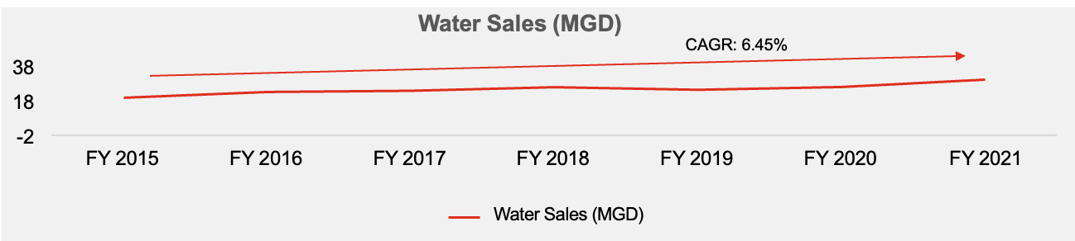
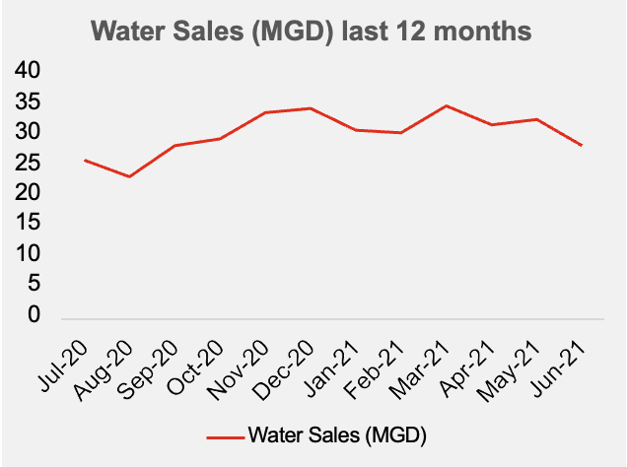
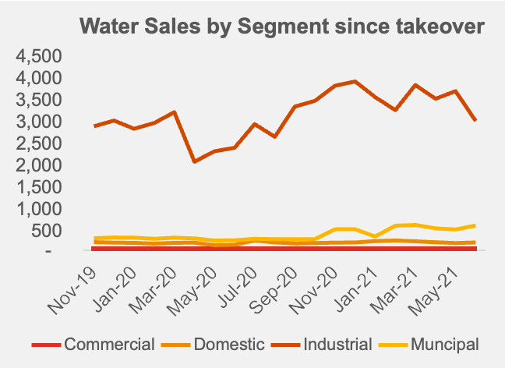
Demand has increased over the period of last 6 years @ 6.45% reflecting that demand increase over a period of time and likely to be in future as well

Slide 19
Electricity cost is the major cost in O&M for the project. Cheaper open access supply of power can reduce cost significantly thus adding to bottom line
Significant increase in sales results in
lower consumption per MG and vice versa
HWSPL has already achieved 5% savings and monthly benefit of INR 7 lakhs / month on account of improving of power factor through installation of APFC panels. It is expected that combination of efforts to improve factor through APFC Panels and efficient motors and pumps can bring down the power cost by 10-14%
HWSPL is also exploring renewable solar energy proposal under DPR stage. The indicative tariffs for solar power are in the range of 4 to 4.5 per kwh as compared to 6.5 to 6.8 per kwh charged by WBSEDCL. So there is a huge potential savings in power cost.

Slide 20
Why Haldia Model Should be a Show Case model ?
High CAGR
HWSPL is poised to achieve double digit CAGR YoY
Assured
Revenue
Assured Minimum Revenue Guarantee irrespective of actual supply
Future Demand
Increase in Demand will generate more revenue
Reduced NRW
Reduced NRW increases the service efficiency and enhanced revenue
HWSPL Competitive Advantages

Slide 21
PPP Model and SWACH
Public Private Partnership (PPP) model is a proven model for water supply in entire world & also being recommended by Niti Ayog.
Swach propose to work with PHE / State Government on PPP for water infrastructure project.
The model shall be
  New water supply projects under PPP.
  Take over existing water supply infrastructure and rehabilitation /expansion.
  Convert intermittent water supply to 24 x 7 service in Urban Areas.
  Investment by Swach for balance to Government grants / funds available / allotted.
  Revenue stream through tariff and / or gap funding by Government.
  Long term concession agreement / periods

Slide 22
Key Message/ Takeaways
The success of PPP model will hinge on the government’s ability to institute well defined concessional agreement and make timely payments against its capital cost and annuity commitments.
Bot annuity, DBO models or hybrid annuity model better suited for smart city infrastructure for water and waste water.
Smart city to have technology driven initiative and based on two stage selection process with RFQ and RFP, this will have better quality output.
Significant weightage on technology, innovation , energy conservation, user interface.
Contracts should be flexible enough to allow revision in key performance indicators (KPIs) and costs should the initial contours of the project change significantly with the passage of time. It is recommended that KPIs should be progressively tightened as the project progresses instead of stating excessively high threshold values at the time of signing the contract.
Public private partnership (PPP) model is a proven model for water supply in entire world & way forward.

Slide 23

Holistic Approach
Address social and ethical concerns
Effective programme governance structure
Growth facilitated by intelligent systems
Effective Revenue (O&M, NRW, Billing, collection)

Slide 24
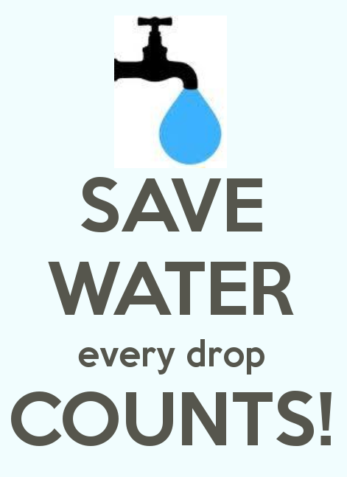


Rudranarayan Kumar
Chief Manager – Business Development
Swach Environment Pvt. Ltd.
Tel: + 91 98306 16299
Email: rudranarayan.kumar@swachenv.com

