Slide 1
Encouraging Green Entrepreneurship in Australia
Supporting economic growth and job creation for all Australians | industry.gov.au

Slide 2
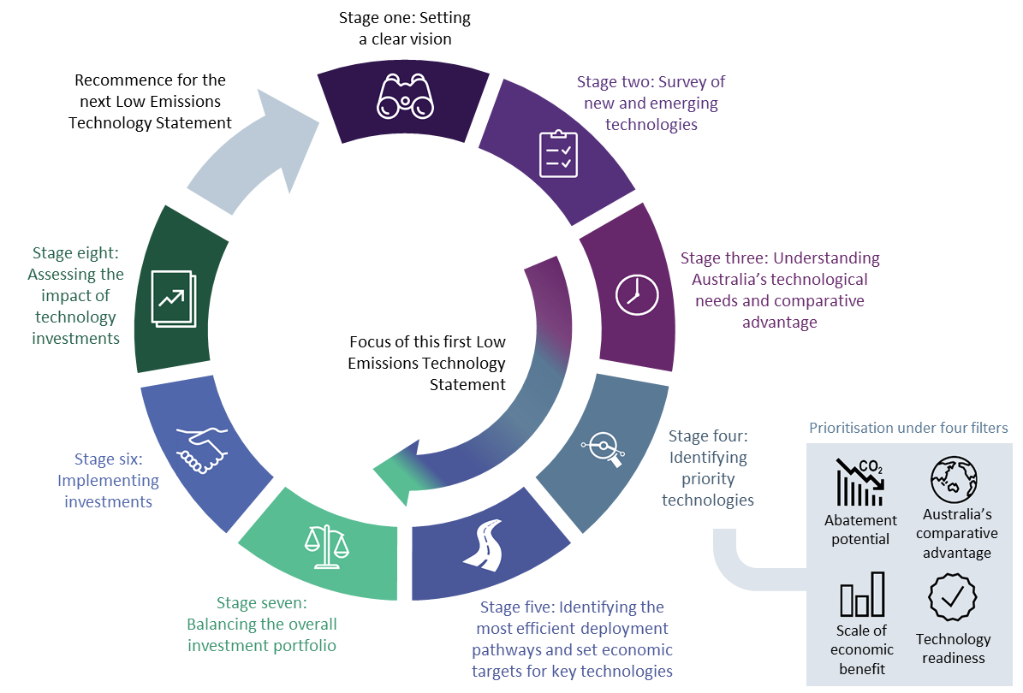
The Technology Investment Roadmap
Notes:
One of our latest initiatives is the Technology Investment Roadmap.
The Technology Investment Roadmap discussion paper was released in May 2020.
The Roadmap establishes a framework for strategic and system-wide technology investments over the short, medium and long term.
An economy-wide survey of over 140 new and emerging technologies underpins this roadmap. The survey studies their abatement potentials, technological and commercial readiness levels and cost-effectiveness.
Annual Low Emissions Technology Statements will be released following the roadmap. These statements will be an ongoing and important mechanism to ensure Australia stays at the cutting edge of technology investment. The first statement is expected to be released later this year.
Development of the statements is supported by a Ministerial Reference Panel, chaired by Dr Alan Finkel, Australia’s Chief Scientist.
Once the first statement is released, the next 12 months will be focused on implementing the statement. This includes exploring opportunities to improve the environment for commercialising research; and establishing a robust approach to impact evaluation.

Slide 3
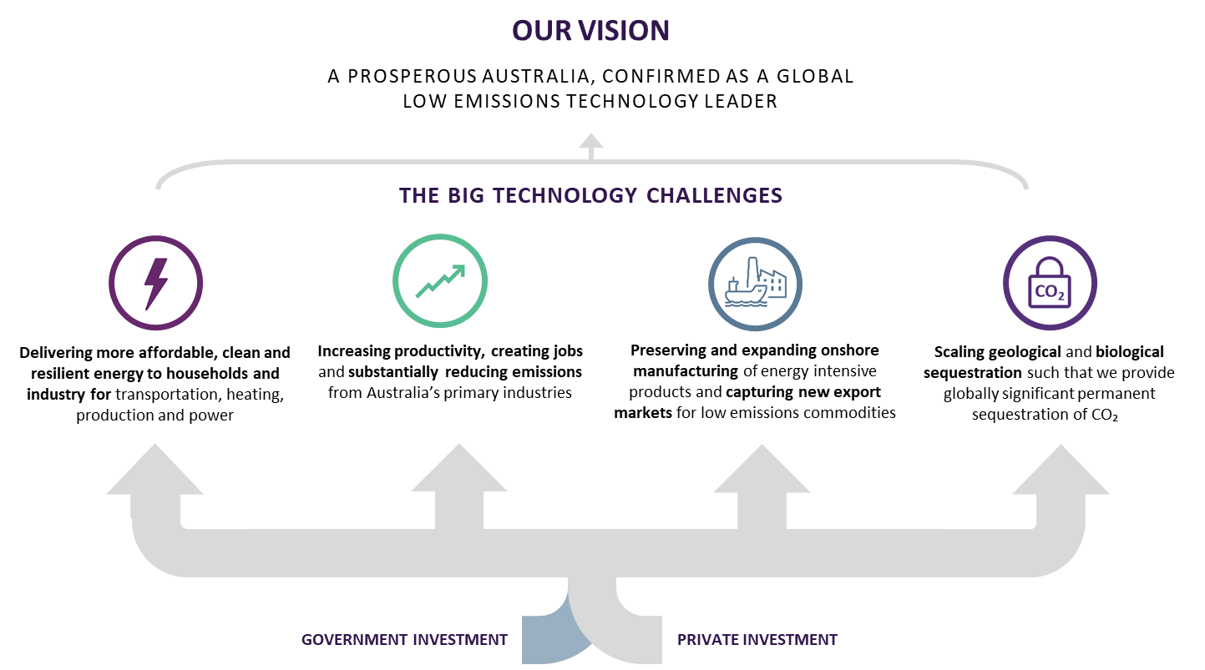
Notes:
This statement identifies Australia’s big technology challenges and opportunities, priority technologies, and economic stretch goals.
The statement sets our vision as a prosperous Australia, confirmed as a global low emissions technology leader.

Slide 4
How do we support businesses ?
DISER
R & D Tax Incentive
Cooperative Research Centres Program
International Collaboration
Entrepreneurs Program
Notes:
The Australian Government has many measures to help support Australian businesses and researchers. Some of the programs include –
R & D Tax Incentive – This program helps stimulate business investment in research and development. The program reduces company R&D costs by offering tax offsets for eligible R&D expenditure.
Entrepreneurs Program – This is aimed at providing a network of business experts to help Australian businesses to strengthen, grow, innovate and commercialise to boost jobs, profits, exports and resilience. It also aims to enable high-potential businesses to strengthen, grow, innovate and commercialise nationally and globally.
Cooperative Research Centres Program – This program enhances Australian industries’ to compete and produce by helping industry to partner with the research sector to solve industry-identified problems in both a short-term and medium to long-term format.
International Collaboration – There are two mechanisms under this initiative –
Global Innovation Linkages - The Global Innovation Linkages program supports Australian businesses and researchers to collaborate with global partners on strategically focused, leading-edge research and development projects. It supports projects focused on developing high quality products, services or processes that respond to industry challenges.
Global Connections Fund - The Global Connections Fund (GCF) encourages international small and medium sized enterprises (SME) to collaborate with researchers. The focus is on making viable projects to grow and test commercialisation in industries of strategic growth.

