Slide 1
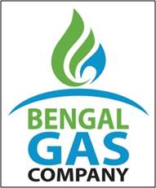

BENGAL GAS COMPANY LIMITED
Welcome
14th Environment and Energy Conclave
(26th and 27th August 2021)
“MOVING TOWARDS CLEANER FUEL”
Presented by: S.Bairagi, CEO, BGCL Date: 27th June 2021

Slide 2
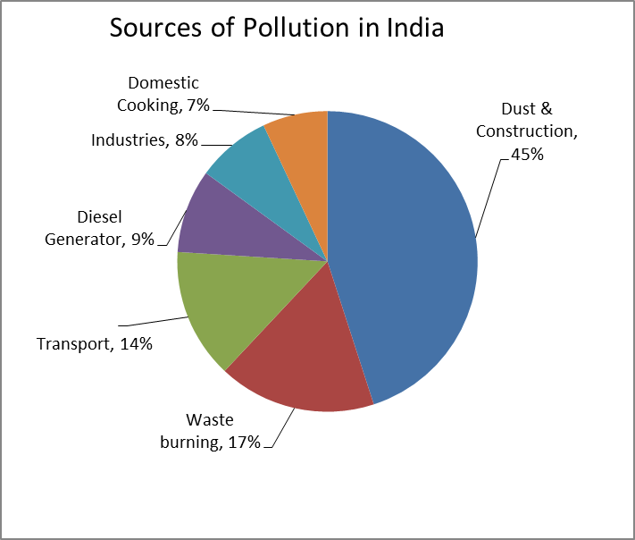
The reality …
Pollutant (lb/mn Btu) | NG | Oil | Coal
Carbon dioxide | 117 | 164 | 208
Carbon monoxide | 0.040 | 0.033 | 0.208
Sulfur dioxide | 0.001 | 1.122 | 2.591
Nitrogen oxides | 0.092 | 0.448 | 0.457
Particulates | 0.007 | 0.084 | 2.744
Mercury | 0 | 0.000007 | 0.000016
Natural Gas is the cleanest among Fossil Fuels
Source –Indpaedia.com
Notes:
Transport and Industrial sectors; and diesel generators are major polluters using Fossil fuel
NG is the cleanest among all fossil fuels

Slide 3
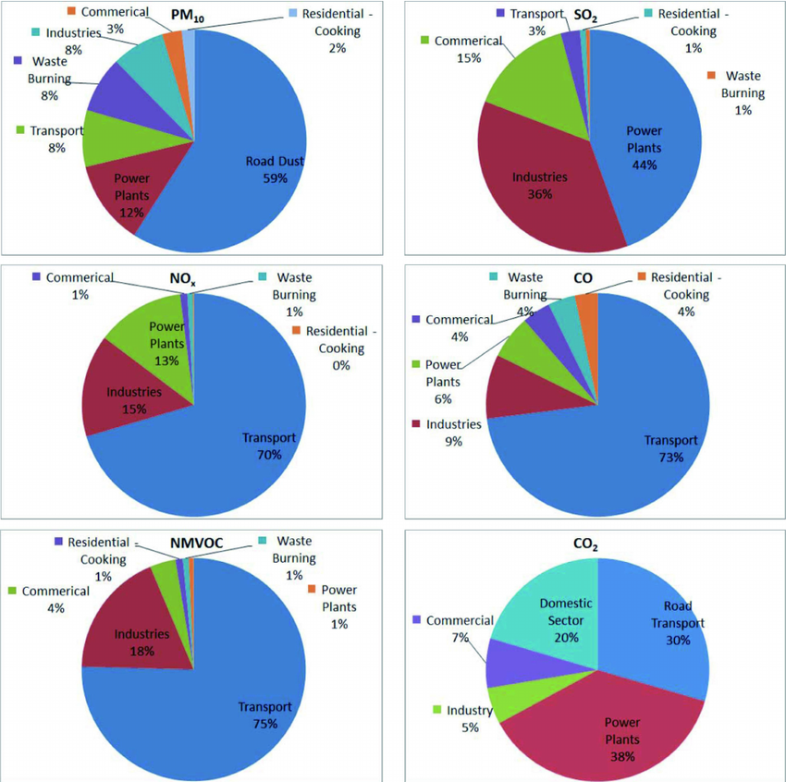
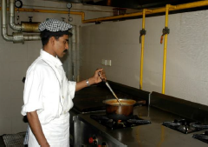
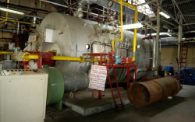

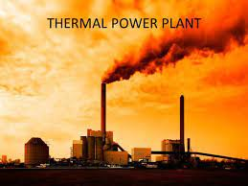
Fossil Fuel users & emissions :
Domestic Sector
Commercial Sector
Industrial Sector
Transport Sector
Power Generation
Scope for significant improvement exist in CGD sector & Power generation
Source –Indpaedia.com

Slide 4
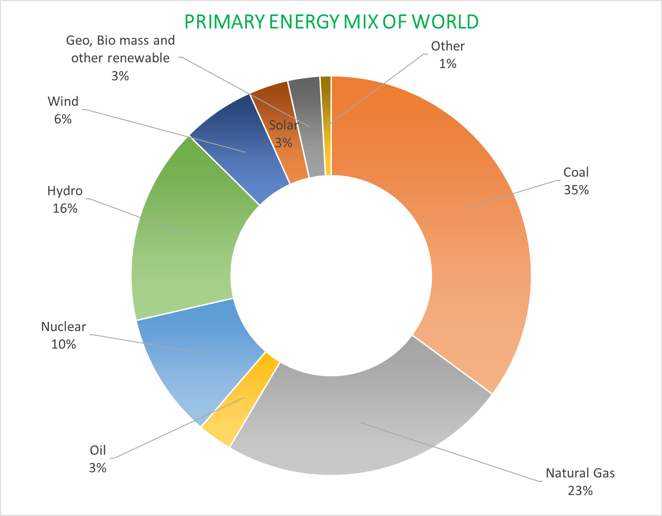
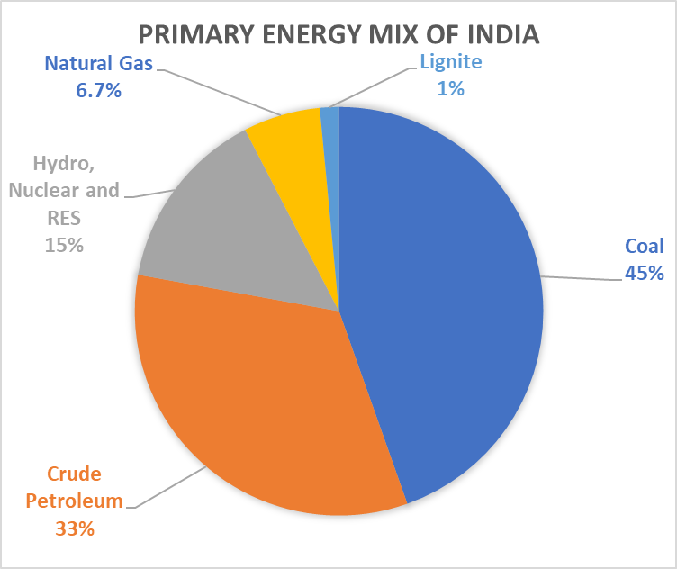
Primary Energy basket
Target: 15% Natural Gas in Primary Energy basket of India by 2030
Source—BP-2021 and Energy statistics India 2021

Slide 5
Steps towards cleaner fuel …
Promote City Gas Distribution
  Domestic gas allocation
  Public Utility Status granted by Ministry of Labour and Employment
  DIPP notified amended Rule 2018 to ease out process to set up CNG facilities at existing OMC ROs
  Gas swap permitted
  Ministry of Defence (MoD) has issued guidelines for use of PNG in its residential areas/unit lines
Directives to switch over from Petcoke & FO to NG
Various Advisory of Ministry of Urban Development
    Provision of Piped gas supply in all Smart Cities, Standardization of Road Restoration and Permission charges, Earmarking plots for CNG stations at town planning stage, Modification in Building Regulations/bylaws to incorporate PNG as Utility at design stage
Notes:
As on July 2021
CNG stations -2622
DPNG - 72.47 L

Slide 6
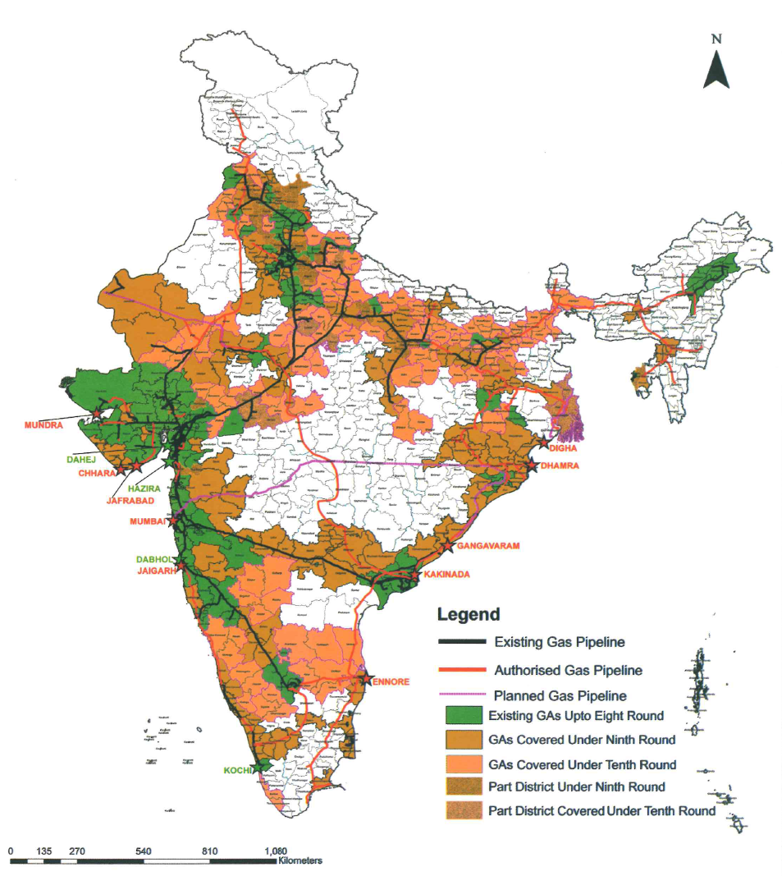
Overview of CGD sector
Till 8th Bidding Round (as on Mar’18)
35 Entities, 92 GAs, 23 States/UTs
10% India’s Area, 18% Population
42.8 lakh DPNG Connections
33,732 C&I connections
1424 CNG stations
27 lakh CNG vehicles
After 10th Bidding Round (as on Mar’21)
41 CGD entities, 230 GAs, 27 States/UTs
53% India’s Area, 70% Population
78.20 lakh DPNG connections
44,142 C&I connections
3101 CNG stations
~36.5 lakh CNG vehicles
By 2028
10000 CNG Stations
2.4 crore CNG vehicles
4.5 crore DPNG connections

Slide 7
We too are part of the Journey ….
The JV - “BENGAL GAS COMPANY LIMITED” (BGCL)
Promoters: GAIL (India) Limited, a Maharatna CPSU & Greater Calcutta Gas Supply Corp, a GoWB Enterprise
Incorporated on 04.01.2019.
PNGRB authorization to BGCL w.e.f. 13.06.2019.
Area: 1529 Sq. Km with 1.64 Cr Population (census 2011)
KMC and part of five adjoining districts.
Plan in next 5 year after hookup -
  CAPEX ≈ Rs 4950 Cr.
  DPNG ≈ 14 Lakh
  CNG Stations ≈ 170 Nos

Slide 8


Slide 9
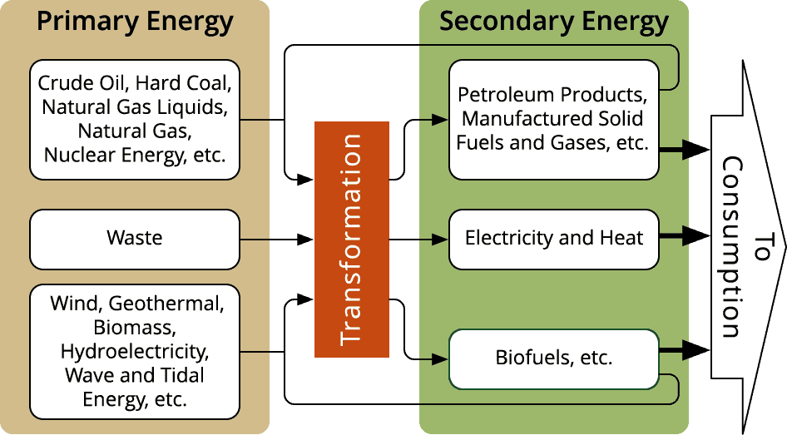
ENERGY CLASSIFICATION
Primary energy consists of unconverted or original fuels. For example, primary energy sources include petroleum, natural gas, coal, biomass, flowing water, wind, and solar radiation. Those are the fuels that can be mined, reaped, extracted, harvested, or harnessed directly. Secondary energy cannot be harnessed directly from nature
Secondary energy includes resources that have been converted or stored. Rather secondary energy is energy that has already been converted. For example, electricity cannot be mined or harvested, though it is available in quick bursts on occasion from lightning. It is generated as a secondary form from primary fuels, like natural gas.

