Slide 1
Is Carbon Capture, Utilisation and Storage a viable option for India?
Jonathan Pearce, Head of CO2 Storage

Slide 2

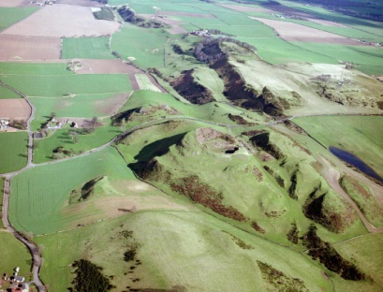
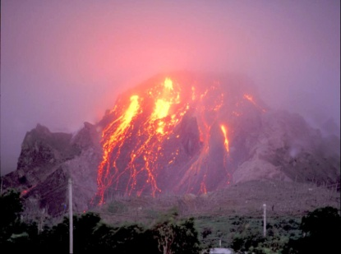
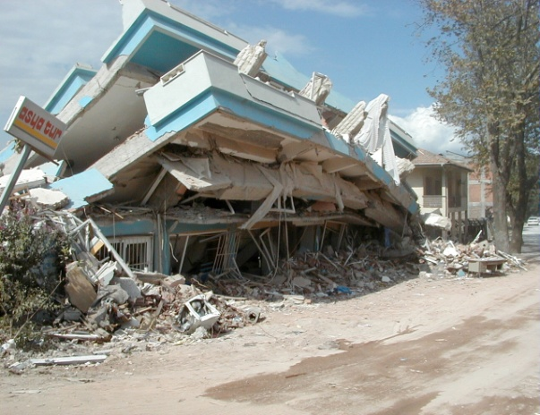
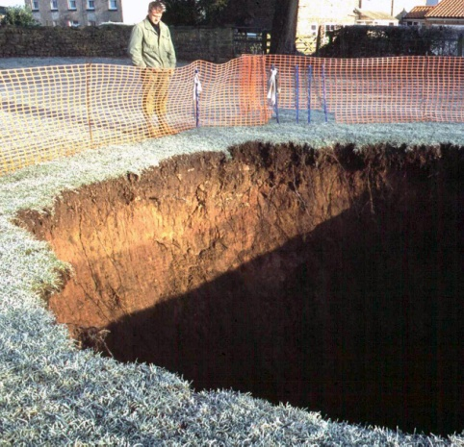
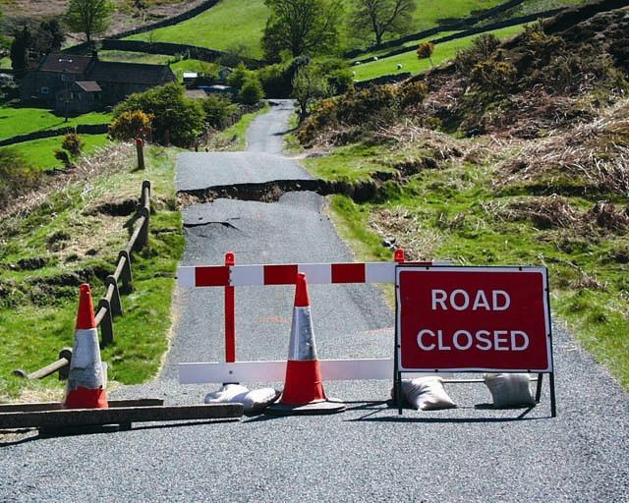
The British Geological Survey
As a world-leading geological survey, we conduct public-good science for government to understand earth and environmental processes.
We are the UK's premier provider of objective and authoritative
geoscientific data, information and knowledge to help society to:
  use its natural resources responsibly
  manage environmental change
  be resilient to environmental hazards
We provide expert services and impartial advice in all areas of geoscience.
Our client base is drawn from the public and private sectors both in the UK
and internationally.

Slide 3
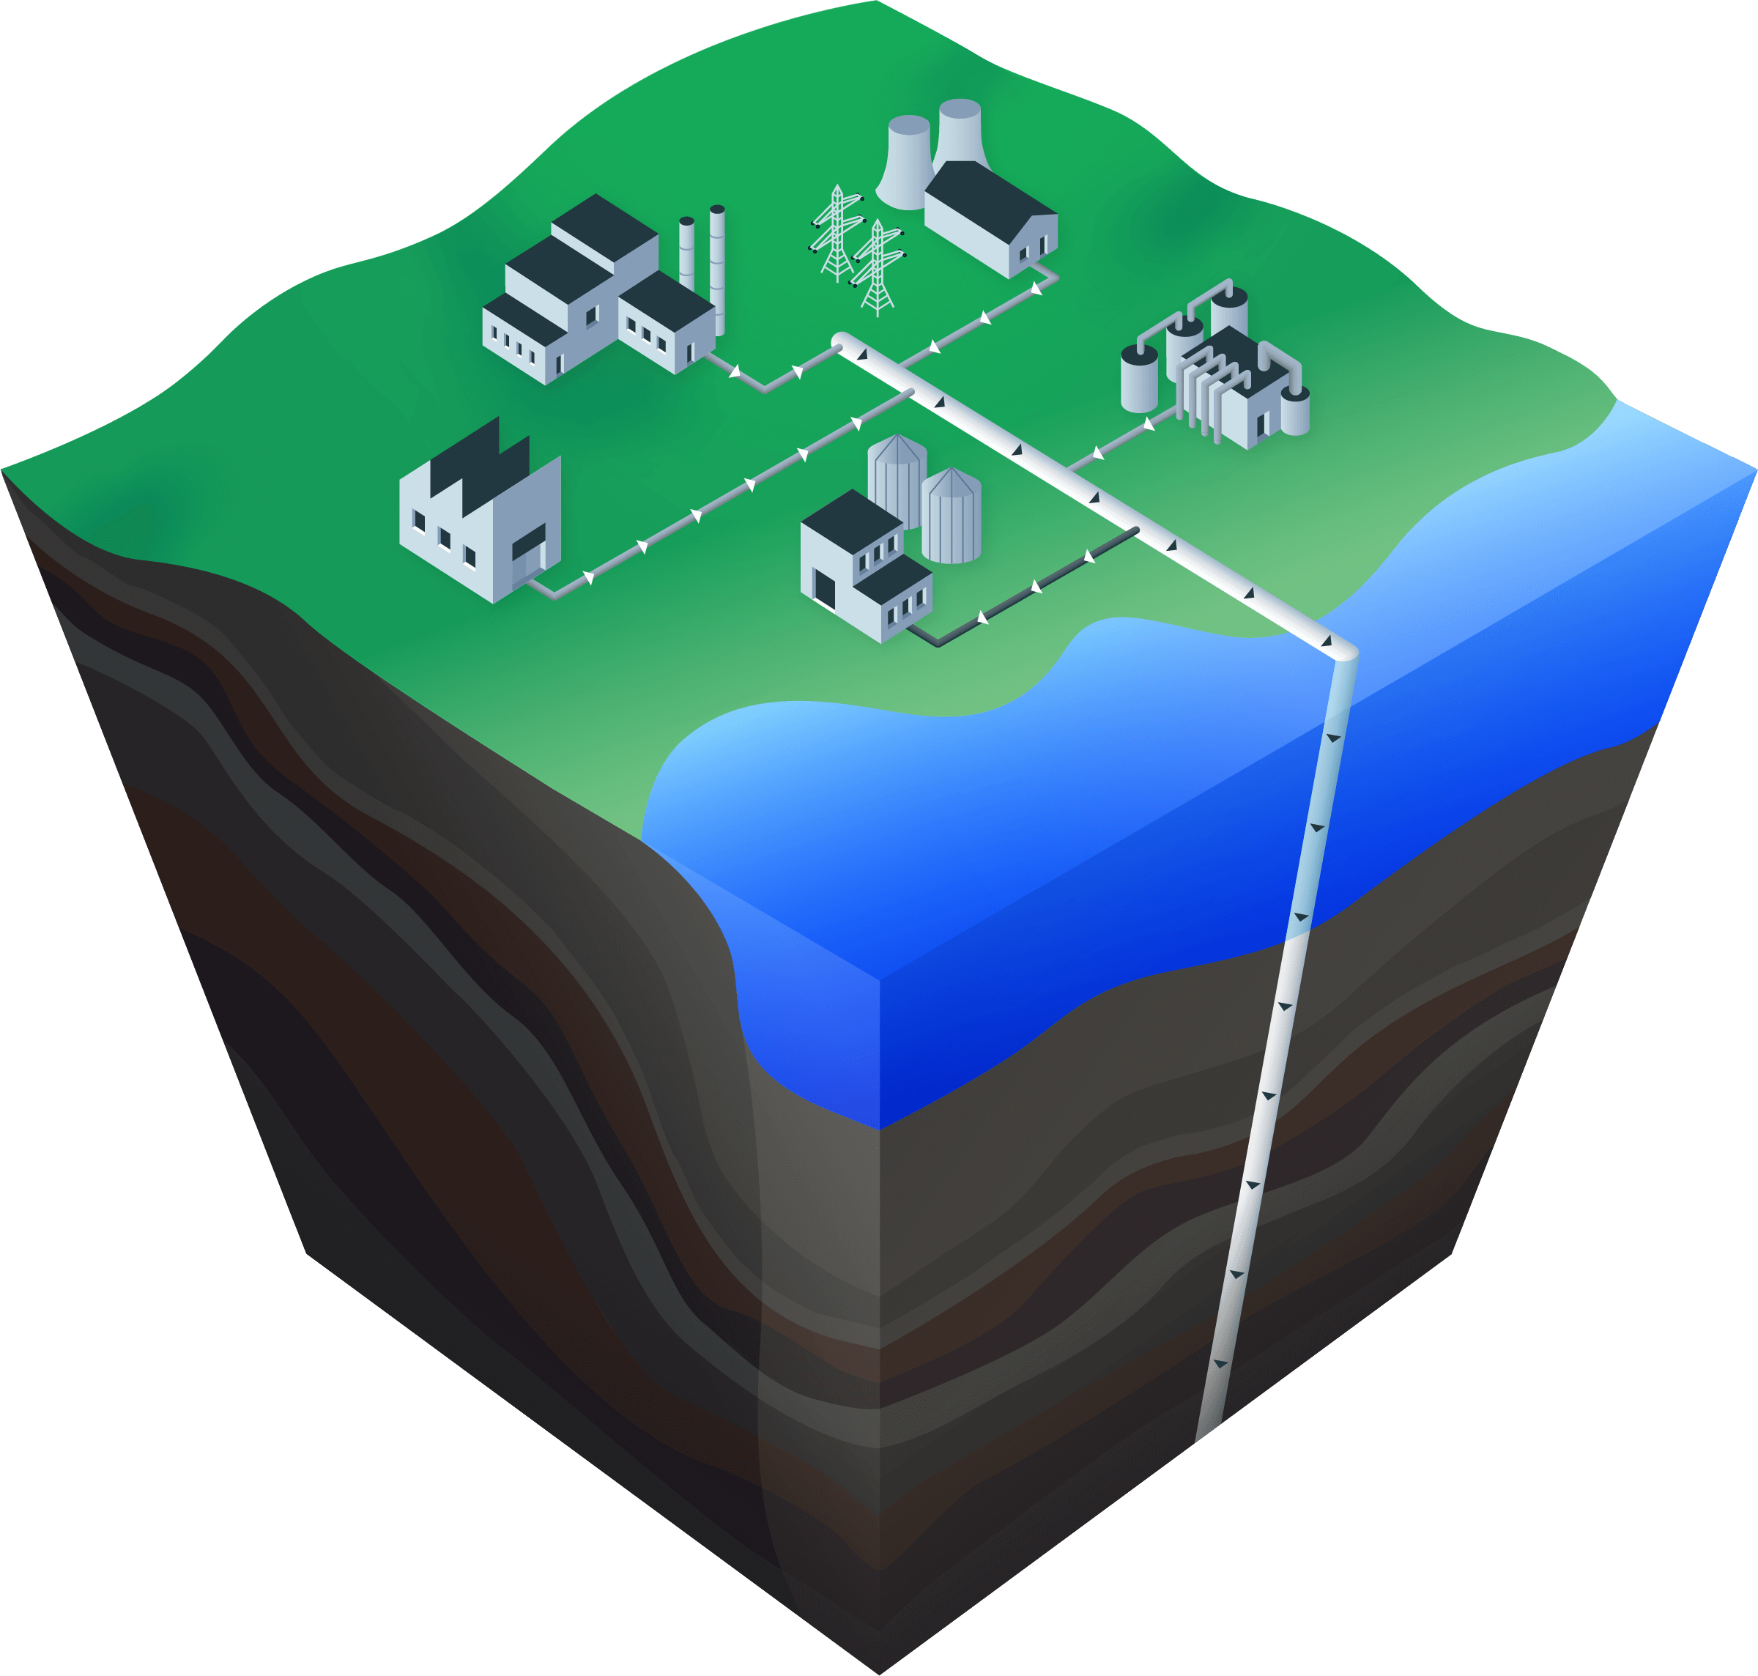
What is Carbon Capture, Utilisation and Storage?
Capture on industry
(cement, fertiliser,
iron & steel,
refinery)
Capture on power
(gas, coal, biomass)
Capture on
hydrogen
production
Globally recognised (e.g. IPCC, IEA) as an important tool in mitigating climate change
CCUS is needed to decarbonise hard-to-abate industrial and power sectors
In 2020, globally 65 commercial facilities were in operation, under construction or in development (Status report 2020, Global CCS Institute)
India has several operational capture and utilisation plants (soda ash & fertiliser) with plans for further CO₂ utilisation in enhanced oil recovery
Direct
greenhouse
gas removal
Utilisation
www.ccsassociation.org
Deep geological storage
(on- or offshore)
3

Slide 4
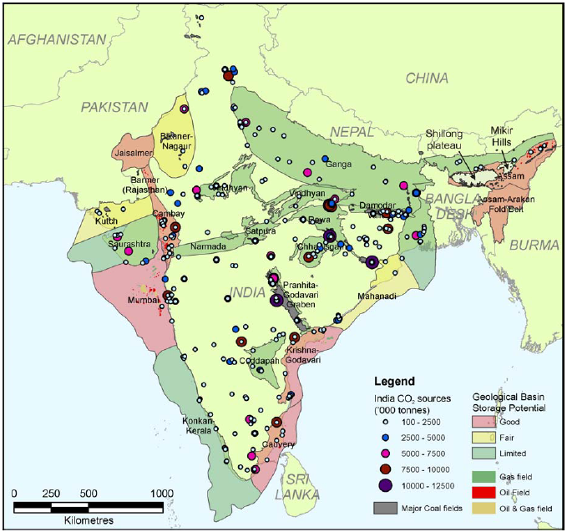
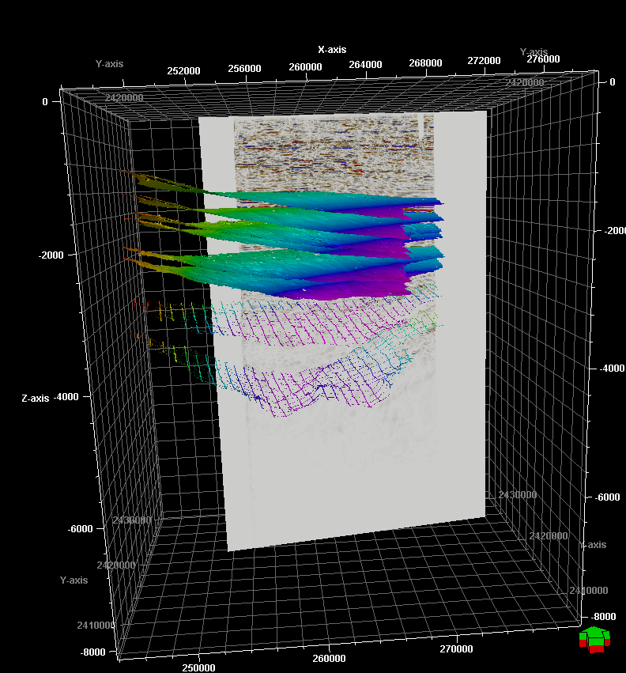
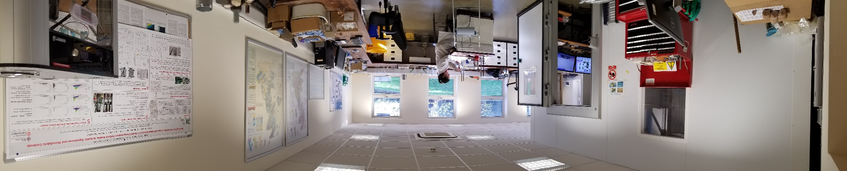
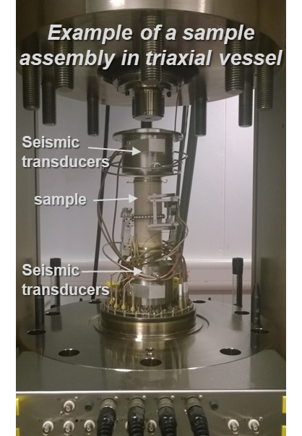
Is deep geological CO₂ Storage feasible in India?
Collaborating with IIT(B) and NGRI to investigate feasibility of deep CO₂ geological storage
  How can demonstrate it is safe?
TIFAC, 2018
Ensuring safety: Can we monitor CO₂ underground
in Indian basalt?
Determining detectability of CO₂ in shallow subsurface
Measurements of seismic velocities under variable conditions on Deccan Trap basalt samples
How much can be stored and where?
BGS Rock Mechanics Laboratory
IEAGHG, 2008

Slide 5
Carbon capture, utilisation and storage may be a feasible option to decarbonise Indian power and industry whilst increasing economic growth but more studies needed
Key message
Jonathan Pearce: jonathan.pearce@bgs.ac.uk
5

