Slide 1
Your future. Our focus.
Introducing LRQA, a leading global assurance partner.
20th July 2022
Notes:
SLT

Slide 2
We are everywhere you are
UK & I
N Europe
S Europe
N Asia
6000 Clients
775 Experts
29000 Clients
1200 Experts
10000 Clients
1220 Experts
6000 Clients
570 Experts
TOTAL
Americas
SAMEA
148 Countries
61000 Clients
4925 Experts
3000 Clients
620 Experts
7000 Clients
545 Experts
Notes:
SLT
we operate in 120 countries
delivered by global player with extensive reach
can support our clients in almost every country

Slide 3
LRQA Assurance Portfolio
Compliance and Certification
Risk Analysis
Reliability & Asset
Performance
Business Assurance
Process Safety Studies
Environmental Impact Assessment
Consulting Training
Notes:
SLT

Slide 4
Hydrogen
20th June 2022
Nilay Ball – Principal Consultant – India

Slide 5
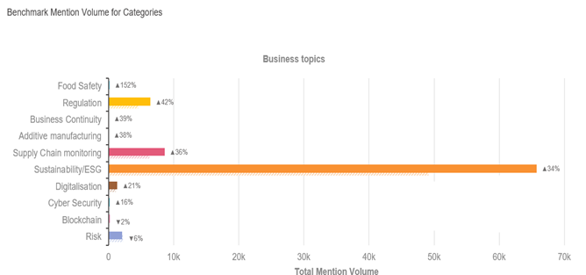
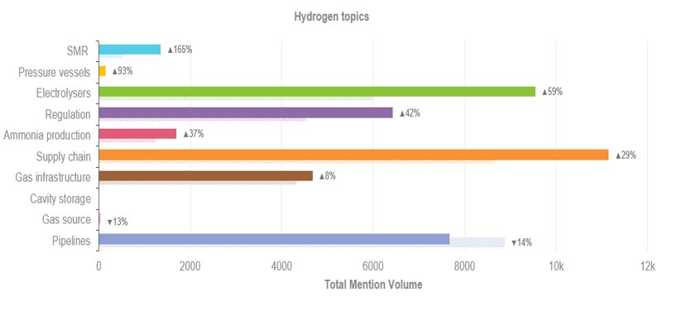
What's happening today – Internet activity watch
July 2021 – May 2022
Source: Brandwidth - LRQA Analysis
Notes:
Andy

Slide 6
Challenge Overview

Slide 7
Widespread use of hydrogen in global energy transitions faces several challenges – technical assurance
Causes of challenges in market where certification / assurance service could support
Impact
Technology and Supply Chain
Regulation and Standards
Social License to Operate
Technology is not new – Scale and required cost point is
Diversified / new supply chains - Risk of unknown and new markets
Plants in “different” locations
Personnel / skills shift
Regulations and standards needs across all aspects
Production – not new
Storage
Transportation
Fueling and distribution
Limited knowledge of best practices / standards
SAE J2601-02 + ISO 17268
ATEX certified for Zone 1
EN 13445
EN ISO 10961
ASME Section VIII & Sec X & ADR
PESO
H2 projects will impact the general public – gas blending / fuel stations
Perception from past disasters
Learn lessons from Coal Seam Gas and other new sectors - “not in my back yard”
Lack of trust to allow scale up
Delay
Risk in supply chain - costs
Risk of first mover
Lack clarity on regulation delays development
Delay
Complex regulatory environment
Reduced cross region / boarder trading
Increase costs
Poor public perception of H2
Delay
Cost
Corporate reputation in other fields
Source: LRQA Consulting analysis
Notes:
Nilay

Slide 8
LRQA Products

Slide 9
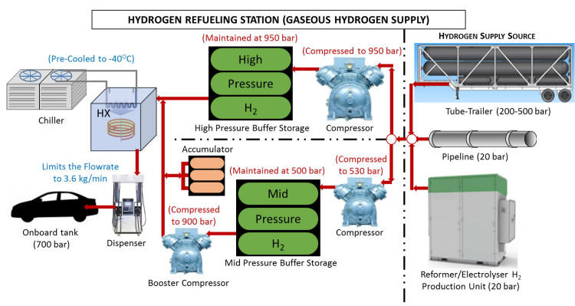
Mobile H2 Dispensing unit
Electrolyser
Low Pressure Storage (350 Bar)
Compressor unit
High Pressure Buffer storage
Dispensing Unit

Slide 10
Equipment access to Market - Approval in Principal and Type Approval
Focus - Documentary review of the main design and construction documents outlining design basis, risk assessments and other documents providing information on the Codes and Standards that may be identified to be applicable for this type of facility.
Disciplines Involved
• Process Safety
•Technical safety
•Mechanical
• Pressure Systems
• Electrical and C&I
• Materials
1
Risk Review
Hazard and Failure Mode Identification and QRA
Identification Hazards and failure modes applicable to the plant along with support information demonstrating the control of these hazards and failure modes is proved to be feasible.
1
Define codes and Standards
2
Code and Standard selection
Confirm applied Codes and Standards, Specifications and Practices that has been selected for the design and construction of this type of equipment are suitable
2
AIP
Concept Design Review
3
Concept Design Review
Review Design Philosophies, Design basis, System and functional details such as functional flow block diagram, process flow diagrams, Piping and Instrumentation Diagrams, Interfaces
3
Deliverable
Approval In Principal (AIP) Certificate to be used for marketing purposes
Include caveats on required including
Required Testing
Addional details for detailed design
Regulatory
AIP Certificate
4
Approval for use / Type Approval
4
Approval for use
/ Type approval
Review of detailed design- Similar process to above now investigating
Detailed design and testing for specific market use
Regulatory review
Additional HSE Studies / Regulatory advise and support
Notes:
Andy

Slide 11
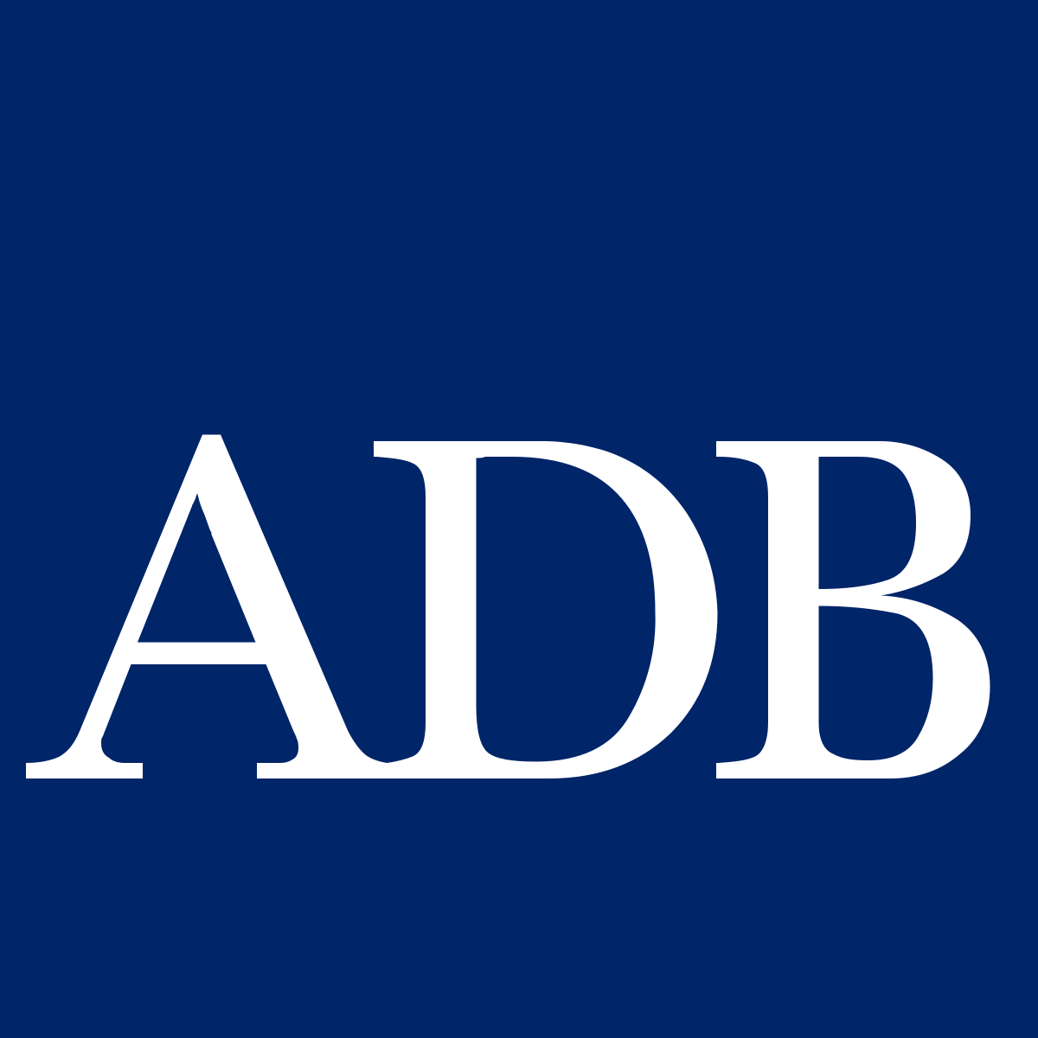
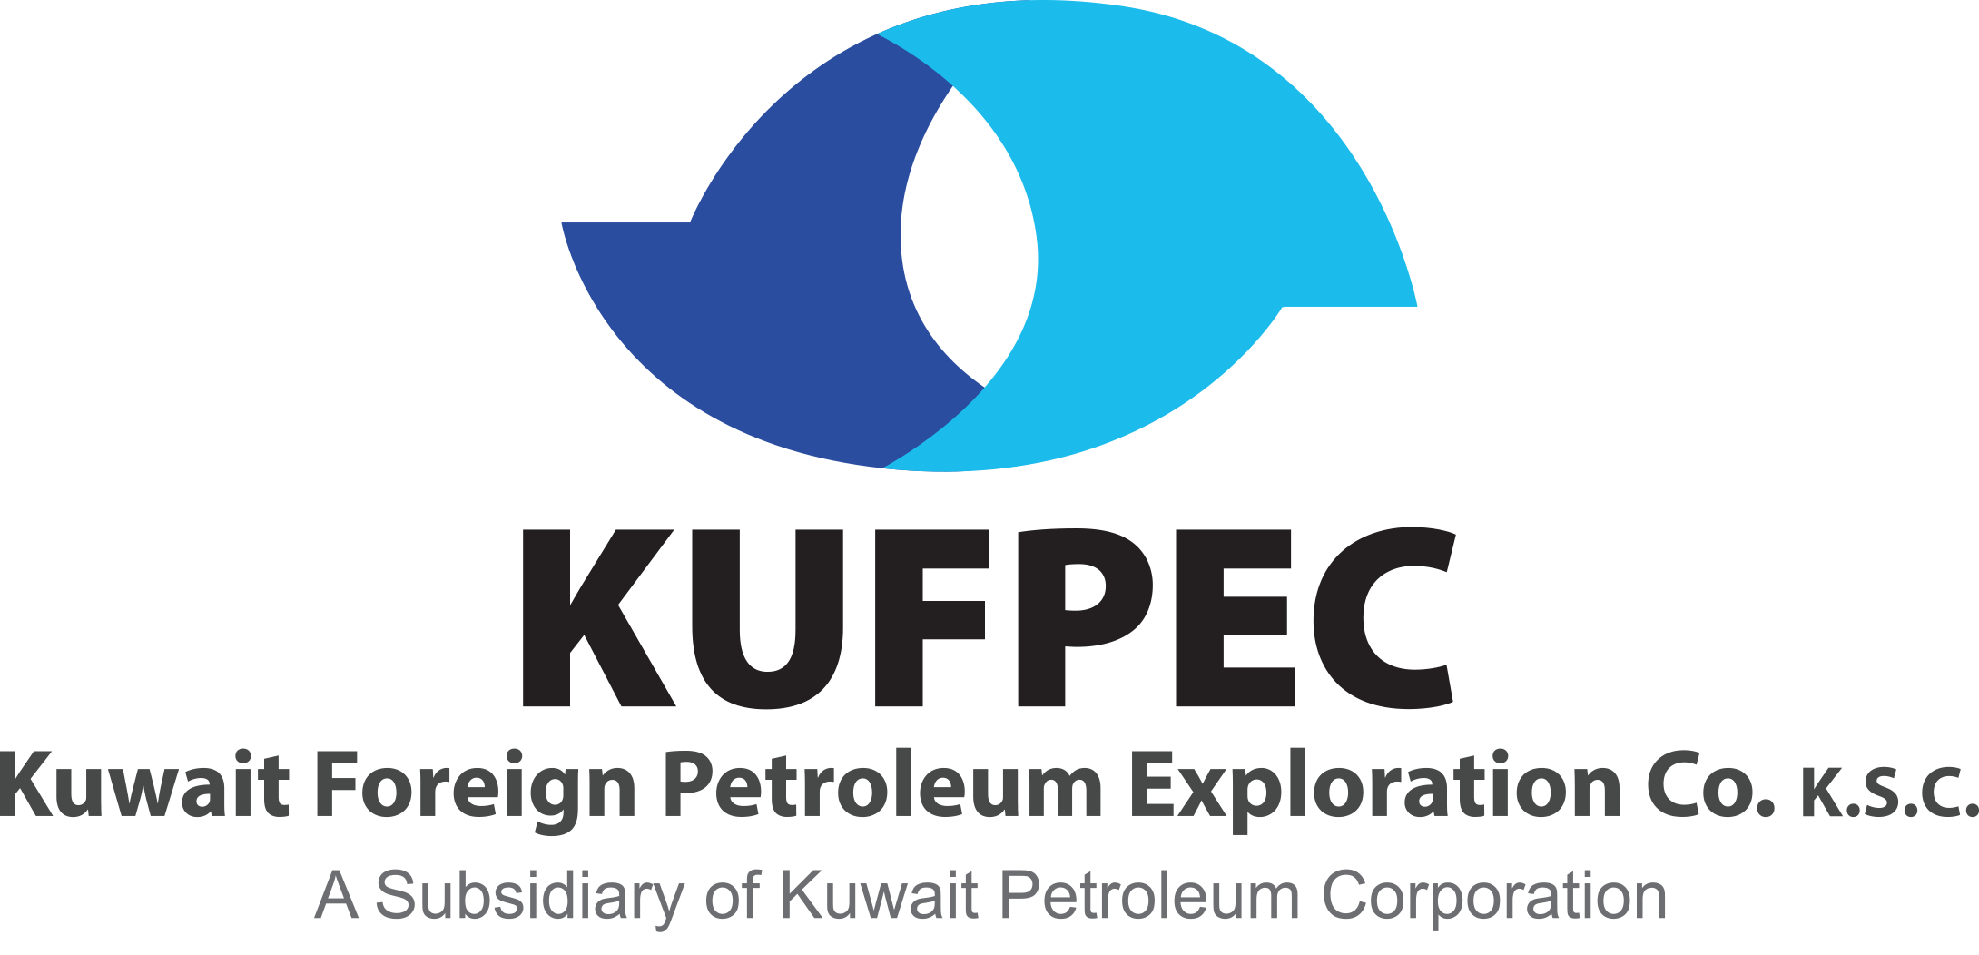
LRQA is working with wide range of companies to drive their Hydrogen agenda
Blue hydrogen process elements
Sample of Clients
1
Feasibility
2
Production
4
Storage
Carbon Capture & Storage / EOR
3
Transportation
Usage
5
Regulatory Framework / HSE
Notes:
Andy

Slide 12
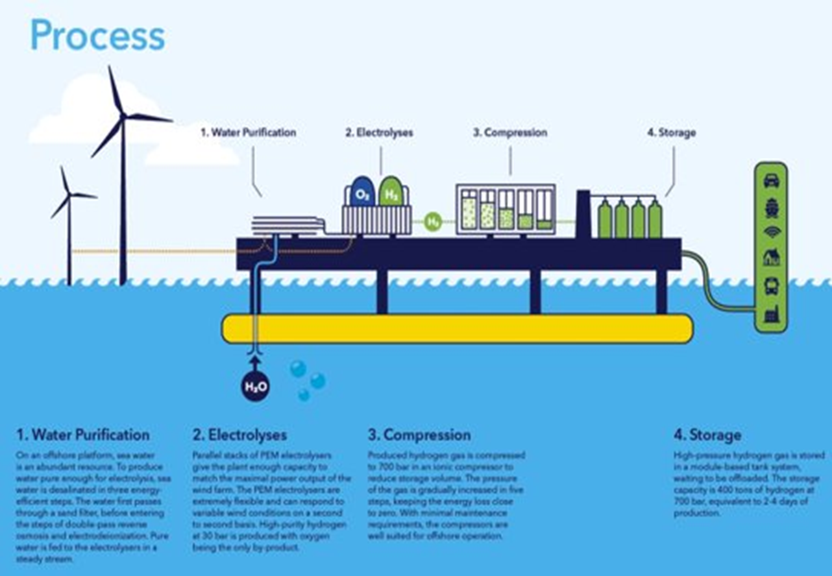
Process Design
What we Deliver
1. Process Engineering Support: Check the proposed system design including line/vessel/ instrument/ safety device sizing & develop the model. From the model devolve a series of datasheets for each of the components. 2. Technical Safety Support: Map the required fire and gas system for the facility. Prepare philosophy and diagram. 3. Mechanical Engineering Support: Provide technical analysis of material used for gaskets and fittings and suitability for hydrogen. Prepare the equipment data sheet

Slide 13
Safety Studies
Qualitative
Quantitative
HAZID (Hazard Identification)
HAZOP (Hazard & Operability)
SIL Classification
Bow Tie Study
FMEA (Failure Mode Effect Analysis)
SAFOP (Systems Safe Operability
SIL Classification
Consequence Analysis (Fire, Explosion & Toxic Hazards
Quantitative Risk Assessment (QRA)
Escape Evacuation and Rescue Analysis (EERA)
Emergency System Survivability Analysis (ESSA)
Flare / Vent Dispersion / Radiation study
SIL Verification study
Reliability, Availability, and Maintainability (RAM)
Notes:
Nilay

Slide 14
How we can support The Project – OWNERS/Investors
Project Lifecycle
Initiation & Planning
Design
Build
Start-up and Operations
Strategy
Establish contracting and execution strategies
Design basis review – optimised detailed design methodologies/plans
Supply chain and construction quality assurance strategy
Commissioning plans, operating and maintenance procedures
Compliance
Set PMC, Technology Providers & contractor quality requirements
Detailed design compliance, regulatory compliance
Ensure Supply chain and construction quality
Pre-start-up Safety Reviews
Measure
Establish quality goals
Audit engineering processes, management of design
Assess effectiveness of project QA and QC
Project milestone health checks
Optimise
Best practice project management and risk management processes
Using safety studies to reduce risk and optimise layout
Tailored safety management system
Completeness of project data carried forward to operations

Slide 15
Experience in Hydrogen

Slide 16
Our Recent Engagements
Name of Client | Location | Scope of Work | Date
Total Energies Gas Mobility | Netherlands | Design Appraisal, Inspection and Certification of refuelling station according PED 2014/68/EU | 2022
Alliander | Netherlands | Design Appraisal, Inspection and Certification of Electrolyser skid according PED 2014/68/EU | 2022
Hydron | Netherlands | Design Appraisal, Inspection and Certification of Electrolyser according PED 2014/68/EU | 2021
Air Products | Netherlands | Design Appraisal, Inspection and Certification of Hydrogen pipeline according PED 2014/68/EU and partly NEN3650. | 2021
GHD Group Pty Limited | Australia | Inspection of Hydrogen Pressure vessels as per AS 3788 section 4.2- for LAVO project - Using solar energy for H2 production | 2021
Neste Netherlands B.V. | Netherlands | Design Appraisal of Pressure Equipment for New built of Green hydrogen pilot plant on Maasvlakte Rotterdam | 2021
Total Energies Gas Mobility | Netherlands | Design Appraisal, Inspection and Certification of refuelling station according PED 2014/68/EU | 2021
Notes:
Andy

Slide 17
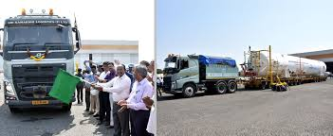
Case Study 1 - Certification Hydrogen storage facility
Metallic & Non Metallic FRP storage tanks
For Metallic Storage tanks we appraise the tanks to ASME SEC VIII Div. 1 + SMPV Rules - Static and Mobile Pressure Vessels, Petroleum & Explosives Safety Organization (PESO)
For the plastic FRP storage tanks our certification scheme follows - PED Module B and Module F and ASME Class I, Section 10
INDIA’s LARGEST LIQUID STORAGE TANK MANUFACTURED IN SRI CITY
Notes:
Nilay

Slide 18
Case Study 2 – Flexible use of Standards for Hydrogen Storage
Adapting of standards for H2 use / reducing cost
German consortium (Emano, Fraunhofer-Institute and the Leibniz-Institute) developed bespoke hydrogen storage, manufactured from Composite
Weight and price advantages, as well as improved risk performance in terms of brittle fracture.
This material and use case did not have a prescribed certification route
LRQA certified design and manufacture, taking knowledge of global standards to find most appropriate way to certify using mix of current guideline
PED Module B and Module F and ASME Class I, Section 10 , which specifically focuses on fibre reinforced pressure vessels
Vessel now can be sold and exported globally
Notes:
Nilay

Slide 19
LRQA Expertise in Renewables
Your Future, Our Focus
We have a global reach with offices in 90 countries and have Supported 600+ projects generating 36 + GW of renewable energy
Feasibility & Appraisal Services
We help you assess and make decisions based on the outcomes of feasibility studies and assessment reviews – Including Technical due diligence
Site Assessment
We help you to characterize the profile of your site.
Risk Management
We help you identify and manage risk throughout the entire life-cycle, from concept to decommissioning – Including Dispersion modelling, SIL, HAZOP, QRA
Project and Product Certification
We provide assurance to assets components or projects; for you and for third party interests – including AIP and Approval to market / type approval
Vendor Assessments & Audits
Vendor assessments and audits give you crucial information about a vendors' capabilities, machinery, management systems, and other factors.
Supply Chain & Site Inspection services
We ensure the quality and reliability of your component and supply chain as well as site during installation & commissioning
Asset Performance Failure Investigation
We help when your asset is not preforming as expected.
Regulatory Consultancy / support
We know global regulations, working across all jurisdictions and having dedicated teams interacting and influencing with regulators and standards committees globally, we are well placed to provide advise and support.
Notes:
Andy

Slide 20
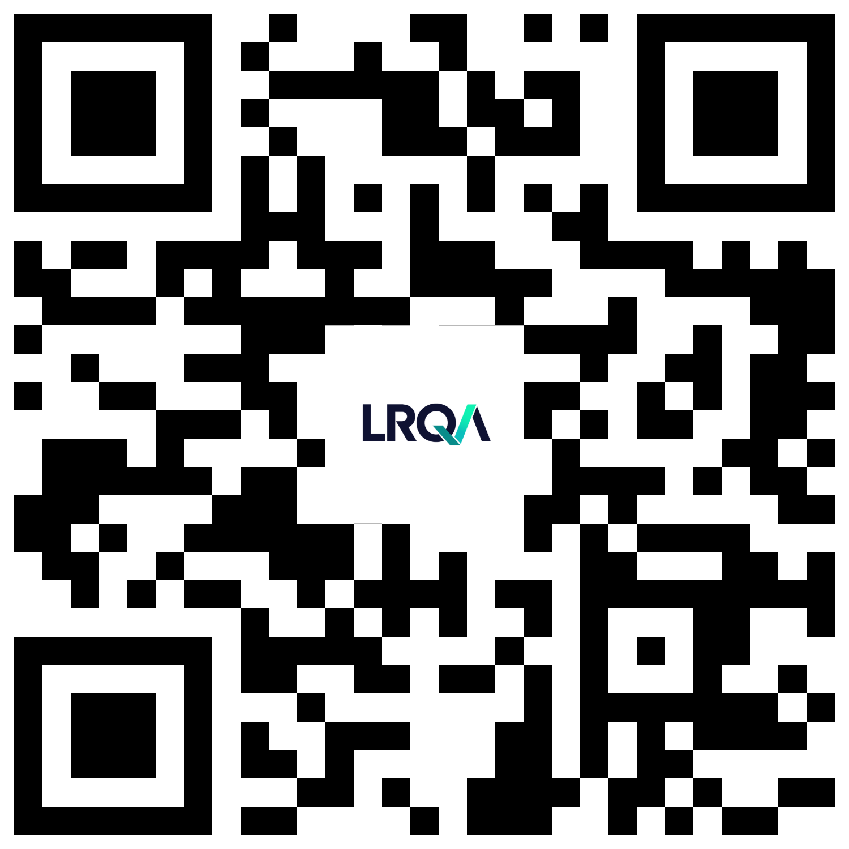
Thank you
Nilay Kumar Ball – Principal Consultant Asia, Middle East Asia & South Europe.
Nilay.Ball@lrqa.com
Tel +91 8800556668
Visit LRQA SharePoint page for list of Performance Services

