Slide 1
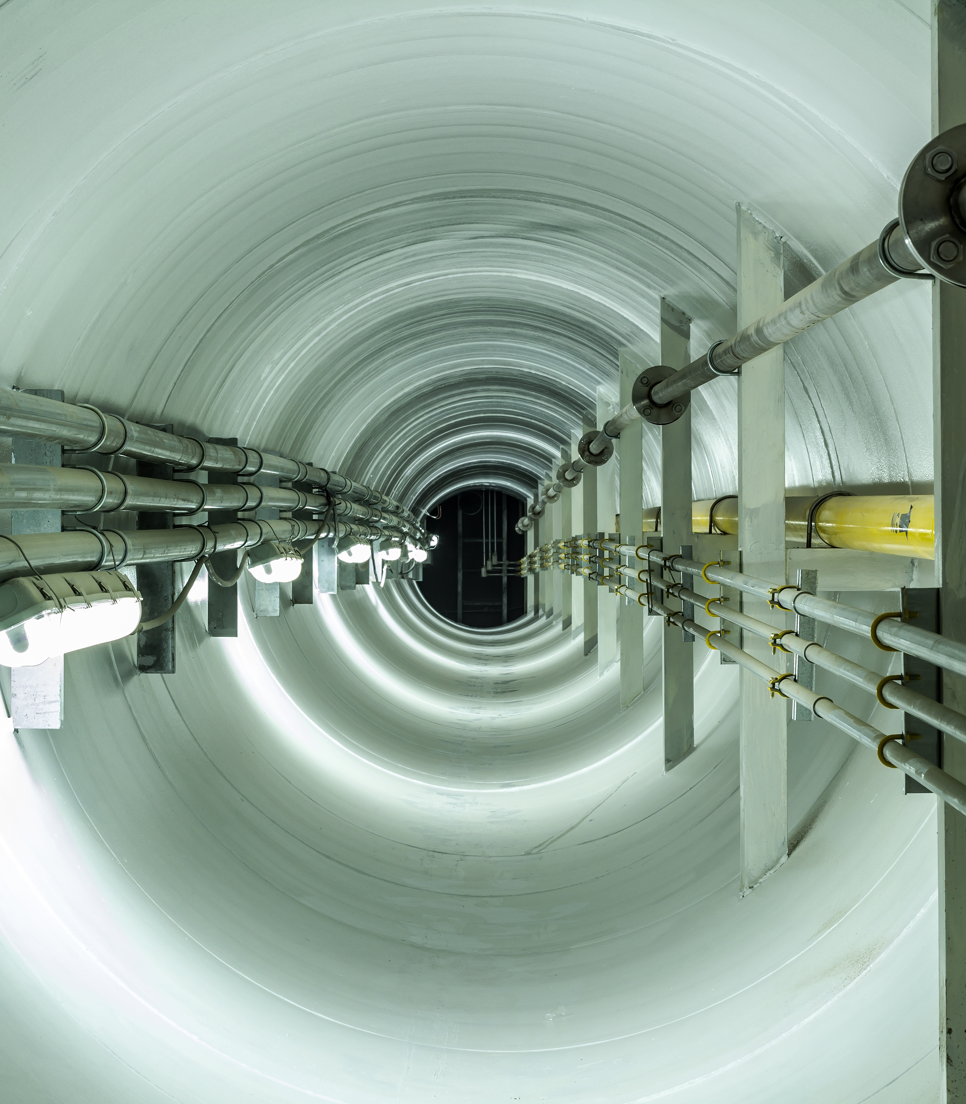
Synaptec -
Distributed Electrical Passive Sensing –
Cable Condition Monitoring & Protection
February 2022

Slide 2
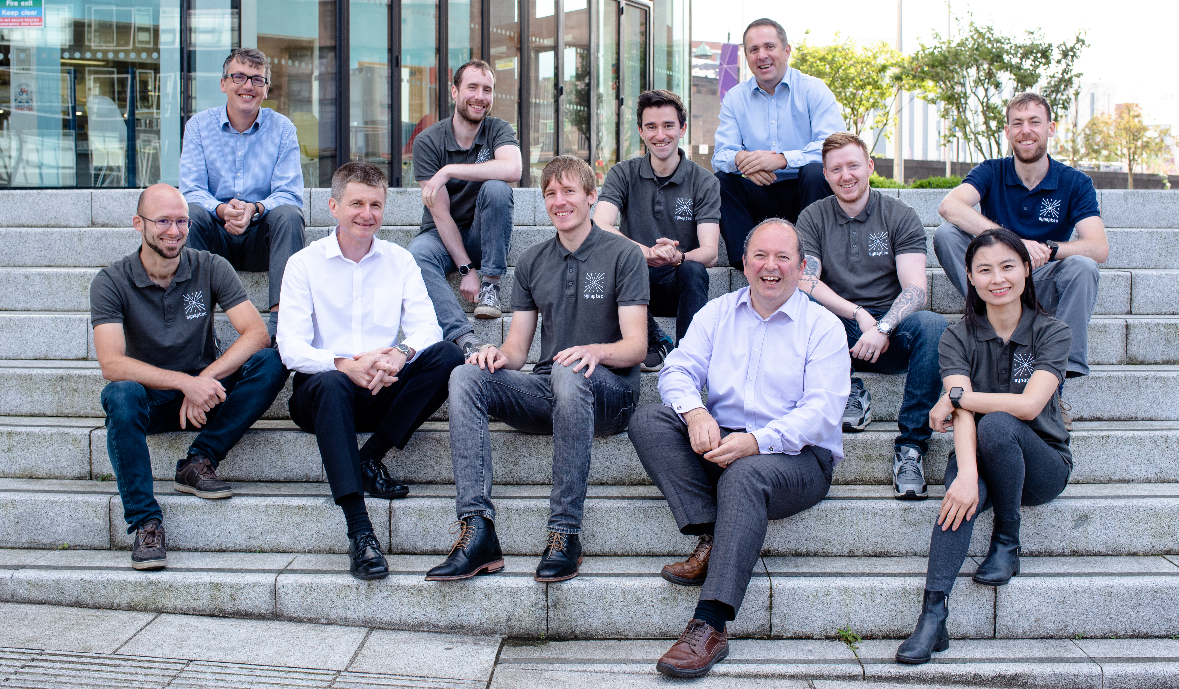











Light speed system awareness
Reduces capital cost and carbon footprint of instrumentation
Reduces outage time and repair cost
World first: Distributed Electromechanical Sensors (DES)
Passive sensors networked by light, not data
Some of our customers

Slide 3
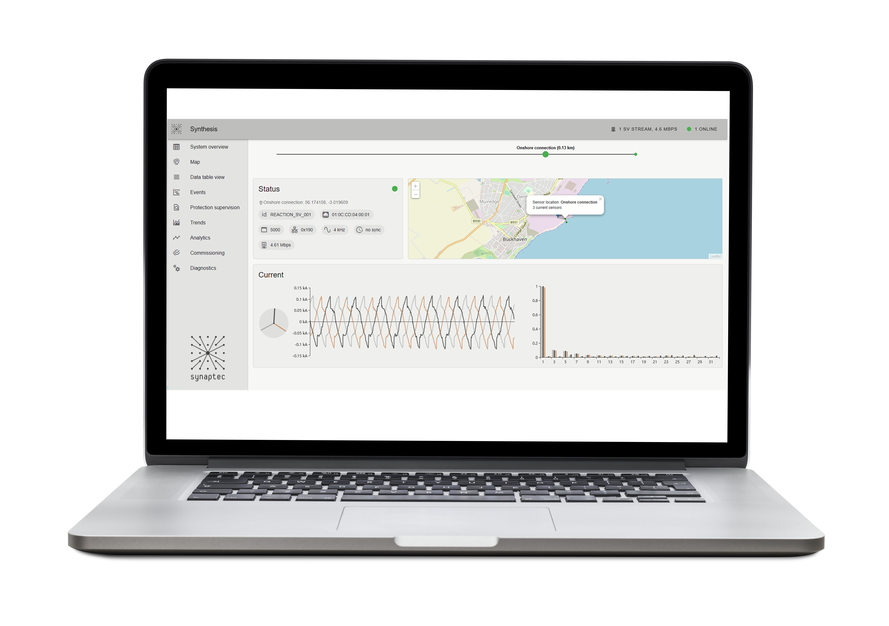
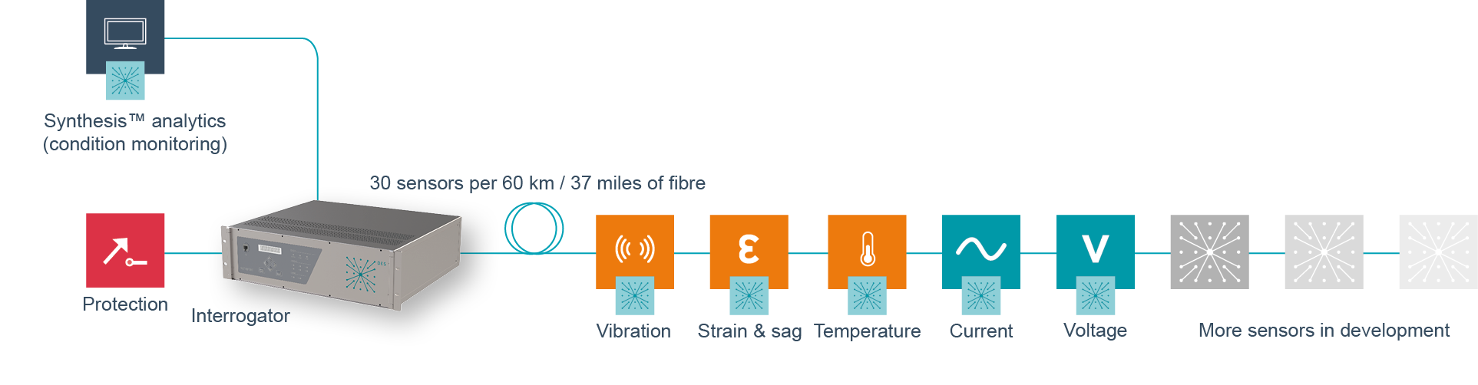
One passive monitoring platform, three levels of benefit
Improves | Application | Benefits
Asset Performance Management | Multi-point comparative analytics | Condition- based maintenance decisions Earlier warning of more failure modes
Real-time monitoring | RTTR Alarms and ampacity | More accurate systemic thermal rating for the circuit Instant warning of overheating and losses Works where 4G / IoT cannot
Multi-zone protection | Mixed Circuit Protection | Auto reclose on overhead faults, block reclose on faults in underground cable sections
Years
TIME
Minutes
<2 ms
Permanent, synchronous monitoring for inaccessible and remote HV assets
Sheath current, phase current, harmonics, temperatures correlated in one view
Earlier warning of more failure modes buys more response time

Slide 4
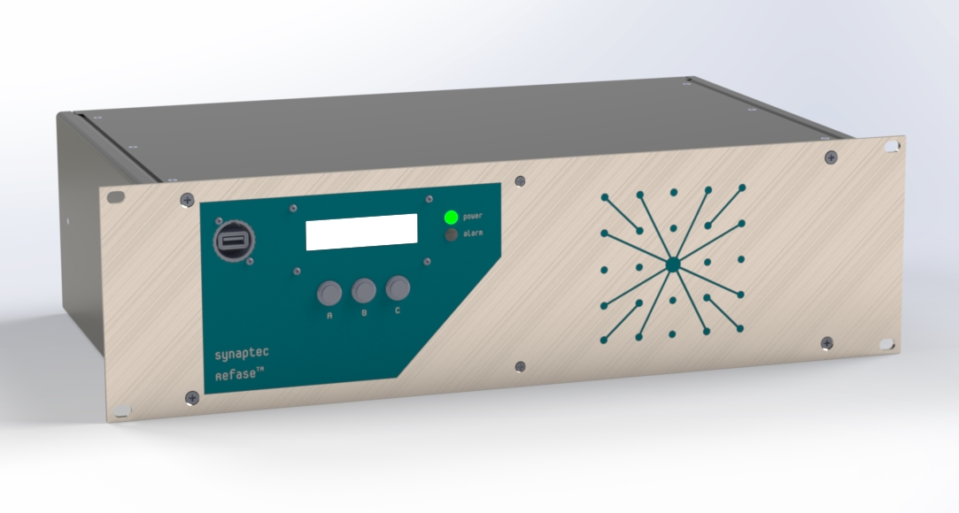
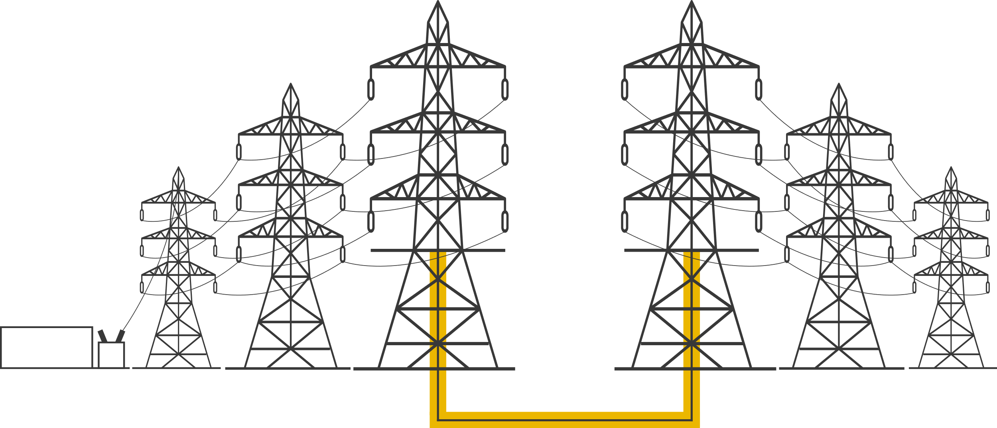
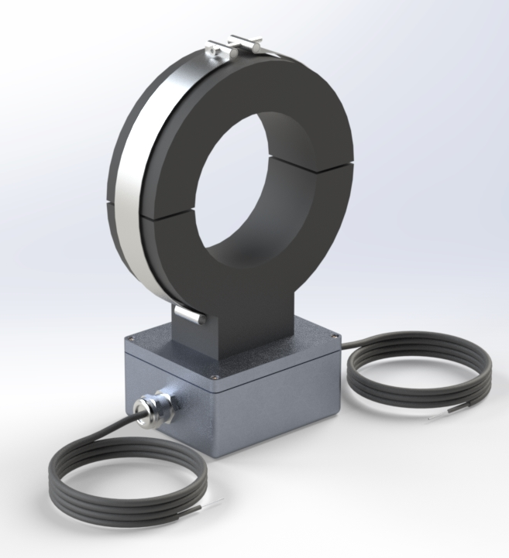


Mixed Circuit Protection (MCP)
One Refase™ Interrogator in substation
AR block (ANSI 87L)
IEC 61850-8-2 GOOSE or dry contact
Optional SV stream
Supports many remote sensors
Passive split-core CT
Installed on transition platform
Easy access to fibre patch box
87L
AR block
Protection
Up to 60 km range

Slide 5
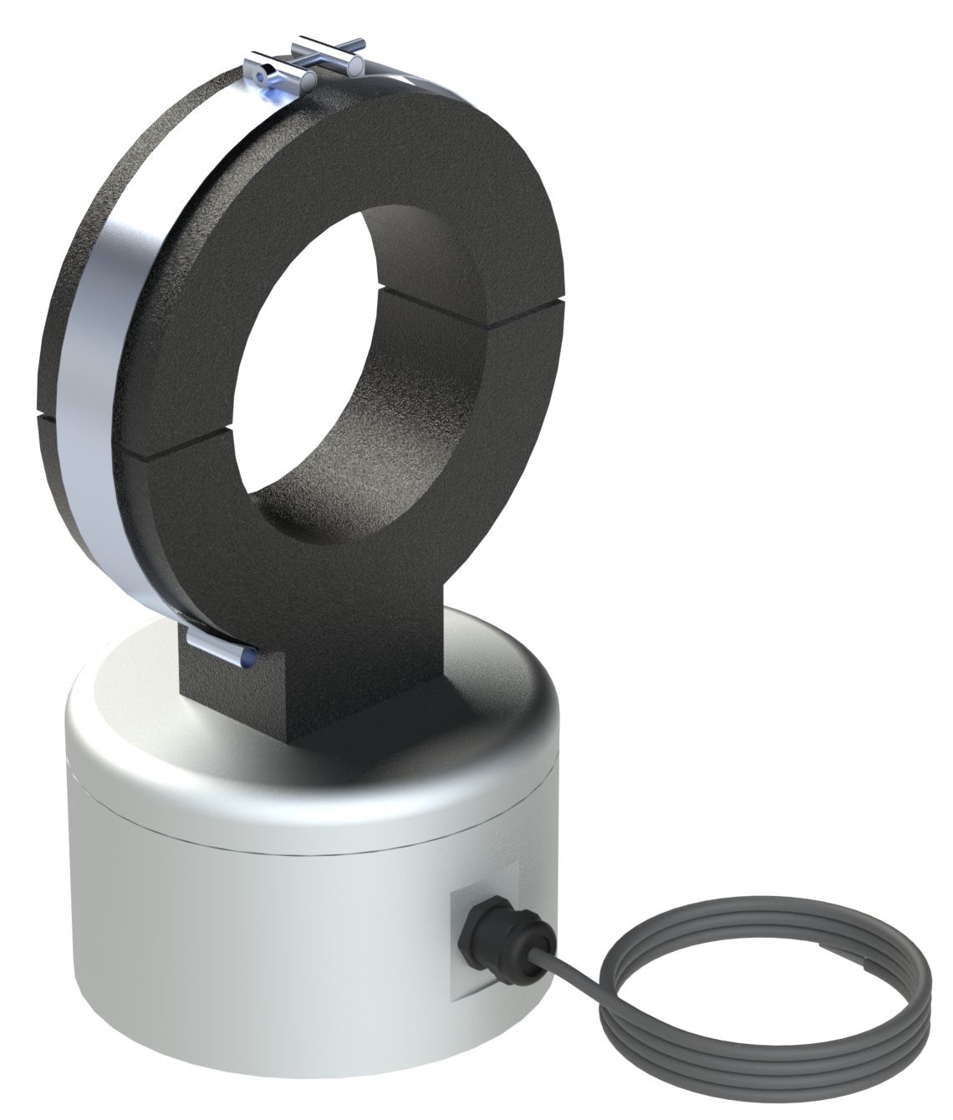
Fiber comes down to splice box from OPGW (the earth wire at the top of the tower)
overhead lines and fiber come down to platform
Splice box
The 3 phase conductors and fibers separate out and are held & terminated on this platform
Underground cable comes up to meet on a platform (10m up from the ground)
=

Slide 6
Cable condition monitoring (link box monitoring)
Substation-1
IED - 1
IED - 2
Towards
Substation-2
Underground Cable
Cable joint
Humidity sensor
Passive Voltage module connected to classic
Or conventional VT
Passive Current module connected to classic
Or conventional CT
Underground Cable
Sheath voltage limiter
Circuit Breaker
Temperature sensor
Iron Core, Split/Solid Ring type
Low Power CT in sheath cable, earth bonding
Cable sheath /shield
Straight / cross boding link box
Single Mode Fiber Optic cable (single core per IED``)

Slide 7
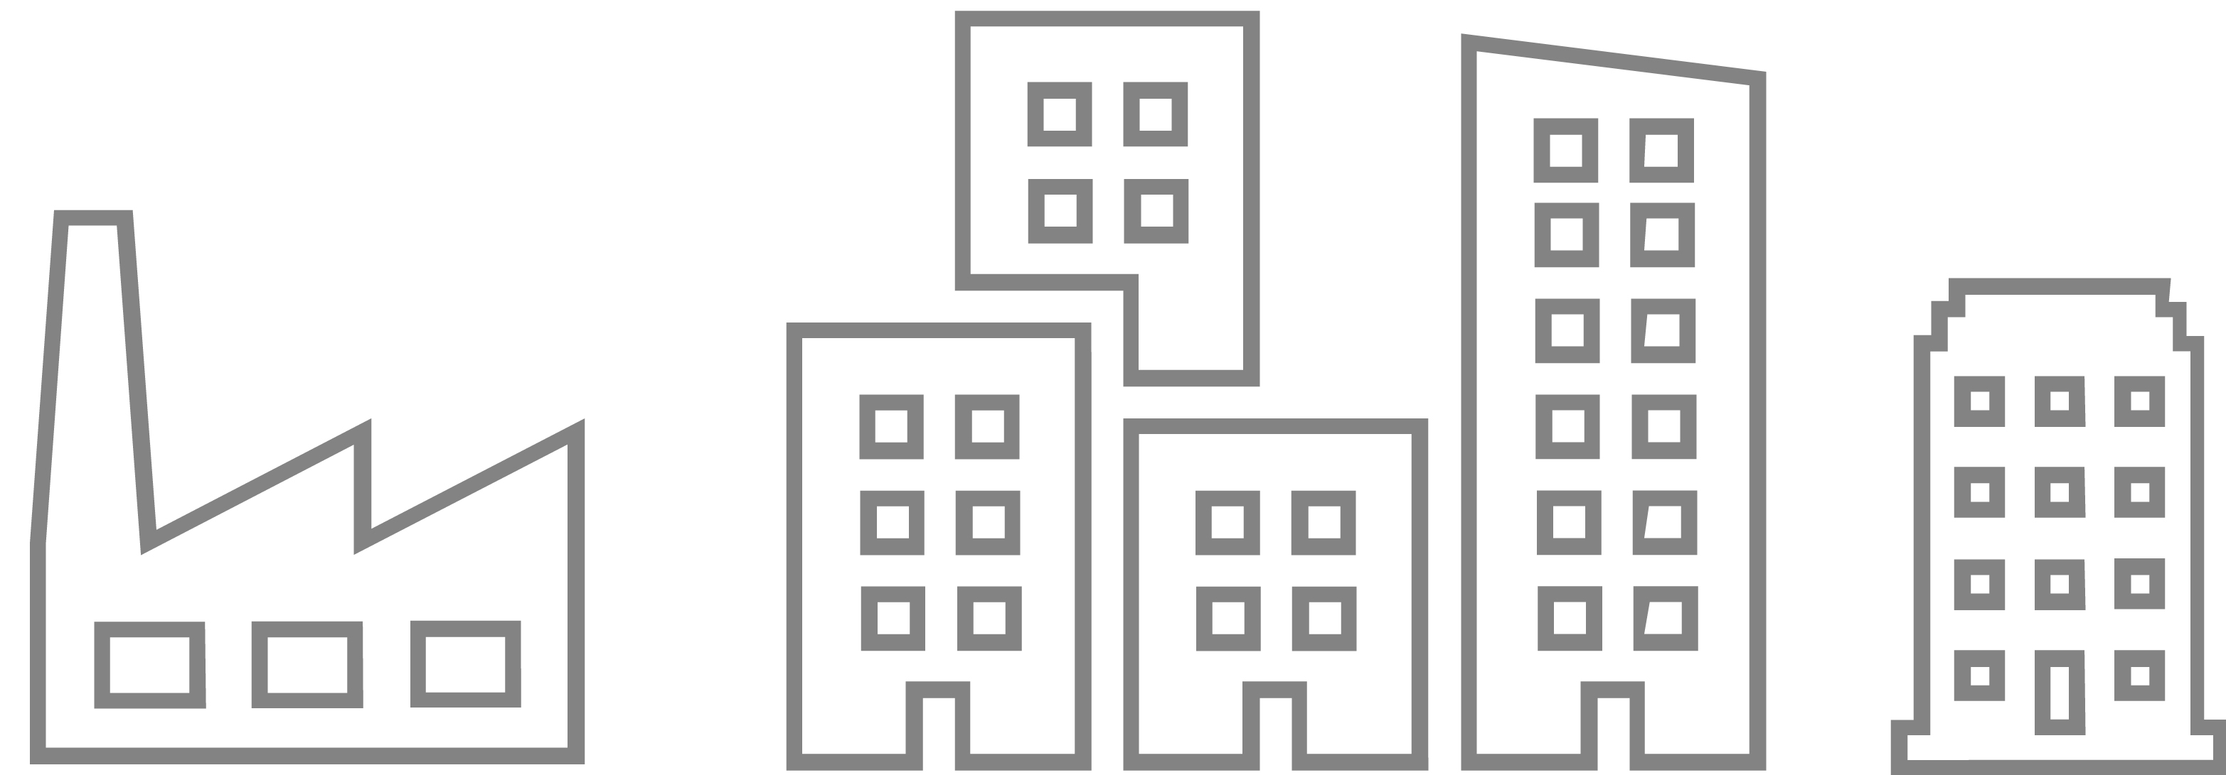
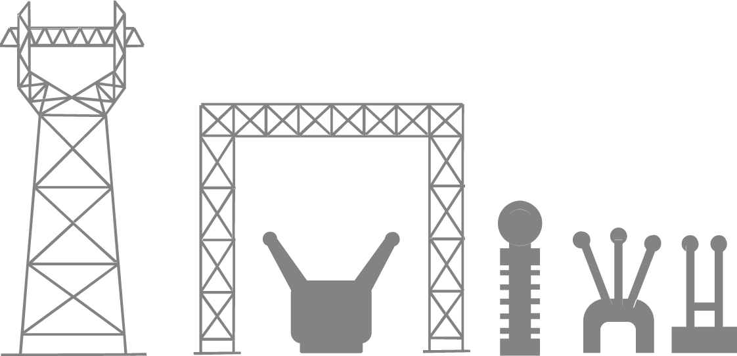


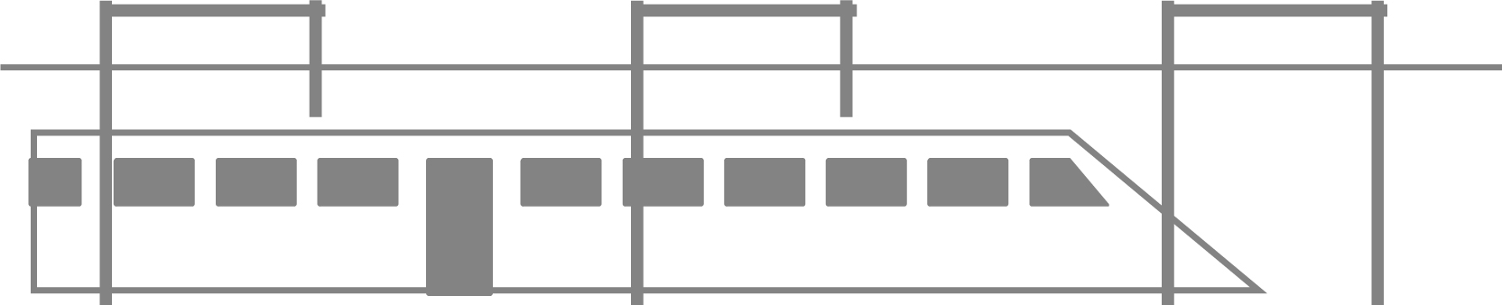

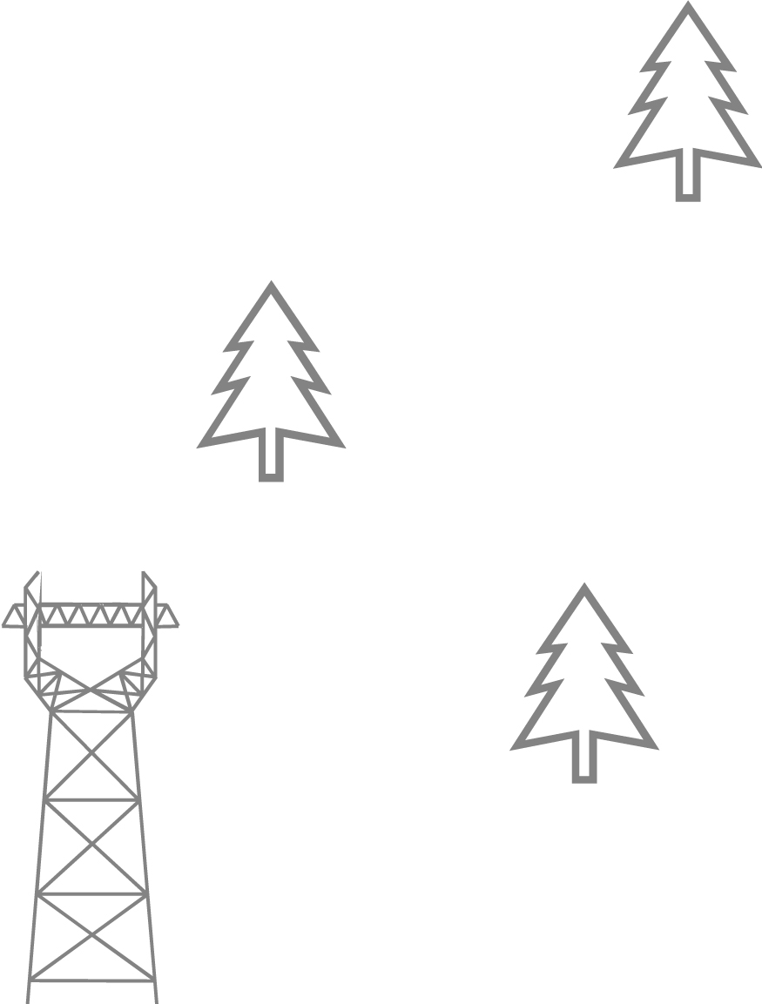
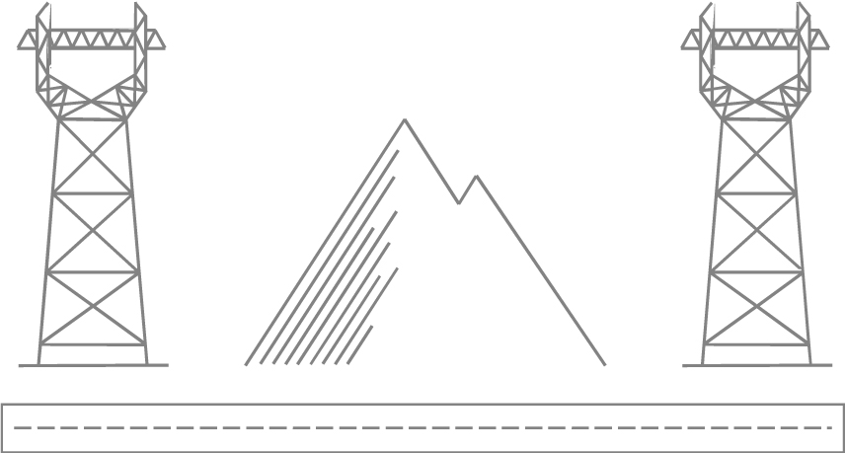
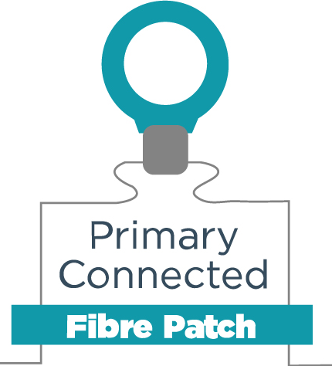
More sensors, better data, smarter decisions
SINGLE-MODE OPTICAL FIBRE
INTERROGATOR
Connected in digital or conventional substation
Complex circuit protection
Digital substations
Rail
Wide area
monitoring
Renewable generation
Mixed circuits

Slide 8
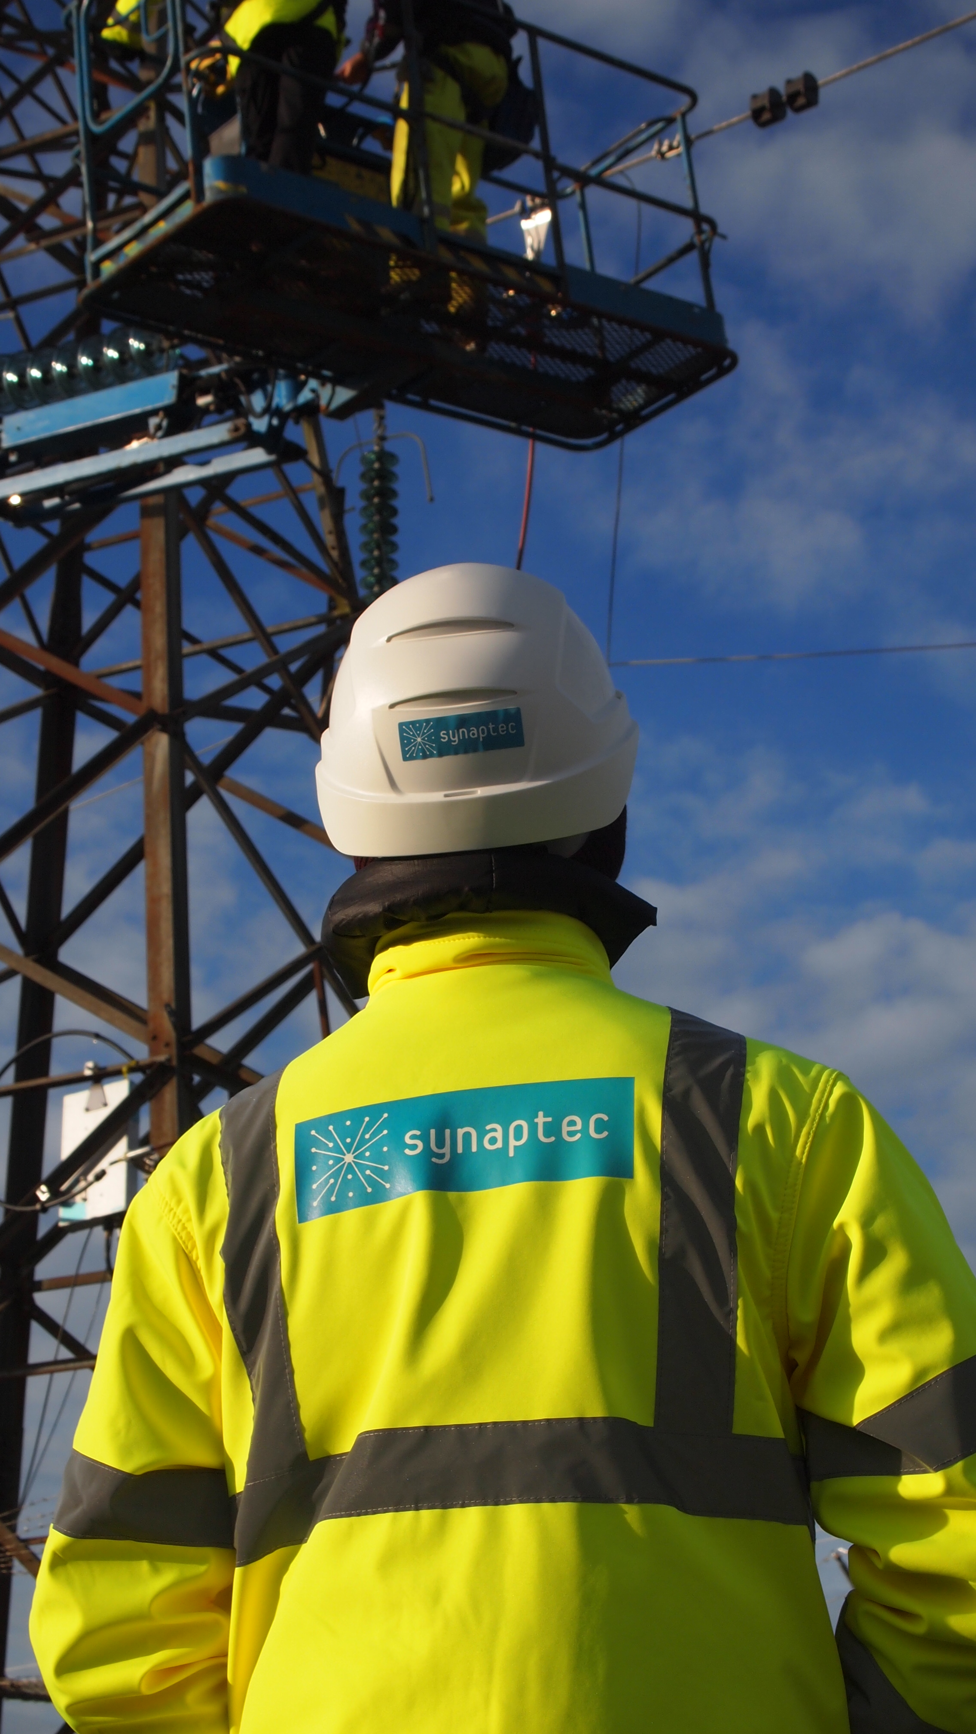
Summary
Capex
Opex
Risk
Safety
Control
Resiliency
Zero power, zero comms, zero data, zero maintenance sensors
More operational insight without traditional limitations
Protections & Earlier failure warnings for remote HV assets
to avoid outage
Safely optimised capacity and scheduled maintenance
Can we help your business?

Slide 9
Thank You

