Slide 1



RENEWABLE ENERGY INTEGRATION
Grid Stability & Cross Country Connectivity
Sanjoy Mukherjee
Executive Director (Distribution Technical)
CESC LIMITED

Slide 2



Power Sector in India at a Glance
RES, 28%
Installed Capacity
399 GW
236 GW
Thermal
47 GW
Hydro
7 GW
Nuclear
110 GW
RES*
Solar: 54 GW; Wind: 40 GW
Others: 16 GW
as on Mar’22
Hydro, 12%
Thermal, 59%
Nuclear, 2%
* RE capacity today 114 GW (28% of installed capacity); as on 30.06.2022
Evolving Generation Capacity mix (GW)
2014
14
Largely coal-based capacity expansion to meet the growing energy demand in India
2022
28
Major capacity expansion of greenfield solar capacity
Distributed generation with coal capacity growth slowing down and solar PV and wind ramping up, the share of variable renewables in installed capacity has doubled since 2014.
*All in GW
Source: https://cea.nic.in/installed-capacity-report/?lang=en

Slide 3

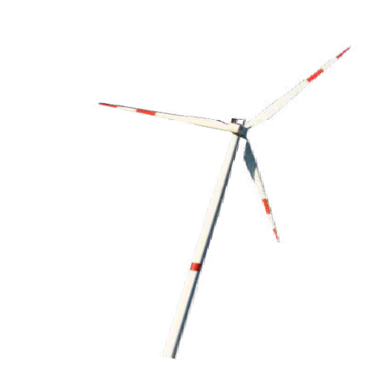
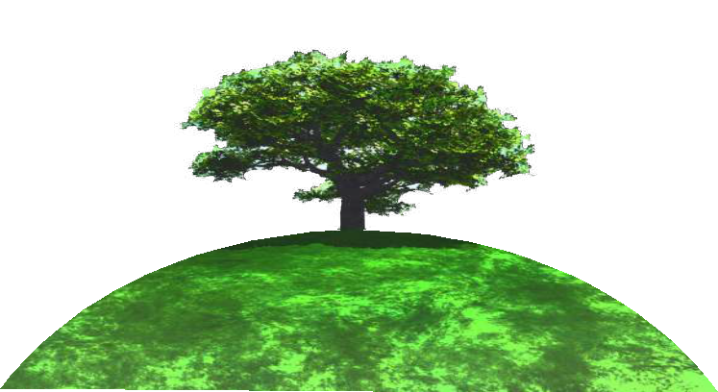
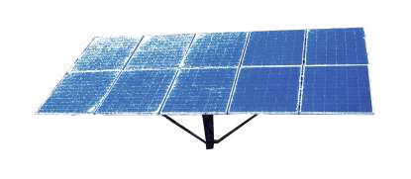
India’s RE ambitions
2022
Total RE Target 175 GW
2030
Total RE Target 500 GW
RE Target
Total RE Target by 2022
175 GW
India's non-fossil energy capacity to reach 500 GW by 2030.
Solar
100 GW
Wind
60 GW
By 2070, India will achieve the target of net zero emissions.
India will meet 50 per cent of its energy requirements with renewable energy by 2030.
*Out of 100 GW solar capacity target, 40 GW is from rooftop
Bio-mass
10 GW
Small Hydro
5 GW
31%
drop in reliance on coal
51%
Solar and wind will make up
820 GW
CEA Projection by 2030
2030
Source: https://economictimes.indiatimes.com/industry/renewables/india-keeps-renewables-target-flexible-goal-of-500-gw-green-energy-by-2030-dropped/articleshow/93357477.cms?from=mdr
https://powermin.gov.in/sites/default/files/uploads/MOP_Annual_Report_Eng_2021-22.pdf

Slide 4

Measures to Promote Growth of Renewable Energy
Transmission Planning for 500 MW of non-fossil fuel by 2030
Waiver of ISTS Transmission Charges and Losses for Solar & Wind Power
Pan-India market-based Renewable Energy Certificate (REC) Mechanism to promote renewable energy
Issuance of Renewable Purchase Obligations (RPO) Trajectory FY23 : 24.61% to FY30: 43.33%
Deepening of spot markets: Introduction of Green Day Ahead Market (GDAM) & Green Term Ahead Market (GTAM) in Power Exchanges
Procurement of Round The Clock (RTC) Power from Renewable Projects through Tariff Based Competitive Bidding
Scheme for flexibility in Generation and Scheduling of Thermal/ Hydro Power Stations through bundling with Renewable Energy and Storage Power
Green Energy Open Access >100 kW

Slide 5

RE Scenario & Projected Load Curve
Alternative scenario – installed capacity (2030): 820 GW
Thermal, 244
RES, 500
Nuclear, 7
Hydro, 69
2030
Total electricity Demand
Net electricity Demand
All India demand and net demand (for a typical day) − GW
0 2 4 6 8 10
12 14 16 18 20 22
250GW
In order to meet its net demand, India will need a ramp-up of 55−60 GW in 6 hours with RE penetration of 175 GW
200GW
~75 GW
The present capacity of thermal sources can provide 13 GW/min ramp-up capacity. Hydro generation can provide a high ramp-up (25 GW/min but generation will be subject to weather and monthly patterns
150GW
16 17 18 19 20
Hour of the day
As overall electricity demand and renewables’ share of India’s generation grows, the ramping need between 17:00 (5pm) and 19:00 (7pm) is expected to increase from ~13 GW in 2017 to over 75 GW in 2030.
Source: CEA report on ‘Flexible operation of thermal power plant for integration of RE generation’,2019

Slide 6
RE Grid Integration challenges & Recommendation
Meeting net load (high ramp-up/ramp-down)
Meeting variability and intermittency; Maintaining Grid Stability
Maintaining Minimum Load Operation of conventional generators
Challenges :
Challenges :
Recommendation
Recommendation
Additional flexible source addition (pumped storage, battery, hydro, demand side management)
Deeper short-term markets and ancillary markets
Strong enforcement of regulations like DSM regulations
Co-ordinated scheduling and despatch
Battery Energy Storage Systems:
GoI planning to float tenders for sourcing 4000 MWh battery storage, power & renewable energy
Joint operation of solar and hydro energies because of their complementary nature
Flexible power from hydro and gas, with both sources generating less during the day and more during peak hours compared to the present trend of generation
Flexible power from pump/battery storage and coal to provide peak support
Existing power market design (High long-term access [LTA]/PPA, no mature market for ancillary, short-term or capacity market)
Power Quality Issues like Voltage Sag & Swell, Harmonics, Phase Unbalancing
Challenges :
Challenges :
*Out of 100 GW solar capacity target, 40 GW is from rooftop
Recommendation
Recommendation
Improve volume, liquidity and flexibility of the power market
Design of new power market structure with key characteristics such as:
  Retail competition
  compulsory participation in exchange
  implementation of capacity market
  competitive ancillary market
Uninterruptible Power Supply (UPS)
Ferro resonant transformers
Dip correctors
Energy storage technologies
Challenges
Recommendation

Slide 7
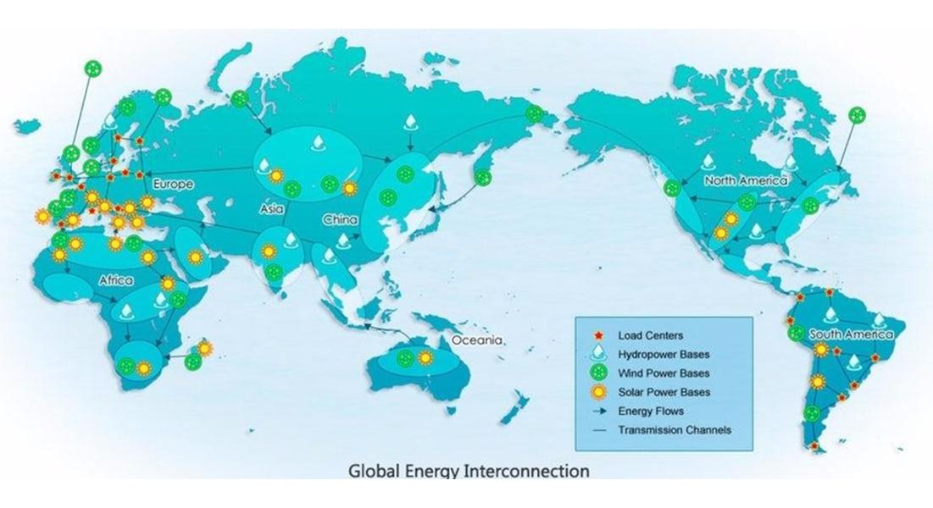
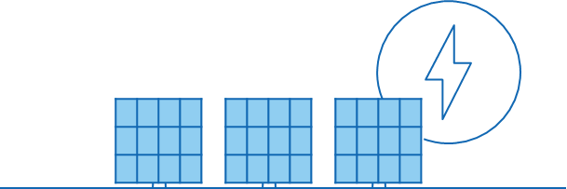

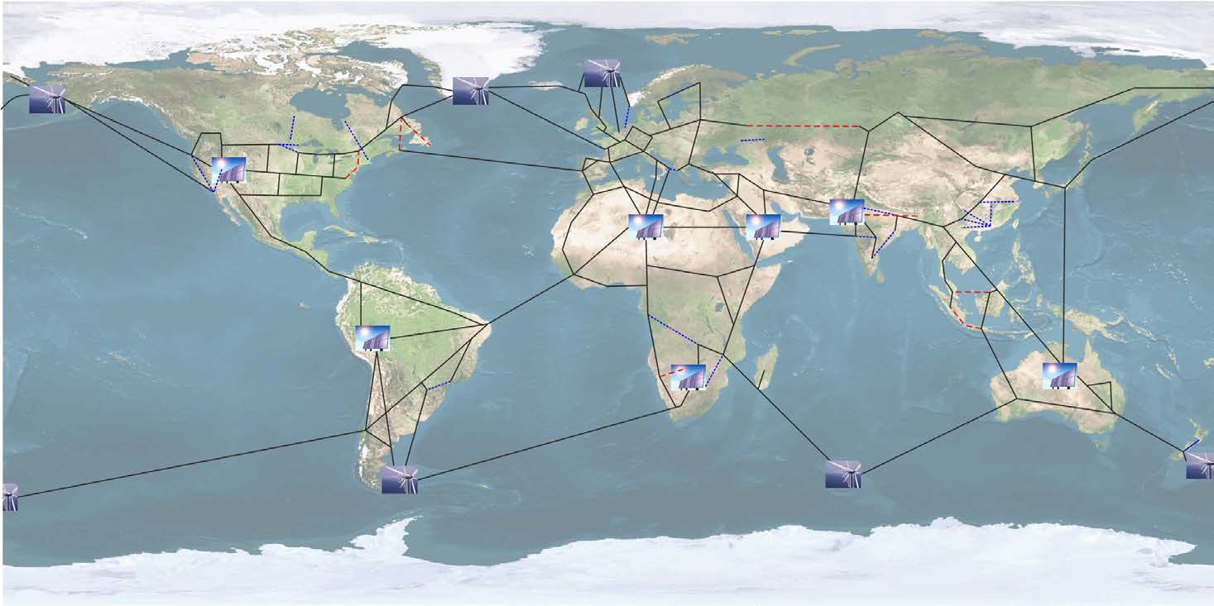
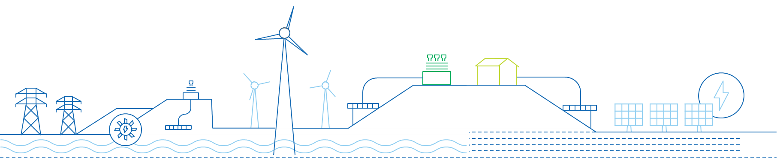
Cross Country Connectivity
Benefits
Towards a 100% Renewable Energy Future
Enhance security of supply, by increasing the diversification of energy sources
Interconnecting more grid increases reliability in supply
Interconnections decrease the need for balancing power
Less need for bulk storage
Cheap RES production over long transmission lines
RES Availability Round the Clock & Optimization of RE resources
Smoothing out electricity Supply and Demand
Boost developing economies and reduce their GHG emissions
Global Grid
India’s Vision
One Sun One World One Grid (OSOWOG)
“We have a dream called One World, One Sun One Grid. We can generate round the clock electricity from the sun as it sets in one part of the world but rises in another part. The sun never sets for the entire earth.”
Sources: S. Chatzivasileiadis, D. Ernst, G. Andersson, The Global Grid, Renewable Energy, 2013
http://theglobalgrid.info/presentations/Chatzivasileiadis_theglobalgrid.pdf

Slide 8
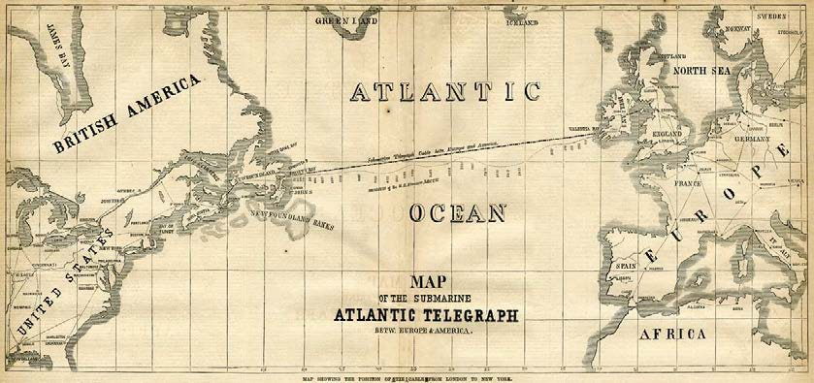
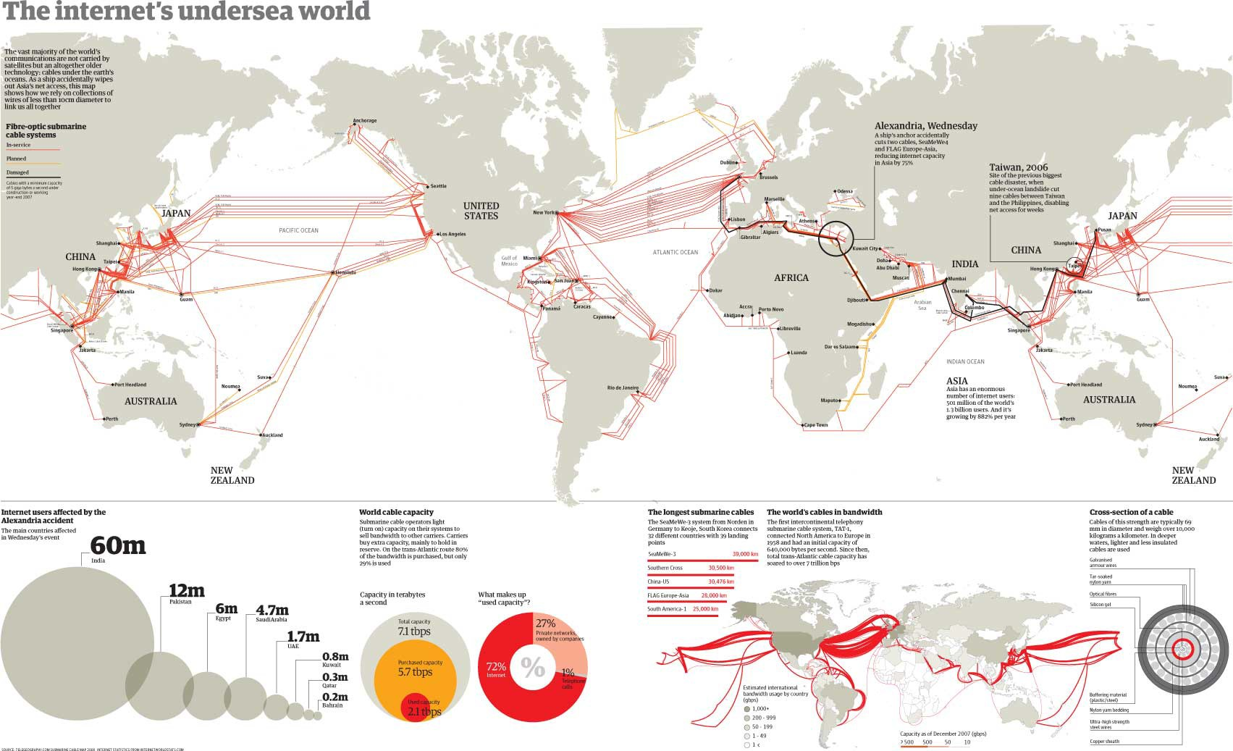
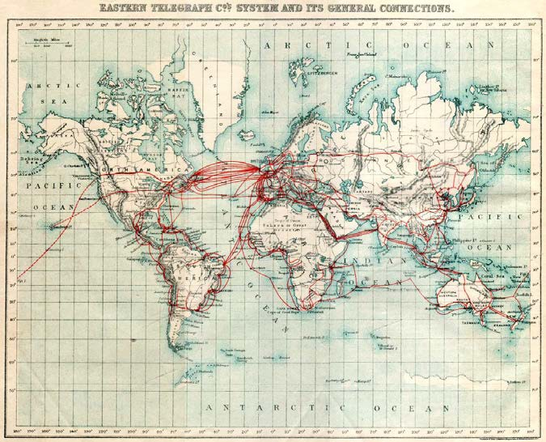
Cross Country Connectivity
The Global Grid is just a few years away
1866: First successful submarine cable
1901: Global Telegraphy Network
Now: An Intensive Undersea Internet World

Slide 9




Cross Country Connectivity
Investments
Regulatory
A Global Electricity Grid is technically feasible and can potentially be economically competitive
Operation
Technical
Key Challenges
Source:
https://blog.forumias.com/discom-sector-in-india-challenges-solutions-explained-pointwise/#:~:text=High%20AT%26C%20losses%3A%20The%20precarious,subsidy%20support%20from%20state%20governments.
http://theglobalgrid.info/presentations/Chatzivasileiadis_theglobalgrid.pdf

Slide 10




Thank You!!

