Slide 1
India’s Electricity Sector-Prospects for Regional Cooperation
Shakuntala D.Gamlin

Slide 2
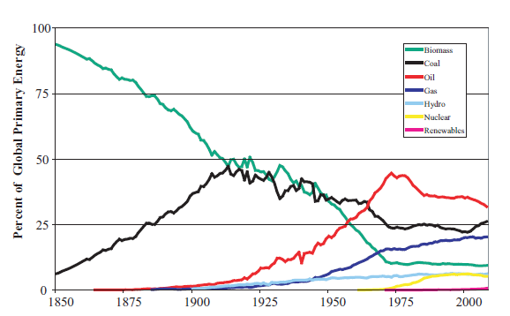
The Industrial Revolution led an Explosive Development Path
  Reliance on muscle power and traditional biomass was replaced mostly by Fossil Fuels
  Now World is exploring ways for carbon free energy
Source: Nakicenovic, N Grubler,A , McDonald, A (1998) IIASA and World Energy Assessment 2012

Slide 3
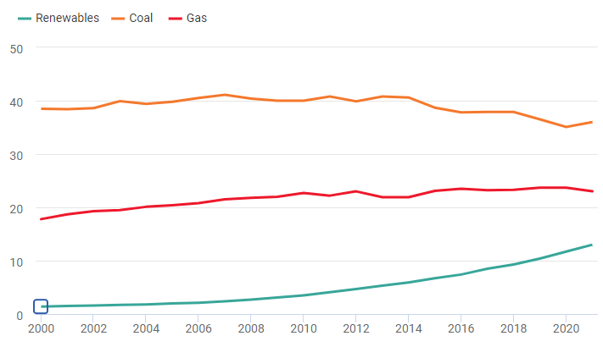
The share of renewables in global power generation
Source: BP Stat 2022

Slide 4
India : Energy and Emissions 2021-A Snapshot
 | Primary Energy (Exajoule) | Electricity (TWh) | Co2 emission from energy (MMT) | Per Capita
 |  |  |  | Energy (GJ) | Electricity (KWh) | Emissions from energy (tonne)
World | 595.15 | 28466.3 | 33884.1 | 76 | 3603 | 4.3
USA | 92.97 | 4406.4 | 4701.1 | 280 | 13353 | 14.2
Indo Pacific | 272.45 | 13994.4 | 17734.6 | 64 | 3270 | 4.1
China | 157.65 | 8534.3 | 10523 | 109 | 5766 | 7.1
India | 35.43 | 1714.8 | 2552.8 | 25 | 1234 | 1.8
Source: BP Stat Review 2022

Slide 5
India Electric Installed Capacity – June 2022
404 GW
114 GW
Source: Ministry of Power

Slide 6
India aims to achieve Carbon Neutrality by 2070
At the 26th Conference of Parties (COP26-Gloscow December 2021), Prime Minister Narendra Modi outlined the strategy of Panchamrit or ‘five elixirs’:-
Short-term goals 2030,
  non-fossil energy capacity to 500 GW
  meet 50 percent of energy requirements from renewable energy
  reduce the total projected carbon emissions by one billion tonnes w.r.t 2021 level
  reduce the carbon intensity of its economy by more than 45 percent
Long term goal 2070
  by the year 2070, India will achieve the target of Net Zeronet-zero carbon emissions
Later, on 3 August 2022, Union Cabinet approved updated Nationally Determined Contributions (NDCs-initial NDCs were submitted to UNFCCC in October 2015) by 2030:-
  reduce Emissions Intensity of the GDP by 45 percent by 2030, from 2005 level; and
  achieve about 50 percent cumulative electric power installed capacity from non- fossil fuel based energy resources by 2030.

Slide 7
Central Electricity Authority (CEA )’s optimal generation mix projections 2030
Source | Capacity |  | Generation
 | GW | Percentage capacity | GWh | Percentage generation
Hydro (including imports) | 66 | 8.1 | 207 | 8.2
Pump storage | 10 | 1.2 | 4 | 0.2
Coal | 267 | 32.7 | 1393 | 55.3
Gas | 25 | 3.1
Nuclear | 19 | 2.3 | 113 | 4.5
Solar | 280 | 34.3 | 801 | 31.8
Wind | 140 | 17.1
Biomass | 10 | 1.2
Absorption of non-hydro renewables into the grid will require battery/energy storage capacity of 27 GW/108 GWh.

Slide 8
Renewable Purchase Obligations (RPOs) 2030
RPOs notified in July 2022 mandate 43 per cent renewables share in electricity mix.
These RPOs are primarily aimed to achieve 500 GW renewable power capacity by 2030.
Year | Wind RPO | HPO | Other RPO | Total RPO
2022-23 | 0.81 | 0.35 | 23.44 | 24.61
2023-24 | 1.6 | 0.66 | 24.81 | 27.08
2024-25 | 2.46 | 1.08 | 26.37 | 29.91
2025-26 | 3.36 | 1.48 | 28.17 | 33.01
2026-27 | 4.29 | 1.8 | 29.86 | 35.95
2027-28 | 5.23 | 2.15 | 31.43 | 38.81
2028-29 | 6.16 | 2.51 | 32.69 | 41.36
2029-30 | 6.94 | 2.82 | 33.57 | 43.33
For energy storage, which has been introduced for the first time, the targets are in the range of 1-4 per cent during 2023-2030. This would be met through solar and wind power projects with energy storage

Slide 9
India Energy -some observations
The increase in India’s demand for energy is driven by economic growth in general and urbanization, rising incomes, and industrial activity in particular-
  electricity constitutes around 17 percent of final energy consumption- growing at around 6 percent per annum
  major energy-consuming sectors - industry, household, transport, and agriculture see a rise in demand
  demand for energy is price sensitive
Accelerated deployment of renewables is driven by
  Falling cost of renewables
  Falling cost of energy storage
  Climate change mitigation commitments- NDCs
  RPOs
Use of green hydrogen(from renewable sources such as solar, wind etc.) for transport, fertiliser and other industrial applications - National Hydrogen Energy Mission launched
India exploring prospects for exporting green hydrogen

Slide 10
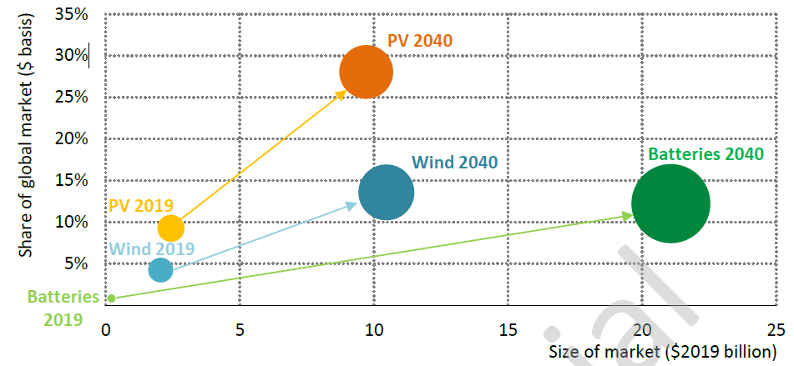
India’s market size and global share in clean energy technologies today and in 2040
Source: IEA’s India energy Outlook December 2020

Slide 11
The SAARC Framework Agreement for Energy Cooperation (Electricity)
Signed at eighteenth SAARC Summit in November 2014 recognizes:-
  cross-border electricity exchanges and trade;
  Cross border investment in electricity sector; and
  Common standards and specification from electricity sector
  It contains guiding provisions for:
  infrastructure building and management of cross-border power interconnections,
  transmission services agreement,
  electricity grid protection system,
  transmission access,
  trading arrangements including pricing and duty structure, and
  overall intergovernmental regulatory requirements.

Slide 12
Major cross-border transmission developments
Country |  | Progress of Cross-border Interconnections
Bhutan |  | Signed a Framework Agreement in 2009, to develop 10GW capacity in Bhutan. Grid reinforcement to evacuate power from various HEPs are in progress. Currently, around 1500 MW being imported. A string of 132kV, 220kV and 400kV lines in the Southwestern border regions of Bhutan are used to evacuate power .
Bangladesh |  | A 400kV, 30 km double-circuit HVDC line from Bheramara (Bangladesh) to Baharampur (India) and a 500 MW 400/230 KV back-to-back HVDC substation established in 2013. Other bilateral connections planned include a 400kV DC line between Surjyamaninagar (India) and Comilla (Bangladesh) for transfer of 100MV from Palatana power project in Tripura, India
Nepal |  | About 12 interconnections through 11kV, 33kV and 132 kV lines connect the Southern Terai region of Nepal with bordering Indian states, enabling access to several existing and developing hydropower projects in Nepal. An integrated Master Plan envisions power evacuation from about 280 hydropower projects in Nepal to India, totaling 45GW installed capacity, through high capacity cross-border links.
SriLanka |  | The proposed India-Sri Lanka 400kV HVDC grid interconnection involves construction of a HVDC connection between Madurai (India) to Anuradhapura (Sri Lanka). The link has a proposed length of 387 km including 127 km of submarine cables with an initial capacity of 500 MW and has future potential of 1000 MW

Slide 13
One Sun One world One grid Initiative
Hon'ble Prime Minister Modi, at the First Assembly of the International Solar Alliance (ISA) in 2018, called for connecting solar energy supply across borders, with the vision of 'One Sun One World One Grid' (OSOWOG)
The concept behind the OSOWOG is that ‘The Sun Never Sets’ and is a constant at some geographical location, globally, at any given point of time
The implementation of OSOWOG is planned in three phases- first Phase, the Indian Grid interconnects with the Middle East, South Asia, and Southeast Asia. Interconnected with the African power pools in the second Phase. A global interconnection to achieve the OSOWOG vision in its final phase
The initiative is expected to realize “three transitions” of energy development. The transition of energy production from fossil fuel to clean energy dominance. The transition of energy allocation from local balance to cross-border and global distribution. And the transition from coal, oil, and gas in energy consumption to electric-centric consumption
At COP 26 , ISA and UK jointly launch the global “Green Grids Initiative – One Sun One World One Grid
The Roadmap is under preparation

Slide 14
Cooperation Opportunities
Investments | RE power projects manufacturing of RE products, energy storage/ batteries; and hydrogen energy supply chain support to start-ups, including through venture capital, mezzanine finance, angel investments
R&D and Training | describing regional standards and specifications regional research and development regional laboratories for testing for standards and certifications training
Grid management | Frequency management, digitized metering, Joint venture with Indian manufacturers
Trading | regional Trade in electricity
Services | Technical support and consultancy services

Slide 15
Thank You

