Slide 1
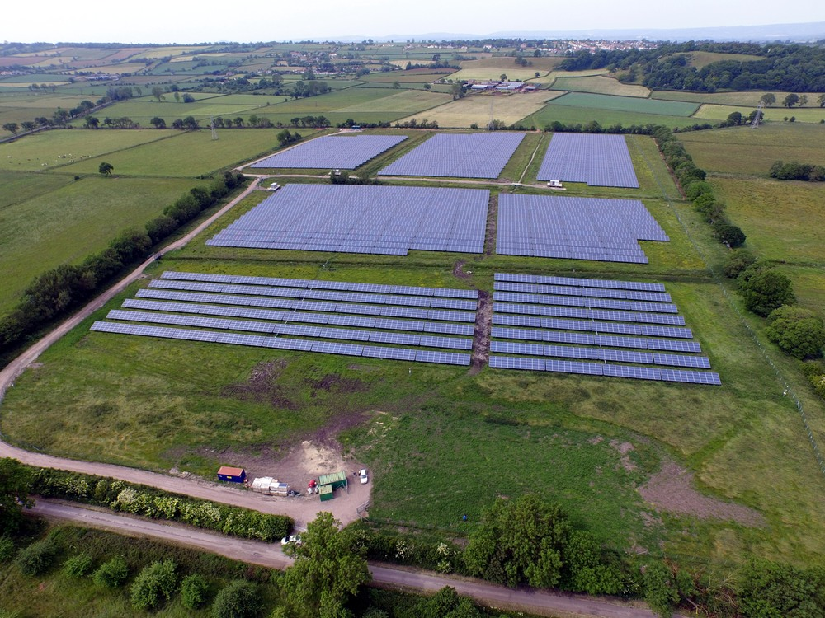


GreenEnco Ltd
__Maximising Asset Values__
Risk Management & Optimisation of Solar and Energy Storage Assets
Sourav Das
Country Manager - India
www.greenenco.co.uk
5.5 GW || 5 Years || 4 Continents || 15 Countries

Slide 2

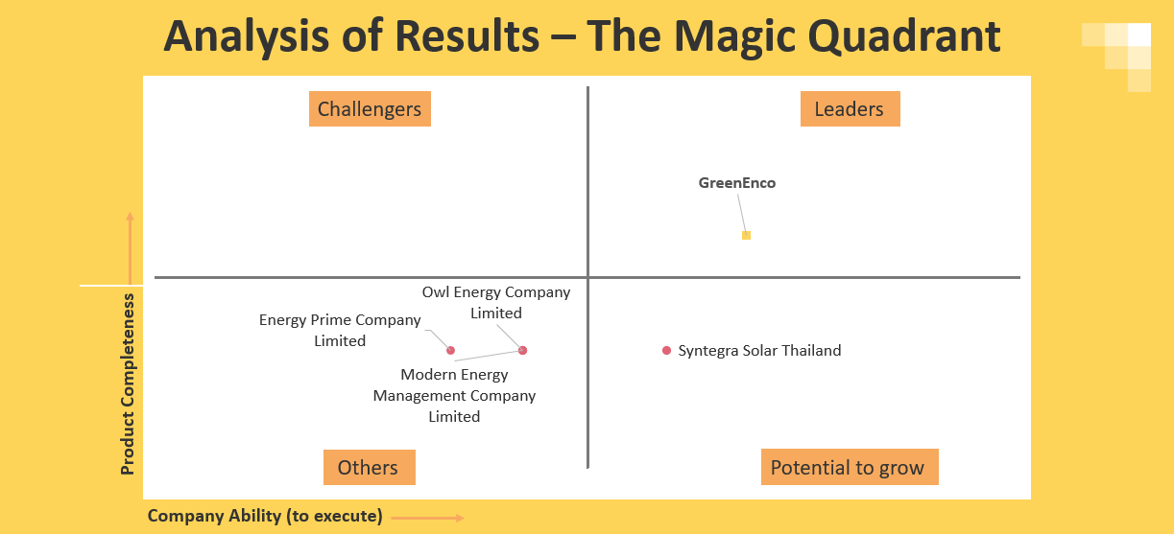
GreenEnco Market Position
An independent market research by Gemserv for SE Asian markets

Slide 3

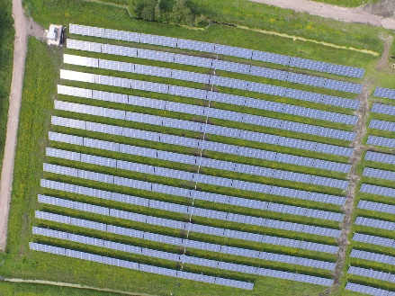
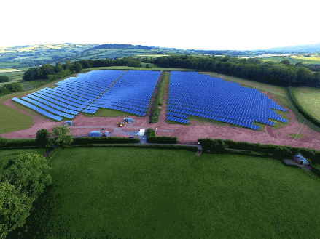
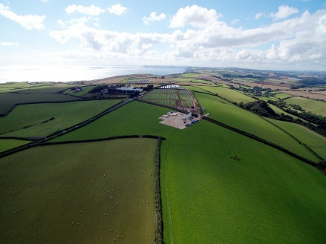
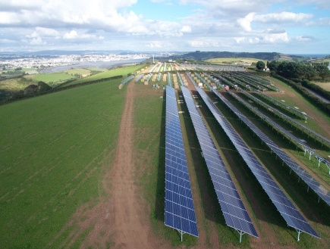
Investment Risks
Operational Assets
Generation loss – Lack of data driven decision-making process
New Development
LCOE (CAPEX & OPEX) has become increasingly sensitive in the competitive tendering process
Reactive O&M - Lack of response from an O&M contractor and missing proactive O&M services
Attitude - Too comfortable in the traditional way of doing things
Robust energy yield estimation
Dynamic nature of supply chain of solar PV system components
Loss of Revenue & Asset Devaluation
Minimising the Project Return

Slide 4
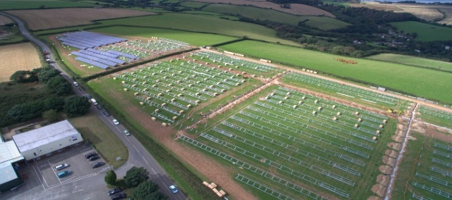
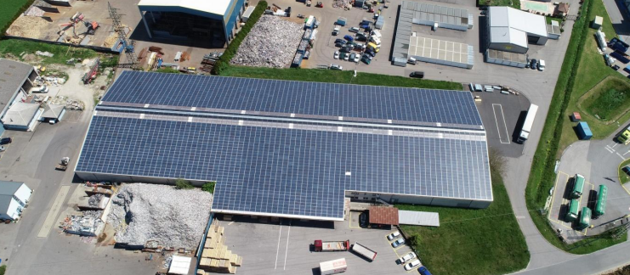
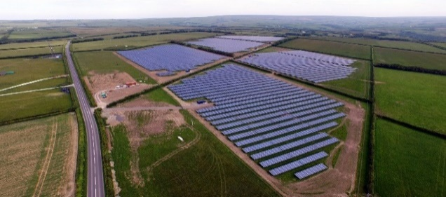






GreenEnco Solutions
Our 360º Innovative Optimisation Solutions are helping to increase the value of the assets for
Developers || Asset Owners || Asset Lenders || Development Corporation || M&A Advisors || IPPs
Technologies
Services
Rooftop PV
Utility PV
EV Charging
infra
PV + Battery
Battery Storage
PV + Wind
Floating PV
Asset Optimisation
Technical Due Diligence
  Asset performance Management
  AI and ML algorithms
  Optimise generation
  Owners/lenders engineering
  Energy yield and irradiance assessment
  Construction audit (QC/QA)
Design Optimisation
Floating Solar
  Designs for building permits
  Value engineering
  Detailed design
  Due Diligence on floater & anchoring system
  Additional generation study
  O&M scope review and H&S
Energy Storage
Re-Powering
  Energy storage sizing
  Solar and storage solutions
  Grid curtailment & storage solutions
  PV module - Mechanical and electrical match
  Inverter – central / string
  LV and HV equipment

Slide 5
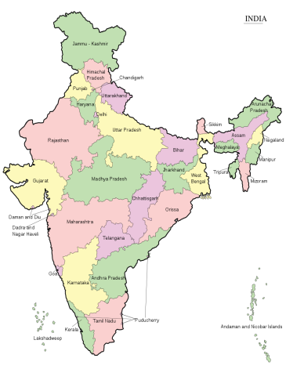
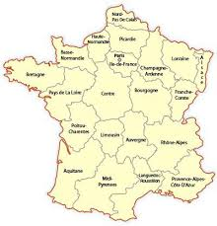
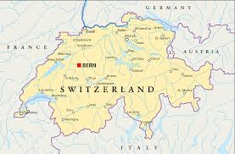


PV Asset Performance Management (PVAPM)
A systematic approach using in-house developed Artificial Intelligence (AI) & Machine Learning (ML) algorithms, driven by human intelligence
PV Asset Performance Management (PVAPM)
____________Asset Optimisations____________
System Efficiency Improvements
Equipment Condition
Monitoring - Health Check
Process Optimisation
Decision Making
Case Study 1 & 2
Location: India
Capacity: 2 x 50MW
CoD: Q3 2017
Case Study 3
Location: France
Capacity: 8MW
CoD: Q1 2016
Case Study 4
Location: Switzerland
Capacity: 1MW (Rooftop)
CoD: Q3 2013
Francesco Girardi
Senior Director, Bluefield Partners, UK
Julien Waehlti
Asset manager Smart City, Romande Energie
Switzerland
"This is a very interesting approach to move towards more active management of assets. I think definitely it is a big move towards more integration of machine learning algorithms and artificial intelligence, as Dr Jyoti mentioned most of the asset owners are driven on looking after their assets with the manual tools also it is a very time-consuming procedure... I think these methodologies are crucial to ensure that we can increase the confidence of the investors that an investment will meet their expectation."
“GreenEnco’s approach and expertise helped us pinpoint technical issues on a plant that were eluding us. The report they provided made the decision making and the implementation of required measures simple and efficient.”

Slide 6
Average Generation Improvement after GreenEnco PVAPM Process India
Average Generation Improvement after GreenEnco PVAPM Process Europe
Location | Commercial Operation Date | Capacity | Generation Improvement
India | 2017 | 2x 50 MWp | 8%
India | 2017 | 2x 65 MWp | 16%
India | 2018 | 50 MWp | 6%
India | 2017 | 10 MWp | 10%
Average age of these plants when APM was performed | 1.75 years | Average generation improvement after APM process | 10%
Location | Commercial Operation Date | Capacity | Generation Improvement
France | 2016 | 8 MWp | 10%
UK | 2015 | 20 MWp | 6%
Switzerland | 2013 | 1.3 MWp | 8%
Average age of these plants when APM was performed | 6 years | Average generation improvement after APM process | 8%
Signed an MOU with Telangana State Renewable Energy Development Corporation Ltd., (TSREDCO), India
Signed an MOU with Arti Enerji (Independent Power Producer), Turkey

Slide 7



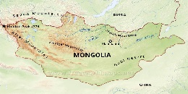


Technical Due Diligence
_____Owner’s Engineering_____
SERVICES
Feasibility
&
Tender
Project management, Procurement & advisory
H&S and Quality Assurance
Construction Risk Optimisation
Project Development
Asset Performance Management
Engineering
&
Design Approval
Operational Risk Optimisation
Yield Assessment
Operational Project Acquisition
Case Study 1
Case Study 2
Location: UK
Capacity: 2400 MW
Location: Denmark
Capacity: 100 MW
Case Study 3
Case Study 4
Location: Netherland
Capacity: 41 MW
Location: Mongolia
Capacity: 30 MW
Case Study 5
Case Study 6
Location: India
Capacity: 10 MW
Location: New Zealand
Capacity: 235 MW

Slide 8
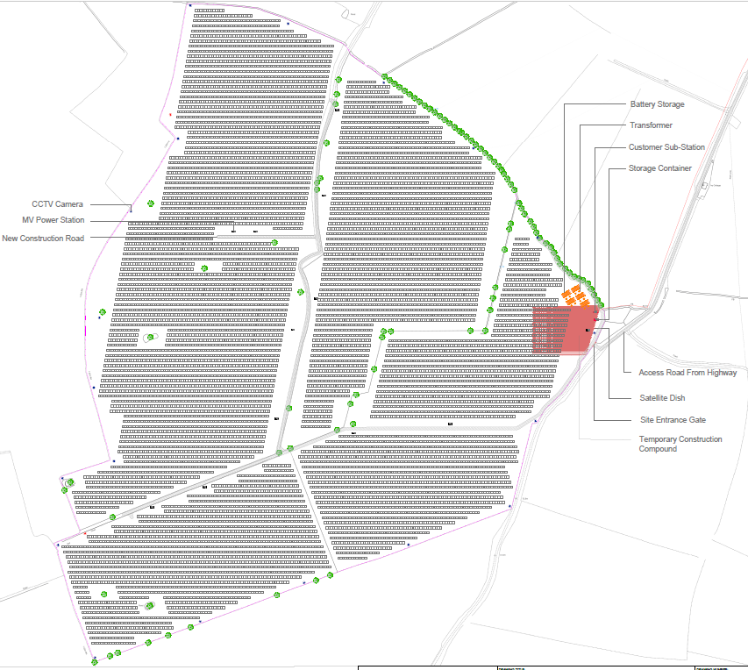
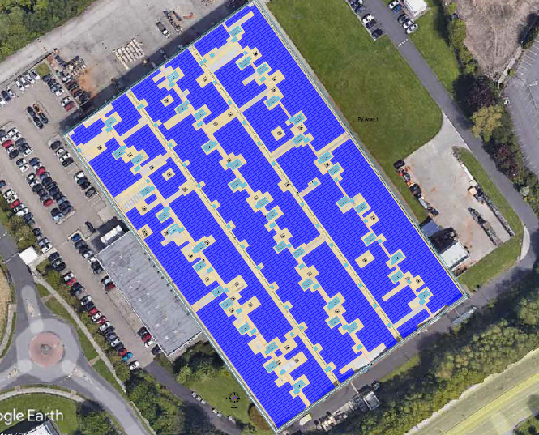
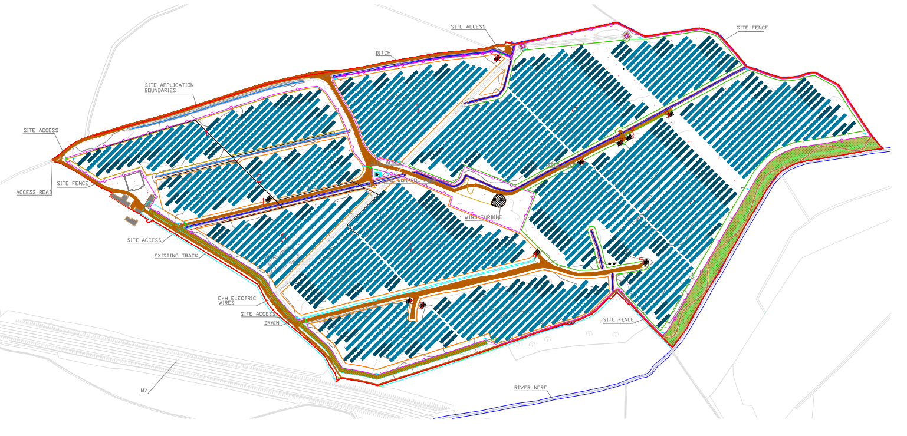
Design Optimisations
____Value Engineering____
360° system design optimisation
a) In-house design tool
b) AutoCAD
c) Virto Solar (3D modelling)
d) SketchUp
e) PVSYST
1. Components selection
i. Module
ii. Inverter
2. System voltage level
3. System configuration
1. Mounting structure configuration
2. Land topography & shadow
analysis
3. Land utilisation
1. Cables and connectors selection
2. Inverter-transformer
configuration
3. Switchgear configuration
1. All Civil scopes
2. H&S consideration
3. Construction management and
O&M consideration
Case Study 1
Case Study 2
Case Study 3
Location: UK
After Optimisation:
    49.99 MW
  Before Optimisation:
    46 MW
Location: UK
After Optimisation:
    1.7 MW
  Before Optimisation:
    1.1 MW
Location: Ireland
After Optimisation:
    34 MW
  Before Optimisation:
    29 MW
GreenEnco design optimization solutions
  help improving LCOE
  help overcoming the challenges of cost and risk
  help decision making challenges of irradiance and energy yield assessment
  help managing the challenges of component supply chain risks.

Slide 9
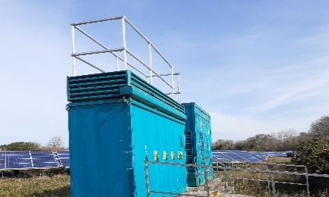
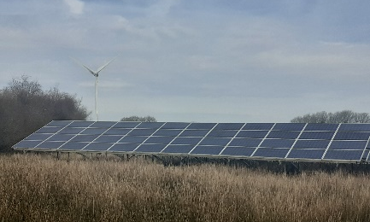
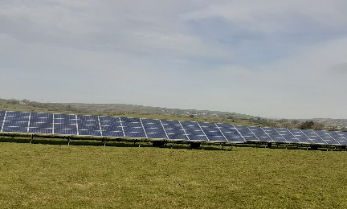
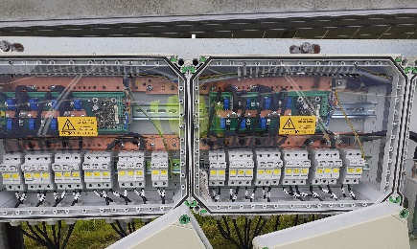
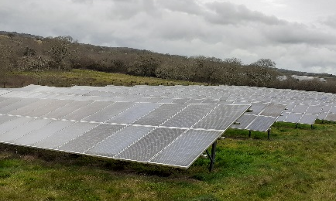
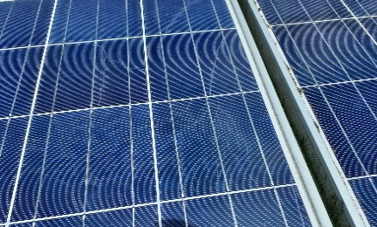
Re-powering of Solar Assets
__Life Extension__
We focus on Technical – Commercial – Compliance - Interface with existing infrastructure (DC & AC):
The mechanical infrastructure of the existing module mounting system
Existing string configuration and the maximum system voltage level
Conditions of the existing modules, DC string cables, DC string combiner box
Condition of the inverter and transformer
MPPT voltage range of the existing inverter
Matching specifications of existing LV and HV equipment of the system
Minimise the change interface and onsite work
Inverter grid code compliance
Location: UK
Capacity: 5 MWp
Module: Poly crystalline (260 Wp)
Inverter: Central
Repowering inverter with matching electrical parameters.
Location: UK
Capacity: 10 MWp
Module: Poly crystalline (245 Wp)
Inverter: Central
Repowering inverter with matching electrical parameters
Location: UK
Capacity: 5 MWp
Module: Poly crystalline (260 Wp)
Inverter: Central
Repowering inverter with matching electrical parameters
Location: UK
Capacity: 8 MWp
Module: Poly crystalline (265 Wp)
Inverter: Central
Repowering inverter, string combiner box and transformer with matching electrical parameters.
Location: UK
Capacity: 5 MWp
Module: Poly crystalline (245 Wp)
Inverter: Central
Repowering module with matching mechanical and electrical parameters
Location: UK
Capacity: 5 MWp
Module: Poly crystalline (260 Wp)
Inverter: Central
Repowering module with matching mechanical and electrical parameters

Slide 10
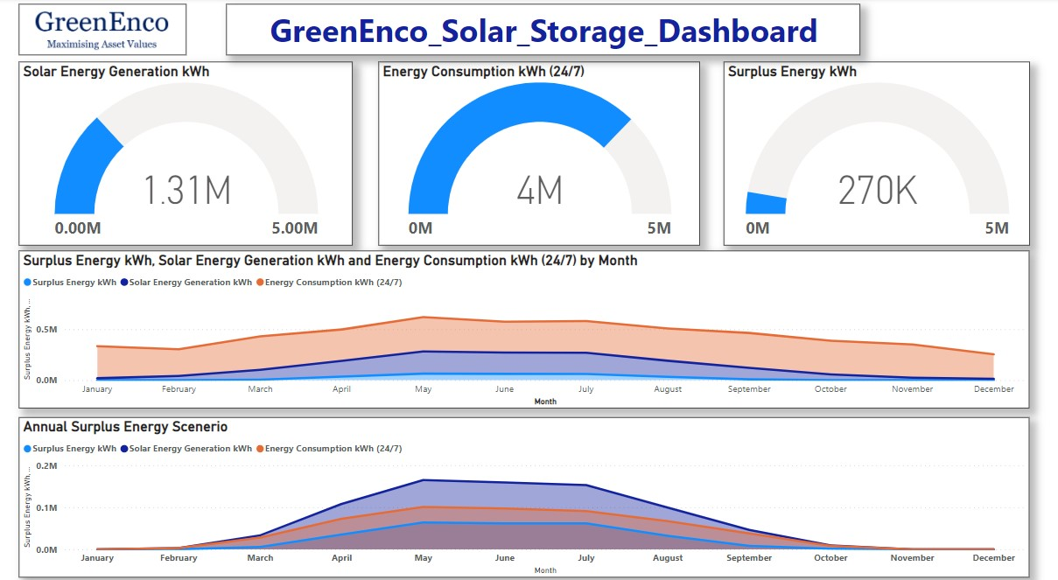
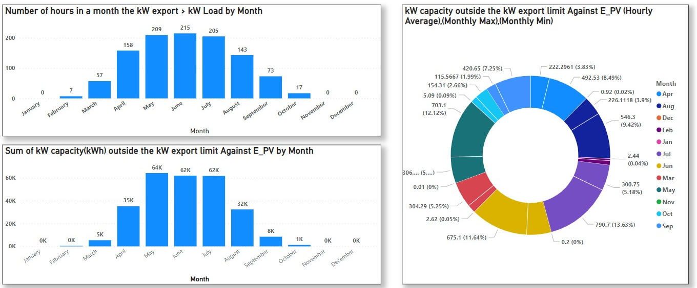
Techno-commercial tool for captive project
Solar and Energy Storage Solutions

Slide 11
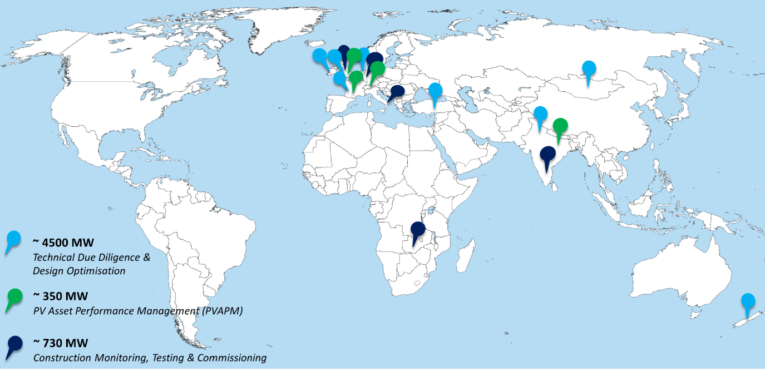



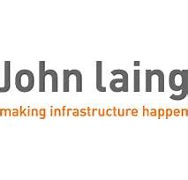












5.5 GW || 5 Years || 15 Countries || 45 Partners
Investors
Developers
Asset Owners/Managers

Slide 12
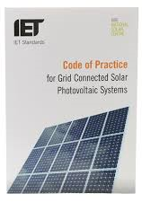
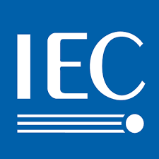





Why GreenEnco?
GreenEnco team has cumulative experience over 10 GW utility scale solar PV projects (EMEA, APAC & USA)
GreenEnco team has delivered techno-commercial due diligence of ca £600m
The founder is
  a co-author of the UK Solar Standard - “IET Code of Practice for Grid Connected Solar Photovoltaic Systems”.
  member of both BSI and IEC international standard committees
Our unique Artificial Intelligence (AI) and Machine Learning (ML) algorithms demonstrated on average 10% generation gain of a 300 MW operational solar portfolio in India
  resulted £20m financial benefit – FINANCIAL IMPACT
  33,000 Tonnes of CO2 offset – CLIMATE IMPACT
GreenEnco has been identified as one of the high potential UK SMEs
  Enlisted as one of the “UK-India Green Business Portfolio” companies
GreenEnco has signed MOUs with Telangana State Renewable Energy Development Corporation Ltd., (TSREDCO), India (GreenEnco Is To Optimize The Generation Of Solar Assets By Using AI And ML Driven Asset Performance Management (APM) In The State Of Telangana – SolarQuarter)
Supported by
Innovation agency of
UK Govt

Slide 13
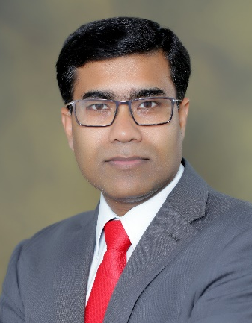

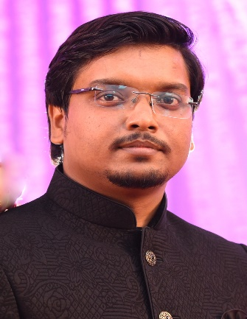
Management Team
Dr Jyoti Roy
Founder & CEO
Dr Somali Roy
CFO
Mr. Sourav Das
Country Manager, India
Jyoti is the founder of GreenEnco. He is an advisor of some key energy organisations in the UK and India. Jyoti has a PhD and Master's degree in solar energy and a Bachelor of Technology in Manufacturing Engineering. He has executed over 8 GW solar PV projects in the last 17 years across the PV project lifecycle in EMEA, Asia and USA. He has performed techno-commercial due-diligence of ~£300m M&A deal in the new built & secondary solar market.
He is a co-author of the UK solar standard – IET Code of Practice for the Design, Installation and Operation of Solar Photovoltaic Systems and a committee member of IEC and BSI standards. He was a finalist for the Great British Entrepreneur Award, 2021 and received the Glory of India Award in 2010.
Somali is the Director of GreenEnco. She has a PhD, Master's and Bachelor's degree in Mathematics. She has over 10 years of experience managing the financial management and sales strategy of an SME company in India before co-founding GreenEnco. She was a finalist for the Great British Entrepreneur Award, 2021.
She is responsible for the company strategy, policies and financial management of GreenEnco and supports solar PV performance optimisation by diagnostic analytics & predictive analytics.
Sourav is the Country Manager - India and a Sr Consultant at GreenEnco. Sourav has a Bachelor of Technology in Electrical Engineering and currently pursuing MBA in strategy and financial management. He has over 9 years of experience as a consultant and system designer of solar PV projects. He has worked in private and govt organisations, including West Bengal Renewable Development Agency (WBREDA), West Bengal India and performed a range of due diligence works in the utility-scale solar and commercial & industrial projects in India.
He is responsible for sales strategy and business development in India and South-East Asian markets. He also leads the system design engineering for GreenEnco's global operation.

Slide 14
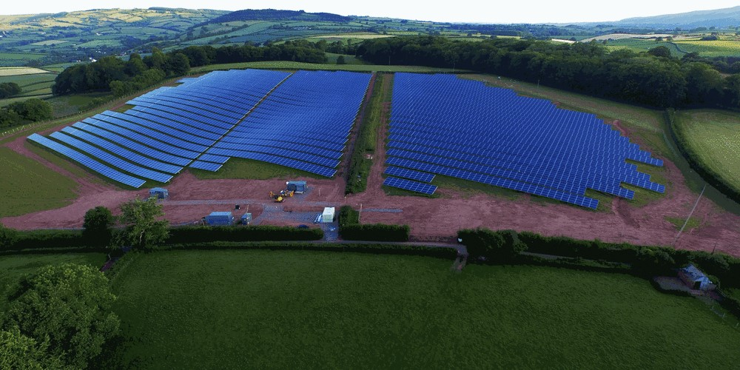

Contact us
GreenEnco Limited
www.greenenco.co.uk
642 Aghor Saroni
Rajpur, Kolkata
700149
Email: sdas@greenenco.co.uk
3 Allington Road
Harrow, London
HA2 6AJ
Email: info@greenenco.co.uk
Disclaimer
This proposal and the content is the sole property of GreenEnco Ltd and should be maintained with strict confidentiality.
GreenEnco accepts no responsibility or liability for the consequence of this document being used for a purpose other than the purposes for which it was commissioned.
We will not be liable to you in respect of any business losses, including without limitation loss of or damage to profits, income, revenue, use, production, anticipated savings, business, contracts, commercial opportunities or goodwill. GreenEnco approval is required before sharing any content of this document to others who are not part of this program.

