Slide 1
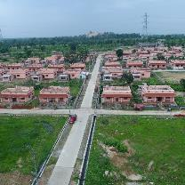
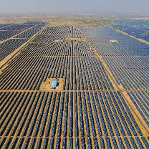
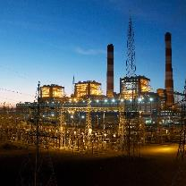

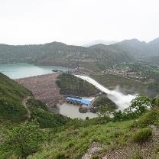
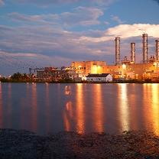
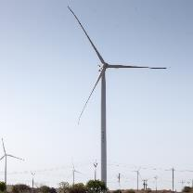
NTPC R&R Colony, Darlipali
NTPC Bhadla
NTPC Kudgi
Energy Transition for Net Zero:
Global Scenario, Challenges and Way Forward
Dr. Vijay Prakash,
General Manager (Engg. Services)
NTPC Koldam
NTPC Kayamkulam
NTPC Rojmal
Follow us on:
/ntpc1
/ntpcltd1
/ntpclimited
/Company/ntpc
/ntpclimited

Slide 2

Global Warming: The Biggest Challenge Before Power Sector

Slide 3
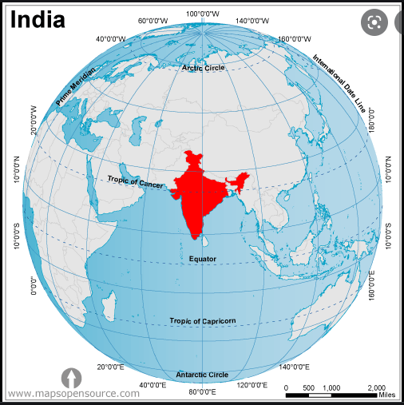
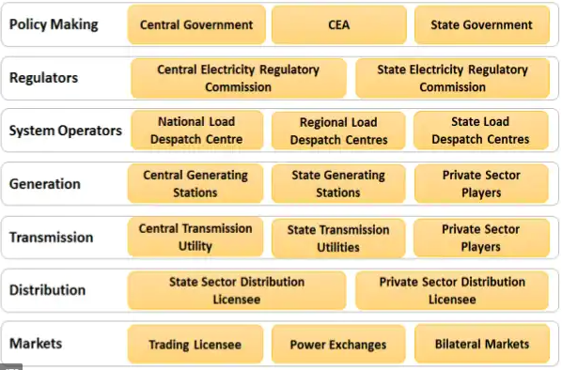

Global Power Sector Scenario
The World
The Country*
The Sector
* - 104th in Per Capita Energy Consumption (1181 vs 3081)
116th in Per Capita CO2 Emission (1.91 vs 4.79)
The Company

Slide 4


Net Zero: A Dream Destination
As of March 2022, 33 countries and EU have set a Net Zero target, either in law or in a policy document & more than 100 countries are considering the same.
137 countries out of 192 are signatories to the UN Climate Convention, accounting for 80% of global emissions are pledging to achieve net-zero emissions by the year 2050.
United Kingdom is the first large economy to enact net-zero legislation in 2019.
Sweden, France, Denmark, New Zealand, and Hungary, have approved net-zero legislation all with a 2050 goal date except Sweden (2045).
Other countries have amended their NDCs, proposed legislation, or stated their desire to achieve net-zero emissions.
USA and EU has set out net-zero target for 2050﻿.
China and Russia announced to be carbon-neutral by 2060.
Apart from countries, a number of local governments and corporations are taking part in the UN Race to Zero campaign.

Slide 5
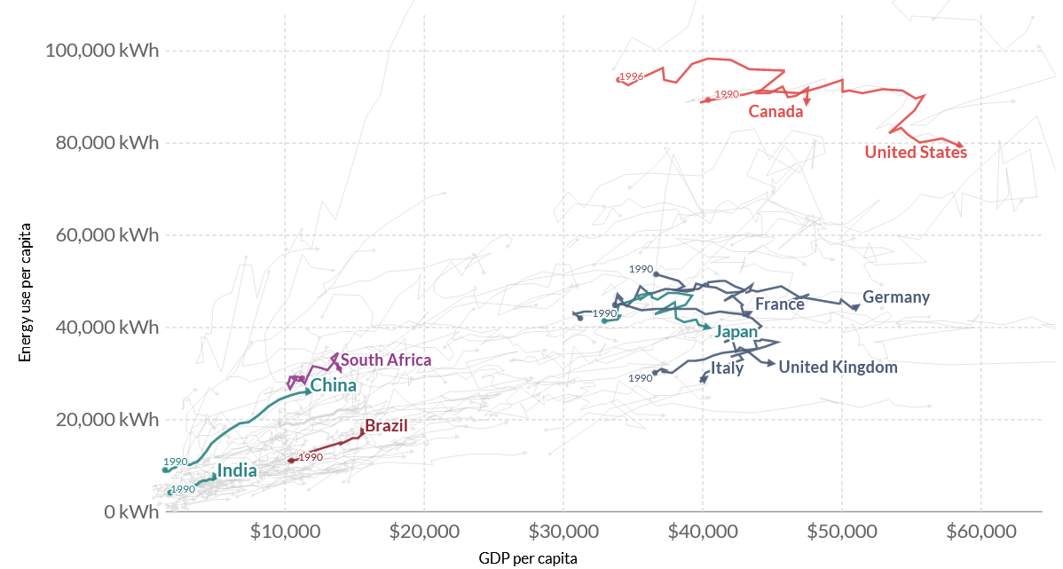
Energy use vs. GDP per capita for G7 and BASIC Countries, 1990-2015
India’s contribution to historical cumulative emissions till 2019, is only about 4% of the global total, against a share of 17% of World Population.
India’s current annual per capita emissions are only a third of the world average.

Slide 6
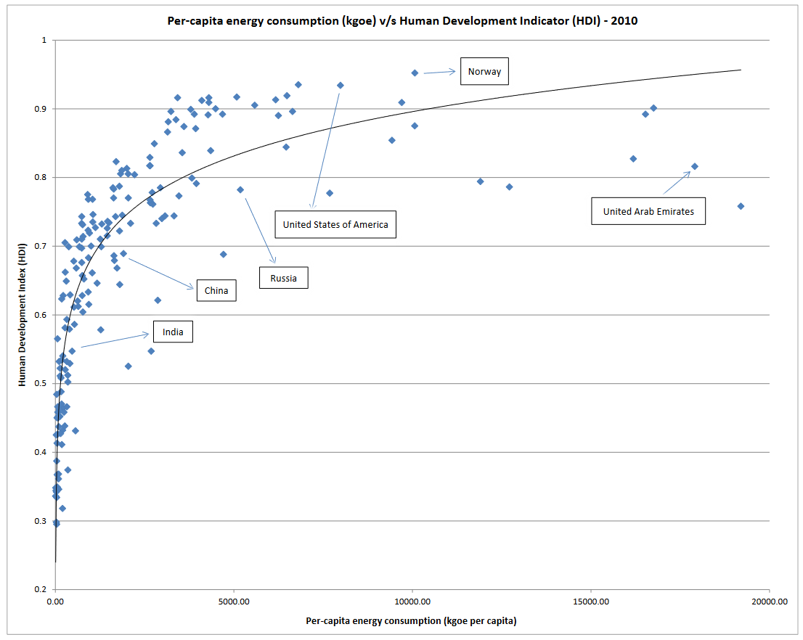
HDI vs. Per Capita Energy Consumption, 2010
India’s primary energy consumption per capita in 2019 was 28.7 gigajoules (GJ), considerably lower than both developed country peers (e.g., 282.2 GJ for the USA, 340.4 GJ for Canada, 106.8 GJ for the UK) and developing countries (e.g., 58.2 GJ for Brazil, 100.1 GJ for South Africa, 101.3 GJ for China)

Slide 7
Global Power Sector Scenario & India
India is still in transition - from a developing to a developed country.
We still require huge energy generation from Coal, Gas, Nuclear, Hydro and Renewables.
CO2 emissions from developed nations have already utilised the carbon space available for developing nations.
Still India is in the midst of another Transition – Energy Transition and doing its best to balance between Energy Security and Energy Transformation, reducing its emissions.
And That is the Biggest Challenge Before Power Sector in India

Slide 8
India has High Ambitions: Towards Energy & Environment
Govt. of India, in its First INDC (2015) committed :
To reduce the emissions intensity of its GDP by 33-35% by 2030 from 2005 level.
To achieve about 40 percent cumulative electric power installed capacity from non-fossil fuel-based energy resources by 2030.
To create an additional carbon sink of 2.5-3 billion tons of CO2 equivalent through additional forest and tree cover by 2030.
In COP26, Hon’ble Prime Minister of India raised the ambition by announcing Panchamrit:
India will reach its non-fossil energy capacity to 500 GW by 2030.
India will meet 50% of its energy requirements from renewable energy by 2030.
India will reduce the total projected carbon emissions by one billion tons from now onwards till 2030.
By 2030, India will reduce the carbon intensity of its economy by less than 45%.
By the year 2070, India will achieve the target of Net Zero.

Slide 9
India’s Updated NDC to UNFCCC
Recently, Cabinet approved India’s Updated NDC to be communicated to UNFCCC, which translates ‘Panchamrit’ into enhanced climate targets:
India now stands committed to reduce Emissions Intensity of its GDP by 45 percent by 2030, from 2005 level and
Achieve about 50 percent cumulative electric power installed capacity from non-fossil fuel-based energy resources by 2030.
The update is also a step towards achieving India’s long term goal of reaching net-zero by 2070.
Recognizing that lifestyle has a big role in climate change, the Hon’ble Prime Minister of India, at COP 26, proposed a ‘One-Word Movement’, to the global community. This one word is LIFE…
  L, I, F, E, i.e. Lifestyle For Environment, which is in tune with our planet and does not harm it. India’s updated NDC also captures this citizen centric approach to combat climate change.
India’s NDC do not bind it to any sector specific mitigation obligation or action. India’s goal is to reduce overall emission intensity and improve energy efficiency of its economy over time and at the same time protecting the vulnerable sectors of economy and segments of our society.

Slide 10
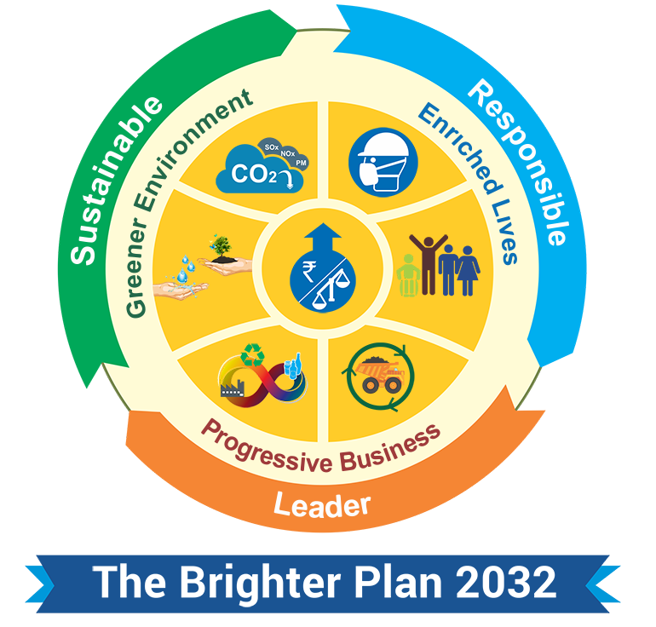
Role of NTPC
NTPC is the largest power generating company in India.
With 17% of the Installed Capacity of India and about 24% of the power generation in India, has a huge responsibility towards Energy Security as well as Climate Change.
NTPC plans to be a 130GW company by 2032 with a diversified fuel mix and annual generation of 600BU, with a plan to increase the RE portfolio from 4.375GW at present to 60 GW by 2032.
Our responsibility becomes even more significant as we are primarily thermal power generating company.
In line with the commitments of Govt. of India, NTPC is making its best efforts to tackle the challenge of Energy Transition.

Slide 11

Commitments of NTPC
NTPC is the first Energy Company of India to declare its Energy Compact goals as part of UN High-level Dialogue on Energy.
It is among the few organisations globally to declare its Energy Compact goals.
As a part of this initiative,
NTPC will install 50+ GW of renewables by 2030
NTPC will reduce its net energy intensity by 8.5% by 2030 vs. 2012 levels
NTPC will join at least 2 international alliances and groups by 2025 to facilitate clean energy research and promote sustainability in energy value chain.
    NTPC has become a partner in Global alliance for Sustainable Energy (GASE) along with other 16 major global organizations for sustainable development in Renewable Energy sector.

Slide 12


NTPC GREEN HYDROGEN INITIATIVES
Green hydrogen based mobility
Microgrids based on green hydrogen
Intracity: Leh,
Intercity: Delhi-Agra & Delhi-Jaipur
Microgrids in Ladakh, Andaman & Nicobar and Lakshadweep
Hydrogen blending in natural gas
At Dadri gas plant
Green Methanol plant (at Ramagundam)
Green ammonia pilot project

Slide 13
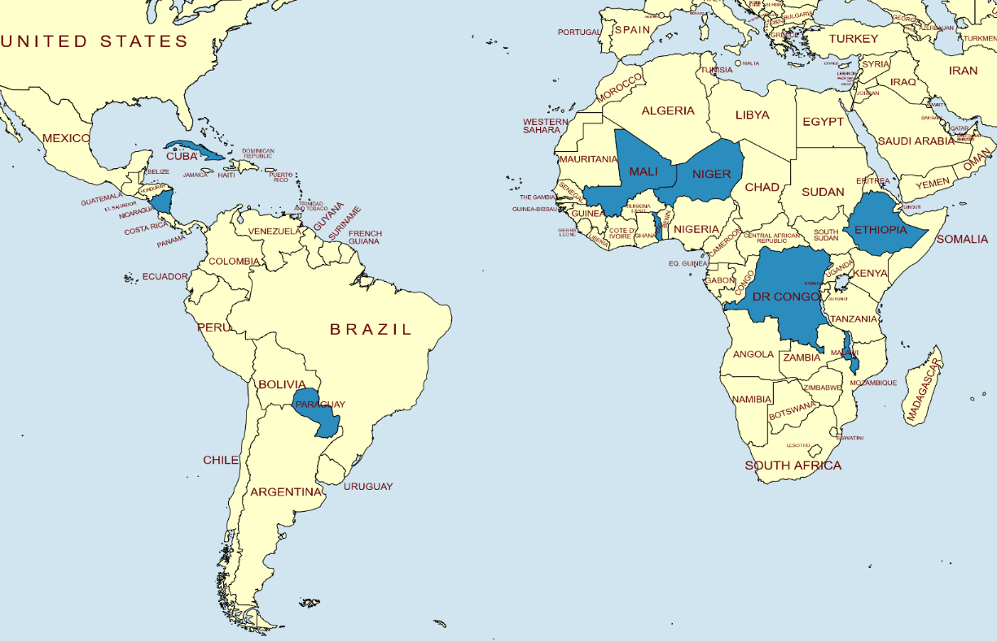
NTPC Supporting Countries in Solar PV Project Implementation
Providing Project Management Consultancy to ISA Member Countries (Total 6495 MW);
NTPC expressed intent to assist ISA member countries to develop upto 10,000 MW bankable solar parks;
NTPC, a Corporate Partner of ISA and endorsed as PMC consultant;
Cuba 1150 MW
Mali 500 MW
Niger 50 MW
Nicaragua 100 MW
Ethiopia 410 MW
Venezuela 2000 MW
Togo 285 MW
Paraguay 500 MW
DR Congo 1000 MW
Zambia 400 MW
Malawi 100 MW
13

Slide 14
NTPC Vision for 2032- A Decade of Transformation
Moving from a Power Generating Company to an Integrated Energy Company as a supplier of CLEAN, GREEN and AFFORDABLE power.

Slide 15
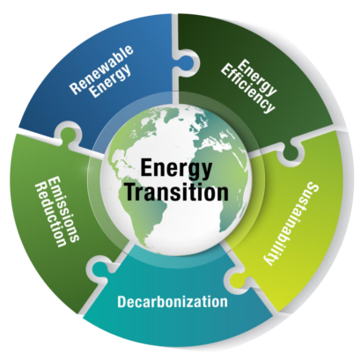
Challenges before Power Sector and NTPC in India
Coal is the only source of base load power generation in India due to limited potential of hydro and India being a non-member of Nuclear Suppliers Group.
Therefore, the Coal will continue to be an integral part of India’s energy requirements and the major challenges to low carbon transition are
  CO₂ capture and utilization
  Flexibilization of coal-based power with RE power
  Smooth Transition from Coal to RE (Socio-economic Issues)
Other Areas which need
  Energy Storage
  Hydrogen Economy

Slide 16

Challenges Before Thermal Sector
India did not and does not have any legally binding international emission targets and our INDC is voluntary.
Similarly, there is no legally binding domestic emission targets, but our voluntary commitments are reflected in domestic pressures to reduce CO₂ emissions through various activities covered under other legislations and permits.
However, there is a lot of pressure from funding agencies and financing institutions, sustainability assessors, various international forums to reduce emissions and commit for net zero emissions.
16

Slide 17

Technical Challenges
Integration of thermal with renewables, which have flexible generation and large seasonal & diurnal variations.
Flexibilisation of thermal plants.
Improving energy efficiency and reliability of thermal power plants at part load operations.
Investments/ technology required for energy storage
Dependency of Solar sector on imported modules and silicon feed stocks - Technology transfers for indigenous manufacturing of renewable energy systems.
Bidirectional Flexible Energy Systems

Slide 18

Financial Challenges
Huge long-term investments in coal mines & thermal power plants including investments to meet new emission norms in thermal power plants.
Necessity of existing energy systems as a strong foundation for the growth of industries and economy as well as grid infrastructure required for clean energy.
Uncertainty in financial and political environment with respect to investment in these systems.
Discrepancy in benefits from the energy transition.
  Most of the states with high solar potential and capacities are situated in the western regions, whereas the coal belt is largely situated in the eastern states.

Slide 19
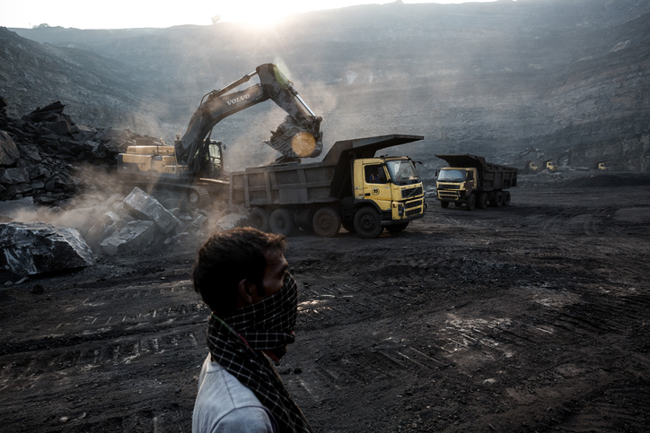
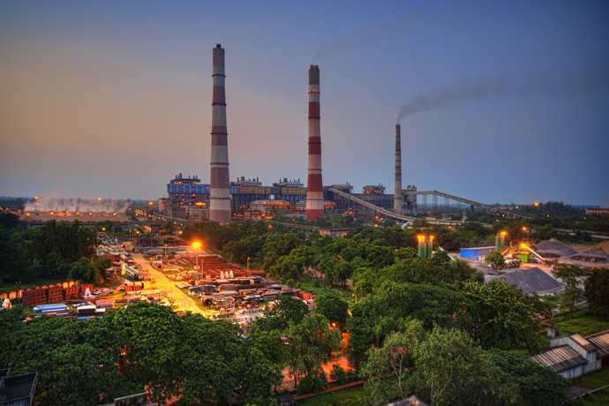
Social Challenges
Huge workforce with different skill levels as well as unskilled workforce.
Creation of unemployment. Supporting communities and individuals who might be affected directly and indirectly due to the transition.
Research and development of new indigenous technologies to suit the requirements of clean energy transitions as well as to meet the social challenges of providing jobs.
Investments in multidimensional factors such as education and human capital.
Decentralised generation of the clean energy instead of large plants and embedding the same in the fabric of society improving their livelihoods, making it accessible to all.

Slide 20




Mitigation of Challenges
Technology Transfer at Affordable Rates through Demonstration and Pilot Projects
Large scale manufacturing set-up in India in line with Atma Nirbhar Bharat
Soft Loans/ Funding for Climate Change Initiatives
Support through Carbon Market
Technology Transfer
Atma Nirbhar Bharat
Climate Finance
Carbon Market

Slide 21
Issues of Technology Transfer and Financing
Notwithstanding its efforts, financial resources, and trained workforce, India needs to adopt technologies developed elsewhere to suit its own needs to
  avoid reinventing the wheel,
  learn from innovators' collective wisdom,
  complement its national effort, and
  fast-track the development of technologies appropriate to its conditions.
India needs to adopt technologies for Indian Conditions in several key areas
  A) CO₂ Capture and Utilisation
  B) Hydrogen Economy
  C) Energy Storage Systems
  D) Waste (MSW) to Energy & Biomass to Energy Projects
  Nuclear Power
  Offshore Wind
  F) Manufacturing Solar PV Cells and LED Bulbs

Slide 22
Mitigation Actions by NTPC
Fuel Diversification
Increase in Renewables: By 2032, NTPC will have 60 GW of renewable capacity.
Retirement of Old and Inefficient Units: Decommissioned 1,385 MW of thermal capacity and 660 MW in pipeline.
Technology Upgradation & Efficiency Improvement
Super Critical, Ultra Super Critical and Advance Ultra Super Critical Technologies.
Regular Renovation and Modernisation &M of its Fleet.
Research & Development
CO2 Capture from waste flue gases to convert it to hydrocarbon viz Methanol.
Use of Biomass (agro-residue) for power generation.
Battery Storage
Green Hydrogen and Green Ammonia.
Integrated Waste Management & Energy Generation facilities.
EV ecosystem.
Carbon Sink Development
Afforestation.
22

Slide 23
Collaboration with NITI Ayog
NTPC has signed a Statement of Intent with NITI Ayog for
Development of Net Zero GHG emissions Roadmap for NTPC
Emissions and energy (portfolio mix) modelling
Development of scenarios for future
Assistance in establishment of Carbon Management Unit (CMU)
Organising Workshops & Focused Group Activities – Engaging experts, think tanks, Institutions etc.
Identifying clean energy technology Pilot projects at NTPC sites/ Installations.
Conduct joint research projects

Slide 24
Thanks

