Slide 1
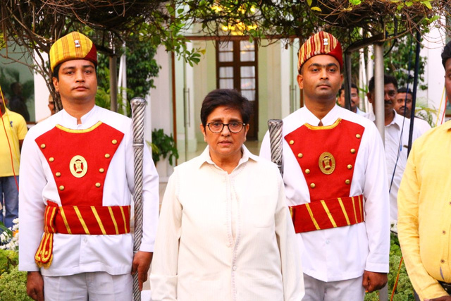

BCC&I ENVIRONMENT AND ENGERGY CONCLAVE
Water Conservation Models
Administrative & Community

Slide 2
WATER HARVESTING MEASURES
IN GURUGRAM
BY

Slide 3
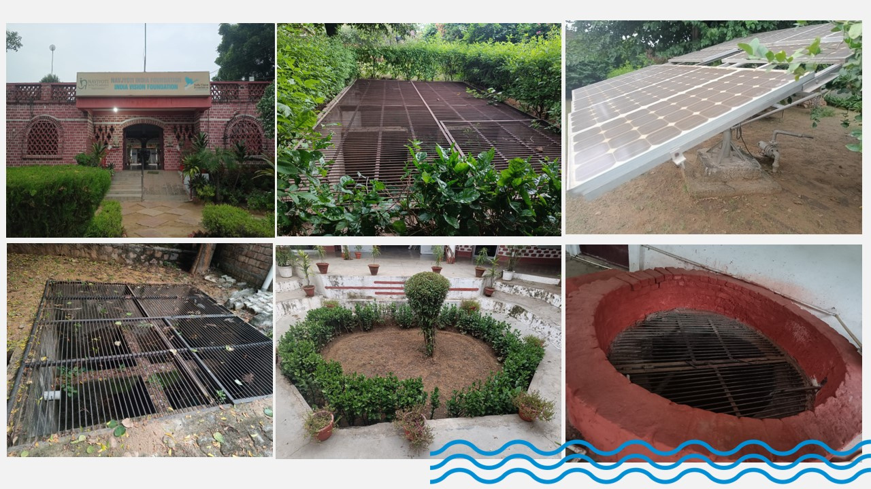

Water Harvestings Pits on the Premises of Navjyoti
2001

Slide 4
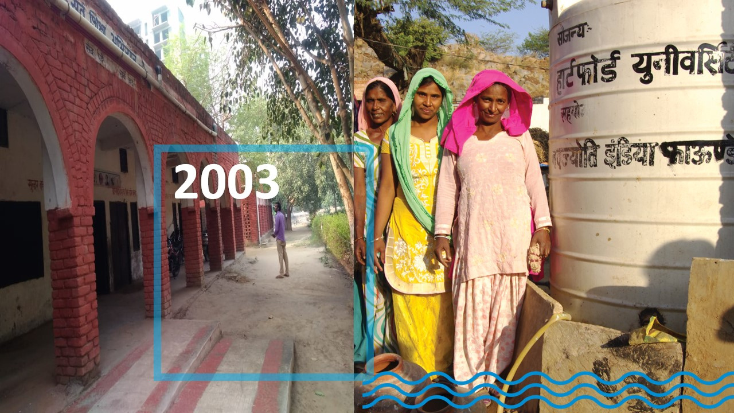
2003

Slide 5
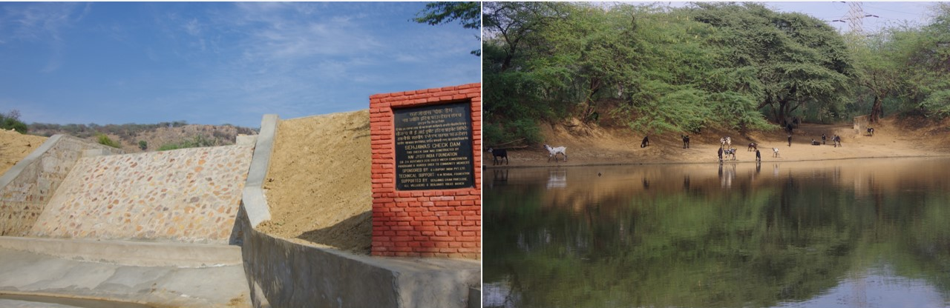
Check Dams
Ponds

Slide 6
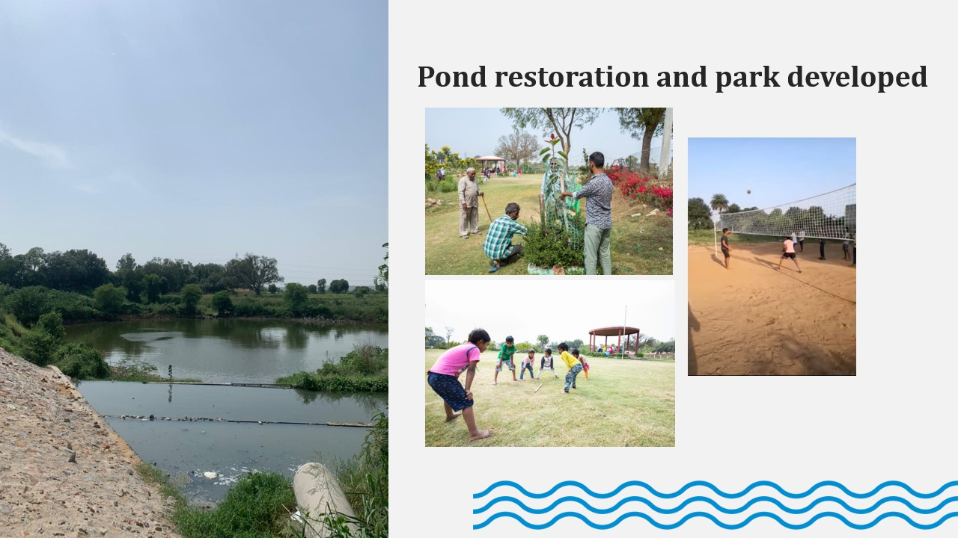
Ponds Restoration and Parks Developed

Slide 7
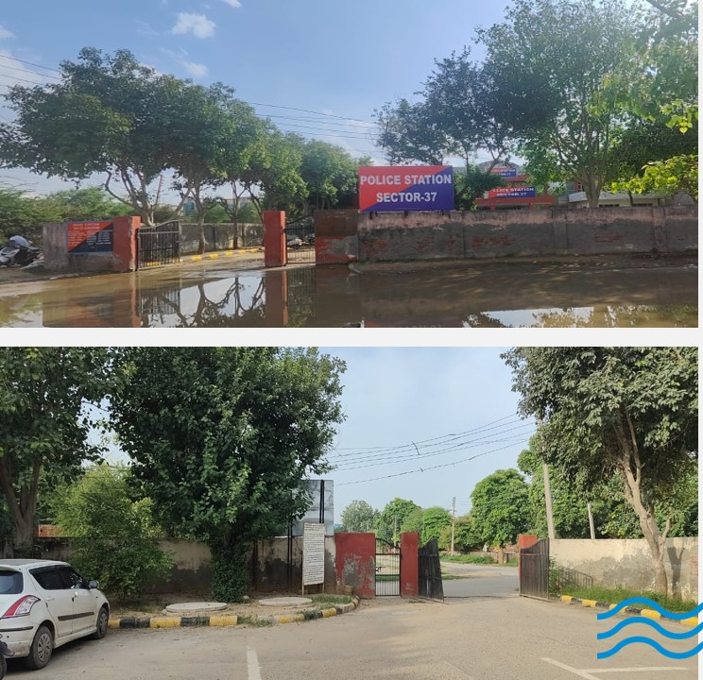
POLICE STATIONS
BEFORE
AFTER

Slide 8
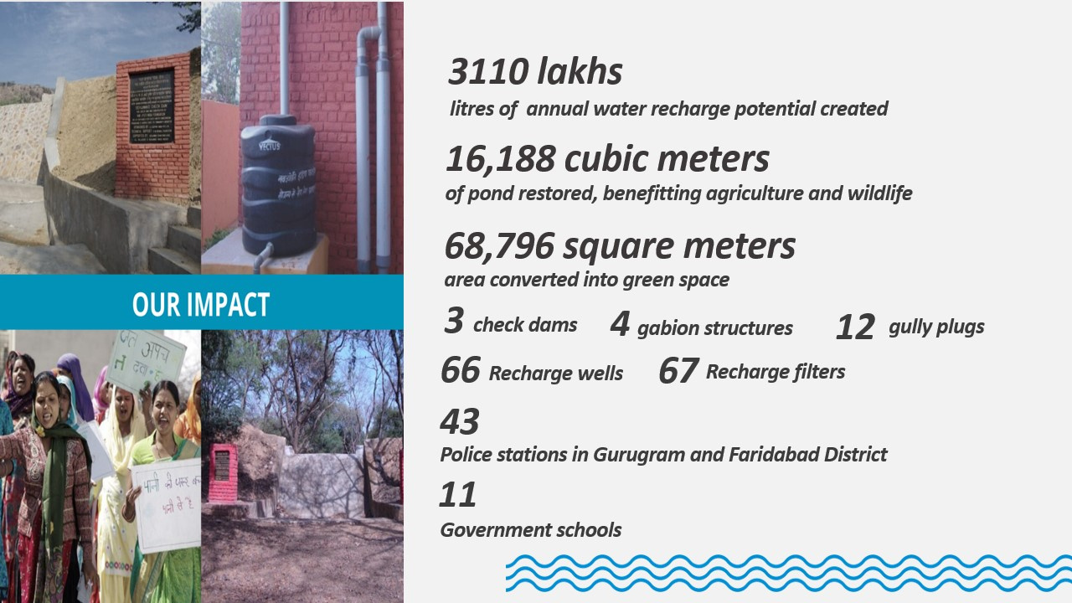

Slide 9
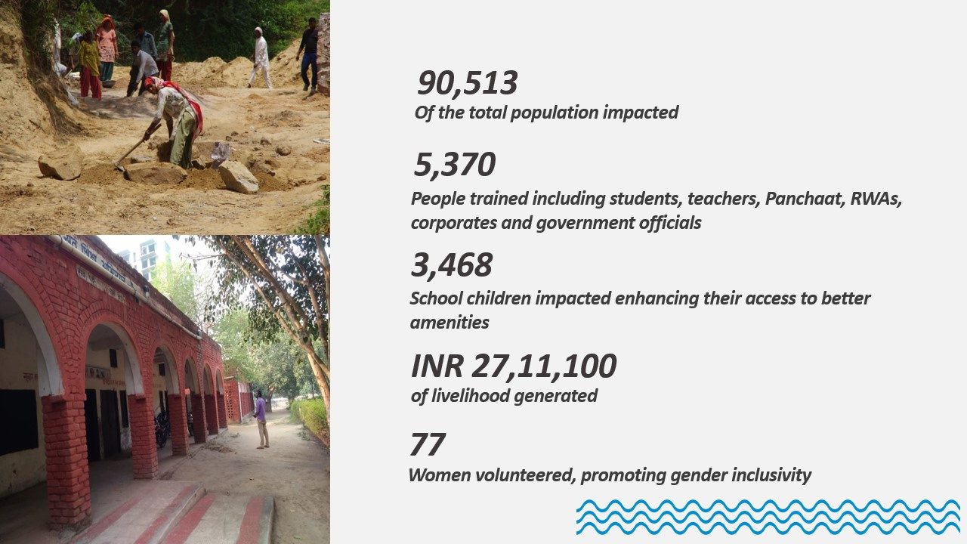

Slide 10


PUDUCHERRY
WATER RICH MODEL

Slide 11
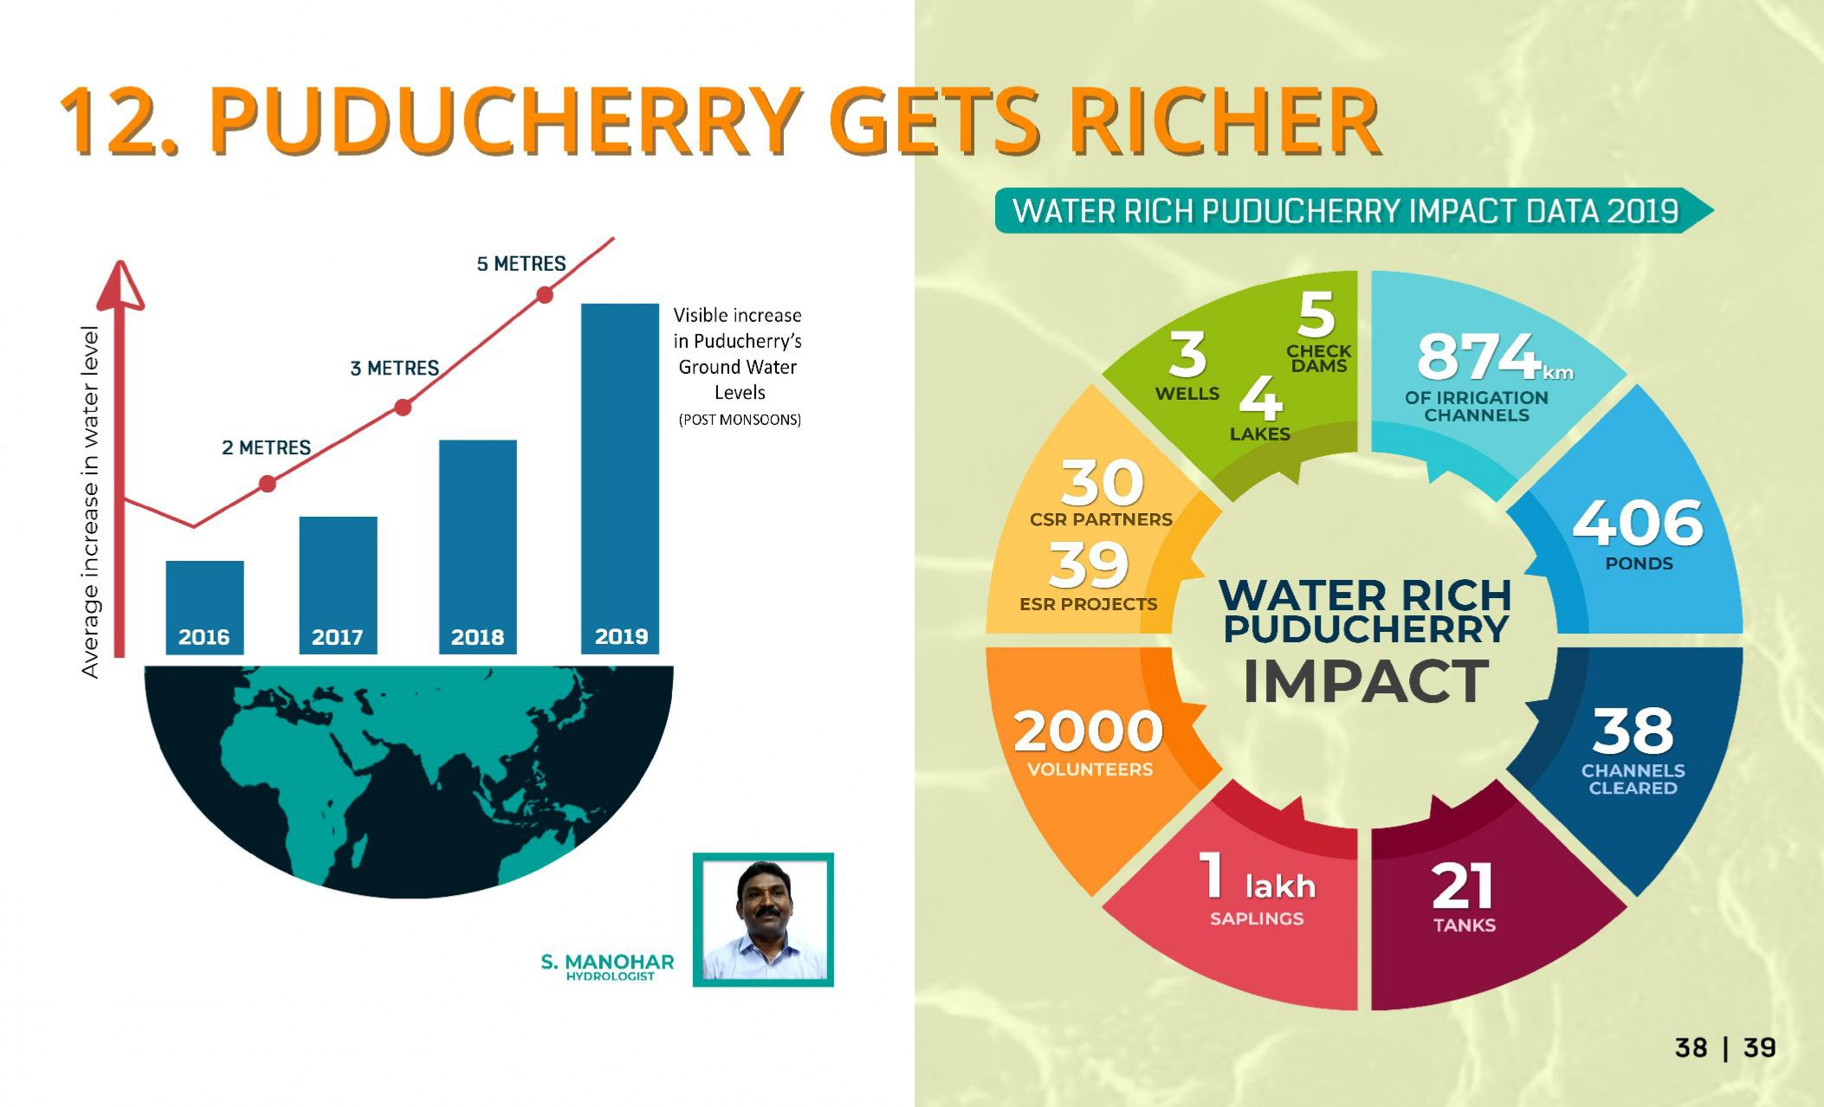
I
M
P
A
C
T

Slide 12
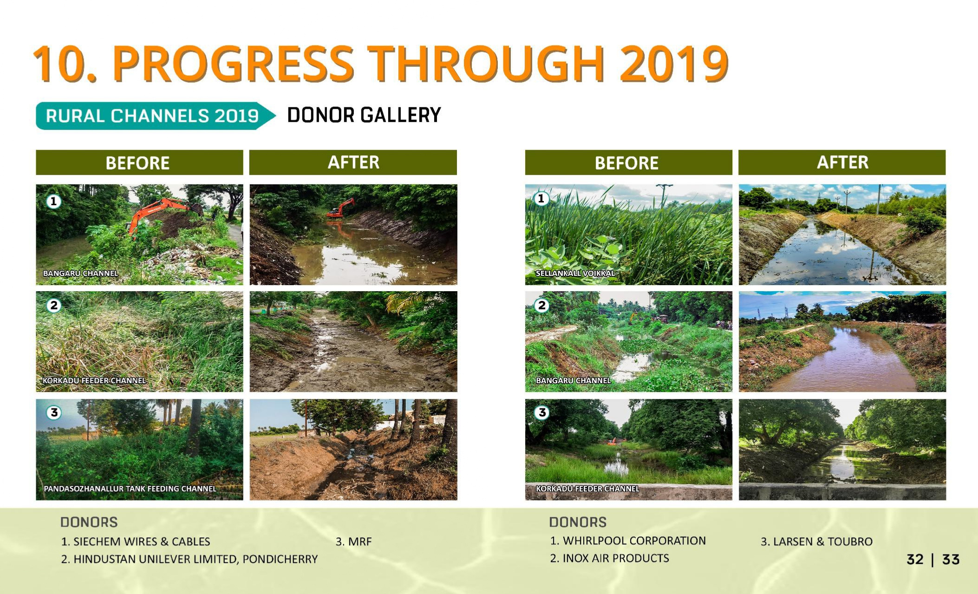



Slide 14
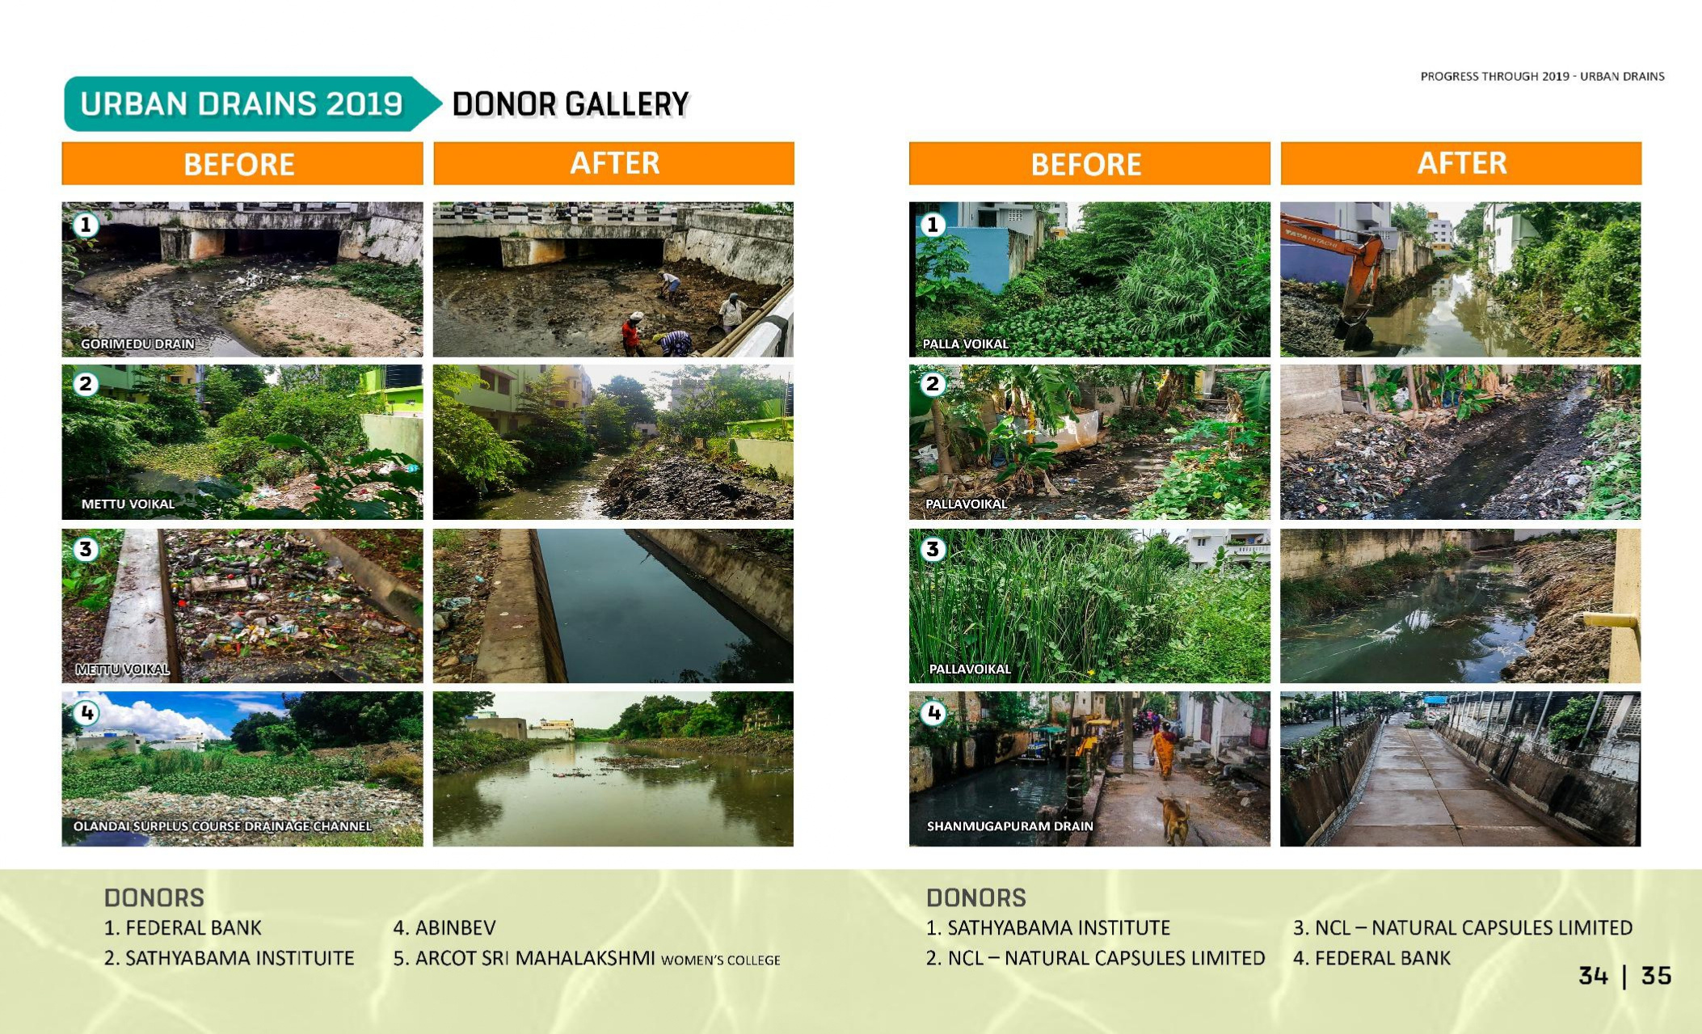




Slide 16
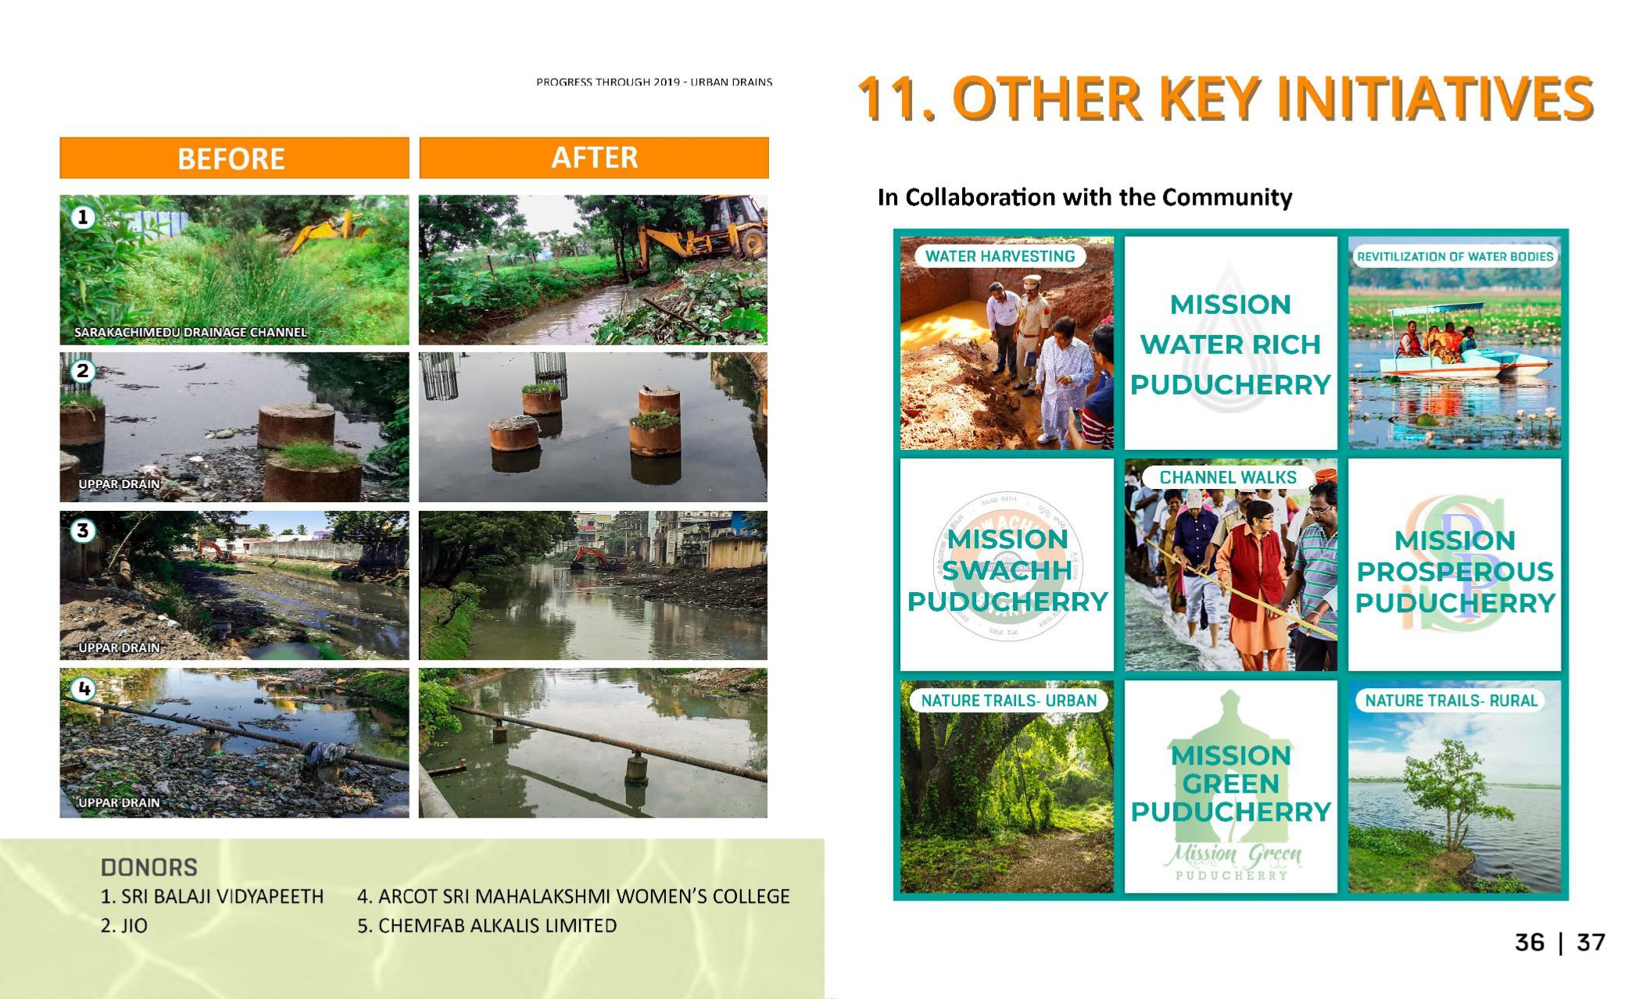

Slide 17
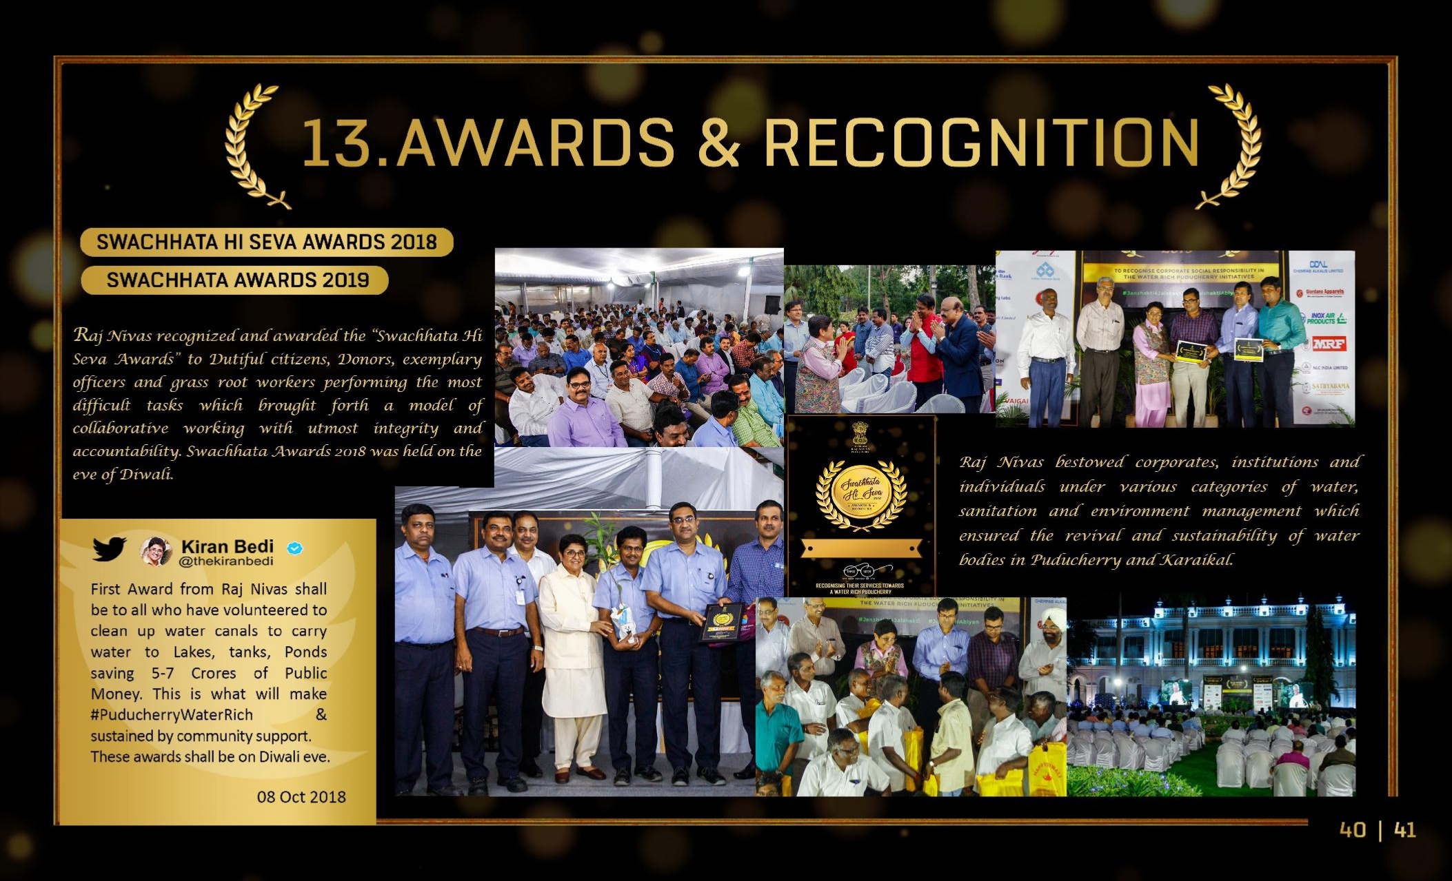

Slide 18
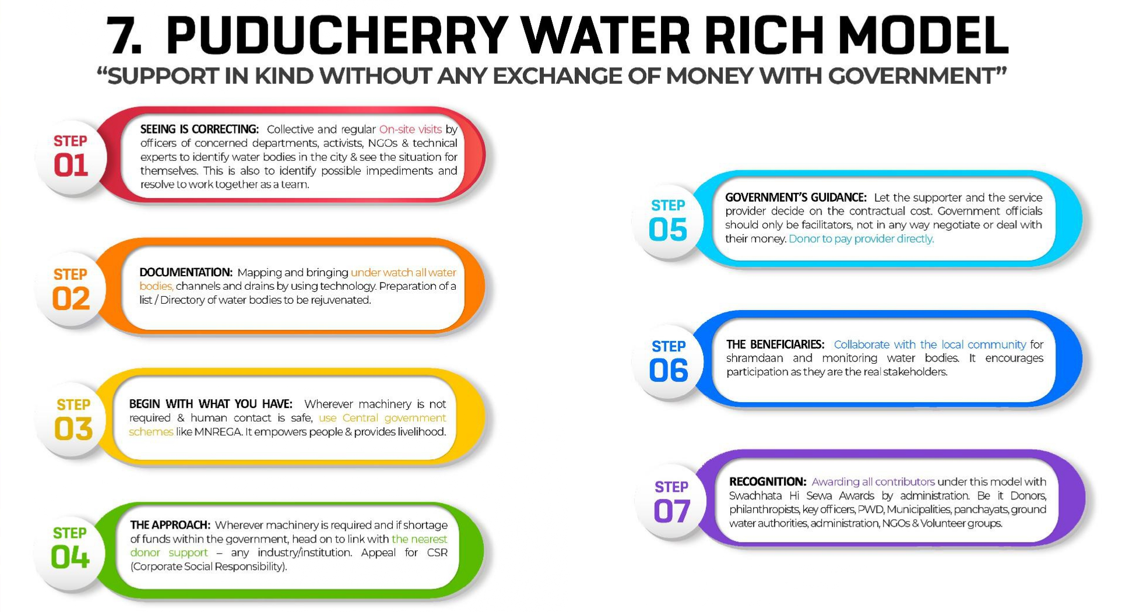








Slide 19
Seeing is Correcting
Documentation
Begin with what you have
The Approach – The CSR
Government’s Guidance
The Beneficiaries-Local Community
Recognition
THE
SUM- UP

Slide 20
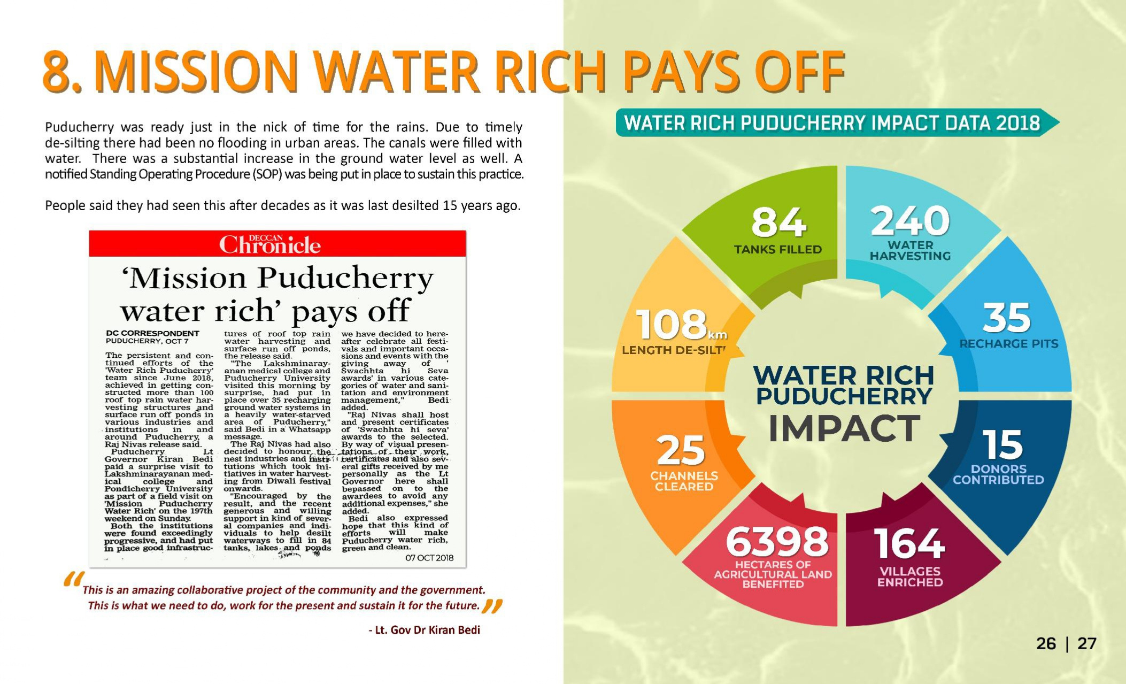

THE CANVAS

Slide 21
The Result

Slide 22


Slide 23



DR. KIRAN BEDI
&
NAVJYOTI INDIA FOUNDATION
www.kiranbedi.com
kiranbedioffice@gmail.com
www.navjyoti.org.in
chandni@navjyoti.org.in

