Slide 1

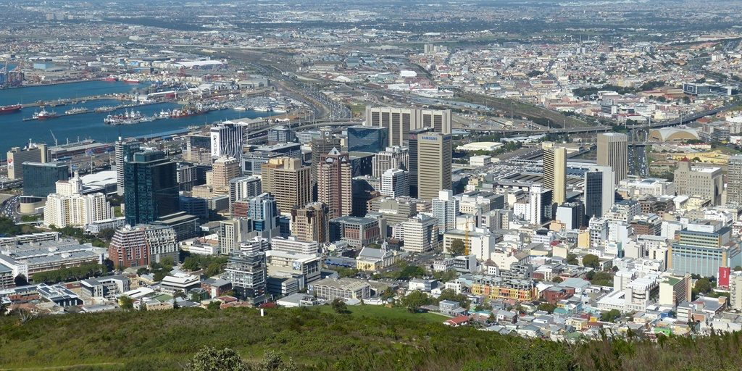
16th edition of BCC&I Environment and Energy Conclave

Slide 2

The World Bank Operating Model
IBRD
IDA
IFC
MIGA
Public Sector Focus
Private Sector Focus
IBRD
IDA
IFC
MIGA
International Bank
for Reconstruction
and Development
International Development Association
International
Finance
Corporation
Multilateral
Investment Guarantee Agency
Est. 1945
Est. 1960
Est. 1956
Est. 1988
Financing for middle-income and creditworthy low-income countries
Financing for the world’s poorest countries
Investment
(Equity/Debt)
Risk
Insurance
Technical assistance
Technical assistance
Advisory
Services
Credit
Enhancement
Policy advice
Policy advice
Support countries’ economic and institutional development
Encourage private sector development
Promote foreign direct investment
Shared Twin Goals: Eliminate Extreme Poverty and Boost Shared Prosperity

Slide 3

Key Parameters of MIGA Cover
Offshore
Financials instruments
Host Country
Equity and
shareholder loans
Investors
& Lenders
Project
Loans, swaps and other debt instruments
Management contracts, corporate guarantees, etc.
182 eligible investor countries
Can cover all/ some foreign investors in a project
Collaborates with other development institutions (MDBs, DFIs, WB & IFC)
154 eligible host countries
95% coverage for debt, 90% for equity
Broad range of cover size
Tenors up to 20 years
Client can reduce, cancel, and - subject to approval - transfer or assign the policy
Identified project
Developmental impact
E&S Performance Standards
Integrity/ KYC

Slide 4

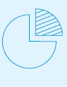

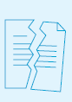

MIGA’s Product Line
Instrument
Cover
Transfer Restriction and Currency Inconvertibility
Expropriation
Risk Insurance
War and Civil Disturbance
Breach of Contract by Governments and State-Owned Entities
Non-honoring of Financial Obligations by a:
Credit
Enhancement
-Sovereign
-Sub-sovereign
-State-Owned Enterprise
Trade
Finance
Non-Payment by a Public Authority or Government-Owned Entity of its Obligations Relating to a Cross-Border Trade Transaction

Slide 5


Georgia’s first large-scale private hydropower project
Shuakhevi and Skhalta Hydro, Georgia
Project Structure
Project Overview
Norsk Mineral
Founders (CEG)
Description:
Construction and operation of a 184.8MW hydropower plant station under Build-Own-Operate (BOO) agreement, situated on Adjaristsqali river in Georgia
20-year BOO agreement and Transmission Line Development Agreement
70%
30%
Tata Power International
(Singapore)
CEI
IFC
40%
40%
20%
Equity
Guarantee Holder(s):
Holding Company Adjaristsqali Netherlands BV
Asian Development Bank
European Bank for Reconstruction and Development
Senior
Loan
Adjaristsqali Georgia LLC (Georgia)
BOO and TLD Agreements
Government of Georgia
MIGA cover:
Amount: $63m (equity)
Tenor: 15 years
Risk(s): Breach of Contract, Expropriation, War and Civil Disturbance
Issued: December 2014
IFC
EPC: AGE (Turkey)
E&M: Alstom (France)
Obligor
Guarantee holder
Project enterprise

Slide 6

Supporting economic recovery following the negative effects caused by the COVID-19 crisis
Findeter S.A. Climate Facility, Colombia
Project Structure
Project Overview
Non-Honoring Guarantee
Description:
Local currency financing to support Findeter’s on-lending activities
The MIGA-covered loan facility will be used by Findeter for the financing of climate finance projects in the areas of renewable energy and urban mobility, contributing to Colombia’s objective of diversifying its energy mix and fostering its green economic recovery, and in the key strategic social sectors of education and health, that were severely impacted by the effects of the COVID-19 pandemic.
Claims Payments (USD)
JP Morgan Chase & Co.
(United States)
Premium Payments (USD)
3-year Loan of COP623.7 billion (~US$142.9 million)
Principal & Interest Payments (COP)
Guarantee Holder:
Findeter S.A.
(Colombia)
Intermediate Financial Institutions
MIGA cover:
Amount: COP 877 billion / ~US$201 million (loan, interest, premium, embedded cross currency swap breakage and transaction costs)
Tenor: 3 years
Risk(s): Non-Honoring of Financial Obligations of a State-Owned Enterprise
Issued: September 2022
Use of Proceeds
Climate finance,
health and education projects
Obligor
Guarantee holder

Slide 7


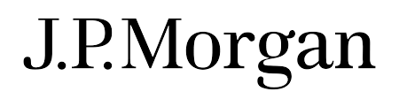




Providing working capital facility for PPA payments to seven renewable energy IPPs
PT Perusahaan Listrik Negara (PLN), Indonesia
Project Structure
Project Overview
Non-Honoring Guarantee
Description:
COVID-19 Response Package for PLN, a nationally integrated, state-owned electricity company in Indonesia
Use of funds is restricted to PLN’s U.S. Dollar denominated tariff payments under PPA for selected 7 renewable Sub-Projects (geothermal and hydroelectric power)
The project enabled PLN to access medium-term credit from commercial lenders during COVID-19 pandemic
Citibank
DBS
JPMorgan
KfW IPEX
Standard Chartered
PT Bank BTPN
LBBW
OCBC
Loan
Guarantee Holder(s):
PLN
(Indonesia)
100% ownership
Government of Indonesia
Purchase of electricity from Sub-Projects under PPAs
Use of Proceeds of MIGA-guaranteed Loans
MIGA cover:
Amount: $522.3m (loan)
Tenor: 5 years
Risk(s): Non-Honoring of Financial Obligation of a State-Owned Enterprise
Issued: January 2021
Sub-Projects
(7 pre-determined renewables IPPs only)
Obligor
Guarantee holder
Project enterprise

Slide 8



miga.org
miga-twitter
miga-linkedin
I N S U R I N G I N V E S T M E N T S  E N S U R I N G O P P O R T U N I T I E S

