Slide 1


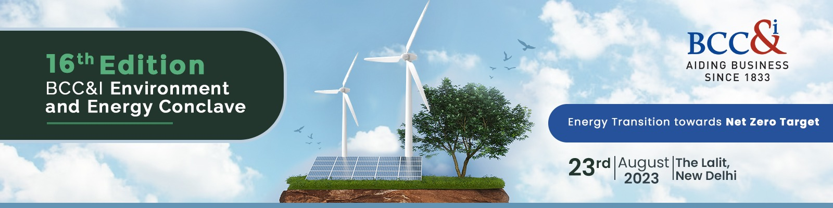
ENERGY EFFICIENCY AND RENEWABLE RESOURCES – NEW SOURCES AND INTEGRATION
Sri Sourav Daspatnaik
Managing Director – Swach Environment Pvt Ltd.

Slide 3
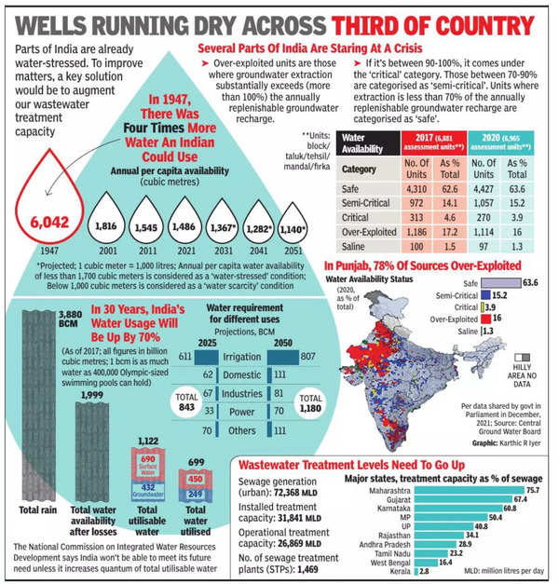

Slide 4
Accelerated urbanization and the expansion of municipal water supply and sanitation systems contribute to rising water demand.
Water for irrigation and food production constitutes one of the greatest pressures on freshwater resources, with agriculture accounting for over 70 per cent of global freshwater withdrawals and up to 90 per cent in some fast -growing economies.
Reduced freshwater supplies economic development comes with increasing water demand, technologies such as desalination and water re-use are often recognized as solutions with a great potential in reducing the gap between availability and demand.
Reclaimed water reuse is currently implemented in many countries. However, its potential is yet to be exploited in many areas.
Proportion of water reuse in total wastewater generation is still small.
Overall, reusing water requires physical and chemical treatment processes, pipelines, waste disposal mechanisms, and other systems. The level of treatment will depend on the water quality needed for the proposed use.

Slide 5
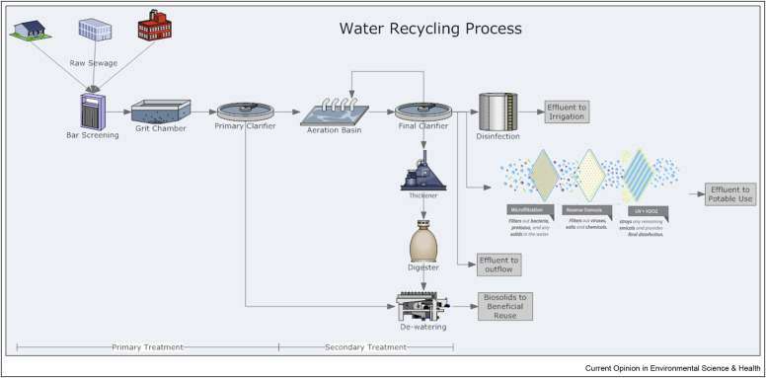

Slide 6
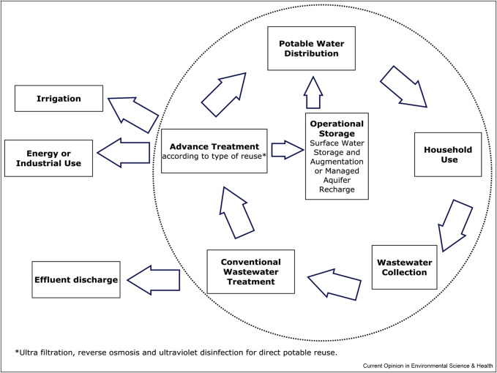

Slide 7
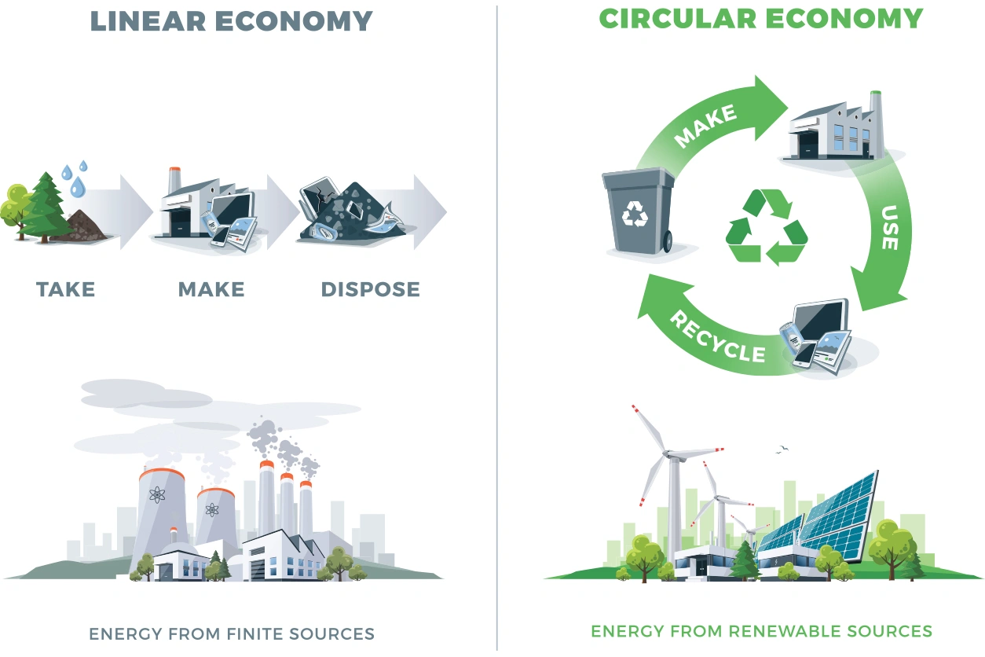

Slide 8
THE TRANSITION TO A CIRCULAR ECONOMY
A business model that enables the economy to grow, while minimizing the amount of virgin resources that are extracted.
The important principle is to confront abstractors with a cost associated with their water use, which is large enough to figure in their calculations, and which is a factor in their decisions.
Requirement for policy and regulations to enable circular economy, to help economies break away from a polluting economic trajectory (linear) and move to a ‘clean’ one.
Many industries are still mismanaging water and waste, while others have become showcases of a circular economy with promising advances in good water stewardship.
Some industries have demonstrated the ability to recycle and reuse water to achieve zero net water consumption, while others are striving to demonstrate a zero-pollution record.
Water is often free, although increasingly abstraction charges signal the scarcity value of water.
The charge rates can be different between surface and ground water users, but often apply to both since these two resources are inter-dependent and should be managed in a unified way.

Slide 9
THE TRANSITION TO A CIRCULAR ECONOMY
Reclaimed water is used for non-potable or potable uses, there are several factors that affect the costs of a water reuse program.
Location of a reclaimed water source (i.e., the wastewater treatment facility), treatment infrastructure, plant influent water quality, customer use requirements, transmission and pumping, timing and storage needs, energy requirements, concentrate disposal, permitting, and financing costs.
The potential promotion of water reuse from a circular economy perspective could also pose some significant risks regarding water quality and human health.
Concerns and unknowns about the impact of the quality of the recycled water depending on its use.
Water quality issues can create real or perceived problems in agriculture including nutrient and sodium concentrations, heavy metals and the presence of contaminants such as human and animal pathogens, pharmaceuticals and endocrine disruptors when irrigating with reused water.

Slide 10
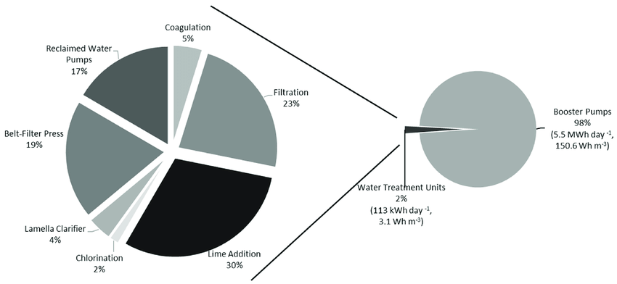
ENERGY CONSUMPTION – WATER TREATMENT PLANTS
Pumping is typically ~ 90% of water system energy use
Ways to save energy cost:
Operational Optimization
Chemical Energy
Operational and Capital Improvements

Slide 11
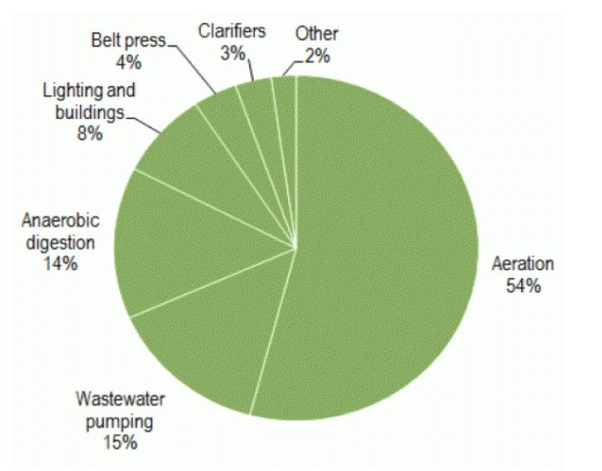
ENERGY CONSUMPTION – SEWAGE WATER TREATMENT PLANTS
The power consumption of an STP in India can range between 0.5 to 1.5 kilowatt-hours per cubic meter of wastewater treated.
The cost of electricity in India is around 7 to 10 INR per unit (kilowatt-hour). The power cost for treating 1 cubic meter of wastewater can range from Rs. 3.5 to Rs. 15.

Slide 12
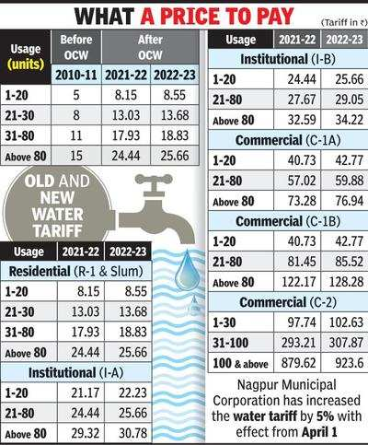
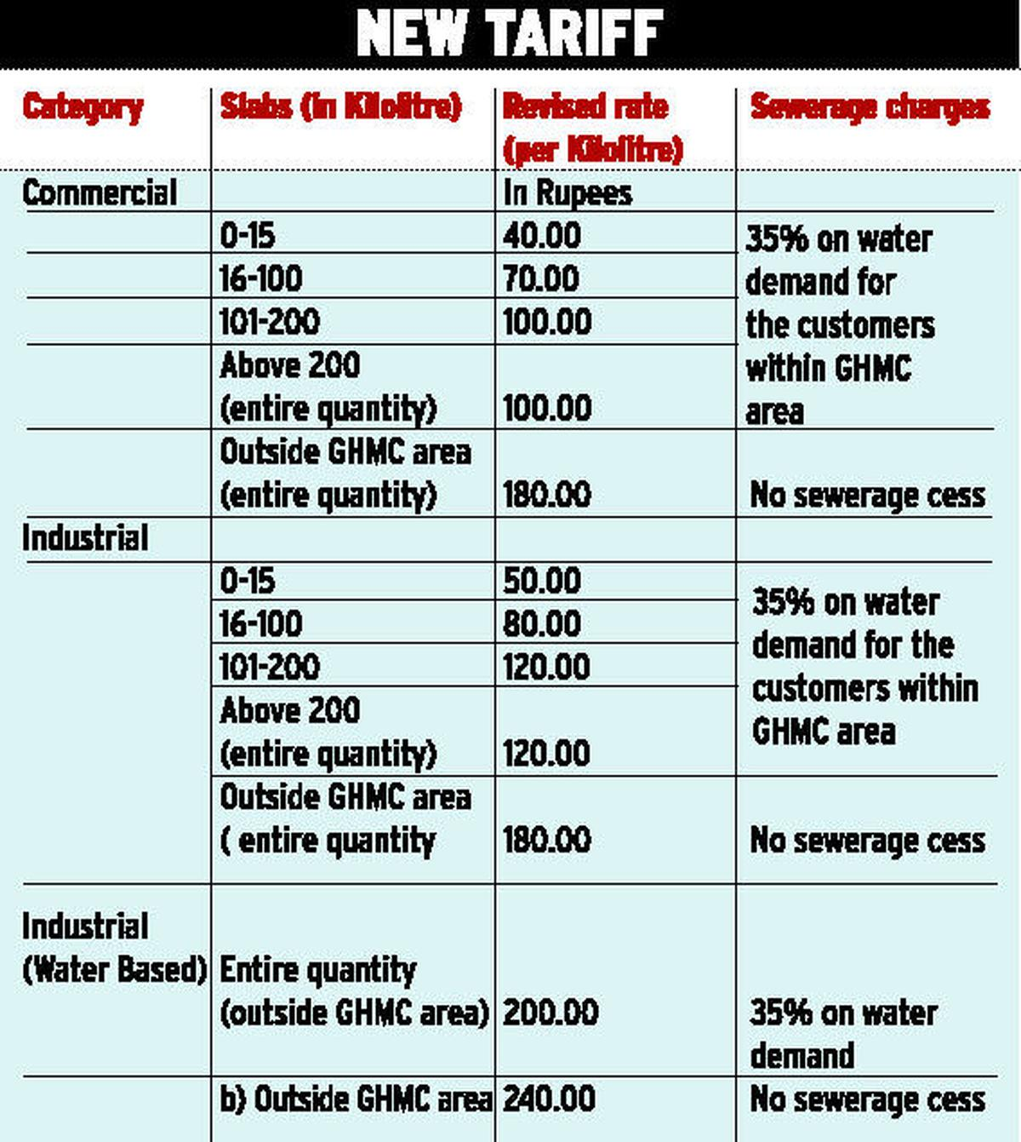
Hyderabad Metropolitan Water Board

Slide 13
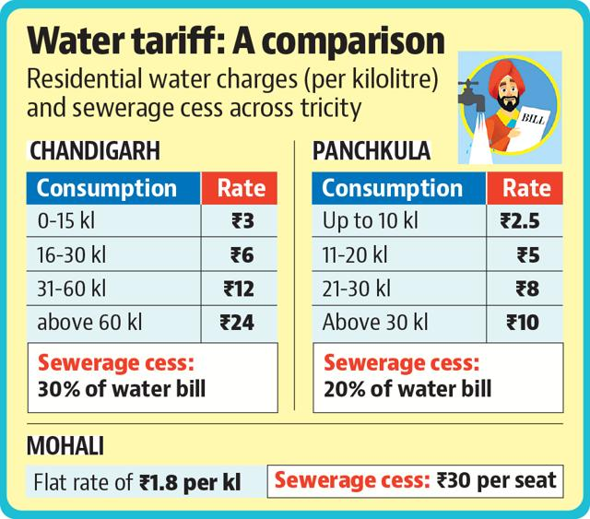
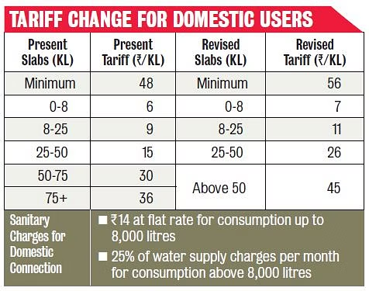
Bangalore Water Supply & Sewerage Board

Slide 14
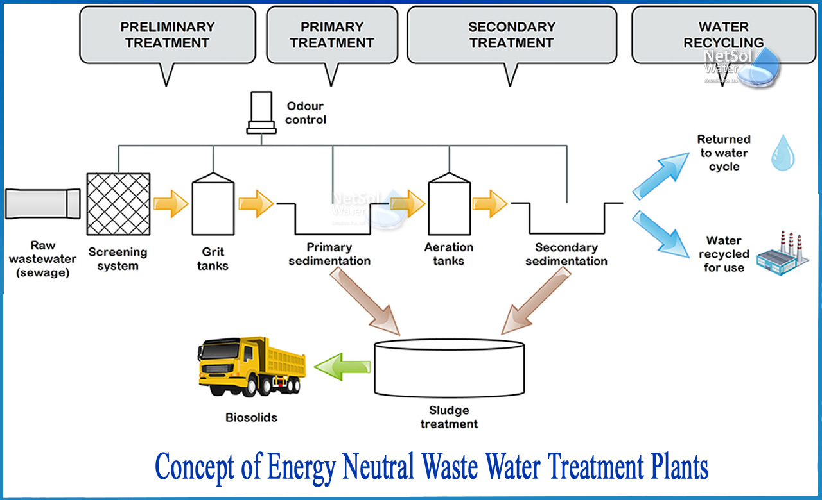
A ROAD TO ENERGY NEUTRAL WATER TREATMENT
Energy conservation, on-site power generation, and renewables.
Production of renewable energy, regenerate nutrients (such as phosphorus and nitrogen), and recover resources that may reduce dependence on fossil fuels.

Slide 15

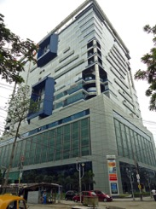
For further details, please contact:
Mr. Sourav Daspatnaik
Managing Director – Swach Environment Private Limited
Director – Haldia Water Services Private Limited
Director – Nangloi Water Services Private Limited
Mobile: +91 90071 42318; Email: sourav.daspatnaik@swachenv.com;
Website: www.swachenv.com
      Registered Office:
      Unit No. 130A 18th Floor
      Infinity Business Center
      Infinity Benchmark Building
      Salt Lake Electronics Complex
      Plot G1, Block - GP, Sector – V Salt Lake
      Kolkata-700091, West Bengal

