Slide 1
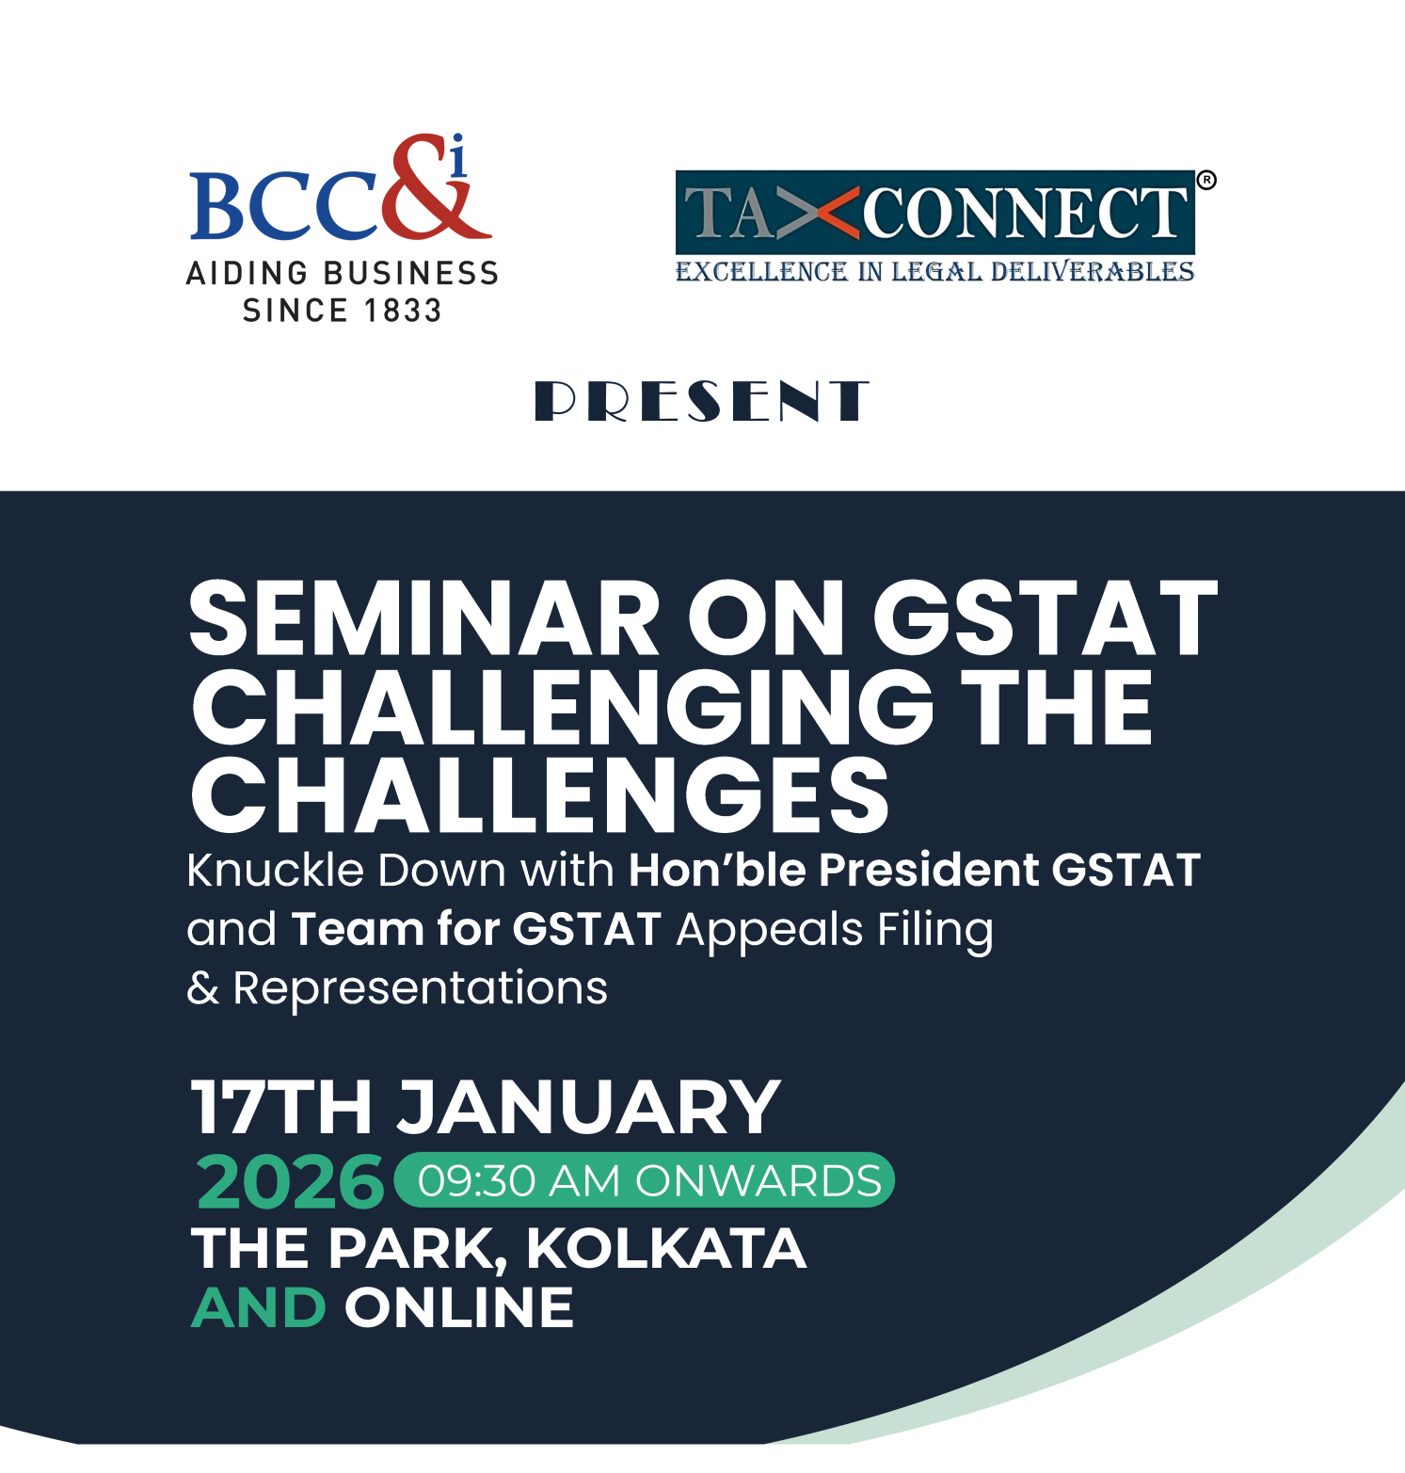

Slide 2
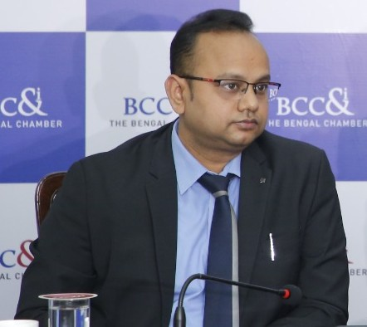
Vivek Jalan is a Chartered Accountant & a qualified L.LM (Constitutional Law), LL.B and MBA (International Trade). He is the Founder & Partner of Tax Connect Advisory Services LLP. He is the Chairperson of The National Fiscal Affairs & Taxation Committee of The Bengal Chamber of Commerce and Industry. He is a Member of The Managing Committee of The Bengal Chamber of Commerce and Industry. He is the Conveynor of The Indirect Tax Core Group of The Confederation of Indian Industries.
He has worked as a Finance Manager in ITC Ltd. and Chief Compliance Officer with IntraSoft Technologies Ltd. He has more than 20 years of experience in the field of Taxation, Finance, Information Technology and Logistcs. He was also an All India Rank holder in CA Final Examination conducted by the Institute of Chartered Accountants of India.
Mr. Vivek Jalan
Chairperson - National Fiscal Affairs & Taxation Committee, The Bengal Chamber of Commerce and Industry & Partner, Tax Connect Advisory Services LLP

Slide 3
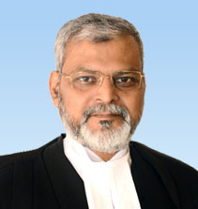
Hon'ble Dr. Justice Sanjaya Kumar Mishra

Slide 4
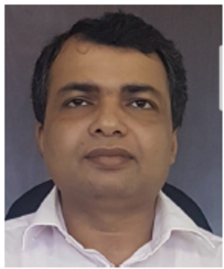
Shri AIok Kumar is an Indian Revenue Service (Customs & Indirect Taxes) officer from the 2006 batch. Over the past 19 years, he has served in various capacities across the formations of Customs, Central Excise, and Service Tax. He was a key member of the National Targeting System of Customs, and in recognition of his outstanding contributions, he was awarded the World Customs Organisation Certificate of Merit in 2018.
He has played an instrumental role in the implementation of the Goods and Services Tax (GST). As Director in the GST Policy Wing, CBIC, he was actively involved in drafting key GST laws and procedures for presentation before the GST Council through its Law Committee.
In his present role as Executive Vice President (Services) at the Goods and Services Tax Network (GSTN), Shri Alok Kumar functions as the organisation's Chief Business Officer (CBO). He is responsible for the design, delivery, and continuous enhancement of both the GST Common Portal and the Tax Officer Back Office Portal, which together serve as the technological backbone of the country's indirect tax administration.
Mr. Alok Kumar
EVP, Goods & Services Tax Network &
Officers from Goods and Services Tax Network (GSTN)

Slide 5
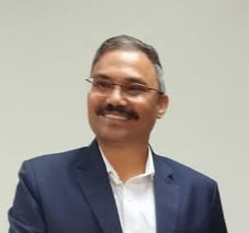
Mr. Madhav Chandra Mishra, IRS
Commissioner of CGST & CX (South)
Central Board of Indirect Taxes & Customs, Department of Revenue, Ministry of Finance, Government of India

Slide 6
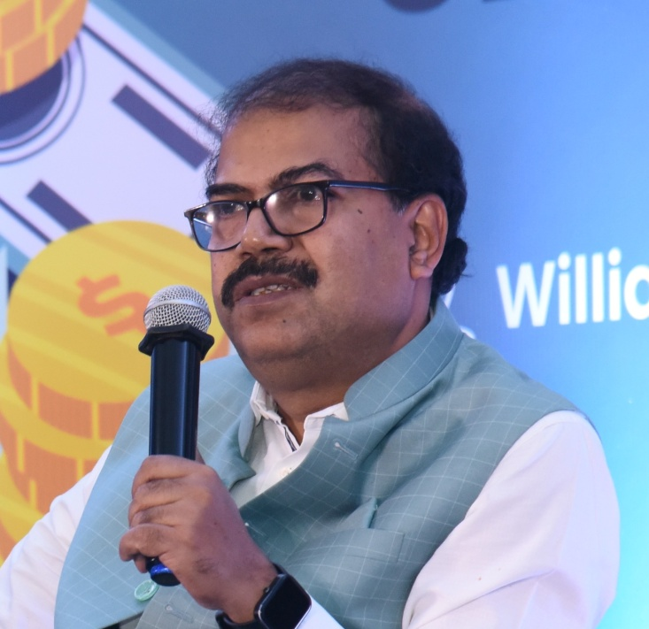
Mr. Joyjit Banik
Additional Commissioner of Revenue & PRO
Directorate of Commercial Taxes, Government of West Bengal

Slide 7
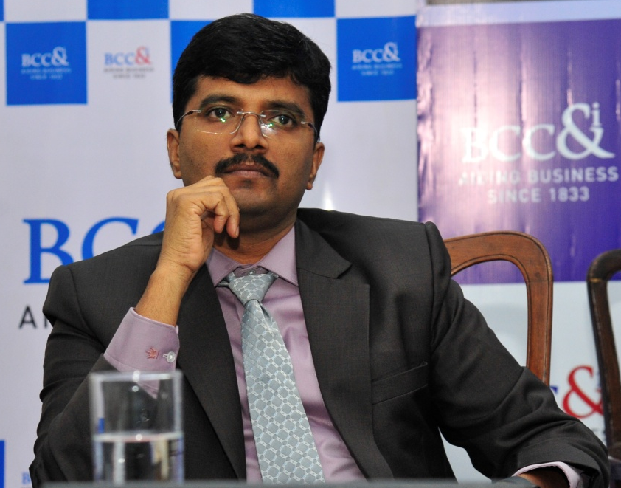
Dr. Uma Sankar S, IAS
Commissioner, Commercial Taxes
Directorate of Commercial Taxes, Government of West Bengal

Slide 8
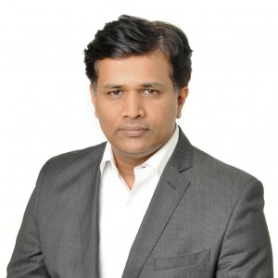
Surya Prakash BS is Programme Director at DAKSH a civil society organisation working on transforming India's law and justice system. He has been working closely with courts, tribunals, governments, researchers, and academic institutions over the last 12 years. He is published writer and editor and has guided teams in carrying out original research that has contributed to understanding ground realities and envisioned systemic changes. His areas of interest are empirical legal research, complex social systems, technology, tax and analytics. He is a chartered accountant and law graduate who has worked in the corporate sector prior to this role.
Mr. Surya Prakash BS
Programme Director, DAKSH Society, Bangalore

Slide 9
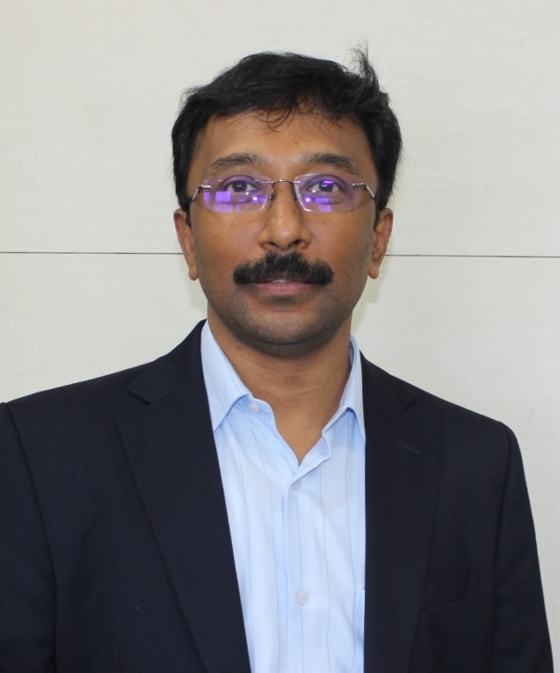
Badrinath leads the tax and regulatory vertical at Singhvi Dev & Unni LLP. He is a Fellow Member of the Institute of Chartered Accountants of India and is an Associate member of the Institute of Cost Accountants of India.
He is very closely associated with the subject specialization and has addressed the officers at Central Board Indirect Tax and Customs, members of the ICAI, industry bodies, tax associations and others. He is the Chair-person for the Expert Committee for Indirect Taxes at Bangalore Chamber of Industry and Commerce and is a member of the IDT Committee at FKCCI. He is a member of the GST Grievance Redressal Committee recently notified and jointly set up by the Central and the State Governments.
Mr. N R Badrinath, Chairman – Indirect Taxes, Bangalore Chamber of Industry and Commerce & Partner, Singhvi, Dev & Unni LLP

Slide 10
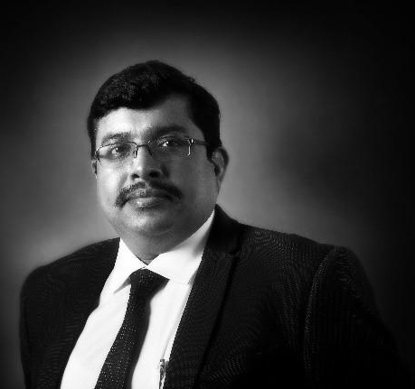
Rajarshi has over 22 years of experience in GST, Income Tax, Customs & Indirect Tax Dispute Resolution. He advises several Indian and multinational corporations, trade bodies on Indian indirect taxes and GST, including GST Impact Analysis, Transition related provisions, Constitutional matters, designing Business Process Mapping and Blueprints, VAT/Sales tax, Service Tax, Customs Duty, Excise Duty and matters relating to foreign trade policy and has handled their GST/indirect tax litigations across the country before different forums.
Mr. Rajarshi Dasgupta
Executive Director and Head of Indirect Taxes, Aquilaw

Slide 11

Thank You

