Slide 1



CONSERVATION SURGERY IN BREAST CANCER
Dr.Tapti Sen
Head of the Department
Consultant Breast Surgeon
Medica Institute of Breast Diseases
Kolkata

Slide 2


Slide 3

Every 4th women suffers from some or the other breast disease
Out of this only 4-5 % are cancer
Rest of the breast diseases are benign breast disease

Slide 4
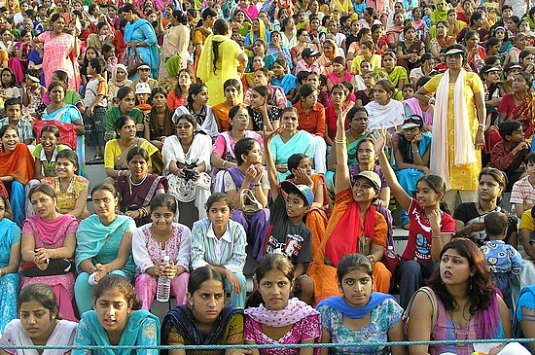
Cancer

Slide 5

Breast diseases %
95% benign breast disease
5% cancer

Slide 6


The Numbers Don’t Lie
240,000 new patients a year in India.
Every 3 minutes a woman is diagnosed.
Every 12 minutes a death occurs
  85% of breast cancer cases occur in women who have no identifiable risk factors.

Slide 7
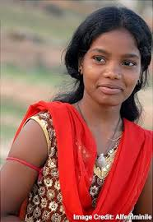

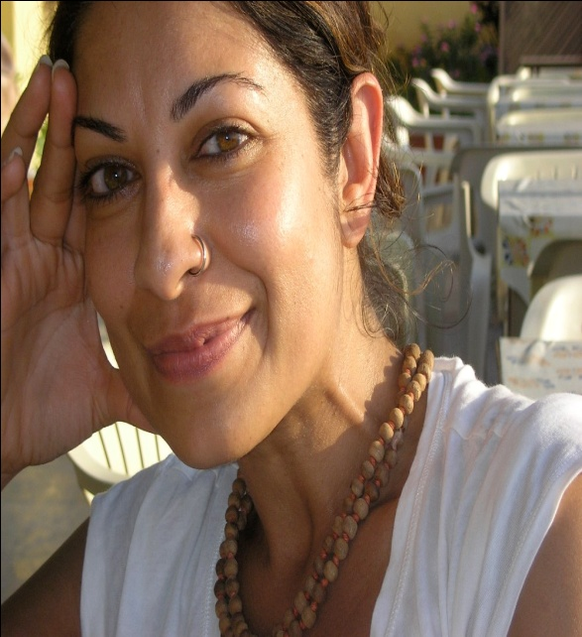
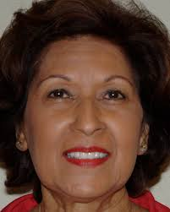
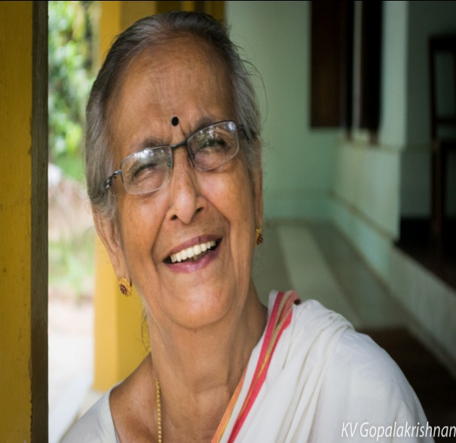
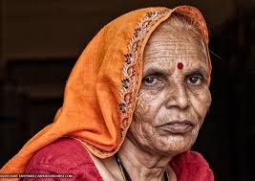
Below 20
20-30 Yrs
30-40 Yrs.
40-50 Yrs
50-60 Yrs
Above 60 Yrs

Slide 8

Benign disease are common in younger age group…

Slide 9

Which age group of females are suffering from breast cancer in our society????

Slide 11

61%
30- 40 Yrs
40-50 Yrs

Slide 12
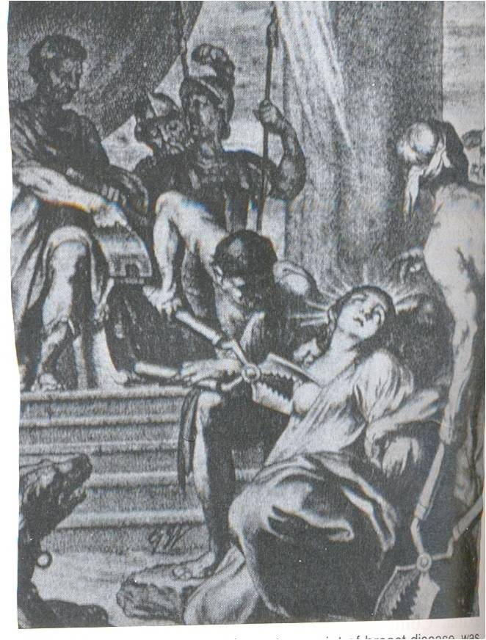
The evolution of breast cancer surgery

Slide 13
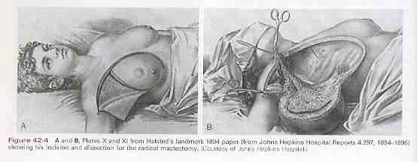

Slide 14
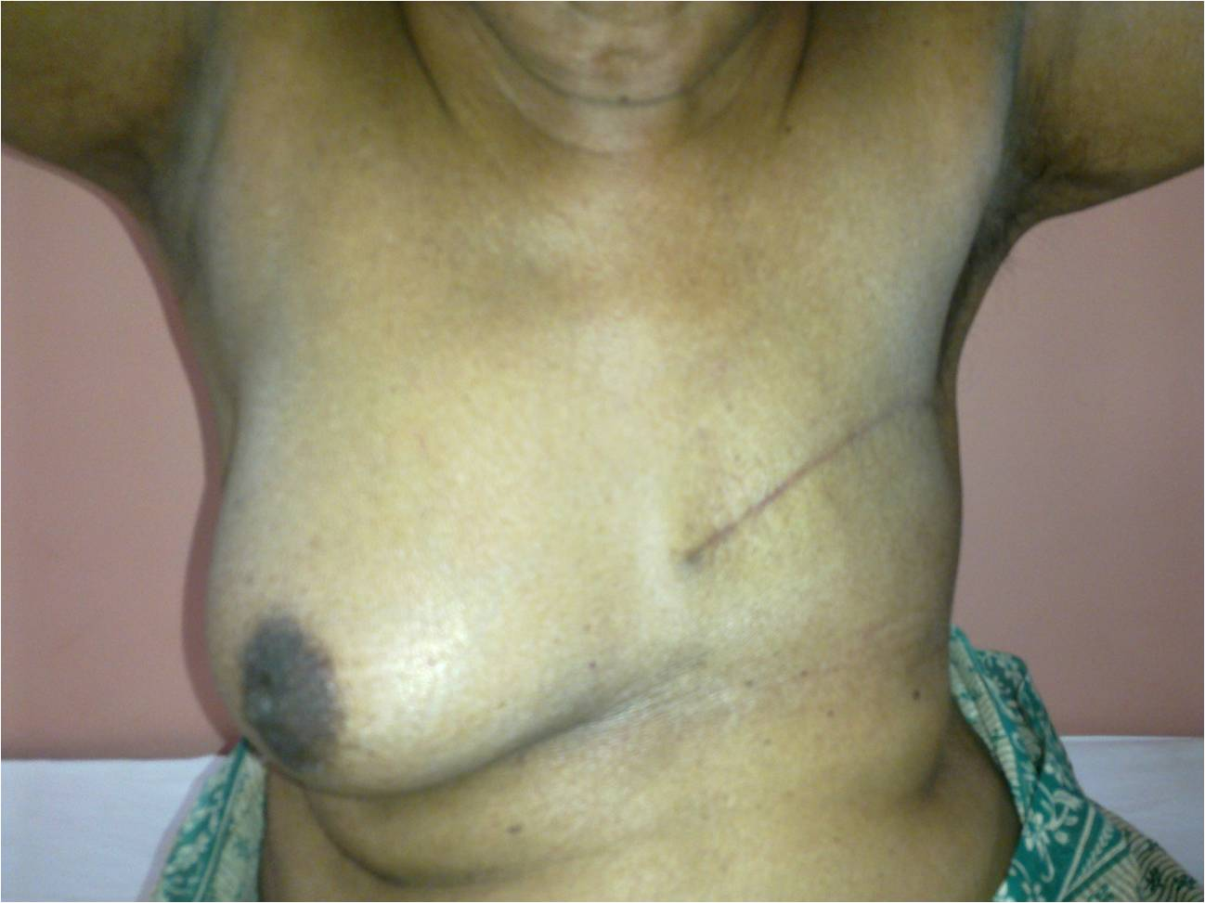


Slide 15
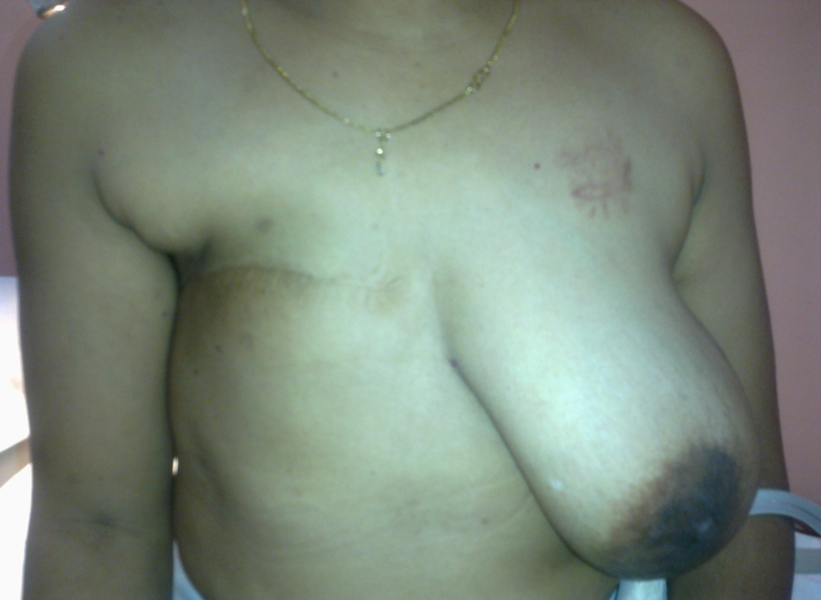

Slide 16
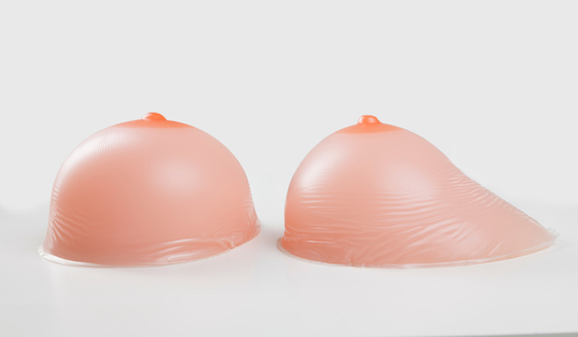
Silicon external prosthesis

Slide 17
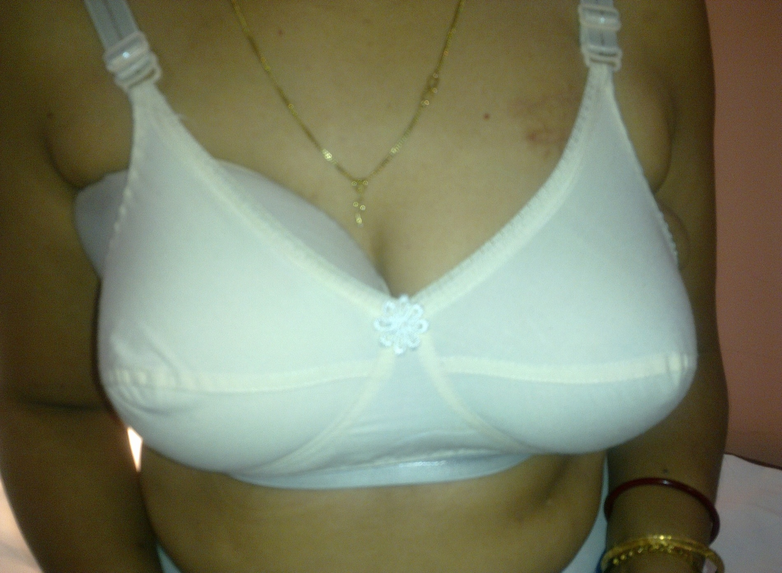

Slide 18
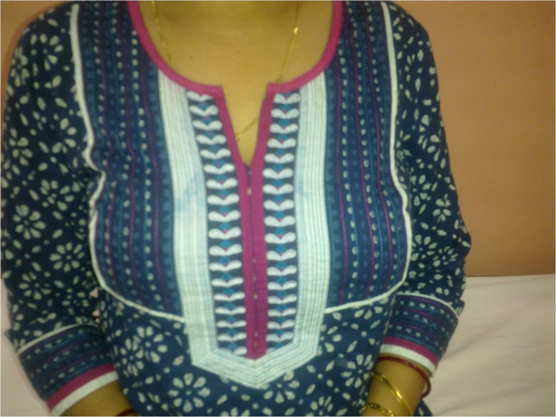

Slide 19
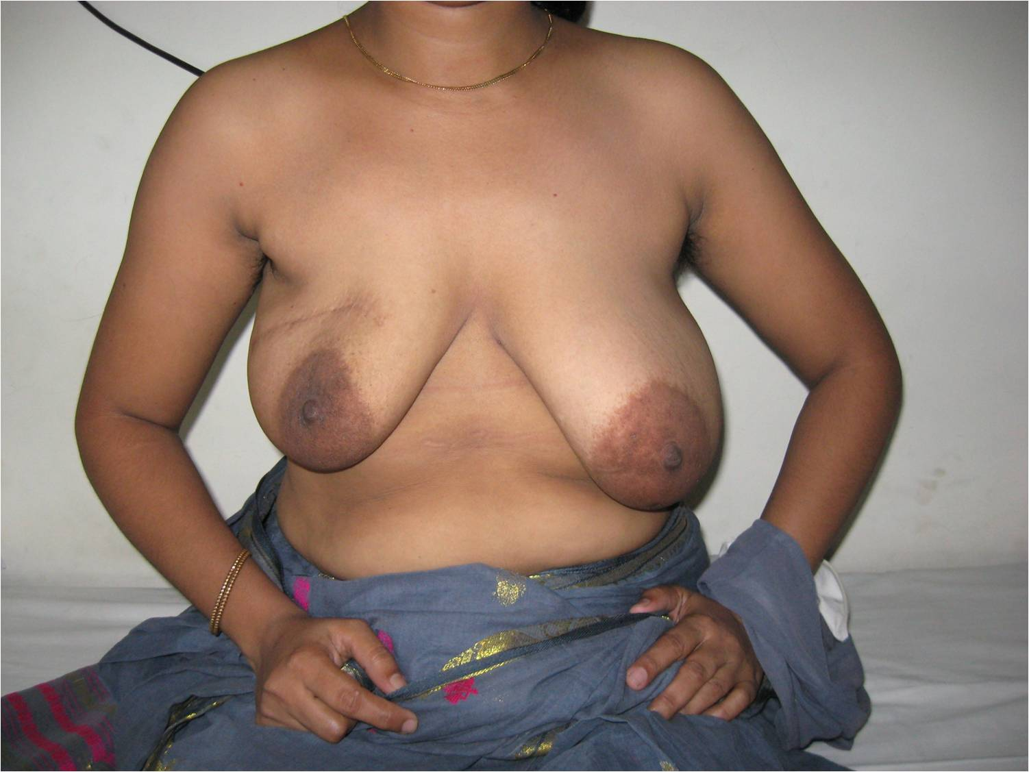

Slide 20
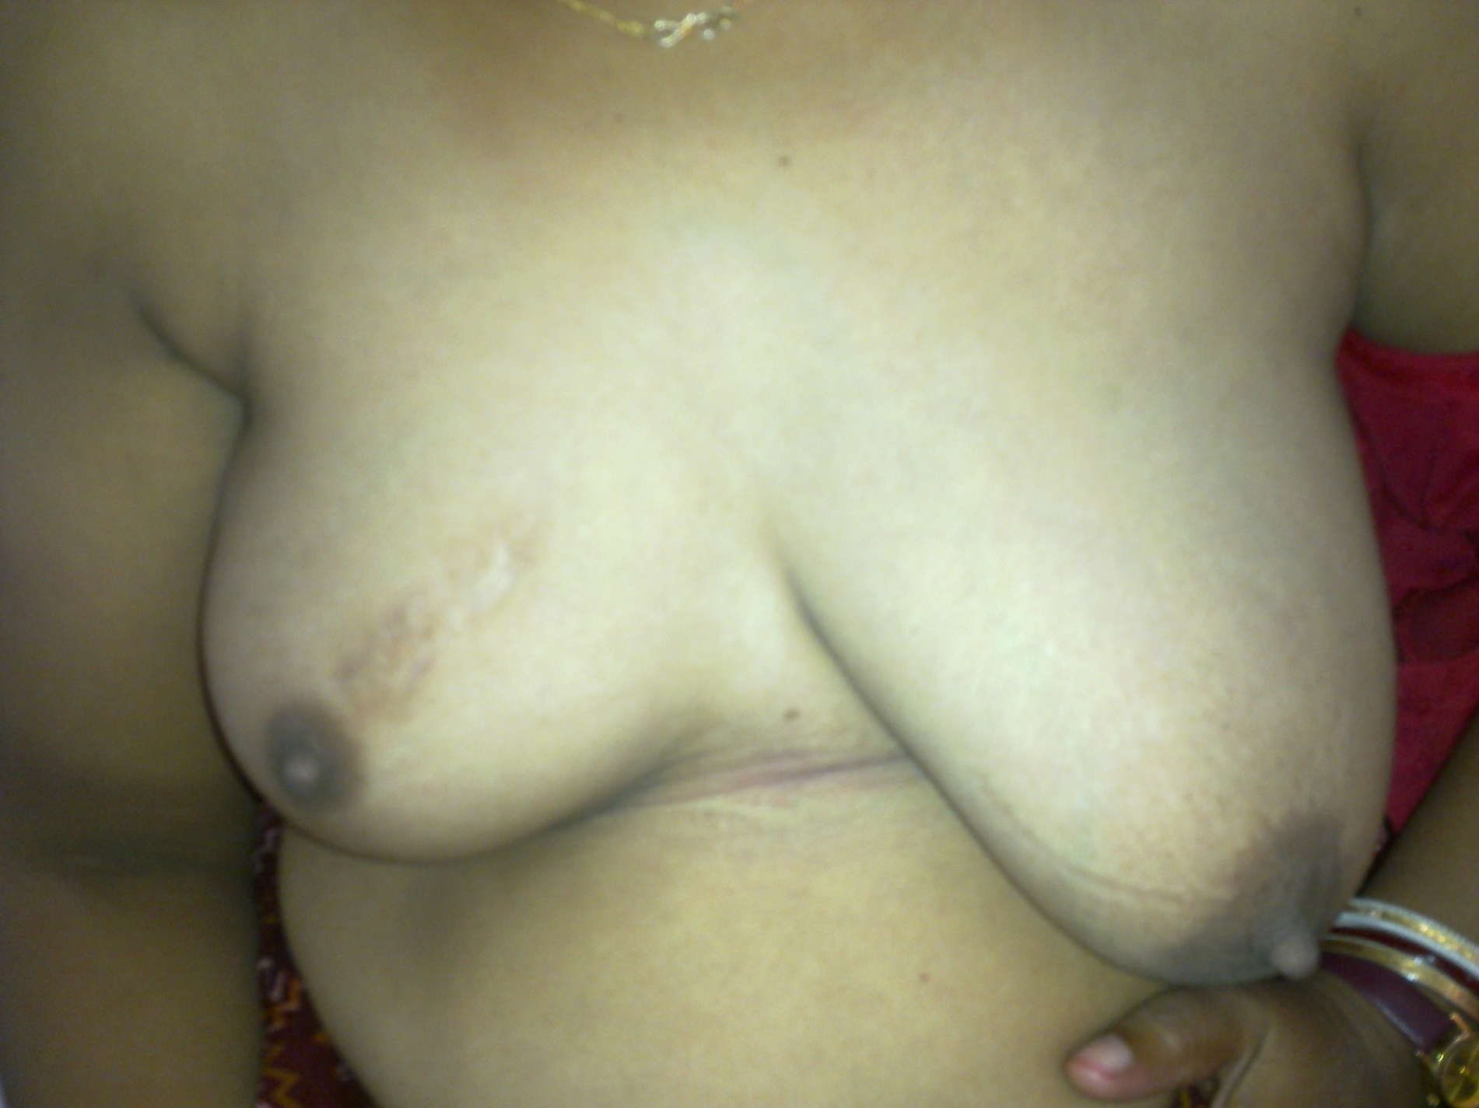

Slide 21
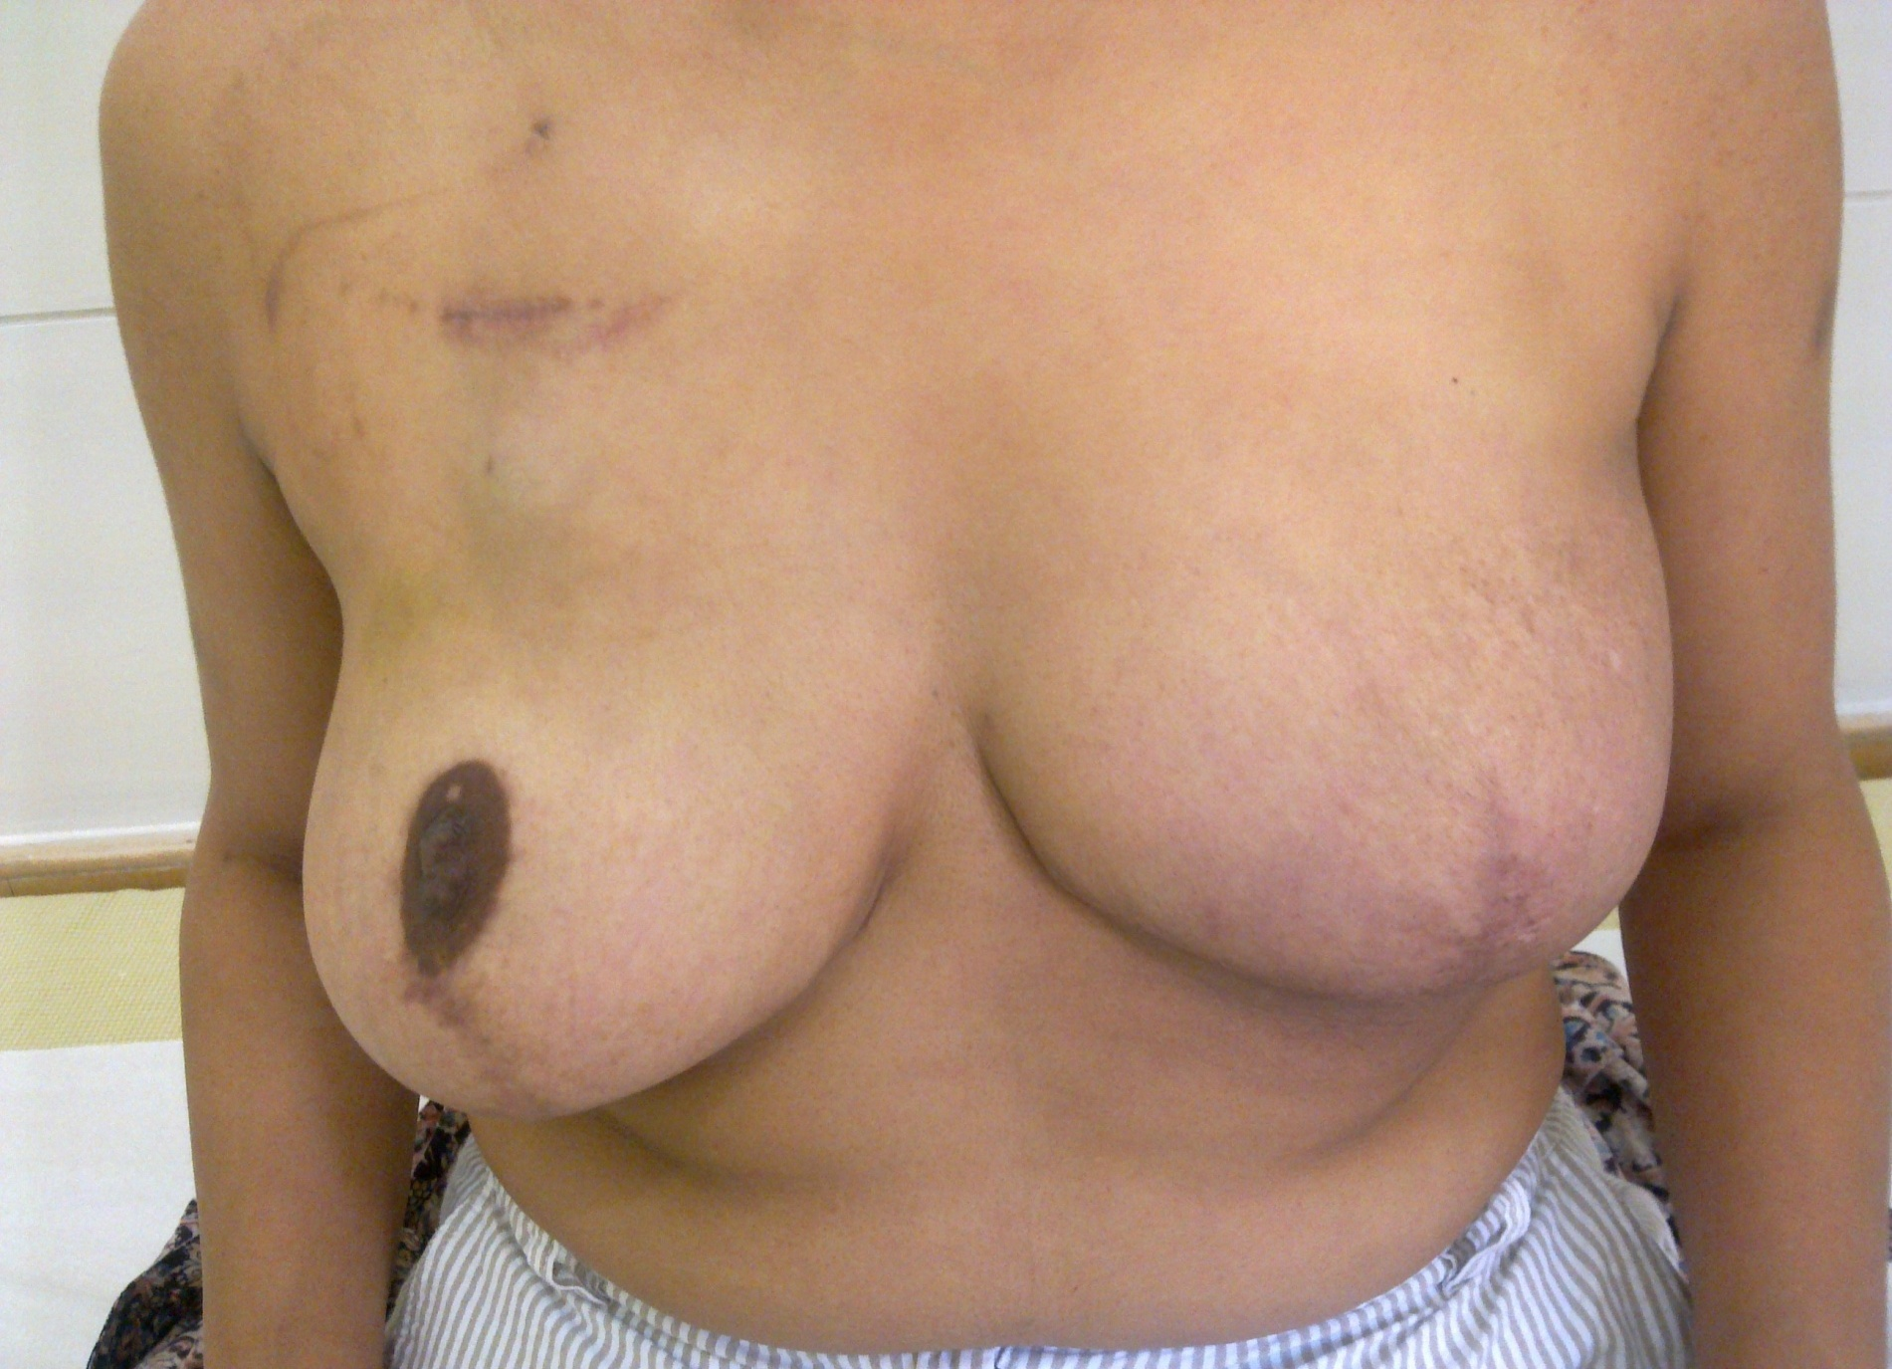

Slide 22

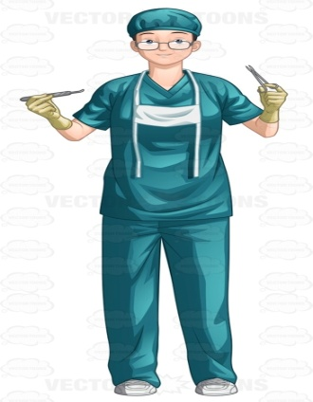

Breast Conservation Surgery
Early diagnosis and multidisciplinary approach can prevent mastectomy

Slide 23
Objectives of BCS
1. Surgically excise the bulk of tumor
2. Preserve cosmetically acceptable breast
Avoid BCS 1. If high risk of recurrence
2. Chances of complications
3. Unsatisfactory cosmesis

Slide 24
Absolute contraindication of BCS
Advanced breast cancer
Pregnancy -but can be done in 3rd trimester
2 or more lesions in separate quadrants or diffuse microcalcifications
Previous irradiation of breast
Persistent positive tissue margin

Slide 25
Relative contraindication of BCS
Collagen vascular disease- scleroderma or active lupus erythematus
Tumor breast ratio
Extensive intraductal component but if margins are clear BCS can be done
Medical contraindications - Subjective
Other influencing factors
1. Residence for follow up
2. Level of education
3. Financial condition
4. Age of the patient
5. Patient’s choice

Slide 26
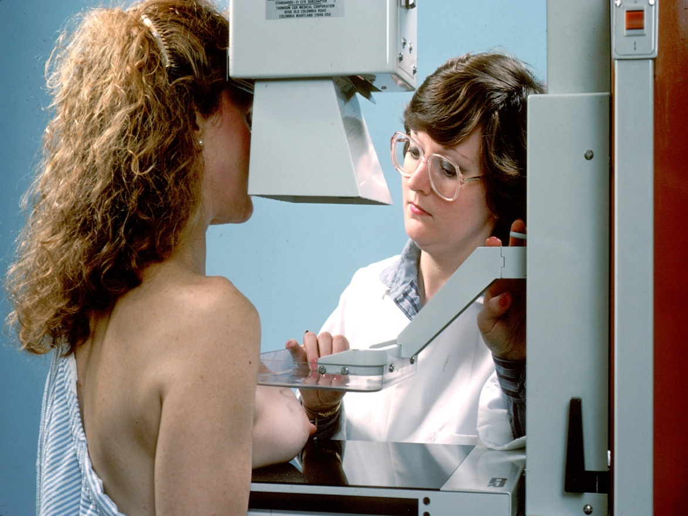
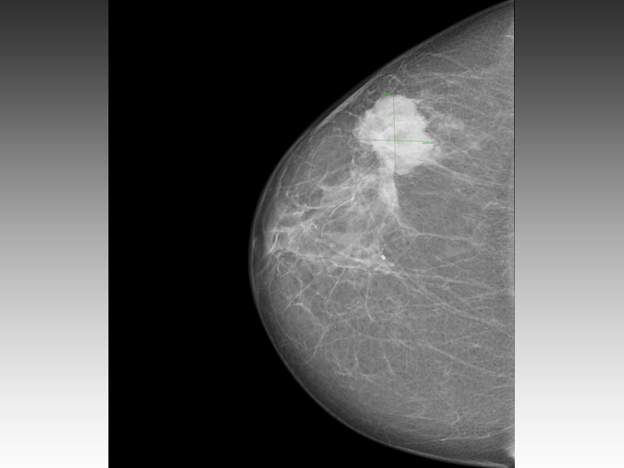

Slide 27
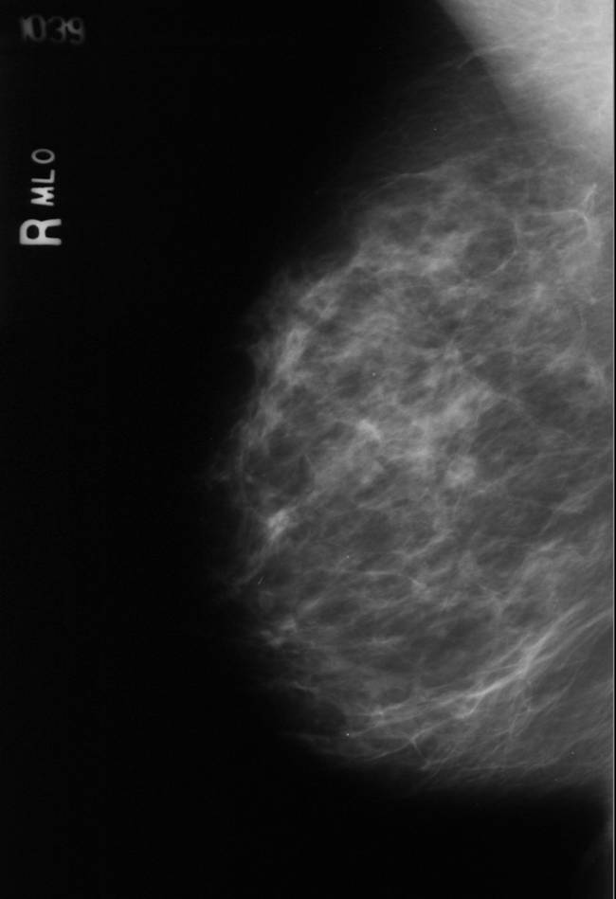
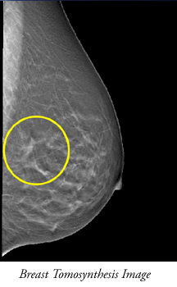
Comparison of Screen Film & Digital Mammography

Slide 28
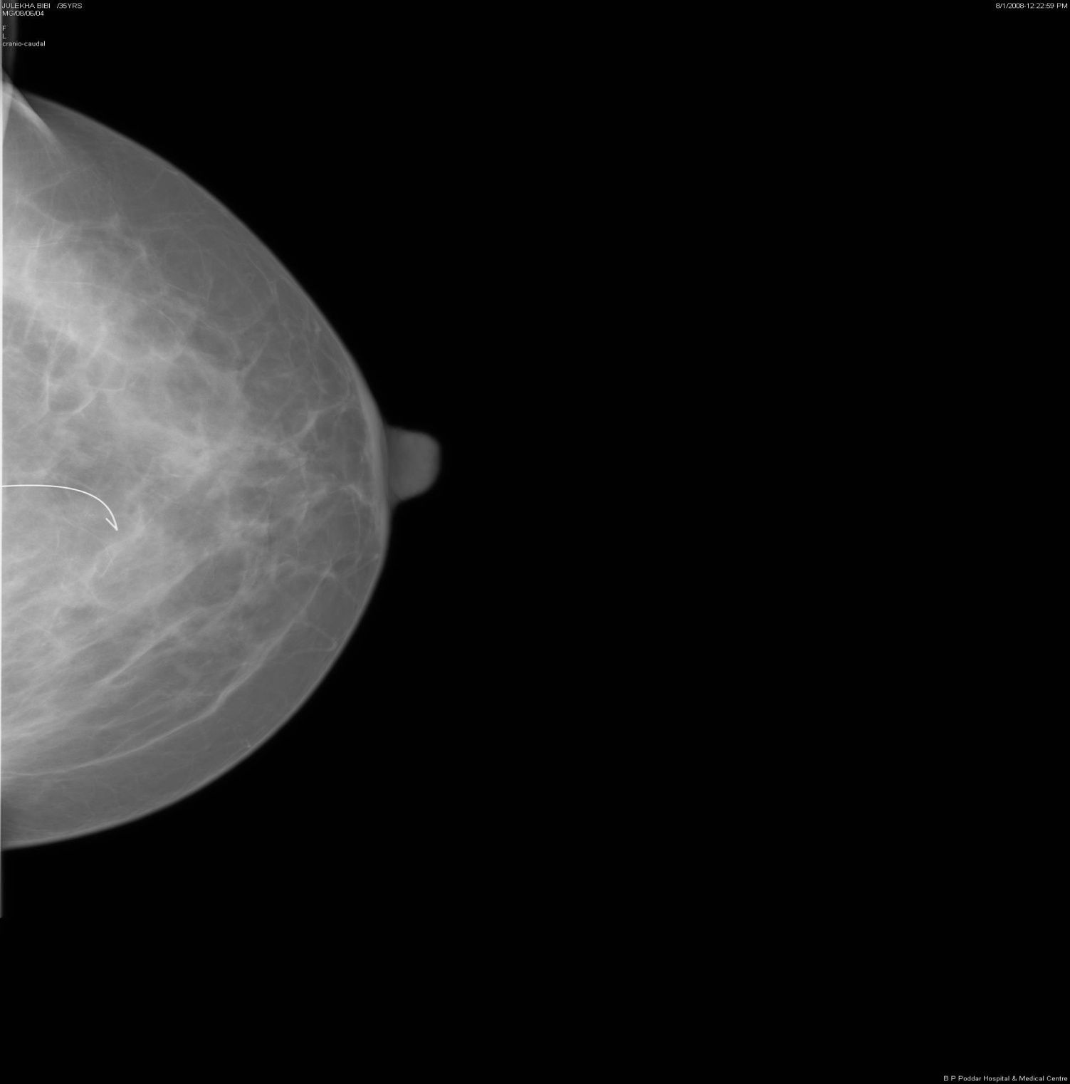

Slide 29
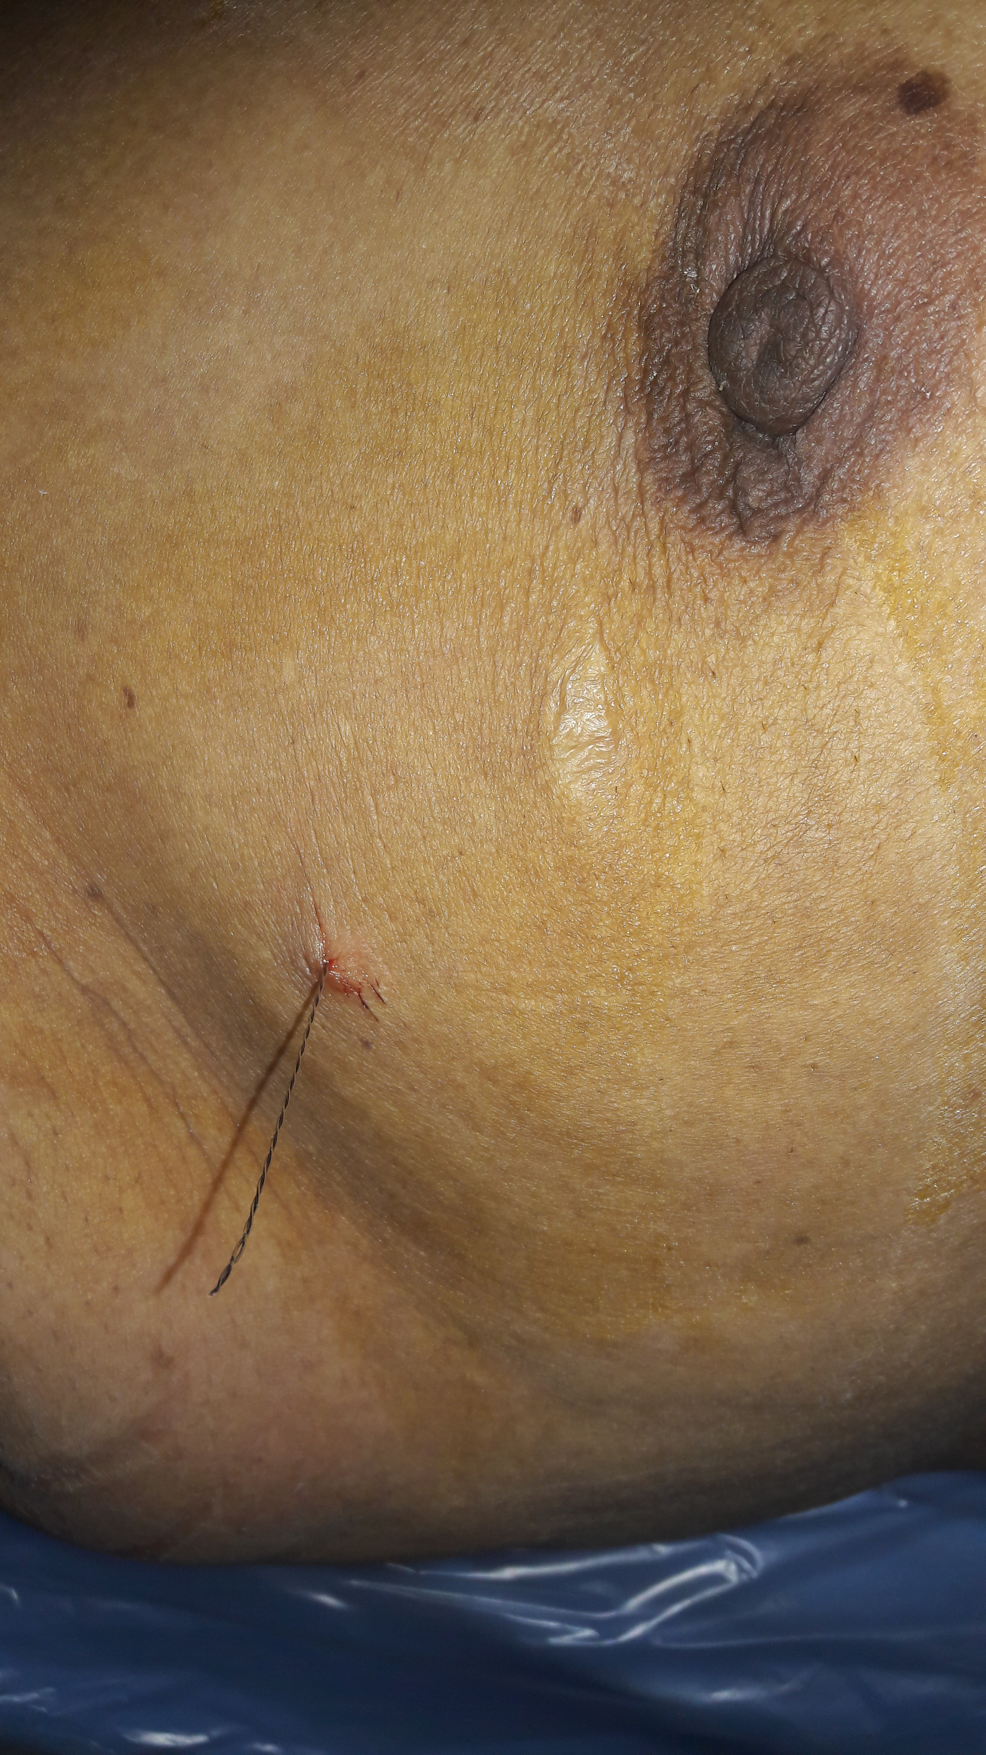

Slide 30
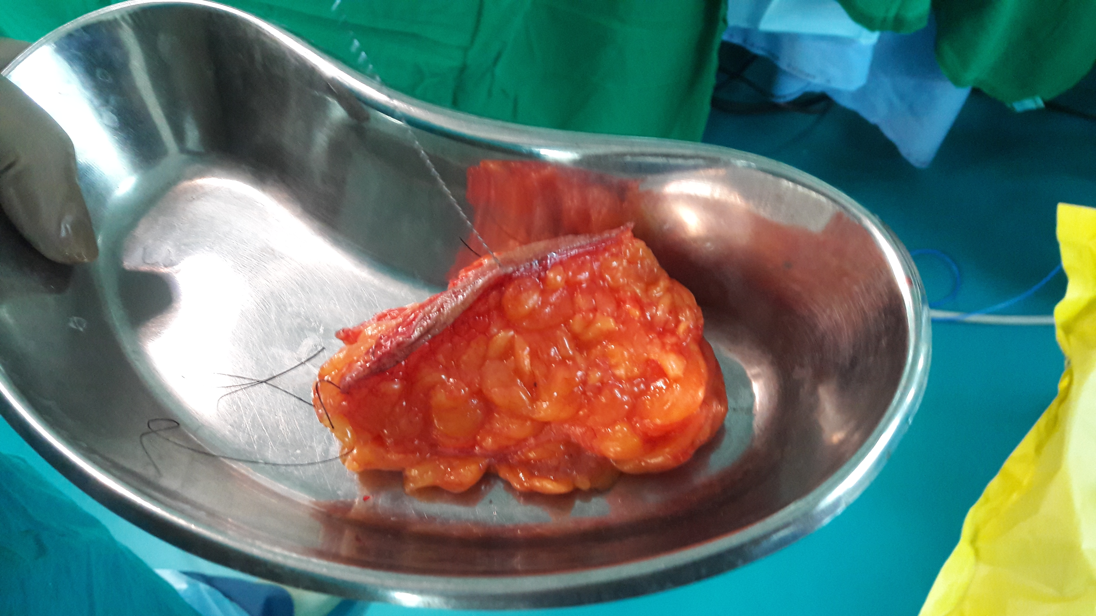

Slide 31
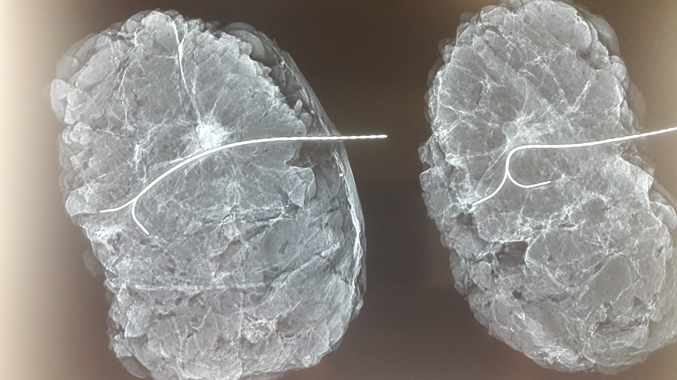

Slide 32
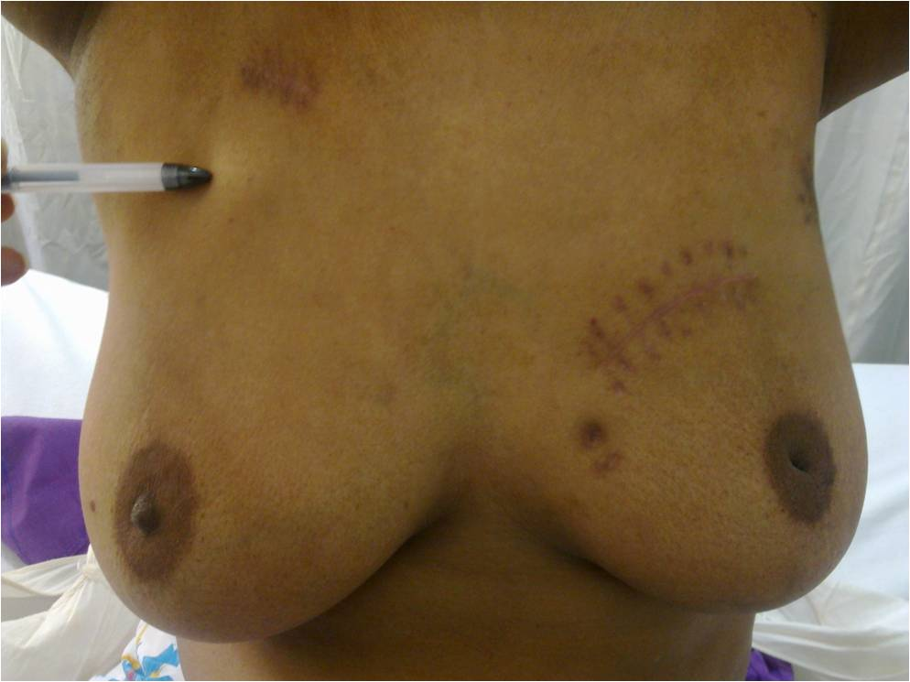


Slide 33
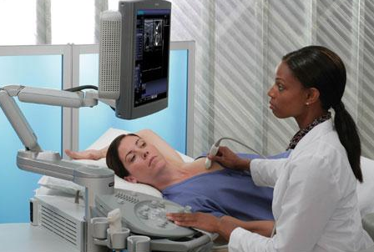
Ultrasonography of the breast

Slide 34
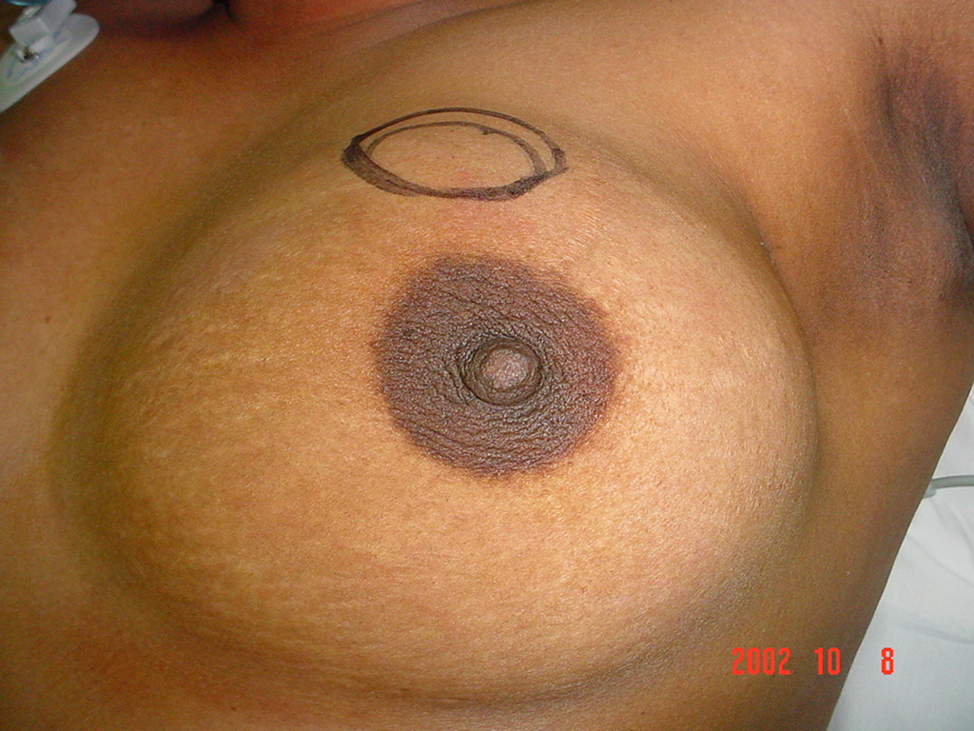

Slide 35
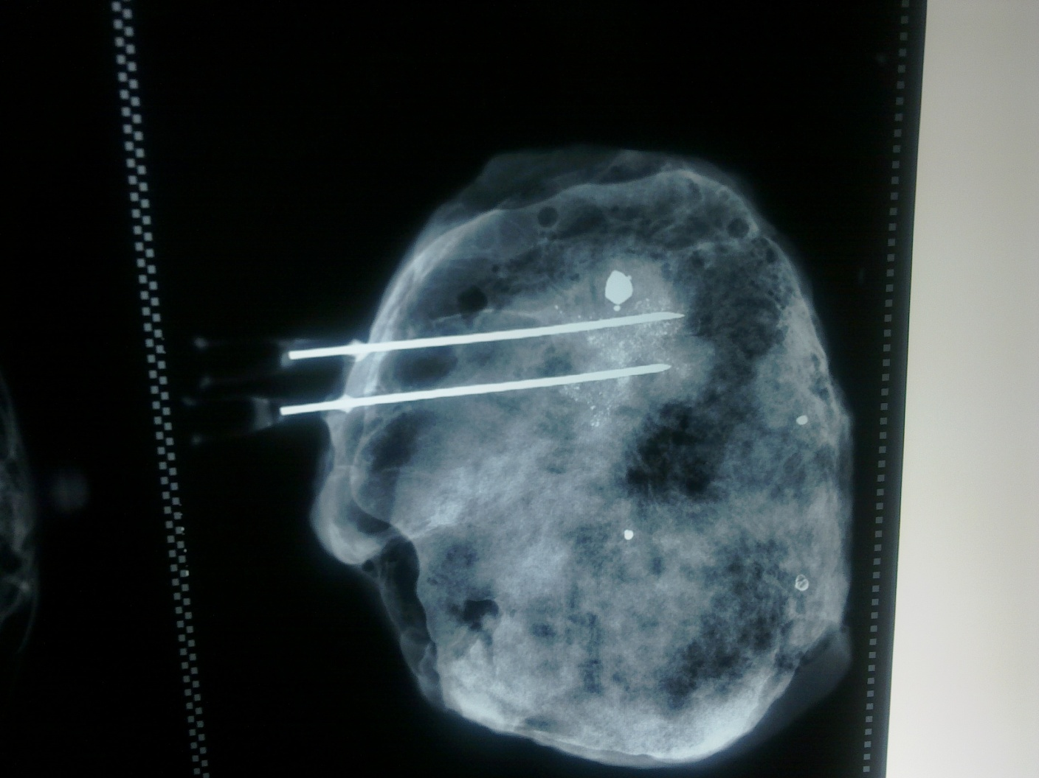

Slide 36
BCS WITH ADVANCEMENT RECONSTRUCTION

Slide 37
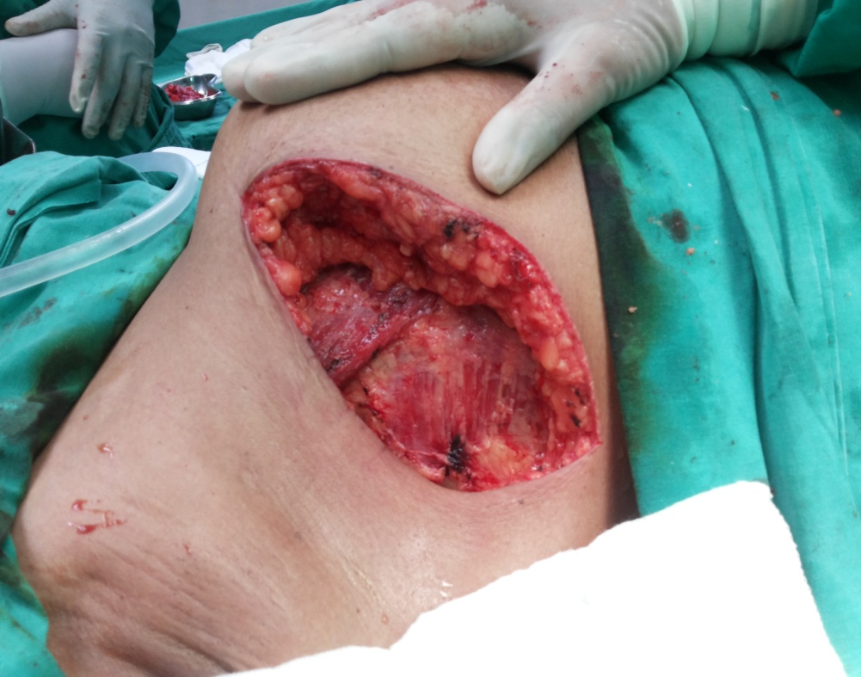
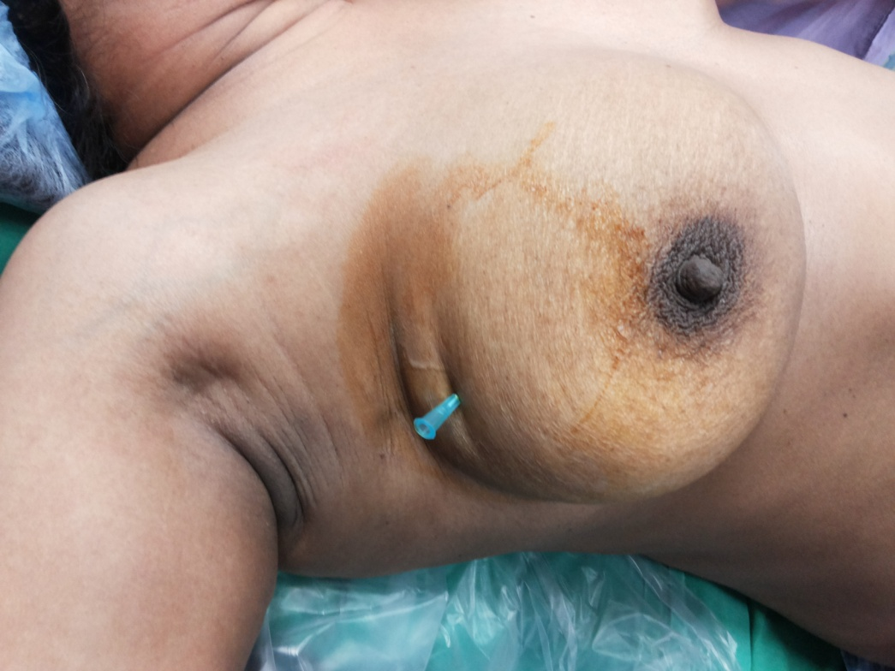
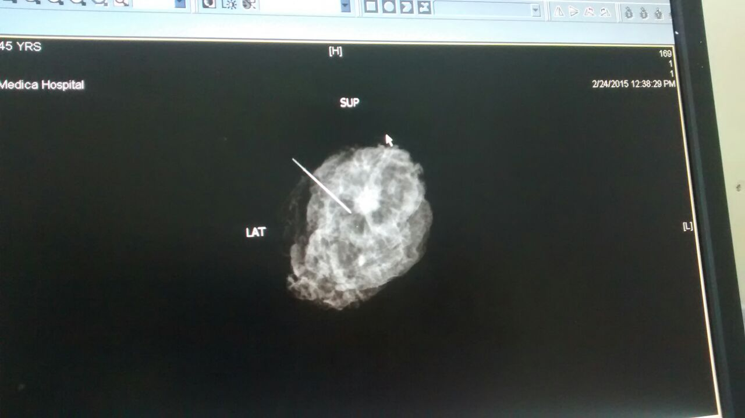
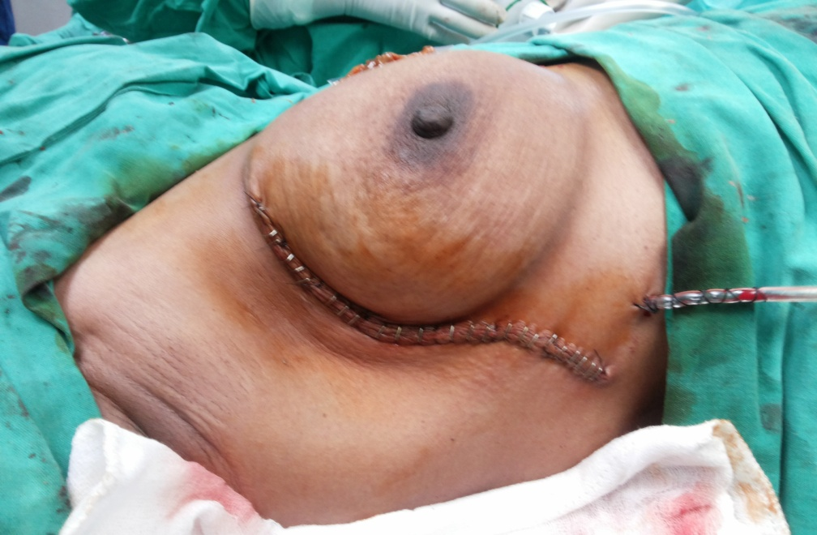

Slide 38
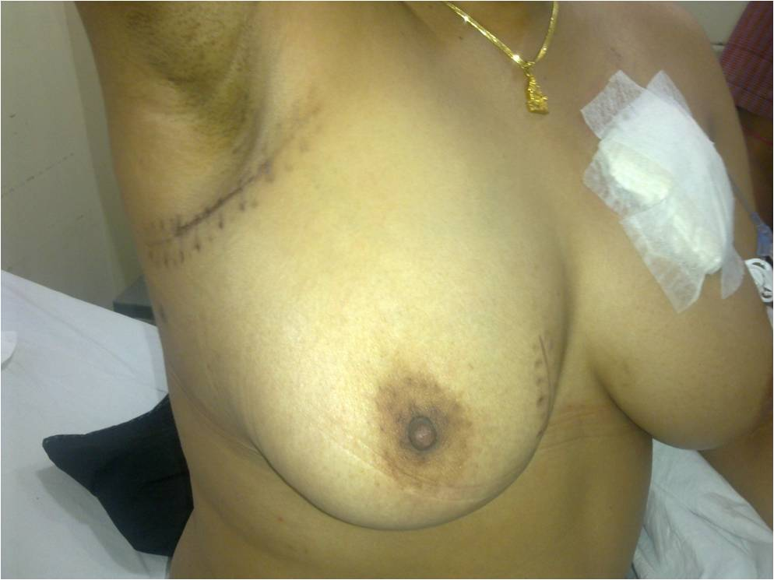

Slide 39
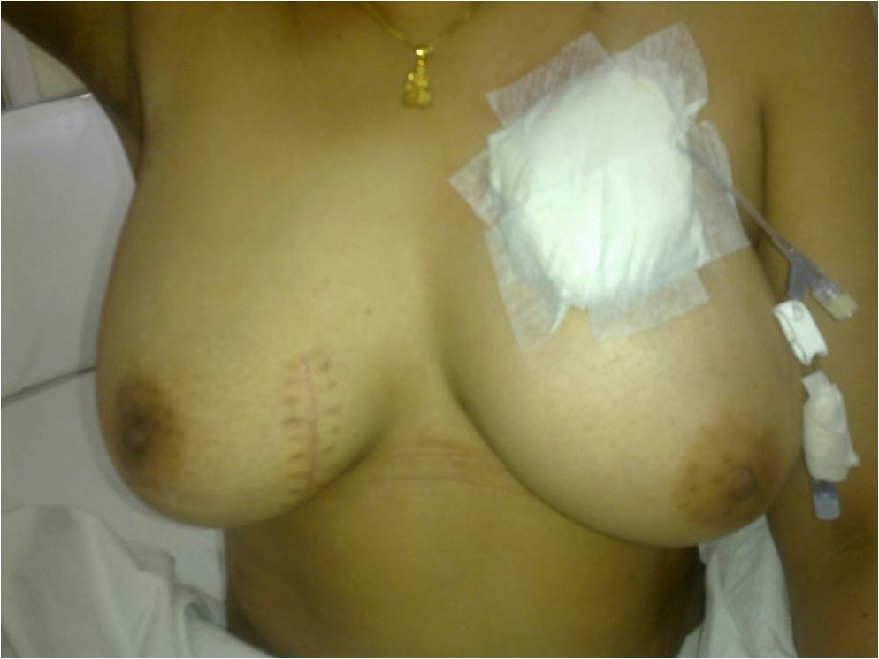

Slide 40
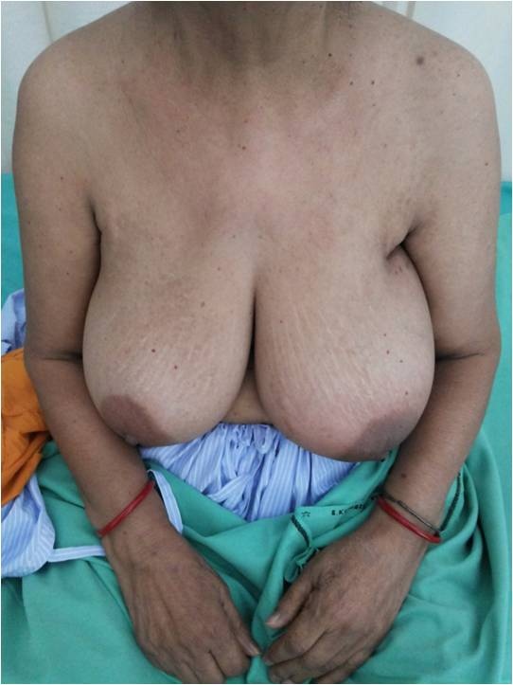
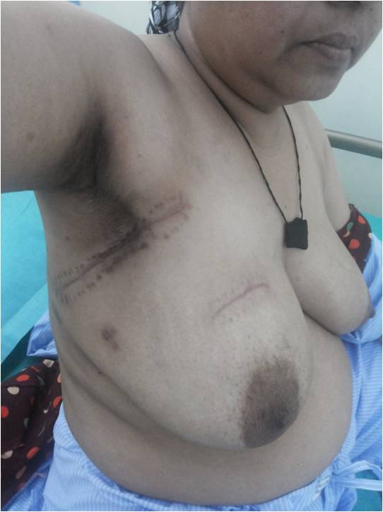
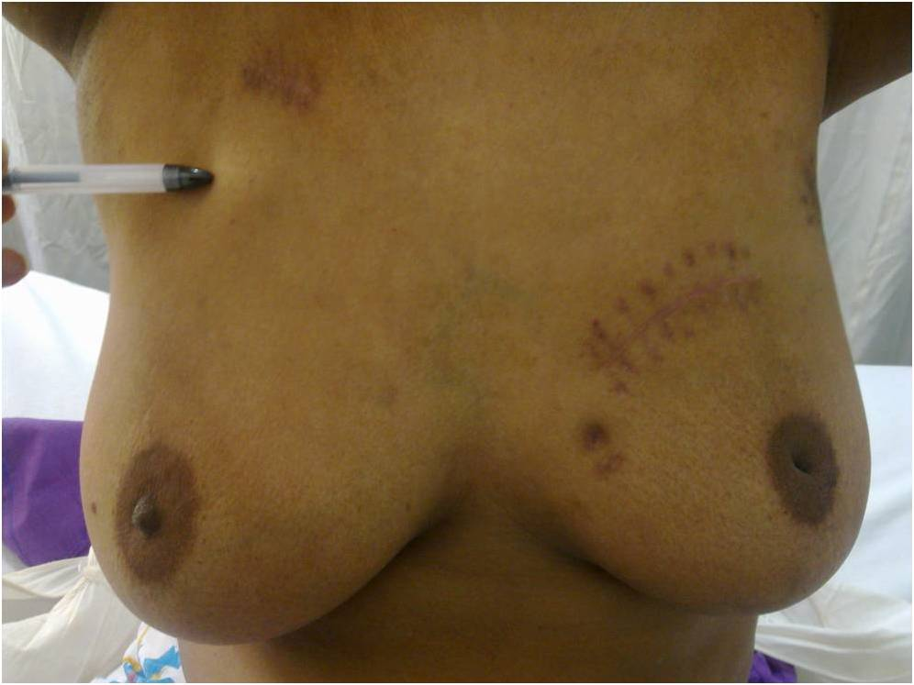
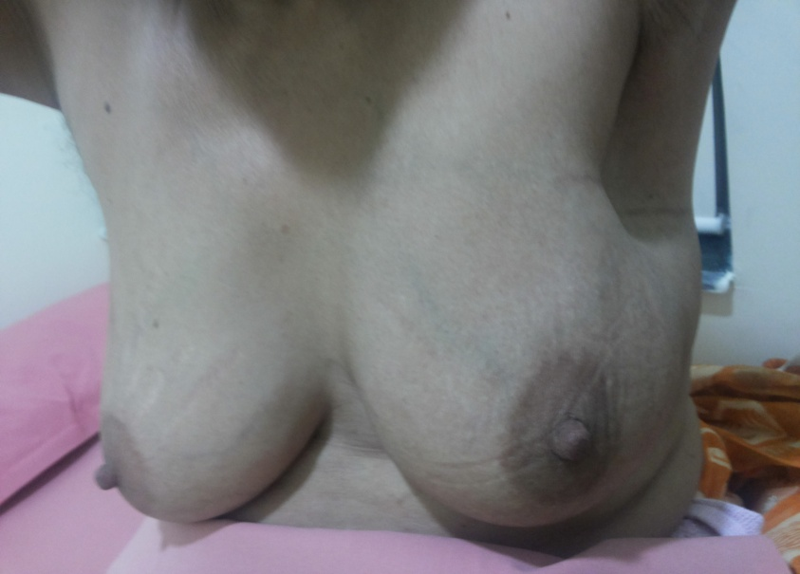

Slide 41
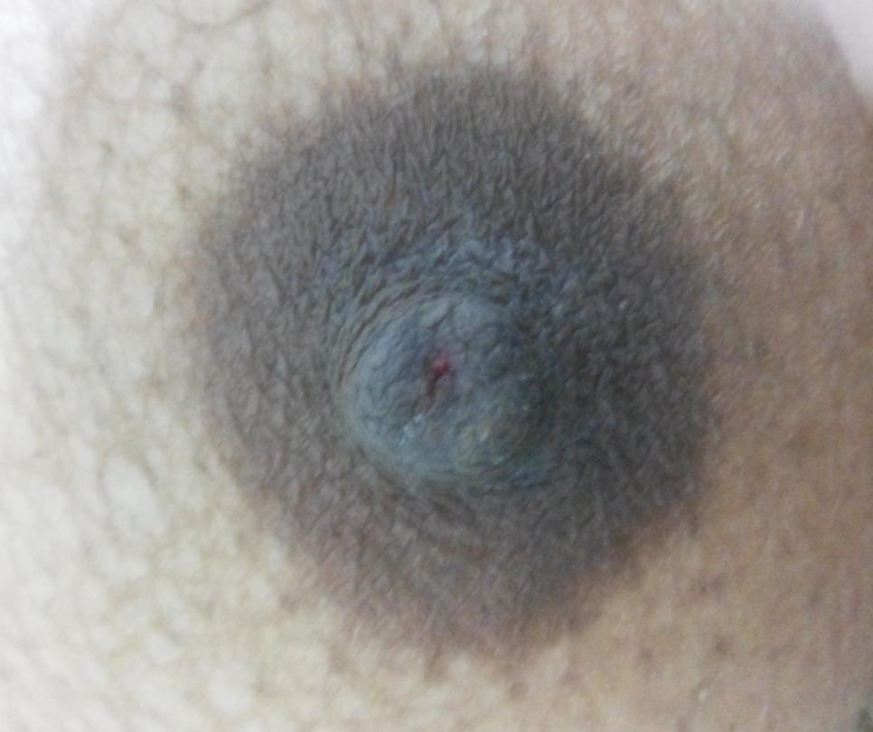
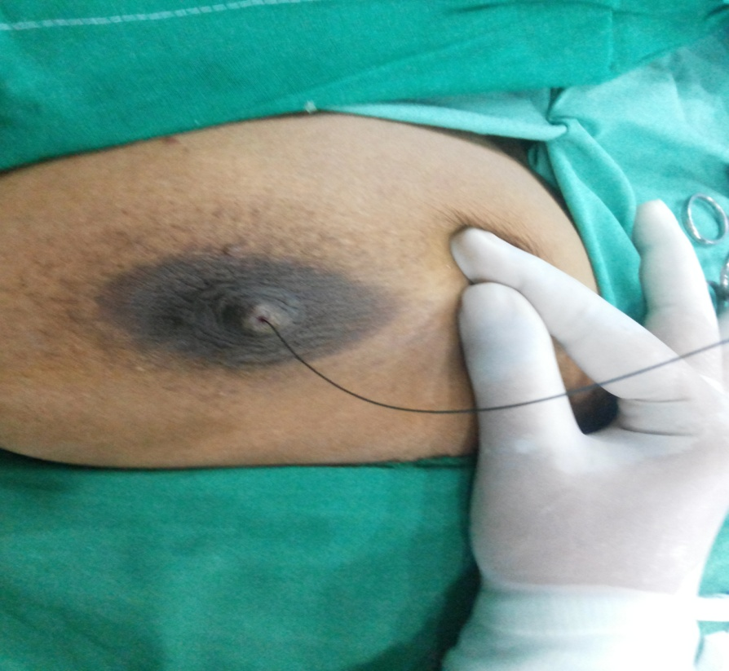
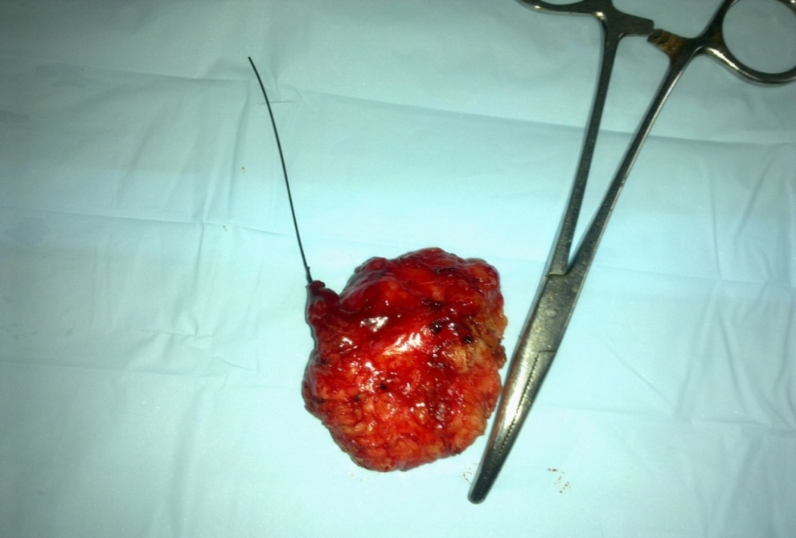
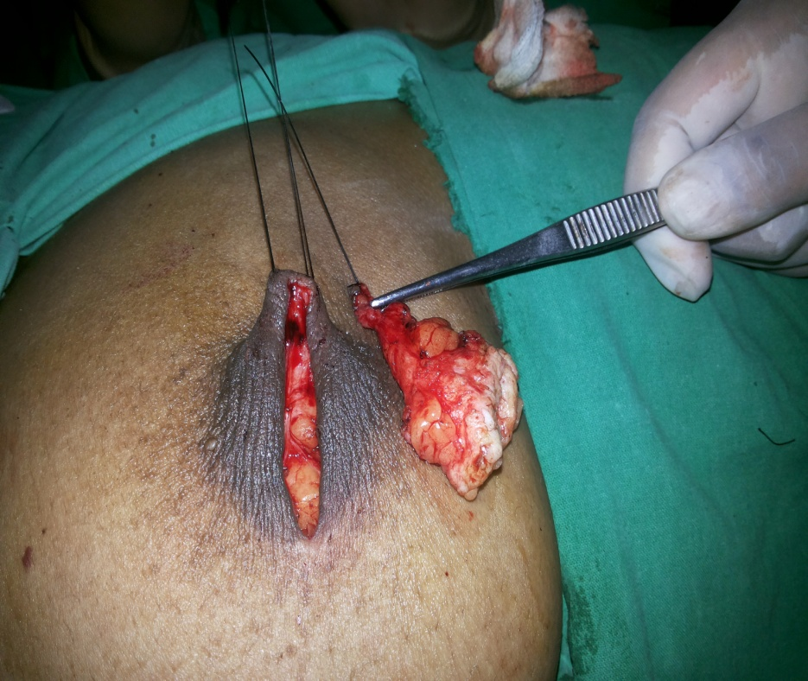

Slide 42
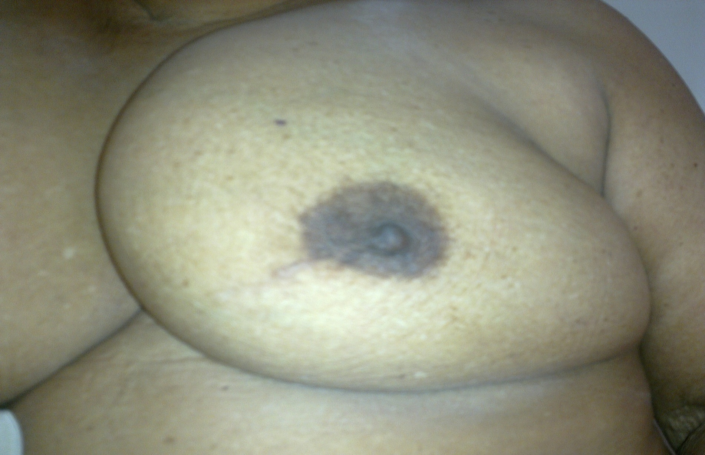
After 3 years

Slide 43
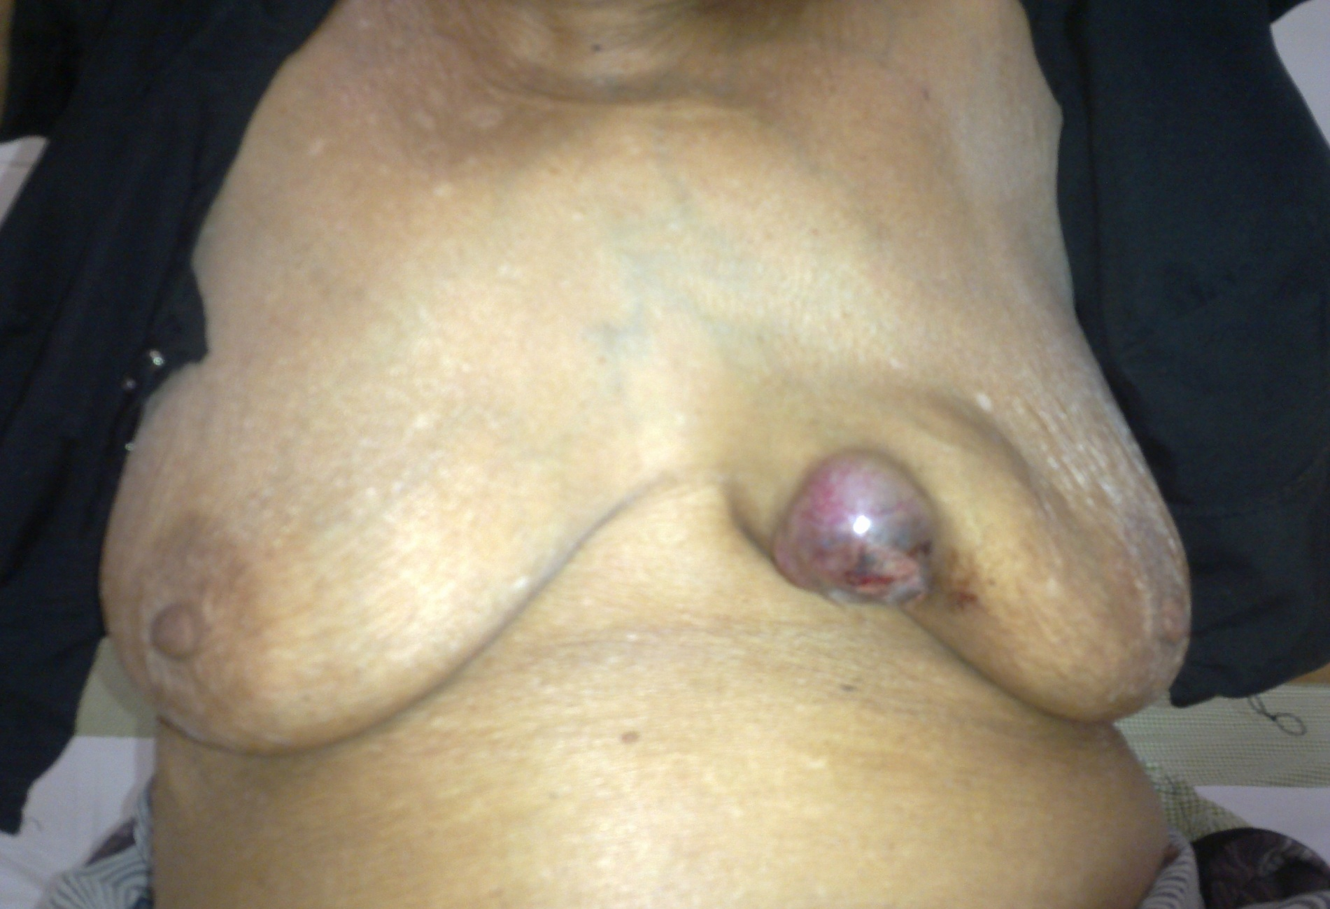

Slide 44
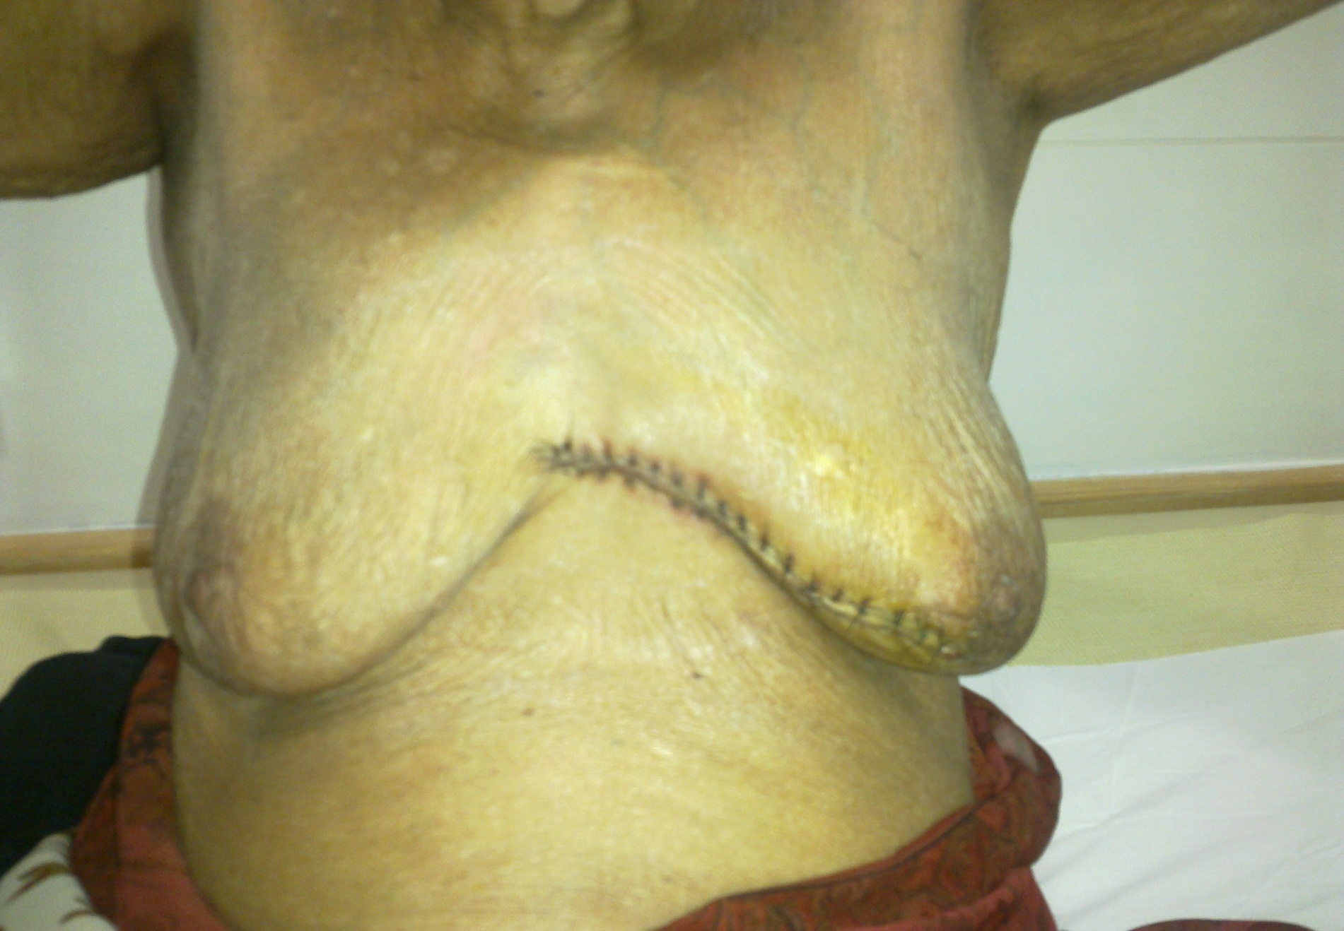

Slide 45
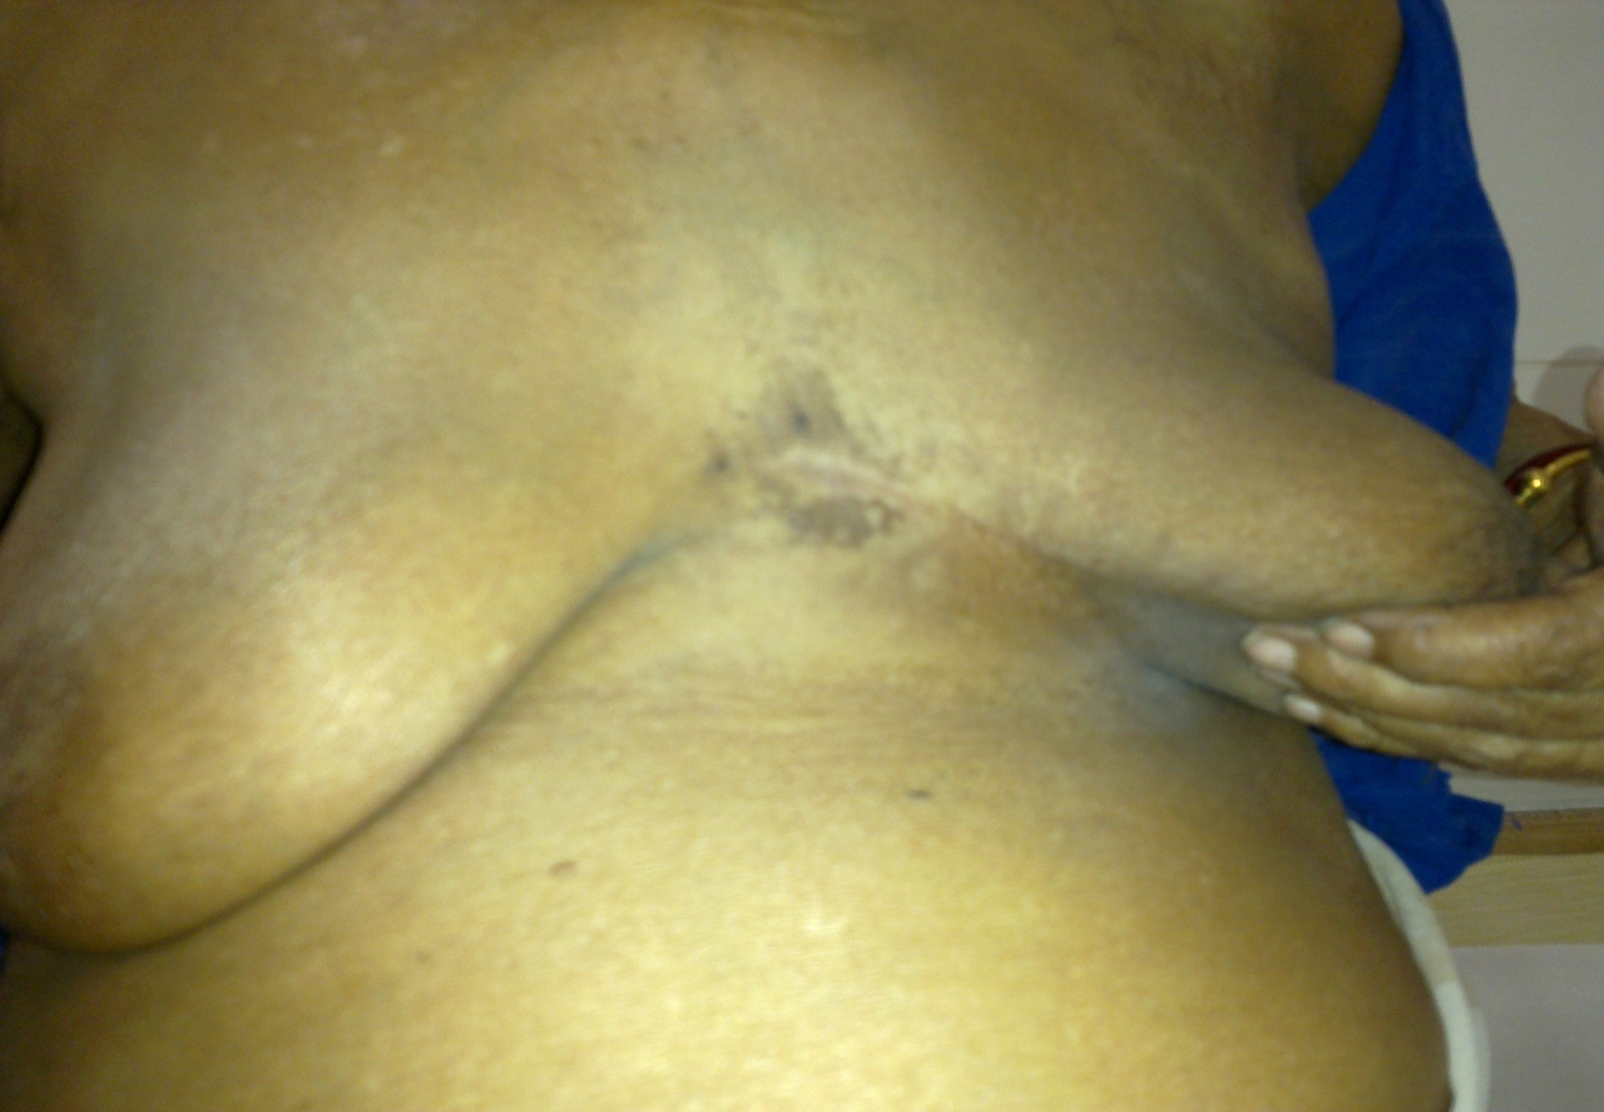

Slide 46
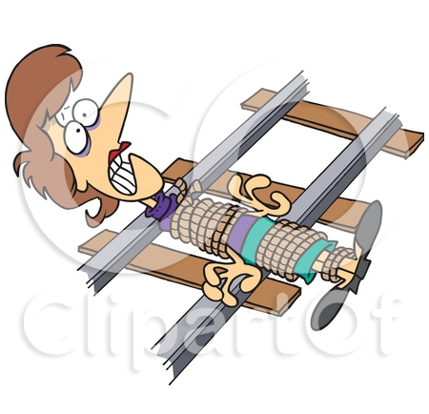
BUT…..

Slide 47
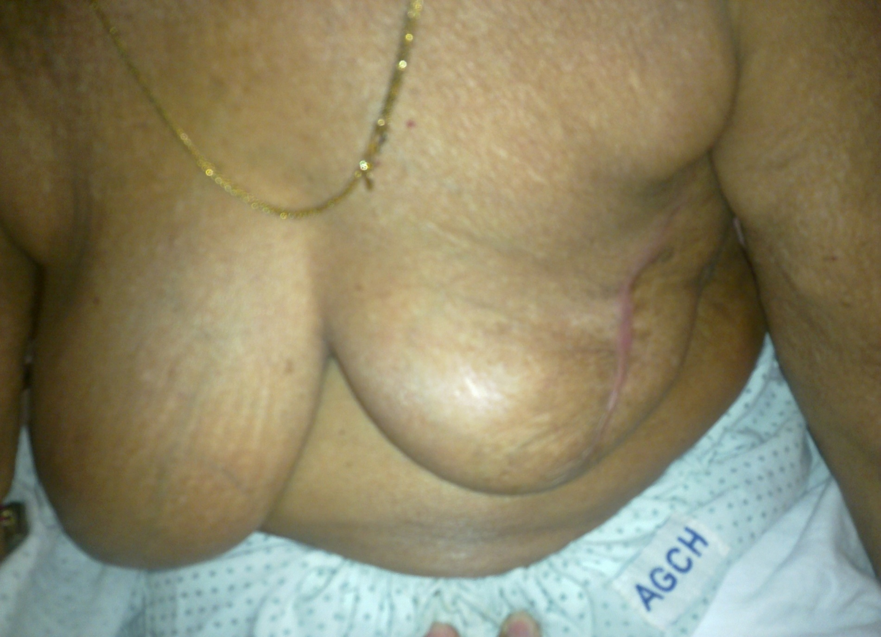

Slide 48
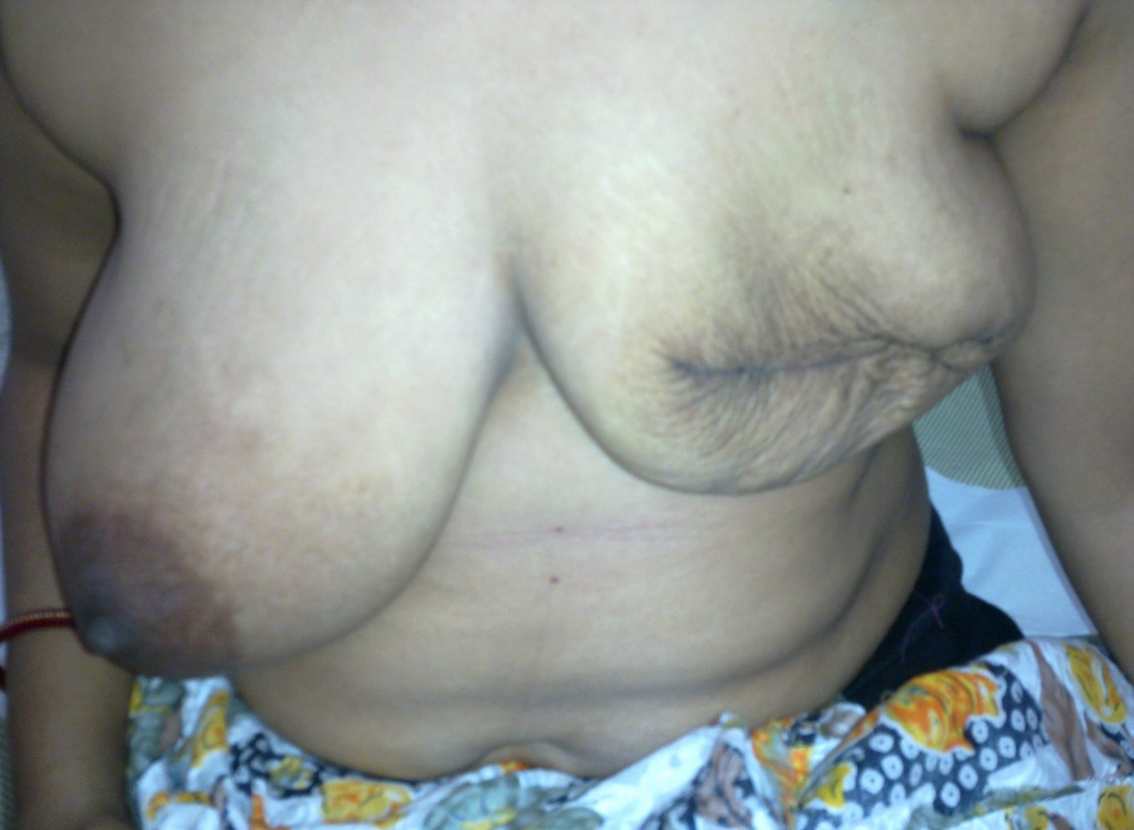

Slide 49


Slide 50


Slide 51


Slide 52


Slide 53


Slide 54

Prosthesis with poor cosmesis

Slide 55


Slide 56


Complications of axillary clearance

Slide 57


Slide 58
Sentinel node mapping & biopsy for axillary staging for breast cancer
Peritumoral or periareolar injection of
Blue dye
Methylene blue
Technetium colloid

Slide 59
How SLNB is done?
An SLNB is usually done as an outpatient procedure in the nuclear medicine department of a hospital.
The surgeon injects a radioactive substance (radiotracer), a blue dye or both into the tissue around the tumour or into the area from where the tumour was removed.
  The radiotracer is injected anywhere from 1–16 hours before the surgical procedure.
  It takes about 5 minutes for the blue dye to reach the sentinel nodes, so the dye is often injected in the operating room just before the surgery.
The dye or radioactive substance is taken up by the lymph vessels. It travels along the lymph vessels draining the area around the cancer to the sentinel lymph node(s).

Slide 60
A special scanning device detects the radioactivity in the sentinel lymph node(s), or the surgeon looks for the lymph node(s) stained blue.
  Sometimes, the sentinel lymph node cannot be identified.
  If the sentinel lymph node is positive or if it cannot be identified, then more lymph nodes will need to be removed.
The surgeon makes a small cut (incision) over the node(s).
The radioactive or blue lymph node(s) is removed and sent to the laboratory to be examined under a microscope by a pathologist (a doctor who specializes in the causes and nature of disease).

Slide 61


Slide 62


Slide 63


Slide 64


Slide 65


Slide 66

Oncoplastic Surgery

Slide 67

Reconstruction of breast

Slide 68

Immediate breast reconstruction after skin sparing mastectomy with extended latissimus dorsi flap

Slide 69

Tranverus Rectus Abdominus Myocutaneous Flap

Slide 70
THEN
NOW

Slide 71


