Slide 1
Emerging Technologies - Healthcare
Person’s Name Dipankar Khasnabish
Name of Meeting Bengal Chamber of Commerce & Industries
Date and Year 1st August, 2014

Slide 2
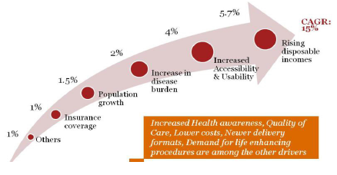
India faces a significant healthcare challenges
0.9 bed / 1000 population
An addition of 1 bed / 1000 will need around USD 80 B
Current population is 1.2 B to be 1.3 B by 2020.
29 % is Urban which is expected to grow to 40% by 2026
Middle class household > 3 times in the last 10 years
Elderly population is growing at 40 %
Healthcare Insurance is growing at 35 % - to cover over 35 % of the population from the current 2 %. IRDA driving this especially in the rural sector with innovative schemes and better coverage
Disease burden will increase significantly due to lifestyle and non communicable diseases.
Cardiovascular &Diabetes will double to nearly 60 M in 2015, while cancer will increase by 25% & mental health conditions will affect 6.5 % of the population.
Growing Spends by growing middle class
Increasing Urbanization
Growing Senior Citizen population / life expectancy
Epidemiological Transitions
Higher awareness – Changing Mindsets
Increased access to Health Insurance
Growing Medical Tourism
Improving Infrastructure and Specialized Skill

Slide 3
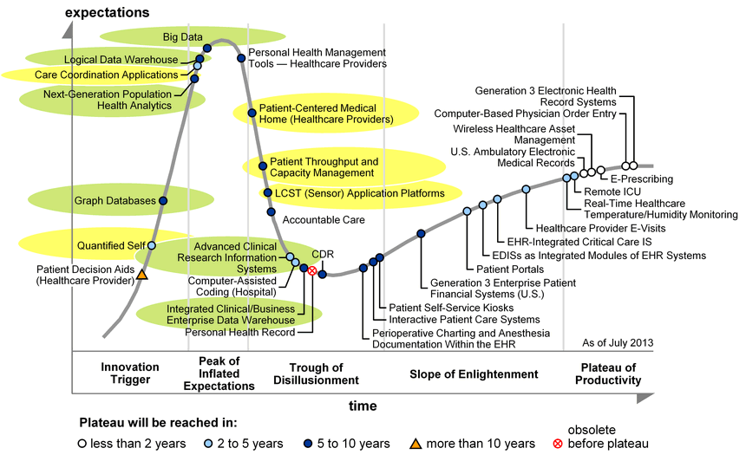
Emerging technology trends impacting healthcar
4G LTE / WiMax networks
Big data computing - Real-time analytics based on huge data volumes collected at high frequencies, Both structured and unstructured data
Mobility - Futuristic apps for citizens
Social media and collaboration - for better citizen engagement in planning / influencing behavior
Open source frameworks for Data Exchange
GPS - Highly accurate positioning
Cloud computing - Optimal and reliable IT infrastructure (e.g. all community systems), Platform apps for lower TCO (e.g. enterprise non-core apps)
Smart devices
Gartner Hype Cycle - Healthcare
India has emerged as tech superpower
Too many technologies, too much expectation

Slide 4
Healthcare clutter
Costs are going up, insurance penetration is still very low. 80% of families with significant health instance goes into permanent indebtedness
Healthcare spend only 6% of the GDP. Developed countries around 10%, many developing countries are higher. Only 25% is government spend.
CAN TECHNOOGY SOLVE ALL THESE
Huge market, great expansion plans, VC funding, corporatization of the healthcare
Pockets of excellence, very best in the world. Significant medical tourism. Indian doctors and nurses are in great demand globally.
Highly fragmented private sectors, 85% of the beds have below 15 bed facility
Technology adoption patchy. Largely done by large private hospitals. Public sector, small and very small players are yet to leverage.

Slide 5
Let us have a look at where we are – private sector
Status
Healthcare Management Information System (HMIS) is being worked on for decades
Global players are too expensive for India, also not localized
Local market is highly fragmented, estimated there are more than 300 players
Large & medium hospitals (100+ beds) has adopted some system, and significantly customized their needs
Small and very small players are wary of technology for various reasons, including the uncertainties associated with selection of vendors, lifecycle management, technical support, cost and uncertainty of data transparency
Even is large hospitals the adoption is patchy, primarily in the administrative side. The adoption in clinical domain is minimal.
Where have we achieved
Multiple systems are running hospital operations
Materials, Finance on ERP
OPD, Labs, Radiology on HMIS
IPD, OT manual
Almost no one is satisfied with IT adoption, and hence very limited value extraction
We have not been make adoption in clinical domain – doctors, nurses, paramedics. There are many broken links
IPD drug request being made manually
Lab samples are taken from IPD after generation of the bar code, followed by reconciliation
Procedures are retrospectively validated – with significant effort. This also has possibility of overbilling or revenue leakages
State governments (barring a few exception) are taking first steps of technology leverage through Healthcare Mission Mode Programme (MMP)

Slide 6
What we have
Technology adoption status
Administrative
Total spend 6% of GDP, USD 120B
Public sector spend USD 30B ~ INR 180,000 Crores
150,000+ sub health care centers, 24000+ Primary Care Centers, 5000 + Community Health Care Centers
A million beds
50,000+ healthcare facilities in private sector
A million doctors
A million nurses
A million Accredited Social Healthcare Activist (ASHA workers)
750 K Angandwadi workers
Clinical
Para Clinical
HOW DO WE EXTRACT VALUE FROM WHAT WE HAVE?

Slide 7
Opportunities
Asset Utilization
Beds – can the hospitals leverage free beds, specially ICU beds
Equipment – use high value equipments like MRI, CT scan in off hours
Facilities – cross leverage lab, radiology
Patient Comfort
Registration – portability of registration with Unique Number across the nation
Online booking of doctor/ facility
Updates – SMS based, Social Media
Standardization
Disease code – ICD 9/ ICD 10
Procedure code – standardization
Asset codes - standardization
Portability
Patient details – on a smart card
Patient records – in a central repository

Slide 8
Process Flow and Technology relevance / readiness mapping – typical hospital
 | Guest Relations | Front Office | Insurance | Registration | OPD | Laboratory | Radiology | MRD | IPD | OT | Purchase | Pharmacy | Store | Billing
Patients | Y | Y | Y | Y | Y | Y | Y | Y | Y | Y |  | Y |  | Y
Doctors |  |  |  |  | Y |  |  |  | Y | Y
Support Staff | Y | Y |  | Y | Y | Y | Y | Y | Y | Y |  | Y |  | Y
Material
Notes
OPD Out Patient Department
MRD Medical Records Department
IPD In Patient Department
OT Operation Theatre
Process mapping
Department | Technology Criticality | Technology Adoption - Private Sector | Technology Adoption - Public Sector
Guest Relations | Low | Low | Low
Corporate Front Office | Low | Low | Low
Insurance Desk | High | High | Low
Registration Desk | High | High | Low
Central OPD | Medium | Low | Low
Private OPD | Medium | Low | Low
Laboratory | Medium | High | Low
Radiology | Medium | High | Low
Medical Records Department (MRD) | High | High | Low
Ward | Medium | Medium | Low
OT | Low | Low | Low
Mortuary | Medium | Medium | Low
Pharmacy | Medium | High | Low
Billing | High | Medium | Low
Purchase | High | Medium | Low
Store | High | Medium | Low

Slide 9
What can be done
Boundary conditions
Public sector spend will not dramatically improve, Number of beds, doctors, nurses; supplies and equipments will continue to be in the present state
1:600 ratio of doctor to patient ratio will remain between urban and rural India. Unattractiveness of rural posting will not reduce
Eagerness to recoup the investment in medical studies will remain a reality
Adoption of technology by the clinical staff (including the doctors) will remain low
What can be way forward
Look at technology as an enabler, not a solution
Instead of looing at a big band solution, break down the issues into smaller segments and prioritized based on a cost benefit analysis
Let us not look at enterprise model for adoption, rather look at priority for each of the stakeholders and build a solution around that

Slide 10
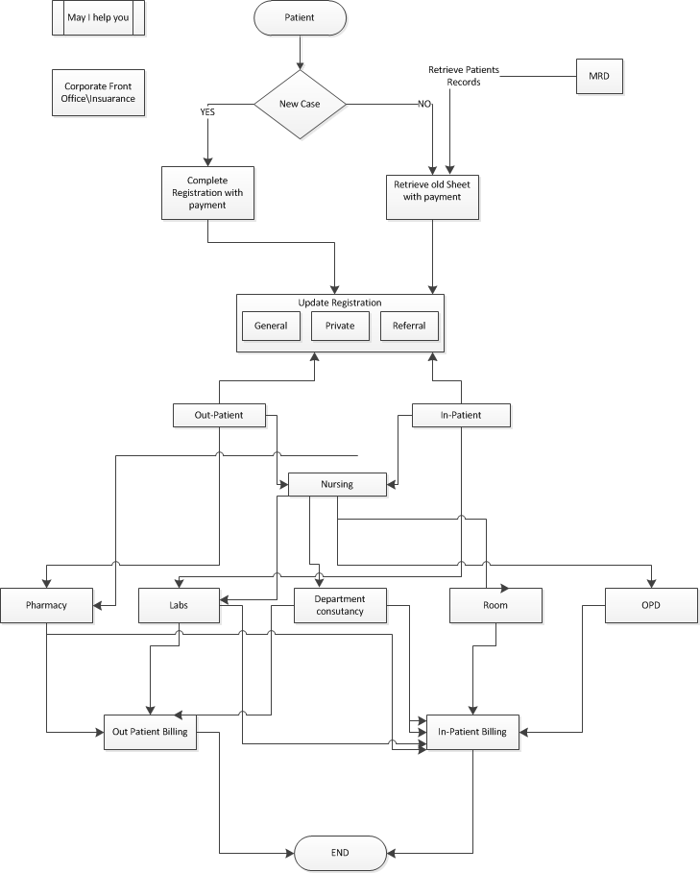
Value Leverage - Patient Workflow

Slide 11
Case Study – How do we ensure repeat visits (including repeat visits) are productive
Assumptions
Average patient visit in India – 1 Billion (no data available, but pro-rated based on US data
30% requires lab/ radiology/ day care process interventions, with repeat visit
50% of the visit to PHC non productive – doctor not there/ supplies not there/ holiday
Approximately 500 million repeat visits
Approximately 50% are non productive half days
250 million person days of effort is lost from economy
Solution
840 million cell phones
SMS cost is almost zero
Simple SMS based alerts can help release bandwidth
GDP loss – INR 2,500 Crores

Slide 12
Case Study – Reduce Check Out time in Hospitals
Assumptions
Large hospital chains are having 50,000 beds
Average bed occupancy 80%
Average stay – 2.5 days
% of insurance patients – 50
Average time for discharge – 6 hours
Average revenue per bed – INR 75Lakhs
Solution
Tighter integration of payer and provider, link the HMIS with MIS
Use standardized data – not just for diseases (ICD9/ ICD 10), but also procedures and consumables
Strengthen the Third Part Administrators (TPA)
Estimated revenue loss – INR 500 Crores
Excludes delay in medium and small hospitals
Excluded non-insurance cases
Note
Data indicative in nature, used to arrive at broad trends

Slide 13
Case Study – Portability of data
Smart card for patient data
Basic demographic and medical data with or without a photo
UHID linked to AADHAR
Acceptable to all hospitals enabled with a PoS device
Avoid repeated data entry, release bandwidth for millions of patients and well hospital staff
Central repository of lab and radiology data
Start with the reports, over period integrate PACS
Adopt a model like Stock Holders Corporation of India Limited (LHCIL)
Digitize & upload the reports in central repository
Accessible through authorization (may be smart card) on payment
Two way bar code for validation
Significant migration from rural to urban India (expected 200 million will move in next 20 years)
A large migrant population, moving in search of employment
People moving from Sub-healthcare Center to Primary Healthcare Center to Community Healthcare Center to District Hospital to Specialty Care
Result in
Multiple interventions
Multiplicity of procedures
Repeat cost
Ignore the health conditions – resulting in complications, higher load on system and loss of productivity

Slide 14
Case study – better clinical intervention using information
Medical records
Digitize and aggregate individual health record and analyze in chorological order
Provide drug intake record based on prescription (sure excludes OTC and other medicines, but can be a guidance)
Present the data to the doctor through a App based interface
Genome data
Use Genome sequencing (cost is down from USD 3,000 to USD200) for targeted intervention
Enabling the doctor with clinical history
Higher adoption in core clinical domain as this is enabler, not a overhead
Better diagnosis, mapped to constitution, health history and drug intakes
Unicast rather than broadcast drug delivery

Slide 15
Case Study – Build a platform to leverage technology
A common platform for payers and providers
Augment vendors, patients and other partners over time
Will help overcome uncertainties on adoption – which product, which technology, how to address technology and product lifecycle, technical support and resource comfort
Pay as you go, delink from Capex – link to Opex
Helps medium, small and very small hospitals to familiarize and adopt at their pace
Platform infrastructure
Open Systems, explore Open Source to reduce cost
Modular structure
Hosted on cloud
Pay per use, transaction pricing model (registration/ bed/ procedure)
Upfront investment, with

Slide 16
Thank You

