Slide 1

Indian IT: Can we stay Competitive?
Sanjeev Varma, CEO Steria India

Slide 2









We have done well as an industry…
Total revenue in FY2014 to reach
$118 billion
Largest
Private sector employer in India: 3.1 million
Leadership
Position in global sourcing market : 55% share
Landscape comprises
~16,000 firms
Widespread
Global presence: ~78 countries serviced;
50 delivery locations within India
Hotbed for startups
3000+ firms
Highest
Outsourcing experience: 25+ years
Widest
Coverage of all outsourcing engagements: 100%
Epicenter
Of global tech industry; ~45% of headcount of global MNCs; 20-30% of headcount of global technology R&D firms
Source: NASSCOM

Slide 3




India’s value proposition continues to hold..
Competitive infrastructure
Focus on untapped potential locations
Industry presence across entire spectrum
43 Tier II/III cities
Strong Ecosystem
Optimum cost
Operational flexibilities, efficiencies
Agility
60-70% more cost-efficient than US
15-20% more cost-efficient than next lowest cost country
Cost Competitive
Largest employable pool
Diverse background
Experience and domain expertise
~36-37% of world
Human Capital
Mature global delivery network
Business continuity, security governance
580 ODCs across 75 countries
~78% increase in patents filled over 2009-2013
Scalability, Security
Customer centric business outcomes
End-to-end services
Niche and domain capabilities
40% of top 100 firms offer
SMAC solutions
Customer Focus

Slide 4
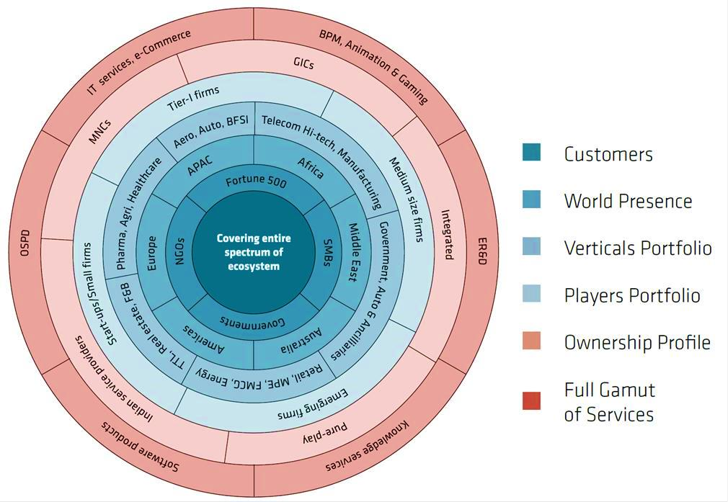
India: Still the only country to offer full spectrum of IT-BPM services
Source: NASSCOM

Slide 5
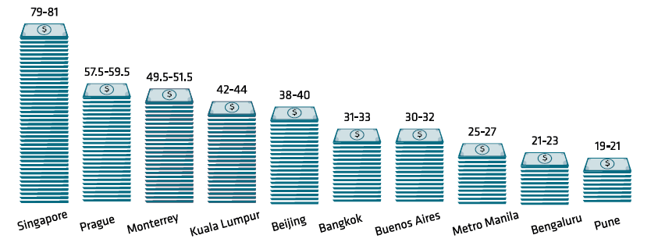
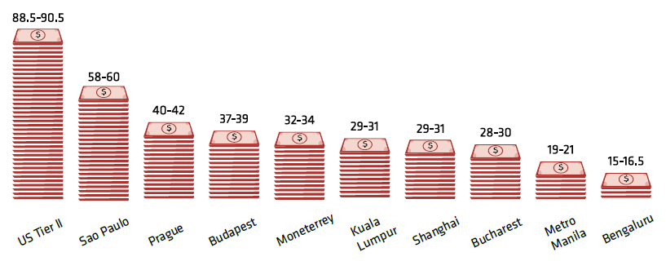
India continues to be the lowest cost location for IT-BPM services
Operating cost per FTE for IT Services: ADM USD ‘000/per annum
Operating cost per FTE for BPM Services: Transactional F&A USD ‘000/per annum

Slide 6
The shift over the years…
Disruptive Innovation
Productivity Improvement / Innovation
Disruptive Innovation
Transferring basic data entry work to low cost locations such as India
Even though work continued to come to low cost destinations with addition to new locations such as Philippines and Brazil , it would still not be count as disruptive innovation
Shared Services
1995- 2000
Emphasis on cost effectiveness and productivity
2000-05
Emphasis on greater depth and breath while embracing the “globalization” of delivery capacity
2005-12
Emphasis on values added end-to-end solutions and inclusive growth in Tier II and III cities
2012 and beyond
Emphasis on platform, multi-tenancy, non-linear revenue growth and utilization of same resources across multiple clients
Cost
Quality
Productivity
Era of GICs
Real-time processing and voice
Multi faceted service offerings
Era of 3rd party offshoring
Specialization
Process re-engineering
Technology enabled platforms
We are at the threshold of another wave of disruptive innovation which posses the ability to create new markets, brands and value propositions

Slide 7
We need to innovate..to stay competitive
Need for Innovation for India and the Global Markets
There is a big push towards specialization – low costs as the basis to compete has steadily given way towards outcome-based, gain sharing type of contracts
Specialization needed in both domain or vertical industry knowledge and new technologies
IT is seen as a great business enabler in the delivery of public services
  Our Indian experience is centred around Homeland Security and Police Modernization
  Our International experience is delivering shared services to Governments around the world, as their trusted transformation partner
There is an increased depth and breadth of services with multifaceted offerings...
  Such as data analysis and real-time processing and more end-to-end services like consulting, business transformation and optimisation
  Value-added solutions with process optimisation, & engineering and technology-enabled platforms like cloud computing, social media, mobility, etc.

Slide 8
Transform Business to Transform India

