Slide 1
Role of Analytics in the indian kpo market
Sudipta K Sen
Regional Director - South East Asia
Vice Chairman & Board Member - India

Slide 2
the Indian KPO Market
Key parameters
The Market
India currently caters to over 70% of the world’s KPO industry
As of 2013, the Indian KPO sector has employed over 3,50,000 professionals
Facing stiff competition from Philippines, Russia, China, Poland and Hungary
Indian KPO market is expected to grow with a CAGR of 30%
The Growth Drivers
Vast talent pool of highly educated and specialised professionals
Availability of cost-efficient skills
Overall cost savings of ~60-70 over the source countries
Competitiveness and efficiency in providing technological solutions
Continuous demand from the global organisations
Expanding economy the propels local demand
Knowledge of English language and process expertise
Supportive investment and tax policies
Ability to manage any kind of outsourcing: Equity Research, IT, Clinical, Financial, etc.
* Source: ASSOCHAM
Notes:
Expected to grow to $30 billion in 2015 from $20 billion in 2013*

Slide 3
Data = asset
Building a competitive advantage in the big data age
Digital Interactions and Social Media are leading to a massive rise in the creation of unstructured data
By 2020, volume of Digital Data is expected to be 50 times of what it was in 2012
In 1986, only 6% of the world’s data was digital. Today, ~99% of the world’s written words, images, music, and data are transmitted in digital format
Organisations are leveraging big data to derive insights and foresights

Slide 4
Notes:
The real value of big data comes-in when organiations start leveraging this data for deriving insights and foresights. Analytics plays a pivotal role in helping businesses uncover the true value of big data. Analytics can help deliver insights across business functions – risk, customer management, fraud, SCM, etc.
Today, organizations are keen on using analytics to not only understand the past and current business serious, but also to predict future outcomes and spot opportunities and threats before they occur
This opens-up a huge window of opportunity for analytics service providers to leverage the best analytical tools and expertise and deliver superior value to end customers.

Slide 5
The growing role of analytics
Some interesting facts
Analytics currently contributes to over 20% of the Indian KPO market
India is seen as the preferred destination for analytics outsourcing
India Data Analytics services market to cross 1$ billion by 2015
CAGR of ~25% between 2010 – 2015
More and more skilled professionals in India are getting trained in analytics
Information explosion has made analytics an imperative for modern businesses
Notes:
67% increase as compared to 2010

Slide 6
The growing role of analytics
Analytics as a priority area for Indian kpo
Market & Business Research
Equity Research, Financial & Accounting Services
IT and Data Services
Biotechnology & Clinical Services
New Media and Marketing Services
Analytics
Notes:
Lotus
Clinigene
Take Solutions
GVK
Max Neeman

Slide 7
Eight levels of analytics
Competitive Advantage
Optimise
What is the best that can happen?
Predict
What will happen next?
Proactive
What if these trends continue?
Forecast
Why is this happening?
Statistical Analysis
Alerts
What actions are needed?
Query drill down
Where exactly is the problem?
Ad hoc reports
Reactive
Standard reports
How many, how often, where?
What happened?
Degree of Intelligence
Notes:
Traditional BI and reporting tools looks backward to provide visibility into historical data that can explain how and why an organization is doing well or poorly.
But in the fast-moving and ever-shifting landscape of today, relying on historical data alone is like driving a car while only looking into the rearview mirror. Predictive analytics promises to uncover challenges and opportunities that are coming down the pike, providing the opportunity to proactively deal with them.
Predictive analytics helps service providers in being proactive, instead of reactive. Imagine if a credit card customer calls the call center for complaining about credit limits. If the call center executive has predictive information on the consumer’s spending trends and preferences, he/she can not only resolve the problem better but also open-up opportunities to cross-sell or up-sell

Slide 8
Data Size and analytic competence
proactive
Big Analytics
Big Data Analytics
Analytics
Reactive
Alerts
OLAP
Ad Hoc Reports
Standard Reports
Proactive
Optimization
Predictive Modeling
Forecasting
Statistical Analysis
analytic capability
reactive
BI
Big DATA BI
large
data size
big data

Slide 9
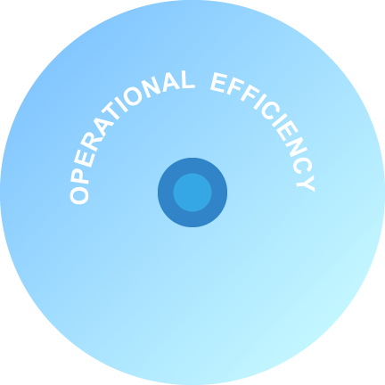
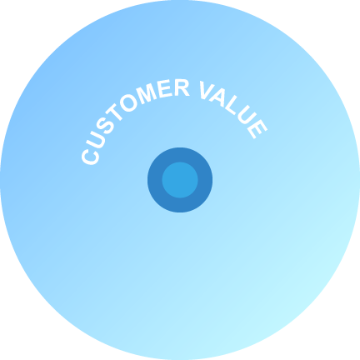
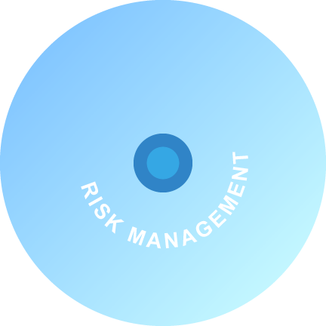
IMPACT of analytics
Spans across business functions
Trusted, analytical-based decisions are needed across the organisation
Notes:
. . Successful analytics are necessary in every business discipline: Manufacturing / Development, Marketing, Sales, Operations, Finance, and IT

Slide 10
Notes:
To summarise, I would say – Every organization has data that can deliver insights. As data continues to grow, more and more organisations will leverage analytics for better decision making. However, not all organisations have the expertise and infrastructure to derive insights and foresights from data. This gap continues to fuel the need for outsourcing analytics to experts who have the technological and domain expertise.
The Indian KPO industry will continue its upward trend and at the vanguard of this growth curve will be the outsourcing organisations who would harness analytics to provide superior value to their customers.

Slide 11
BIG opportunities
Leveraging analytical expertise to stay ahead of the competition
Optimal utilisation on the available talent pool
Cost v/s Value
Exploring new business avenues
Notes:
Leveraging analytical expertise to stay ahead of the competition
While India is facing strong competition from countries such as Philippines, Russia, China, Poland and Hungary; it is important to provide value added, integrated services to the end customers. For instance, if an outsourcing company is currently managing say the customer service desk for a client – it might be extremely valuable for that organization to leverage analytics and reporting in order to identify cross-sell opportunities linked with each service call – thus, adding tremendous value to the client’s business.
Optimal utilization on the available talent pool
India has a healthy and steadily growing pool of young professionals with specific skill-sets in areas of both technology and business. If you look at a place like West Bengal, we have institutes such as Indian Statistical Institute, Calcutta Business School, IIM, etc.; providing skills in statistics, analytics, business know-how and much more. It is important that organisations look at new and creative ways to deploy and nurture this talent in a way that provides breakthrough outcomes for both the candidate and the industry.
Cost v/s Value
Most organizations focus on cost reductions to stay profitable. While this is important, it is even more important to invest in innovation and areas of growth. Getting adept with new technologies, creatively leveraging existing technology in solving customer’s business problems, driving an analytical culture in the organization, etc., must be of prime importance. All of these will have a price tag attached to it however, businesses must look at its returns in the long-run and harness on it to drive sustainable business growth.
Exploring new business avenues
Technology has opened flood gates for several opportunities. Organisations need to foresee trends and transform these opportunities into business impact. Even today, the organisations how have embraced big data analytics, cloud-based models, risk and fraud compliance, marketing automation, etc., are the ones who have stayed ahead of the competition and seen tremendous value being added to their business.

Slide 12
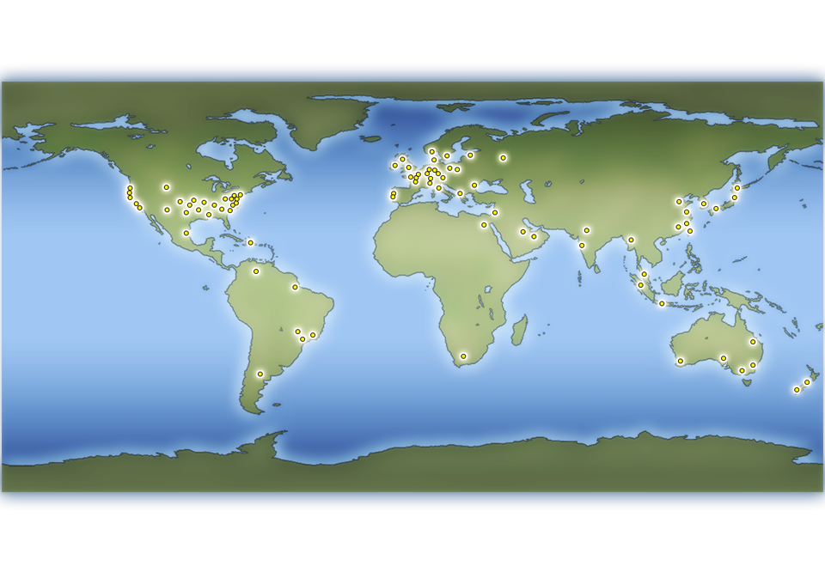
“The business landscape has changed fundamentally. Tomorrow’s environment will be different, but no less rich in possibilities for those who are prepared.”

Slide 13
Thank you

