Slide 1
HR in IT industry
Suresh Bethavandu | Aug 1, 2014

Slide 2
Evolution of Indian IT industry
1960’s: The industry is non existent
1972: Software Export Scheme
1984-86: New computer policy
1990: Setting up of Software Technology parks of India
1992-2000: Entry of various MNCs, Evolution of offshore model and Global Delivery Model.
Post 2000 issues like Y2k, dot com bubble helped India by positioning it as best cost provider.

Slide 3
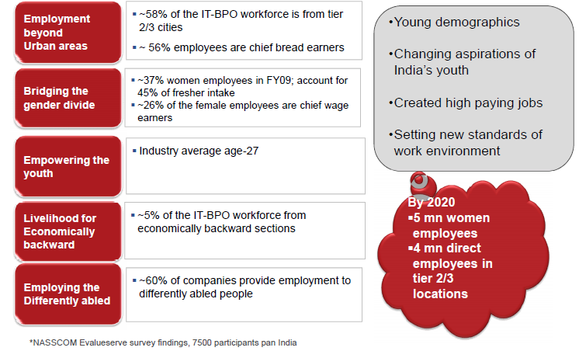
Employment opportunities for diverse sections of the society
Today, we provide

Slide 5
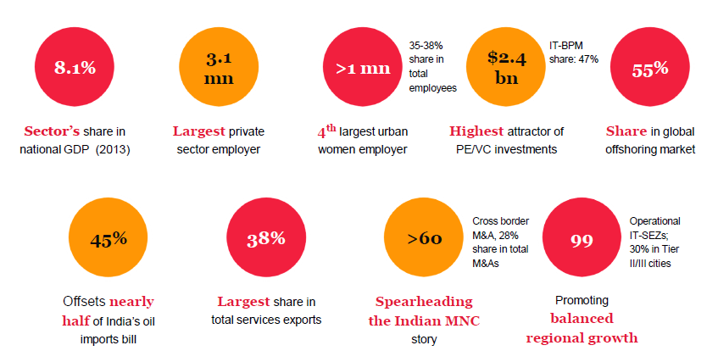
Where we stand now..

Slide 7
The Business models are changing
Notes:
SMAC has risen: At previous events we have shown you our perspective on the expected rise of SMAC. A once-in-a-decade shift in the technology landscape. Well, as we all know, it’s here.
Explosion of data
Implications for business models across industries:
These technologies are enabling our clients to re-imagine and re-design part or all of their business models. In other words, SMAC technologies are enabling our clients to become digital businesses.
Our Clients are re-thinking how they interact with their customers by driving better customer engagement, allowing anytime/anywhere customer interaction and creating new tailored products and services.
In terms of their business partners, our clients are seeking to improve interaction and collaboration to streamline supply chains and better integrate partners upstream and downstream.
In considering the impact of SMAC technologies on employees, our clients are looking to create a better experience by empowering field workers, allowing teams to bring their own devices to the workplace and creating more interactive and engaging collaboration spaces.
And finally, as more industrial and consumer devices become internet-aware, clients are seeking to find value in new machine-to-machine and machine-to-business connections.

Slide 9
New focus areas for HR
Social Media Analytics
Big Data Analytics
Enterprise Mobility
Cloud computing
Emerging geographies

Slide 10
Building a future workforce for SMAC
India Stats

Slide 11
Investing in Vibrant Career growth; Retooling employee sills

Slide 12
The new era HR Manager

Slide 13
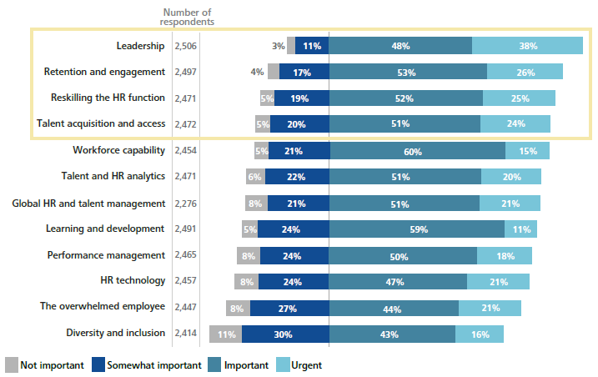
HR in IT – 12 global trends (Deloitte survey)

Slide 14
A Knowledge Employee lifecycle : HR touch points
Exit
Entry/Onboarding
Succession
Exit
Learning
Onboarding
Performance
Source
Start Date
Engagement
Survey
Recruit
Multisource Feedback
14

Slide 15
Entry / onboarding : Skill Gap deficit
In India, about 12 million people join the workforce each year
Current skill capacity of the country is about four million
India requires to enhance skilling and technical education capacity to about 15 million
80% of the entrants into the workforce do not have the opportunity for skill training
Only 10% of the total workforce in the country receive some kind of skill training
The overall labor productivity in India is much lower ($ 5.45 per person per hour while the figure for Mexico is $ 20.51)
Only ~6% of the total workforce (459 million) is in the organized sector
Difficulty in finding a suitable candidate for available jobs due to:
lack of available applicants
shortage of hard skills
Shortage of suitable employability, including soft skills

Slide 16
Performance: Managing the Workforce performance
Traditional Approach
Emerging Trends
Focus on Measurement
Focus on Improvement
Annual cycle feedback
Just-in-time feedback
Weakness-based
Strength-based
Evaluate & direct
Coach & develop
Compliance
Impact
Hierarchical
Networked
External rewards
Intrinsic rewards

Slide 17
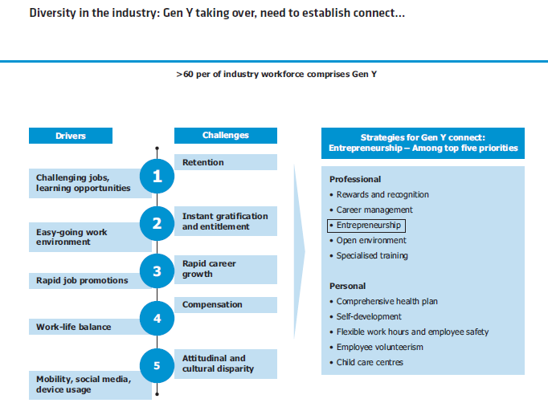
Managing the Gen Y & Gen Z
More than 60% of the industry comprises of Gen Y

Slide 18
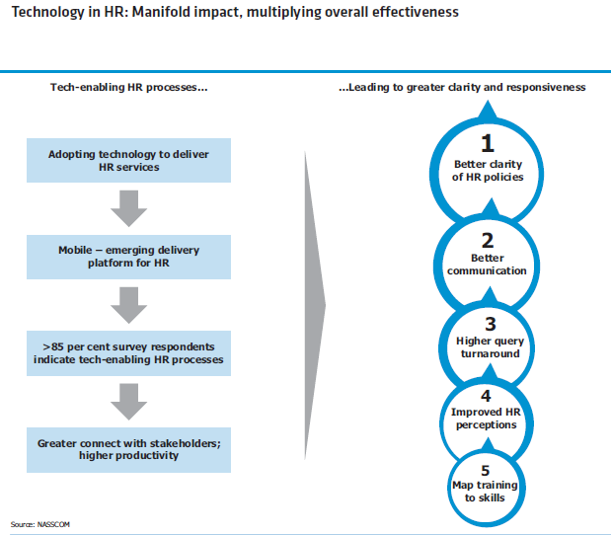
Manifold impact of technology
Tech-enabled HR processes
…Leading to greater clarity and responsiveness

Slide 19
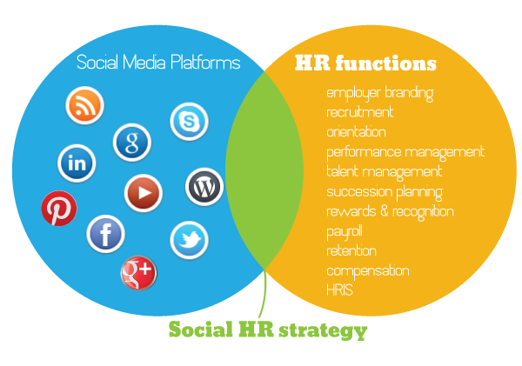
Social HR – the new buzz

Slide 20
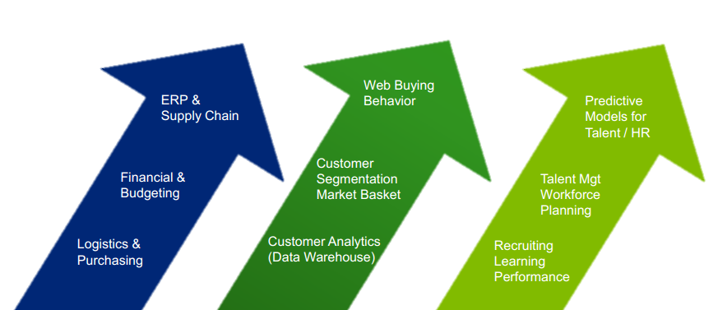
Data’fication of HR
Finance & ERP
Consumer & CRM
Talent, Leadership, HR

Slide 21
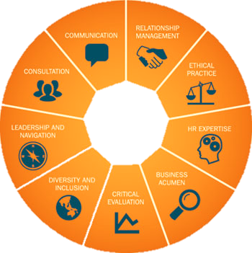
New HR competencies for changing work dynamics

