Slide 1
Technologies in Clinical Development – Next Opportunities
Anita Tripathy
Head Data Science, Safety & Regulatory , Asia
4th December 2020

Slide 2
Technologies in Clinical Development – Next Opportunities
Table of Content
What are the challenges in Pharma R&D ?
How is the clinical development world changing ?
How is technology transforming the Clinical Development space ?
How are Regulators and the Industry responding to the change ?
What are the impact on the India Skill Market and the next opportunities ?

Slide 3
What are the challenges in pharma Clinical Development?
Typical drug development process*
Drug discovery
(5 years)
Pre-clinical
(1-2 years)
Clinical Trials: Phase I, Phase II, Phase III
(6 years)
FDA Approval
(6-24 months)
EMA Approval
(7-15 months)
5,000 – 10,000 compounds
250 compounds
5 compounds
Drug Approval
Most drugs have an average marketing life of ~10 years
*Timeline will vary based on a number of factors including recruitment rate, trial end point design, potential for priority review; and these will differ across disease areas and product classes
Source: IQVIA Pharmaceutical Industry Overview 2019

Slide 4
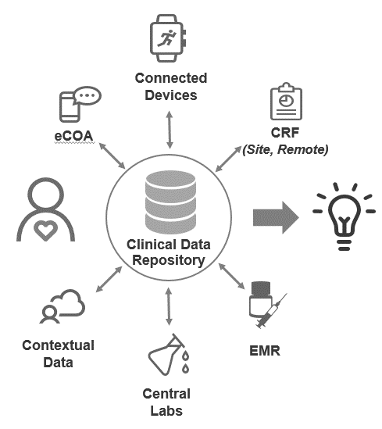
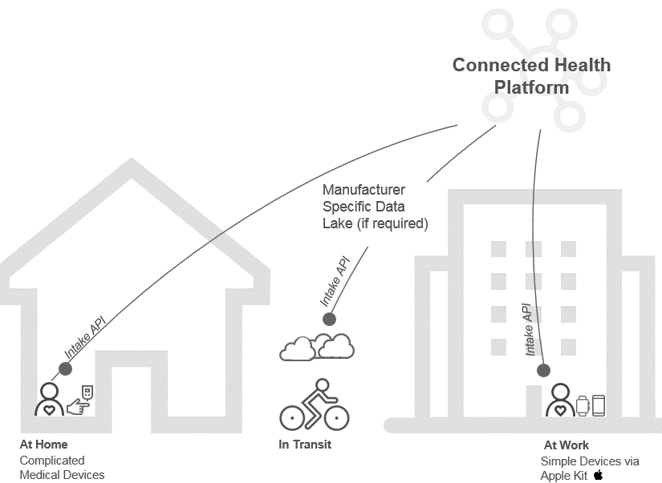
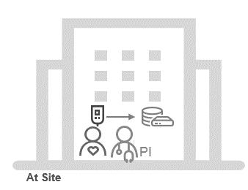
How is the clinical development world changing?
Focusing research and accelerating development speed with technology
Evolution of Connected Health in Clinical Trials
Virtual Trials
ICH E6 and E9
Adaptive Designs
Industry
Trends
Data Driven
Trial Execution
Tomorrow
Trials moving to Patient Homes
Studies designed around patient needs
360º view of patient record
Deeper insights from integrated data
Predictive analytics
Advanced
Analytics
Yesterday
Trials in hospitals
Investigator Controlled
Episodic data collection
Periodic data transfer at site
Isolated snapshots of patient health
Today
Accelerated number of devices
Moving closer to the patient
Real-time, continuous data collection
Longitudinal monitoring
Risk Based
Monitoring
Automation

Slide 5
How is technology transforming the clinical development world?
Connected health transforms the boundaries of Health Care by –
Quality of care/Patient Centricity :
Telemedicine : Shifting the treatment to the patient location
Remote patient monitoring & Tracking
Data Driven Personalization:
Wearables : Real-time and near-continuous data collection
Internet of Things : Incorporating novel data sources (e.g. unstructured)
Big Data and Analytics : Integrating data from multiple sources (clinical, lab, biological, contextual, device data, etc.)
Value based Care:
Artificial Intelligence :
AI-based health assistants
Early and precise diagnosis
Improved patient care and treatment
Wearables
Patient Behavior
Web-based
Programs
Telemedicine
Medical Devices
Disease specific apps

Slide 6
How is technology transforming the clinical development world?
~$1.7B market in 2020, growing at ~12-20% CAGR
eSource
Web-based Applications
Transparent
Empowered
Quality of Care
Ease of Participation
Better Outcomes
Informed
ePRO/
eCOA
Disease Specific Apps
Medical Devices
Patient
AI/ML Predictive
Analytics
Wearables
Remote Monitoring
Telemedicine

Slide 7
How are Regulators and the Industry responding to the change ?
The FDA is already making strides in publishing recommendations on the use of social media. FDA guidelines on social media usage
https://www.fda.gov/media/94313/download
FDA guidelines on patient reported outcomes
https://www.fda.gov/regulatory-information/search-fda-guidance-documents/patient-reported-outcome-measures-use-medical-product-development-support-labeling-claims
Sanofi launches virtual trial with Science 37
https://www.fiercebiotech.com/cro/sanofi-launches-new-virtual-trials-offering-science-37
Pfizer conducts first virtual clinical trial
https://www.pfizer.com/news/press-release/press-release-detail/pfizer_conducts_first_virtual_clinical_trial_allowing_patients_to_participate_regardless_of_geography
Many companies are jumping on the 140-character bandwagon, including Abbvie and Pfizer, making use of their Twitter accounts to engage patients and engage the clinical community. But moving beyond a simple Twitter feed into a comprehensive social media strategy to engage their target audience is something very few companies are doing well, if at all.

Slide 8
What are the impacts on the India Skill Market and the next opportunities ?
Increased offshoring to India across the value chain of Clinical Drug Developments
Quick expansion of number of CROs/Pharma Captive Centers in India and CRO headcount numbers in India.
Domain skills required
B Pharm
M Pharm
MBBS
MD
PHDs in Clinical Biostatistics
PHDs
Masters in Public Health (MPH)
Masters in Computer Applications(MCAs/MS Comp Science)
BE/B Tech in Computer Science
Increased leverage of the technology skills available across India to bring efficiency, automation & insights to the drug development process
Study Programmers
Statistical Programming
AI/ML skills for Predictive Analytics
Big data and cloud
Device integration (wearables/embedded apps)

Slide 9
Thank You

