Slide 1
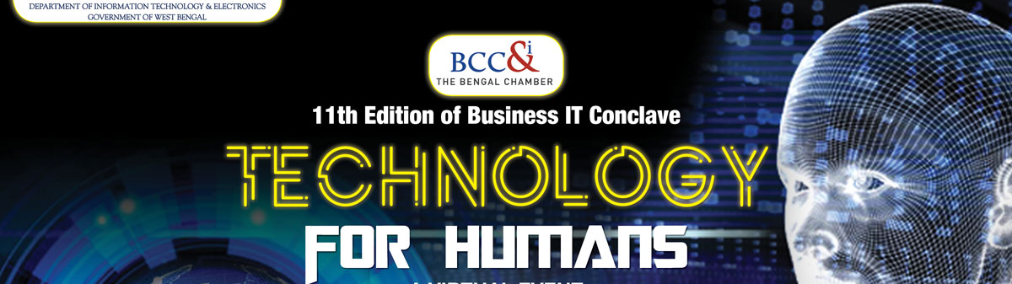
Technologies for Power: To Make it More Abundant, Efficient, and Eco-friendly
December, 2020

Slide 2



Technologies Drivers & Power Sector Strategic Priorities
Utilities Economic Trends
Utilities Strategic Priorities of Industry Leaders
Decarbonization is changing the energy source
total electricity generated by solar, wind, and water by 2050
Distributed Energy Resources
total world energy storage market by 2023
Consumer Experience
of utilities consumers are willing to pay for a better experience
Distributed energy resource operations
Support personal mobility needs making use of customer-produced energy
Digital collaboration with other stakeholders during the asset life-cycle
Smart and efficient distribution
Real-time energy settlement calculations
Demand and supply balancing services
Support market & peer-to-peer trading of energy flexibilities
Omnichannel retail to digitalized consumers
50%
500bn
USD
73%
Technologies Enabling Opportunities
60%
of human tasks will be automated by 2025
75%
of the utilities critical assets will be digitally connected by 2023 to predict and prevent equipment failure and prescribe best maintenance options to optimize and extend asset life cycles
$1.2tn
Internet-of-Things (IoT) spending in 2022
65%
of electricity companies will have invested in digital technologies and platforms by 2023 to support flexibility services, thereby activating a load potential of up to 35% of installed capacity
$15tn
will be added through AI to the world economy by 2030
Notes:
Distributed Energy Resource Operations
Sell new services and create energy communities by developing traditional customers into prosumers
Leverage sensors and meters attached to power-consumption or power-generation devices to stabilize the operator’s grid
Capabilities:
Support for the digital energy prosumer lifecycle from winning, onboarding, and operating to servicing
Management of all energy assets of consumers, from installation to integrated billing of products and services
Smart and Efficient Distribution
Enable smarter asset management with fully digital allocation of spare parts, work, and logistics services
Create cost-efficient, compliant, and safe power generation with smart asset operations and maintenance
Capabilities:
Real-time monitoring of asset health
Just-in-time triggering of maintenance orders
Maintenance schedules based on real-time asset health status and failure prediction
Demand- and Supply-Balancing Service
Generate business opportunities around balancing services in the energy system
Streamline energy-settlement processes for compliance with any regulatory requirements
Capabilities:
Machine-learning algorithms to check and improve metered data
Real-time execution of energy-settlement processes and distribution of results over a cloud-based environment
Visualization and reporting of time-series data and settlement results
Omnichannel Retail to Digitalized Consumers
Create personalized offers mixing commodity and noncommodity
Leverage real-time data analysis to broaden the scope of customer interactions and increase addressable consumer spend
Capabilities:
Target-group selection based on real-time social media data and proposed best offer
Automatic creation of master data and switching of process according to the regulatory framework
Communication over the customer’s preferred channel

Slide 3





India Electricity Segment : Recent and Upcoming changes
De-carbonization through RE Program |  | India has committed to RE targets of 220 GW by 2022. India has further pledged to reduce emissions intensity by 35% by 2030 from 2005 level and have 40% share of non fossil fuel based sources in the total supply mix by 2030
De-Centralization through Solar roof-top Program |  | India aims to install 40 GW of solar rooftop by 2022. Several States in India have shown their commitment to the goal by announcing solar roof-top policies and regulations
Electric Vehicle Program |  | Government of India (GoI) launched the 'National Electric Mobility Mission Plan (NEMMP) 2020', a pioneering effort to strive towards electrifying road transportation. Ten Indian states have issued state specific EV Policies and 14 States have introduced separate electricity tariff for charging of EVs.
Mass Roll out of Smart Pre-paid meters |  | Shaping the next level of business operation through mass scale roll out of smart pre-paid meters for 250 million of Indian consumer base
Empowered Consumers |  | Consumers are becoming more empowered as they can manage their own consumption through smart meters, solar roof tops and mobile applications

Slide 4
Summary: How Technology Can Aid?
Affordability
Reliability
Sustainability
Energy Efficiency
Energy Accounting
Smart Metering Initiatives to Cut Down Losses
Distribution infrastructure management
Connected assets Through Sensors
Managing Decentralized Distribution
Remote Monitoring
Advanced Analytics to Predict Potential Failure
Integrating Renewables in the Power Portfolio
Remote Monitoring of the Renewables Assets
Efficient Forecasting and Generation
Storage and Battery Technologies
Making the Grid Smart and Resilient

Slide 5

Thank You!
“If you don't change what you are doing today,
all of your tomorrow’s will look like yesterday.”
www.jimrohn.com

