Slide 1





Slide 2
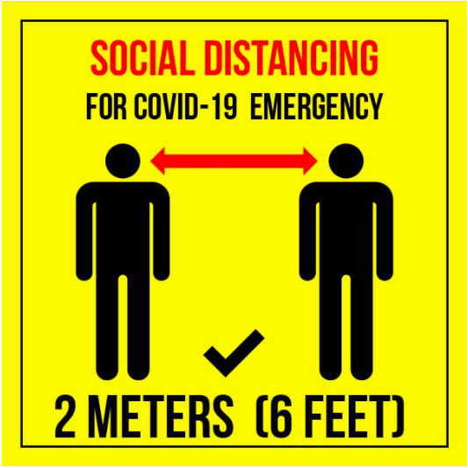

Slide 3
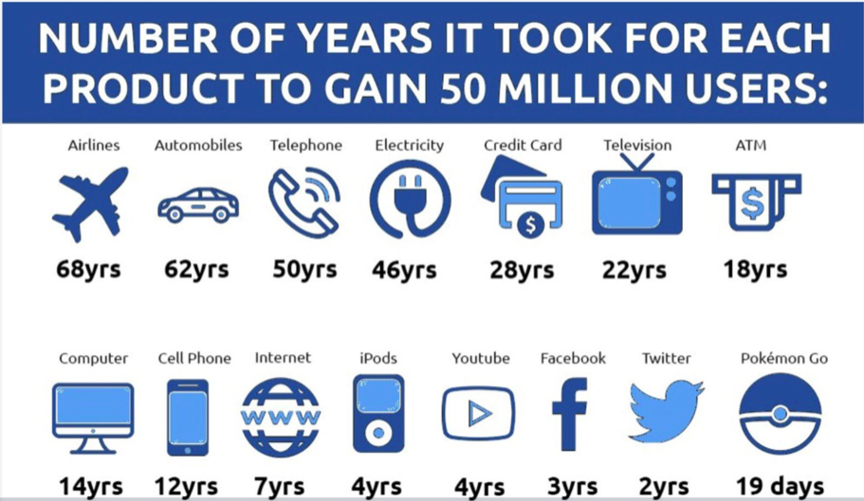

Slide 4
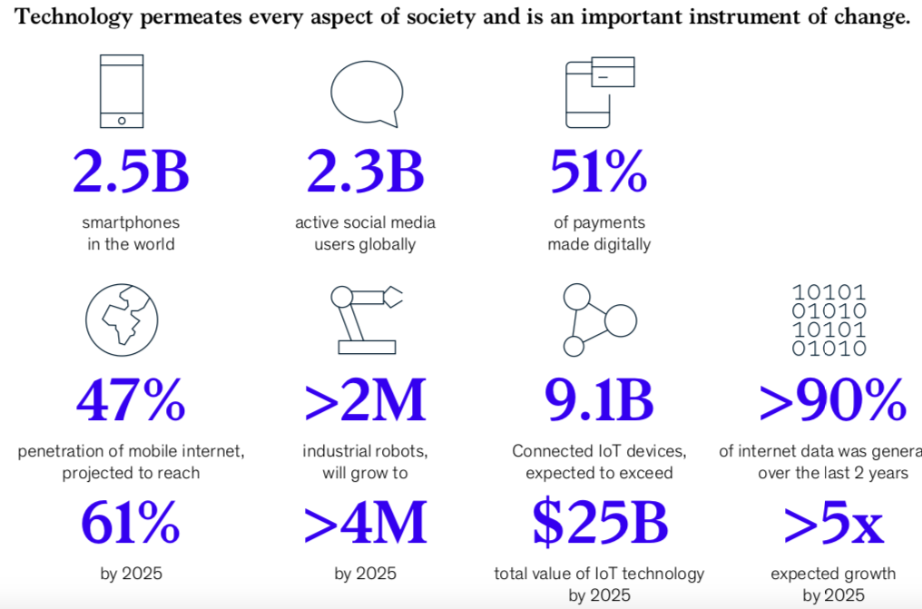

Slide 5
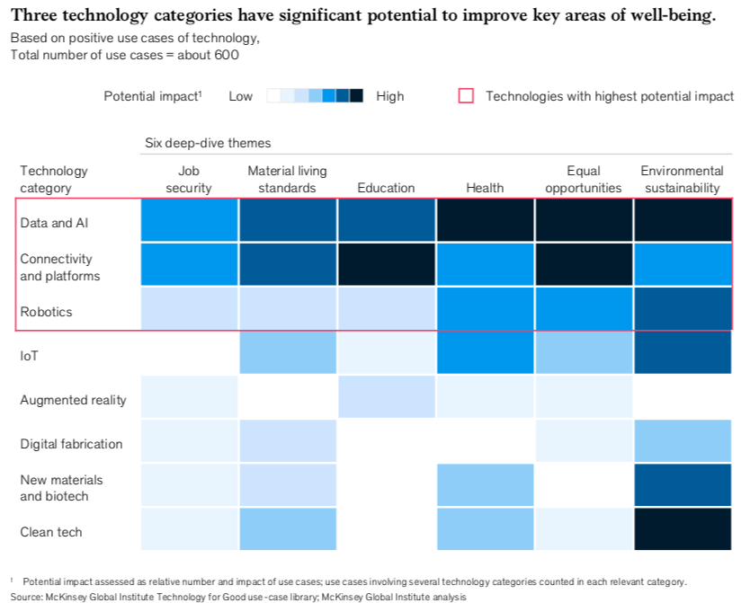

Slide 6
Three Dimensions of Tech Enablement
INFRASTRUCTURE
PLATFORM
APPLICATIONS
Fully Managed Data Center and Cloud Services
Secured and Adaptive Scalability for CPU / GPU Compute Resources
Unified Distributed Exa-Scale Storage & Software Defined Networks
Leading Hypervisors for DevOps and Application Workloads
Robust Platform for Distributed Micro-services as a Pre-integrated solution
Mass-correlation via AI/ML Engines to deliver outcomes
Pre-Integrated, Native AI/IoT/ Data Analytics Enabled Outcomes / Insights
A digital identity to transact
and a Vault for the digital assets
Pre-Integrated ISV Apps for outcome based specific use-cases,
co-developed for customers

Slide 7
A system that brings together consumers and enterprises
on a unified digital canvas to communicate, interact and transact
with each other with trust, leading to infinite possibilities.

Slide 8


Slide 9
Citizens
Businesses
Brand building/Customer engagement for large businesses
Communication with the social circle
Circle
Live-Local
Public Persona
Work Persona
Internal employee Communication and productivity
Personal Persona
In:Collab
Closed group interaction with personal contacts
Circle
Live-Local
Circle
Digital presence and customer acquisition for small traders
Larger Ministries: Health, Post, Communications etc
Work Persona
Interactions between businesses and government
Police stations, Primary healthcare centers etc
Government
Internal department Communication

Slide 10
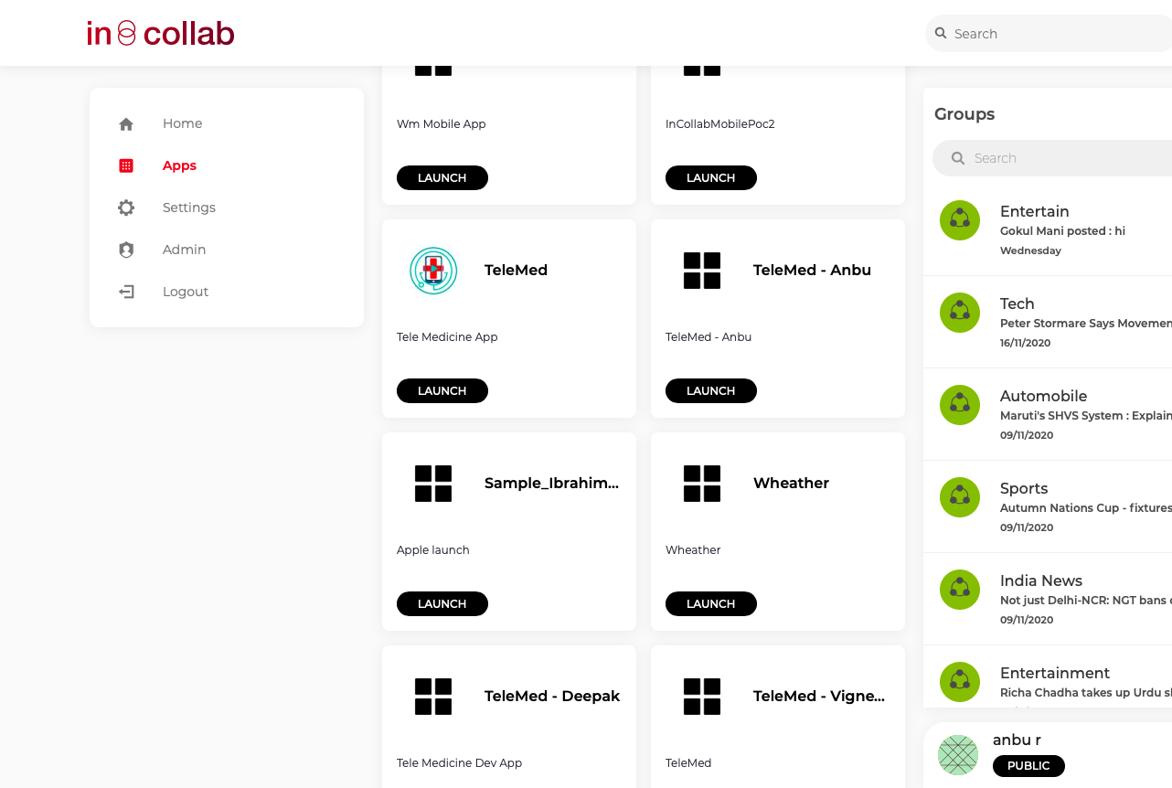
TELEMEDICINE APP IN IN:COLLAB
Telemedicine enables patient to consult with available doctors at any time and from anywhere.
Safe and secure. Contact information is not shared.
SINGLE APP
ALLOPATHY
AYURVEDA
MOBILE
DESKTOP
SELF
FAMILY MEMBERS
PROFILE
REPORTS
PRESCRIPTION
VIDEO
IMMEDIATE
BOOK APPOINTMENT

Slide 11
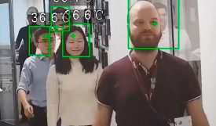
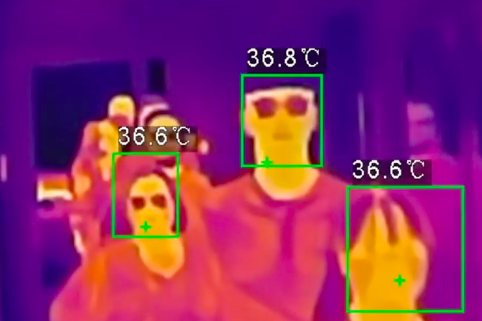
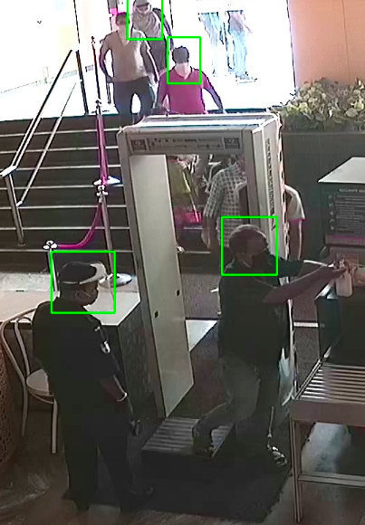
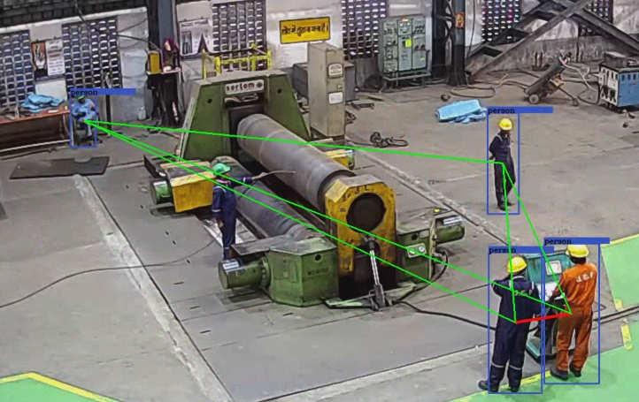
Made for India, Powered by
MultiVerse – Covid19 Surveillance – Video Analytics
Expected Outcomes
Face Mask Detection violations
Identify Temperature via Thermal Cameras
Monitor Social Distancing adherence and report violations
Maintain face data and visitation timing logs for known and unknown faces
Benefits
Automated Surveillance reduces manual security
Reduce risk of Covid19 Infections proactively
People count to helps identify number of people inside protected areas, avoid crowding and people gatherings
Maintain safe work environment
Deliverables
Real time Alert via SMTP/SMS and PDF Report via Dashboard
On Demand Self Service Reports

Slide 12

Our digital services are powering Smart Cities!
And can power Smart Enterprises…

Slide 13
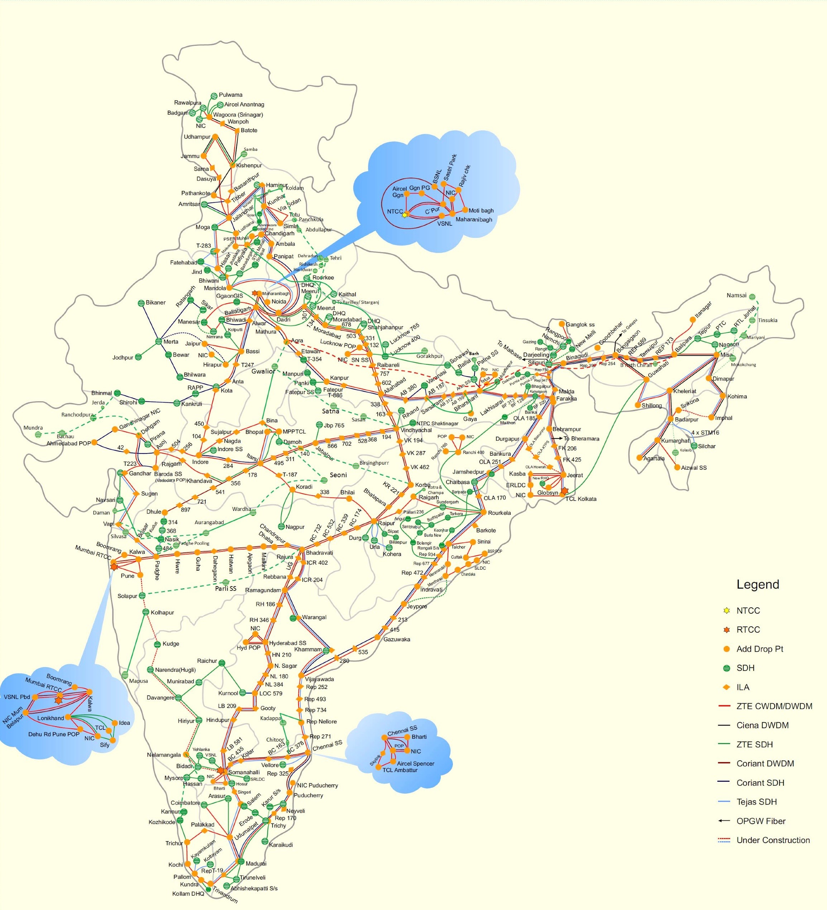

Control over network is key to compelling customer experience.
Leveraging existing telecom networks to progressively create a
Content Aggregation & Distribution Network (CADN).
Creating an ‘Edge Computing’ model with Intel to foster new possibilities.

Slide 14

