Slide 1
Cyber Security Services
Data Centric Security
Welcome

Slide 2

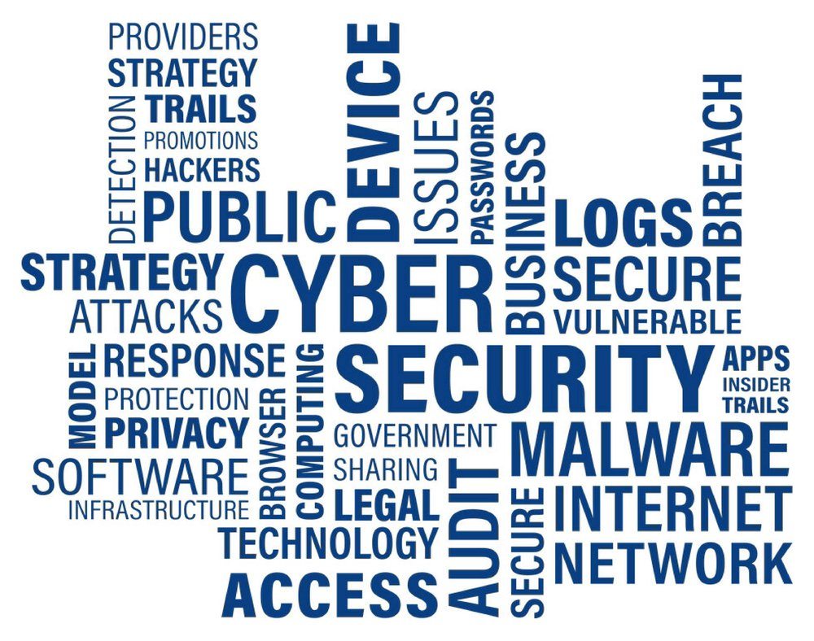

The Cyber World – a fashion trend in everyone's head?

Slide 3
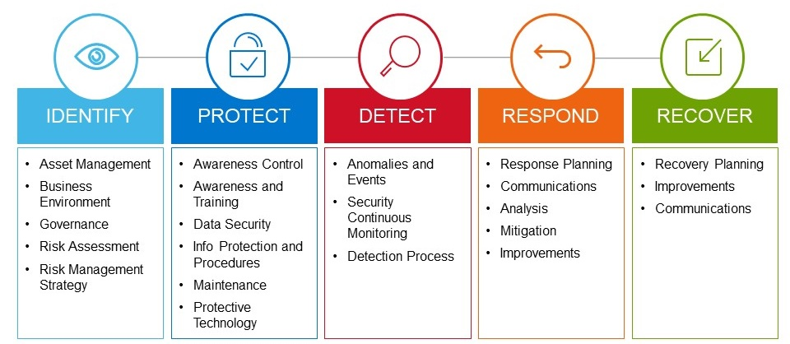
NIST Framework – suitable for all sizes of organizations
What is NIST Cybersecurity Framework?
NIST is the National Institute of Standards and Technology at the U.S. Department of Commerce. The NIST Cybersecurity Framework helps businesses of all sizes better understand, manage, and reduce their cybersecurity risk and protect their networks and data.
The Framework is voluntary.
Link: https://www.nist.gov/cyberframework

Slide 4
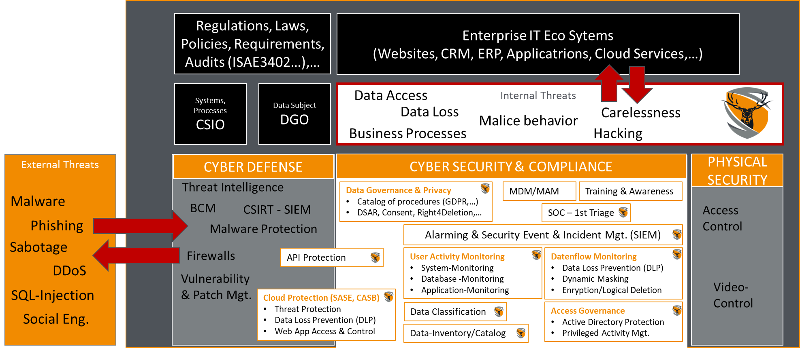
Cyber Security Architecture – Disciplines to be considered

Slide 5
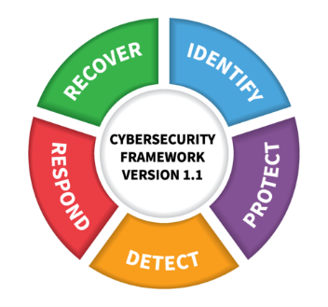
Next considerations – what would be my next steps?
Step 1 – Cyber Strategy, Framework and Policies
Define Threat Scenarios for the organization
Define Cyber Framework tailored to your needs
Define or update Cyber Strategy and Policies
Step 2 – Create Framework Categories content based on GAPs and missing chapters with TOMs
1. Identify
2. Detect
3. Respond
4. Protect
5. Recover
Important: IT Disaster Recovery Plan
Step 3 – Integrate & Operate Cyber Security Measures
Implement technical measures and
Employee training & awarness
Disaster Simulation and Recovery Training

Slide 6
Thank you

Slide 7
and how can we support your organization?
D E F E N D E E R
Data Centric Security Solutions
a bluecoons group LLC division
Suurstoffi 37
6343 Rotkreuz
Switzerland
Phone: +41 41 539 12 13
Mail: office@defendeer.com
URL: defendeer.com

