Slide 1
ESG and Sustainable Development
Responsibility and Opportunity for Technology Businesses

Slide 2
Sustainable development is the masterful balance of meeting our own needs without jeopardizing future generations’ ability to do the same

Slide 3
Why ESG – Global Shifts
Impact of Business & Economic decisions on the environment & communities
The environmental impact of economic growth includes the increased consumption of non-renewable resources, higher levels of pollution, global warming and the potential loss of environmental habitats.
ESG consciousness among corporates in India: Leading examples
ESG a part of top management KRAs and embedded into company’s decision-making and performance evaluation.
Major capital investors keen to support start-ups that actively facilitate ESG goals.
Roadmaps towards reduction in greenhouse gas emissions towards zero.
The Paris Agreement- sets long-term goals to guide all nations:
substantially reduce global greenhouse gas emissions to limit the global temperature increase in this century to 2 degrees Celsius while pursuing efforts to limit the increase even further to 1.5 degrees;
review countries’ commitments every five years;
provide financing to developing countries to mitigate climate change, strengthen resilience and enhance abilities to adapt to climate impacts.
UN Global Compact
The World’s larges corporate sustainability initiative, a call to companies to align strategies and operations with universal principles on human rights, labor, environment and anticorruption and take actions that advance societal goals. The UN Global Compact supports companies to:
Do business responsibly by aligning their strategies and operations with Ten Principles on human rights, labour, environment and anti-corruption; and
Take strategic actions to advance broader societal goals, such as the UN Sustainable Development Goals, with an emphasis on collaboration and innovation.

Slide 4
Sustainable Development goals (SDGs)
GOAL 1: No Poverty
GOAL 2: Zero Hunger
GOAL 3: Good Health and Well-being
GOAL 4: Quality Education
GOAL 5: Gender Equality
GOAL 6: Clean Water and Sanitation
GOAL 7: Affordable and Clean Energy
GOAL 8: Decent Work and Economic Growth
GOAL 9: Industry, Innovation and Infrastructure
GOAL 10: Reduced Inequality
GOAL 11: Sustainable Cities and Communities
GOAL 12: Responsible Consumption and Production
GOAL 13: Climate Action
GOAL 14: Life Below Water
GOAL 15: Life on Land
GOAL 16: Peace and Justice Strong Institutions
GOAL 17: Partnerships to achieve the Goal

Slide 5
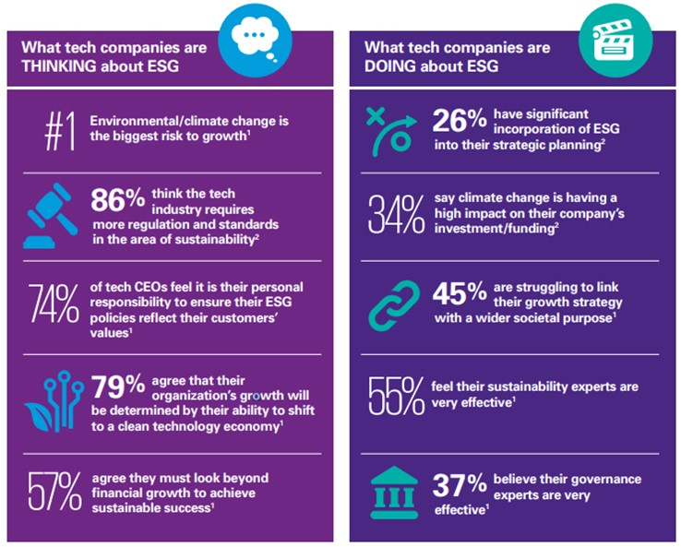
ESG: Tech companies
ESG: What Tech Companies are Thinking & Doing
ESG: At Zensar
ESG charter at Zensar driven by the Board committee
Goal definition – Short, Medium, and Long term
Chief Substantiality Officer appointed, and team formed to drive the charter
Advisory from one of the Top 5 consultants
Centre of Excellence at Group (RPG) level, with representation from all companies including Zensar
Dedicated Webpage on Sustainability on our Website: www.Zensar.com, with CRP declaration
Integrated Annual reports accessible to stakeholders – Sustainable Business reporting

Slide 6
ESG at Zensar- Progress & Industry Validation
SDG Alignment
Key Highlights
Invested in a Renewable Energy Rooftop Solar plant contributing to 10% of total Pune campus energy requirement
Indian Green Building Council-certified facilities
Certified for ISO 14001, 45001 and 50001 (EHSEn) standards
Effective waste management
Environment
Zensar is a signatory member of UNGC, NY India (SDG 5 and SDG 10)
Maternity & Related exclusive benefits
ZIVA- Exclusive pregnancy care program for associates and spouses
Dedicated Employee Resource Group, ZENWEN for women network & engagement
An Internal Complaint Committee (ICC) to redress the complaints received from the women employees in accordance with the provisions of Sexual Harassment of Women at Workplace (Prevention, Prohibition and Redressal) Act, 2013 (“SHW Act” or “POSH”).
LGBTQ+ Internship and Hiring Program – Our ally group PRISM’s goal is to his community members feel safe and an integral part of our company.
Social
Highest standards of integrity through RPG Code of Corporate Governance & Ethics
ISO 27001 certified
Zero cybersecurity incidents reported
Robust Risk Governance framework driven by Board Risk Committee
Governance

Slide 7
Our Pride and Honour
1st Runner Up of the 2021 UN Women India WEPs Awards (Transparency and Reporting Category)
Listed as active participant in the Women in Workplace study by Mckinsey in the US
Winner of Gender Inclusion Practices in Gender Equality Summit by UNGC in 2020
Top 5 Companies in Diversity (Large Enterprises)
Top 20 for Women Leadership Development
Top 20 Diversity Programs
Top 20 Diversity policies
Top 20 Diversity Champion – Sanjana Vaidya
Winner of the coveted CFBP-JB award in category – Highest standard in ethics in business practices
FY21: Recognized in Top 21 Blogathon
FY22: Recognized in Top 20 Blogathon
2020 Tech Beacon Award – Pushpall Kapadia, Sr. VP
Featured in Avtar’s 100 Best Companies for Women In India 2018, 2019 and 2020

Slide 8
Thank you !

