Slide 1
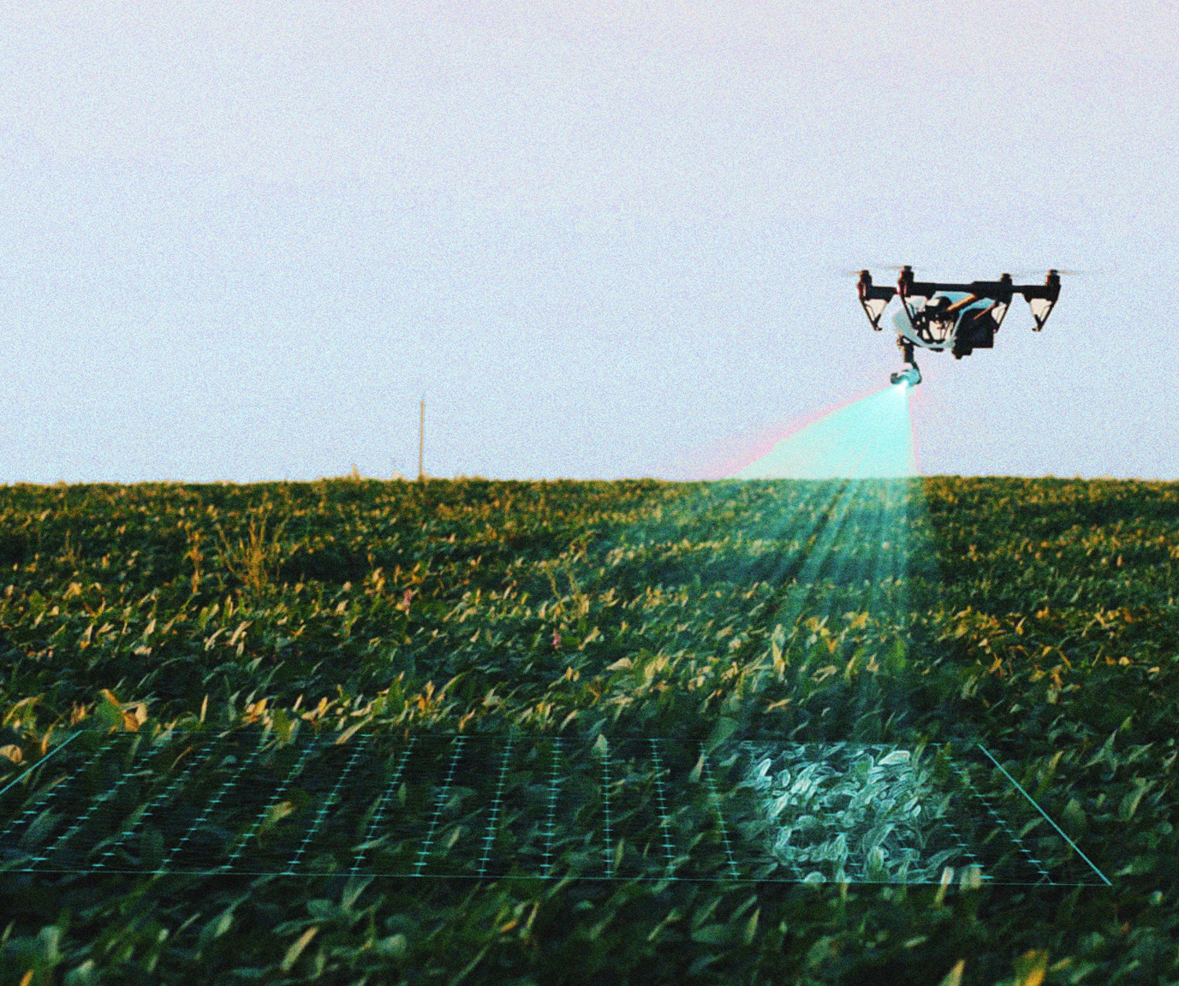
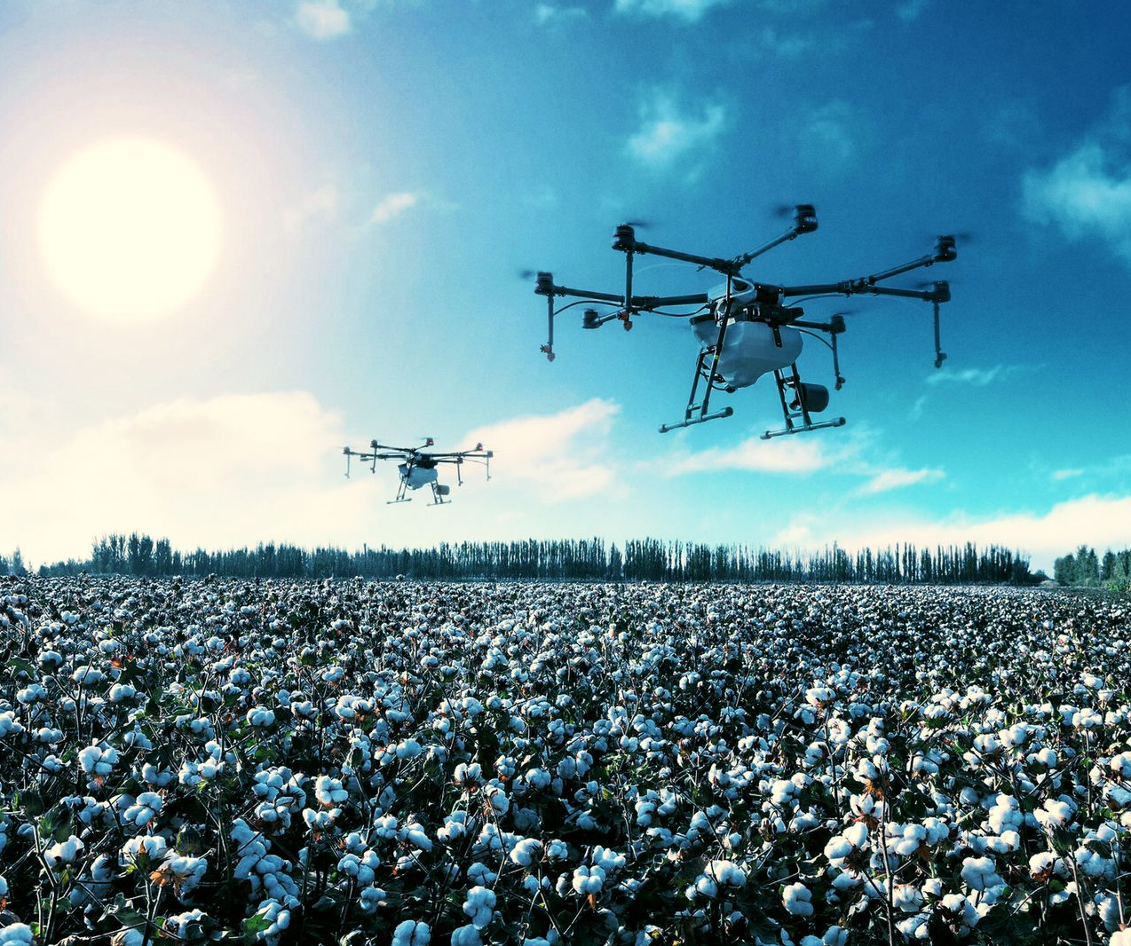
Path Breaking
Drone-borne SAR

Slide 2
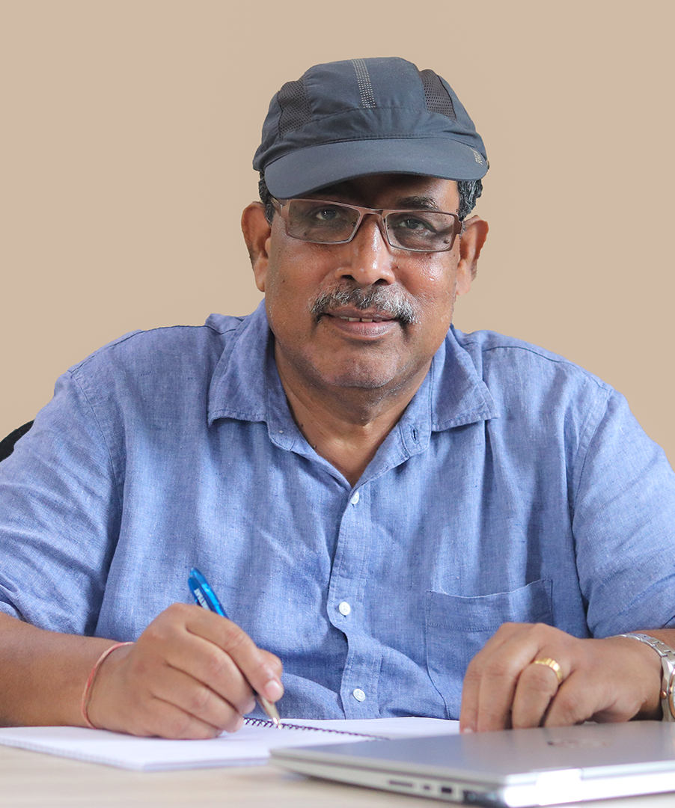
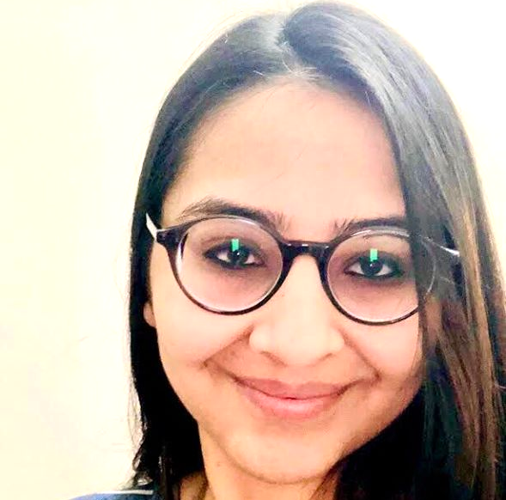
CO-FOUNDERS
SOUMYA MISRA
FOUNDER AND CHIEF SCIENTIST
TAPAN MISRA, DSc
URMI BHAMBHANI
THE TEAM
BTech/MTech, IIT Kanpur
Previous stints at Intel, Creo, and Hike
Selected by GoI to train @ Mediatek Taiwan, as one of Top 50 Mobile Phone Designers in India
Founder & CEO, Summachar
4 decades of experience in Space-Tech and Radar Systems. One of the world’s foremost experts in Synthetic Aperture Radar (SAR) Technology. Father of RISAT, India’s first cutting edge SAR-based reconnaissance satellite.
MTech, VIT
Previous stints at NetApp, Educational Initiatives
Former Director, Space Applications Centre (ISRO)
Former Director, Physical Research Laboratory
Adjunct Professor, IIT Jodhpur
Former Adjunct Professor, IIT Kharagpur
Experience in NL-based AI education products, complex large-scale distributed OS
Founder & CTO, Summachar

Slide 3
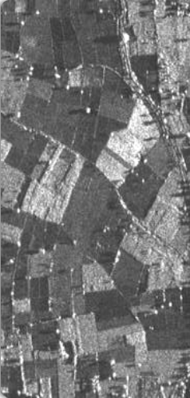
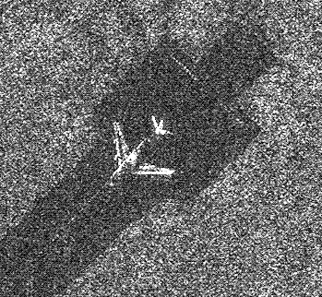
THE PRODUCT
DRONE-BORNE SAR
WILL GENERATE 3x SHARPER IMAGE
0.3 m resolution in azimuth and range direction
Multirotor drone
5kg Mini-payload SAR
10kg loading capacity
X-band: 9.6 GHz
Coverage Range: 50 km
500 MHz Bandwidth
100 sqkm imaging per flight
Reference Images courtesy ISRO

Slide 4
THE CONVENTIONAL CAPTURING MODE
4 Polarisation Data sets
WORLD’S FIRST MIMO MODE (Multiple Input Multiple Output)
8 Data sets ((Forward + Back scatter) X 4 Pol) & 1 Stereo
SAR PRODUCT RANGE

Slide 5
Bidirectional SAR 8 Data Sets (Bidirectional and 4 Pol) & 1 Stereo

Slide 6
SYNTHETIC APERTURE RADAR (SAR) BASED IMAGING
COMPETING TECHNOLOGY FOR REMOTE SENSING
SAR SUPERIORITY
All weather, day - night, 24x7x52 Sensor
Response is invariant & can separate structural difference unlike cameras
Highly amenable for automated machine identification of features
On the flipside,
Technology is very complex & imaging cost is one order higher than camera images
Data is infrequent, once in a month or of that order
Colour Camera, Multi/Hyperspectral Camera
They operate in day time only as they are dependent upon sunlight
Affected by cloud, rain, dust, water vapour, mist, fog, smog, smoke
Substantial variation of signature over day-time, seasons
Difficult for automated machine identification for most of the features
On the flipside, Technology is simpler & imaging is cheaper
$60-100
per sq km
We aim to provide daily high resolution SAR imagery across India at < $6 per sq km

Slide 7
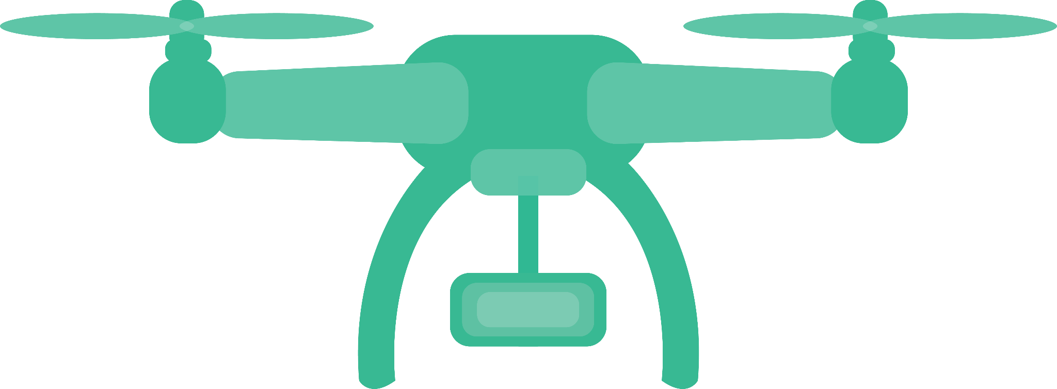
COMPARISON WITH TRADITIONAL SAR PLATFORMS
1 Spaceborne SAR = 100 Drone SARs
100 drones will capture 1 lakh km² each day!
Satellite can capture only 500 km² area per day.
Satellite + Launcher
Unpressurised Drone
Payload Cost: ₹80-250 Cr
Aircraft
Payload Cost: ₹15-30 Cr
Platform Cost: ₹200-350 Cr
Payload Cost: ₹3-5 Cr
Operational Altitude: 500 - 900 km
₹200 Cr + 5 years for first model
Platform Cost: ₹30-300 Cr
Platform Cost: ₹0.1-1 Cr
Operational Altitude: 6 - 14 km
Annual Op Cost: ₹100 Cr
₹30 Cr + 3 years for first model
Annual Op Cost: ₹20-200 Cr
Annual Op Cost: ₹0.5 Cr
Operational Altitude: 3 km
₹20 Cr + 2 years for first model
MOST expensive
STILL expensive
LEAST expensive

Slide 8
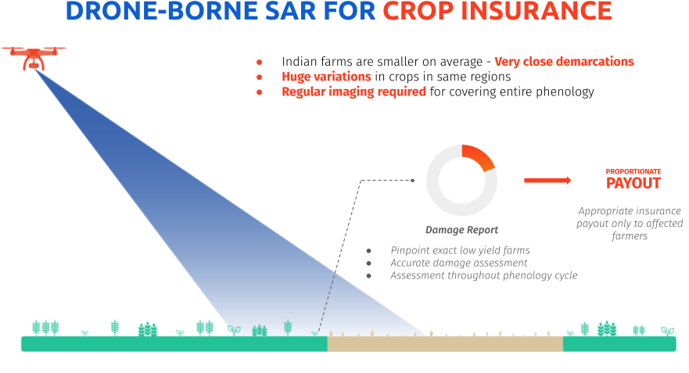
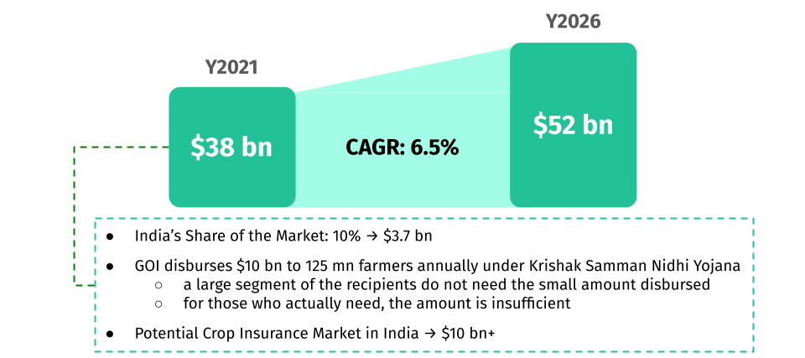
GLOBAL CROP INSURANCE MARKET
Source: Allied Market Research; IRDAI
APPLICATIONS

Slide 9
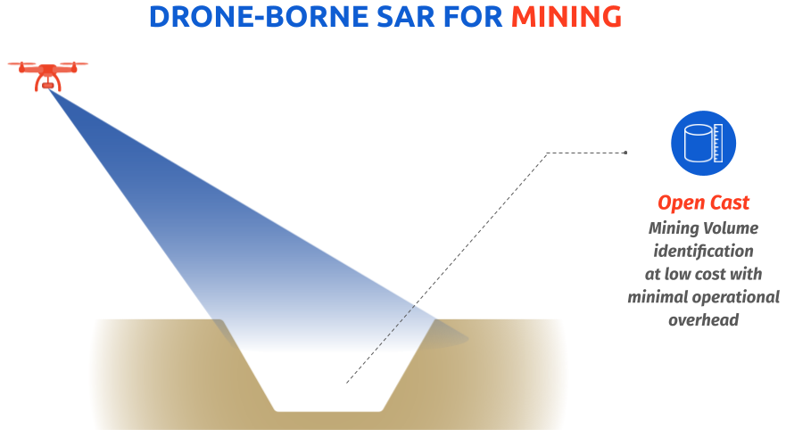
APPLICATIONS

Slide 10
GLOBAL SAR MARKET
APPLICATIONS
Source: Mordor Intelligence
MILITARY & COMMERCIAL MARKET
Source: Fortune Business Insights; Research and Markets

Slide 11
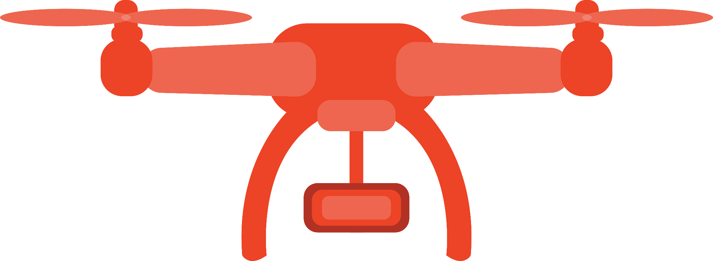
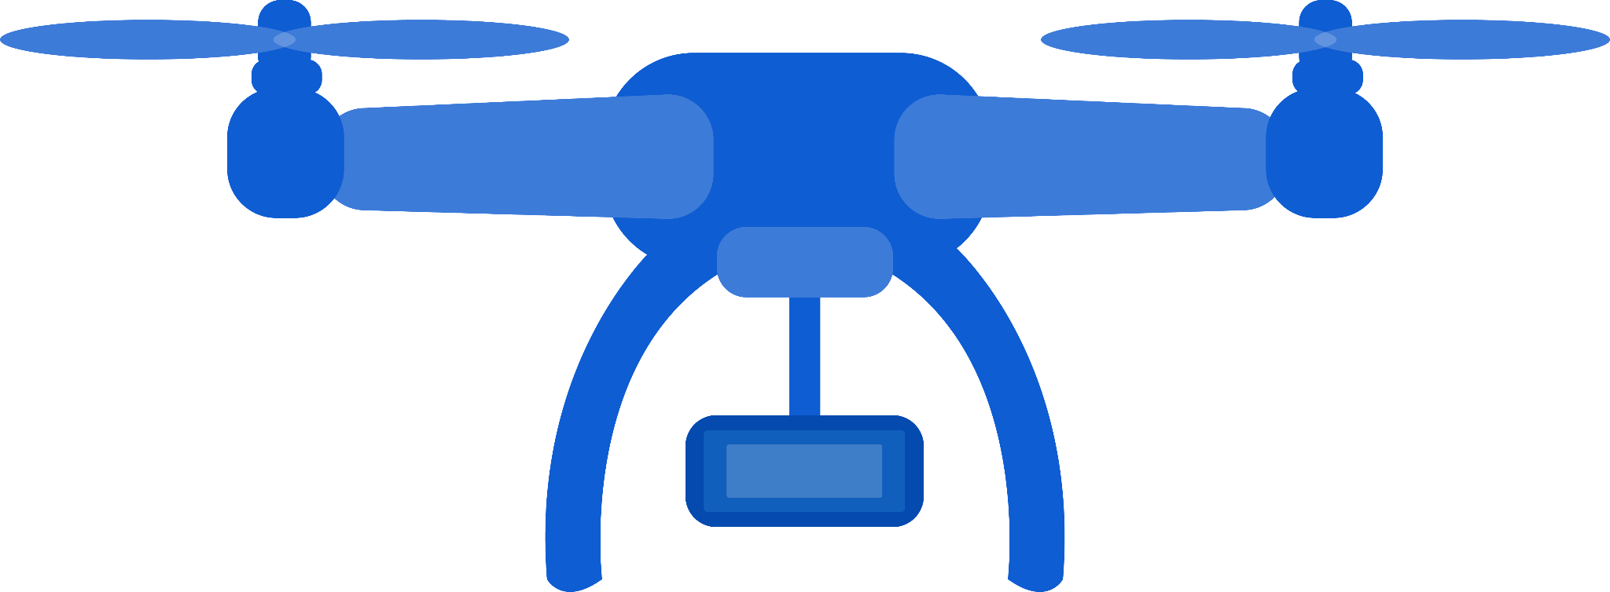
TIMELINE & MARKET IMPACT
Dec 2023: Development of prototype Drone SAR
Aug 2024: Demonstration of all imaging modes
July 2027: Proliferation of 100 Drone SAR via franchise / B2B Model
By 2024, very high resolution SAR Data cost will be reduced from $60 - $100 to < $6
By 2027, data will be updated over India every 3 days

