Slide 1
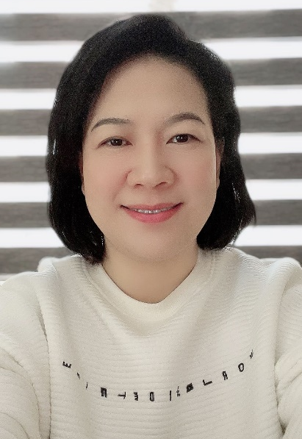
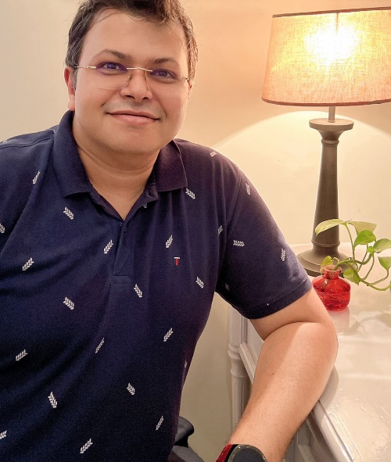
SOLAIRE INITIATIVE PVT LTD
PRESENTS
OM REDOX
YOUR OXYGEN BOX
Prof. Soumyajit Roy, Co-Founder,
Prof. Pei Liang, COO.
BITC
JULY 15, 2022.

Slide 2
IDEA/CONCEPT
We Address Medical Oxygen Demand!
With our
Patented
Technology
Product
OM REDOX.

Slide 3
IDEA/CONCEPT AND TECH
We Address Medical Oxygen Demand!
How?
O₂
Patented Catalyst.
O₂
Patented Design.
Patented Technology.
202131020605;
202231002835.
PCT References.
CE, WHO, ISO 13485
ISO 9001:2015
CERTIFIED
TRL 9 and ABOVE
ONLY ALTERNATIVE APPROVED TECHNOLOGY FOR MEDICAL OXYGEN
OTHER THAN CONCENTRATOR AND PSA TECHNOLOGY.

Slide 4
IDEA/CONCEPT, COMPETITIVE EDGE AND TECHNOLOGY
MADE IN BENGAL. GLOBALLY COMPETITIVE.
CREATING BLUE OCEAN

Slide 5
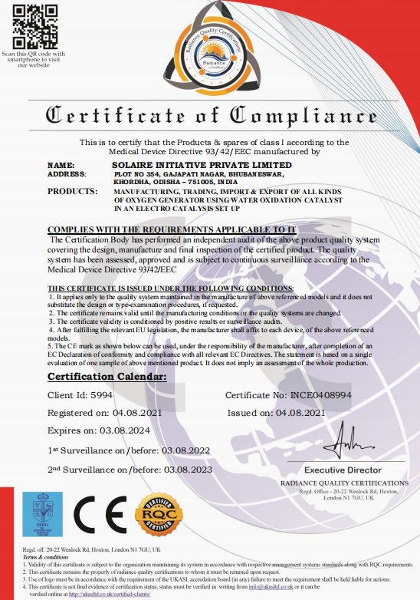
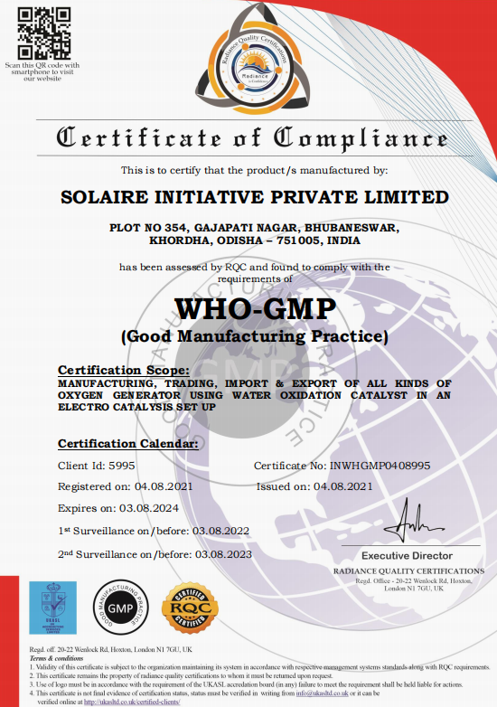
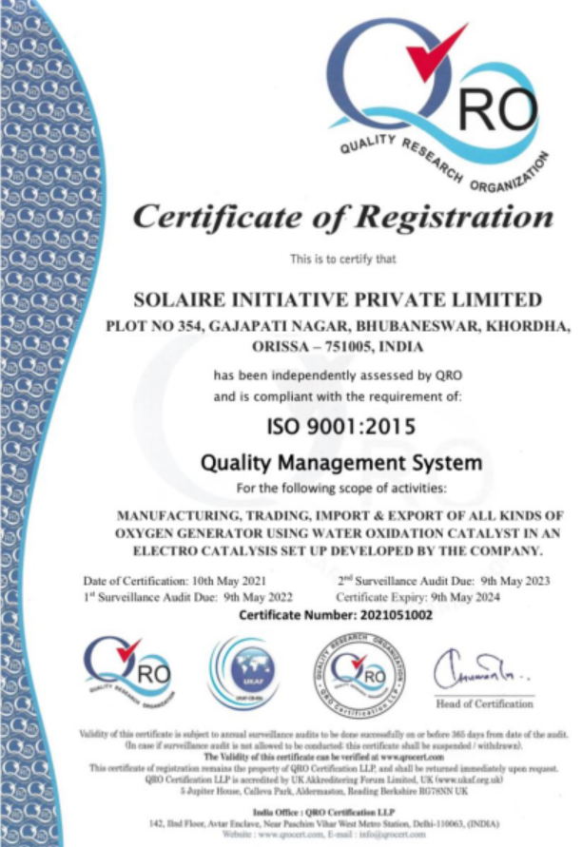
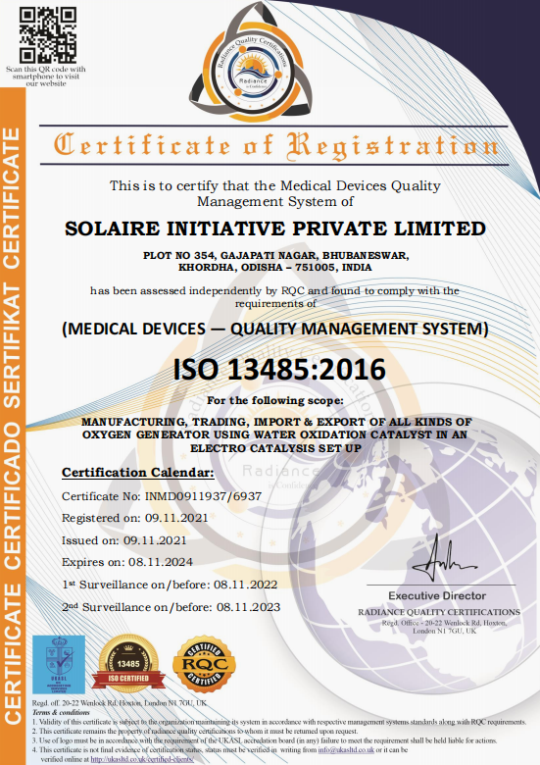
STATUS OF START UP AND FINANCIALS
ISO, EUROPEAN CONFORMITY, WHO, CERTIFIED
VALUED AT PRESENT 10 CR (ICAI VALIDATION STANDARD)
RUNNING SINCE 15/05/2019, GST REGISTERED
RECOGNISED BY START UP ODISHA
SHORTLISTED BY DBT-BIRAC,
SELECTED BY WEBEL-BCCI Incubator

Slide 6
IMPACT, MOMENTUM, MARKET-READINESS
ONE OF THE FIRST MADE IN BENGAL DEEP INNOVATION IN HEALTHCARE
SERVED LOCAL PEOPLE, SOLD 80 UNITS, WORD OF MOUTH MARKETING
SCOPE: MEDICAL MAINTENENANCE OF O₂ LEVEL (NOT FOR CRITICAL CARE)
DRIVING INNOVATION: ESTABLISHING WEALTH-KNOWLEDGE ECOSYSTEM
LOOKING FOR TECH TRANSFER AND LICENSING

Slide 7
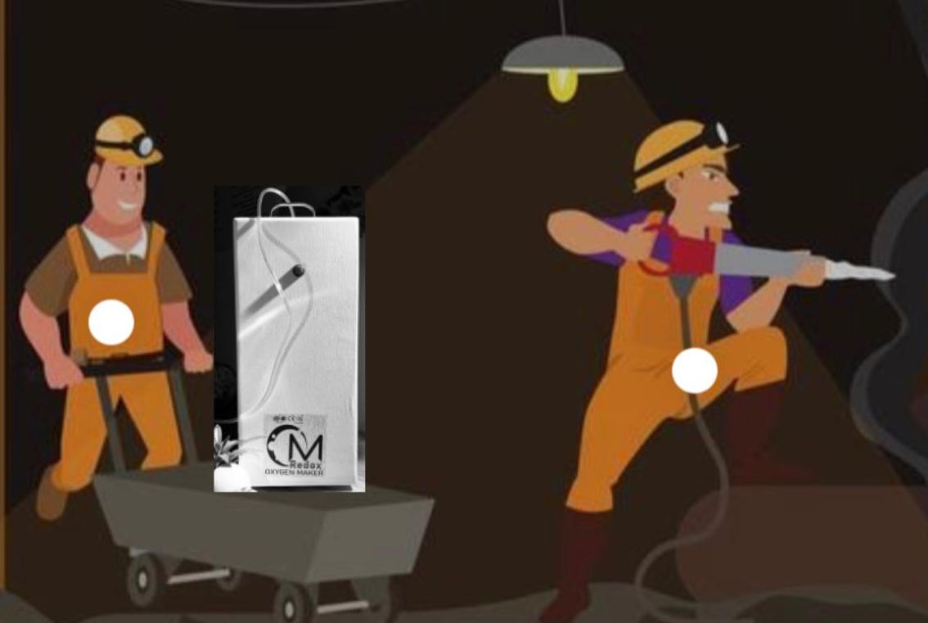
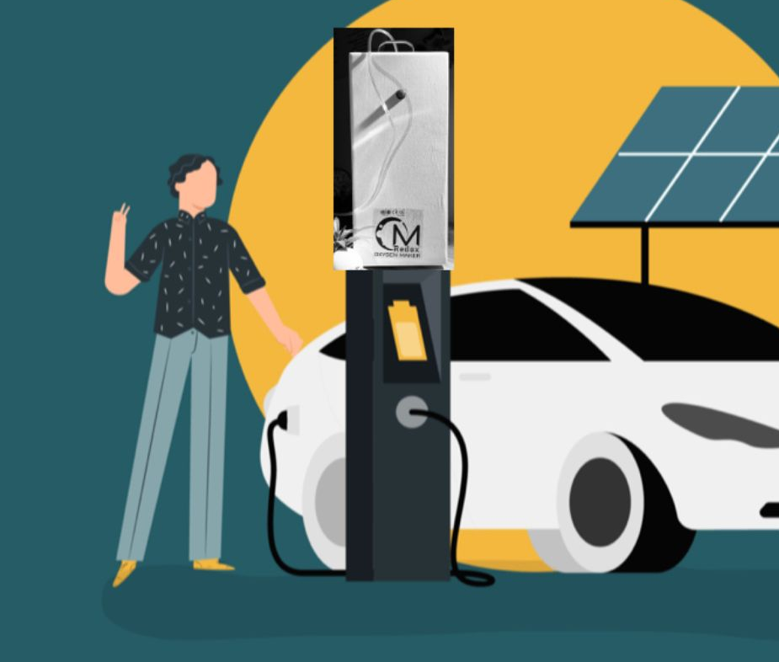
UTILITY AND SCOPE OF FURTHER USE OF PRODUCT
ONE OF THE FIRST MADE IN BENGAL DEEP INNOVATION
SCOPE FOR USE e-Swasthya-Ingit AND BEYOND HEALTHCARE
MINING WELFARE
EV STATIONS
HOTEL/RESTAURANT
WELLNESS SPACE
ENVISAGED FURTHER VALORIZATION OF THE PRODUCT
ABS MODULAR DESIGN
SMALLER BATTERY
IoT IMPLEMENTATION, O₂ UBER

Slide 8
PATH TO ROI AND MARKET-PENETRATION
Global Oxygen Market projected to grow from USD 26 Bn (2020) to
USD 53 Bn (2030).
Open Market Space 34%. Market Leader: Philips Respironics.
Only two certified (CE, WHO) existing technologies for Oxygen Production
PSA Technology
Concentrator Technology.
Ours is a THIRD NEW RECOGNIZED TECHNOLOGY. Blue Ocean.
LOOKING FOR PARTNERS LIKE WEBEL for manufacturing and marketing.
TO CAPTURE GLOBAL EMERGING MARKETS.
Want to make OM REDOX A Household Name here or even in Mars.

Slide 9
RECOGNITIONS OF THE PRODUCT
RECOGNIZED BY THE DBT-BIRAC AS “75 UNDER 75” TOP INNOVATION PRODUCT IN THE FIRST BIO-TECH EXPO, BY THE HON’BLE PM AND SCIENCE MINISTER IN DELHI.

Slide 10
RECOGNITIONS OF THE PRODUCT
RECOGNIZED AS ‘FIRST DEEP INNOVATION PRODUCT’ BY BCC&I-WEBEL TECH INCUBATOR

Slide 11
RECOGNITIONS OF THE PRODUCT
SAVED MANY LIVES, EVEN USED IN IVF-INCUBATORS,
USED IN MAINTENENANCE OF O₂ LEVEL IN SEVERAL PATIENTS.
HYDERABAD BIZBUZZ DAILY
HIGHLIGHT
TRIPURA NEWS, DAILY HUNT TV INTERVIEWS

Slide 12
THANK YOU!

