Slide 1
Benefits of Automation for Channel Partners

Slide 2



ABOUT US
We are a technology & innovation company. Delivering business software for Small and Medium Businesses (SMBs) is our passion.
What sets a company apart is as much in its DNA as its achievements. Today, three decades since it was founded, Tally's product caters to millions of users across industries in over 100 countries.
GVLA businesses are Government and Very Large Account entities. We, at Tally, are committed to serve them with a team of specialized experts to find the best business, compliance, and financial management solutions.

Slide 3

Our Landscape
What we do
Currently we are catering to more than 300 principal companies in all sectors
1. Cement
2. Tyre
3. Paints
4. Many more
Tally supports such organizations to operate multi-location transactions seamlessly by providing a centralized bird’s eye view. Transactional experiences are simplified by integrating the principal company and the dealer network through legacy systems on Tally Prime. Additionally, market demands can be forecasted along with the availability of on-time stock visibility at all levels – all with quick data integration and accuracy.
Principal Companies
Enterprise Segment
More than 50000, channel partners of various companies are using this technology for better business operations
Channel Partners
DMS and Integration
Integrated with all Principal ERP like SAP/Oracle
Implementation of DMS for Secondary Sales and Stock Visibility

Slide 4
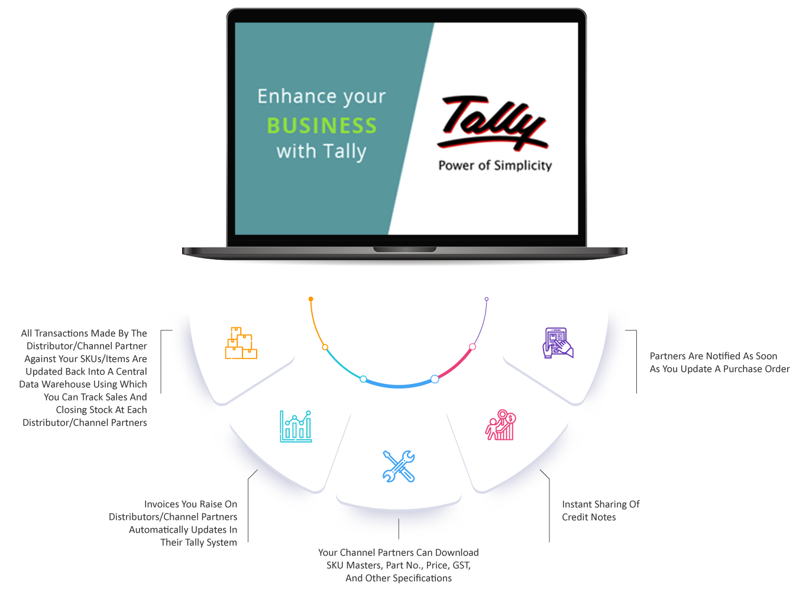
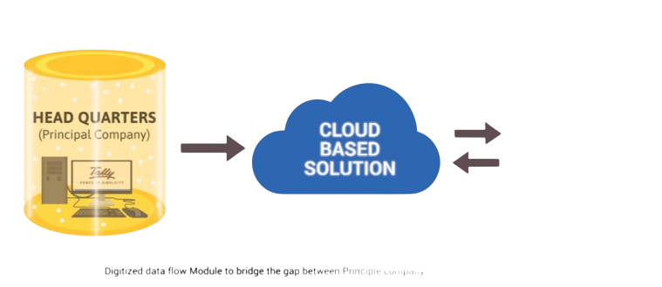
Benefits
Distributor Specific dashboard
Automated and Controlled Order processing
DMS Integration with SSV module
Ideal Stocking based on Sales Pattern
Master and Price Control
Integration with any ERP
Multi Brand Billing
Statutory Complaint
Parent Company
Major Benefits
Channel Partners
Major benefits

Slide 5





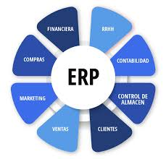

How it Works
Distributor’s Sales Data
Upload from Tally
Auto Scheduler

