Slide 1
IT for the enterprise
IT – Towards User Defined Services

Slide 2
Who is the “USER”
Developers of UDS?
Support team of UDS?
Implementer of UDS?
Customizer of UDS?
In house IT Teams?
(non IT) END USERS for business benefit?
W.I.P
* UDS : User defined Services

Slide 3
How to create a User defined Service
http://support.microsoft.com/kb/q137890/

Slide 4
Typical User Defined Service
IMPORTANT: This article contains information about editing the registry. Before you edit the registry, make sure you understand how to restore it if a problem occurs. For information on how to do this, view the "Restoring the Registry" or the "Restoring a Registry Key" online Help topics in Registry Editor.
To create a Windows NT user-defined service, perform the following steps:
At a MS-DOS command prompt(running CMD.EXE), type the following command:
path\INSTSRV.EXE My Service path\SRVANY.EXE
where path is the drive and directory of the Windows NT Resource Kit (i.e., C:\RESKIT) and My Service is the name of the service you are creating.

Slide 5
Typical User Defined Service …..
Example:
C:\Program Files\Resource Kit\Instsrv.exe Notepad C:\Program Files\Resource Kit\Srvany.exe
NOTE: To verify that the service was created correctly, check the registry to verify that the ImagePath value under
HKEY_LOCAL_MACHINE\SYSTEM\CurrentControlSet\Services\service name
is set to point to SRVANY.EXE. If this is not set correctly, the service will stop shortly after it starts and return an Event ID 7000 "The service name failed to start."
WARNING: Using Registry Editor incorrectly can cause serious problems that may require you to reinstall your operating system. Microsoft cannot guarantee that problems resulting from the incorrect use of Registry Editor can be solved. Use Registry Editor at your own risk.
For information about how to edit the registry, view the "Changing Keys And Values" online Help topic or the "Add and Delete Information in the Registry" and "Edit Registry Data" online Help topics in Registry Editor.

Slide 6
Typical User Defined Service …..
NOTE: You should back up the registry before you edit it.
Run Registry Editor (Regedt32.exe)and locate the following subkey:
HKEY_LOCAL_MACHINE\SYSTEM\CurrentControlSet\Services\<My Service>
From the Edit menu, click Add Key. Type the following and click OK:
Key Name: Parameters
Class : <leave blank>
Select the Parameters key.
From the Edit menu, click Add Value. Type the following and click OK:
Value Name: Application
Data Type : REG_SZ
String : <path>\<application.ext>

Slide 7
Typical User Defined Service …..
where <path>\<application.ext> is the drive and full path to the application executable including the extension (i.e., C:\WinNT\Notepad.exe)
Close Registry Editor.
By default, a newly created service it configured to run Automatically when the system is restarted. To change this setting to Manual, run the Services applet from Control Panel and change the Startup value to Manual. A service set to Manual can be started in one of several ways:
- From the Services applet in Control Panel
- From a MS-DOS command prompt, type the following:
NET START <My Service>
- Use the Sc.exe utility from the Resource Kit. Type the following from a MS-DOS command prompt:
<path>\Sc.exe start <My Service>
where <path> is the drive and directory of the Windows NT Resource Kit (i.e., C:\Reskit).

Slide 8
Typical User Defined Service
For more information on installing and removing a user-defined service, please see the Srvany.wri document provided with the Windows NT Resource Kit utilities (i.e., C:\Reskit\Srvany.wri). This document can also be found on the Windows NT Resource Kit CD in the Common\Config directory.
Back to the top
Note This is a "FAST PUBLISH" article created directly from within the Microsoft support organization. The information contained herein is provided as-is in response to emerging issues. As a result of the speed in making it available, the materials may include typographical errors and may be revised at any time without notice. See Terms of Use for other considerations.

Slide 9
Going back to my question
Let us define the “user” in User Defined Services?

Slide 10
Thank You

Slide 11
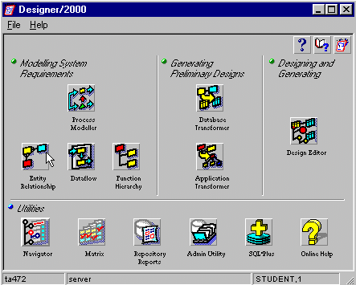
User defined routine

