Slide 1
Enterprise Cloud Computing
Standards,
Innovation &
Shifts
Anubrata Chakrabarti
Director, Technology Integration
July 29, 2011

Slide 2
Standards - the need & the way forward
Notes:
2

Slide 3
Does every cloud have a silver lining ?
Cloud Computing is one choice in how businesses purchase, deploy, and support IT services. It’s a complex topic. How do you get an actionable discussion?
C
I. Does the business problem or technology solution require all of the following?
End-user self service – automating customer subscription and provisioning
Location independence and multi-tenancy for service provisioning and delivery
IP ubiquity – enabling access anytime and anyplace there is a network connection
Elastic performance and load – the ability to scale both up and down by period
Elastic pricing and contract terms – the ability to subscribe services “by the drink”
II. What set (or sets) of the 3 dimensions of Cloud are required for the solution?
Service Type
Service Source
Business Model
Business-as-a-Service
Public cloud
Cloud Service Subscriber
Software-as-a-Service
Hybrid Cloud
Virtual Private
Cloud
Community Cloud
Cloud Service Broker
Platform-as-a-Service
Cloud Service Provider
Infrastructure-as-a-Service
Private cloud
Cloud Service Enabler
3

Slide 4
Cloud computing delivery models
Cloud computing technology is deployed in different ways, with varying internal or external ownership and technical architectures
Vendor cloud (External) | Cloud computing services from vendors that can be accessed across the Internet or a private network, using one or more data centers, shared among multiple customers, with varying degrees of data privacy control. Sometimes called “public” cloud computing.
Private cloud (Internal) | Computing architectures modeled after vendor clouds, yet built, managed, and used internally by an enterprise; uses a shared services model with variable usage of a common pool of virtualized computing resources. Data is controlled within the enterprise.
Hybrid cloud | A mix of vendor cloud services, internal cloud computing architectures, and classic IT infrastructure, forming a hybrid model that uses the best-of-breed technologies to meet specific needs.
Community cloud | Community clouds are used across organizations that have similar objectives and concerns, allowing for shared infrastructure and services. Community clouds can be deployed using any of the three methods outlined above, simplifying cross-functional IT governance.

Slide 5
The need for Cloud Computing Standards
Standards for Cloud Architecture
Standards for Cloud Applications
Everyone’s talking about building a cloud these days. But if the IT world is filled with computing clouds, will each one be treated like a separate island or will open standards allow all to interoperate with each other ?
Emerging
Cloud Interfaces are the key
Leverage autonomic computing, grid, virtualization
Mature technologies but various approaches
Service Oriented Architecture
Web Services standards
Why do we need standards ?
Ability to switch easily between external and internal clouds or amongst external providers
Support development of open source software for cloud based computing
Inherent risk in availability of service and data, when relying on single provider

Slide 6
The Seven Standards of Service of Cloud Computing Platforms
Building blocks of the best practices every successful cloud computing platform tends to follow
World-class security – Provision world-class security at every level.
Trust and transparency – Provide transparent, real-time, accurate service performance and availability information.
True multi-tenancy – Deliver maximum scalability and performance to customers with a true multitenant architecture.
Proven scale – Support millions of users with proven scalability.
High performance – Deliver consistent, high-speed performance globally.
Complete disaster recovery – Protect customer data by running the service on multiple geographically dispersed data centers with extensive backup, data archive, and failover capabilities.
High availability – Equip world-class facilities with proven high-availability infrastructure and application software.
Source: salesforce.com
6

Slide 7
Cloud Standard Groups
Which Organization doing what ?
Cloud Security Alliance (CSA)
Distributed Management Task Force (DMTF)
Storage Networking Industry Association (SNIA)
Open Grid Forum (OGF)
Open Cloud Consortium (OCC)
Organization for the Advancement of Structured Information Standards (OASIS)
TM Forum
Internet Engineering Task Force (IETF)
International Telecommunications Union(ITU)
European Telecommunications Standards Institute (ETSI)
Object Management Group (OMG)
 | SaaS | PaaS | IaaS
Provisioning | OMG | OMG | OGF / OMG / DMTF
Security |  |  | OGF / DMTF / CSA
Quality of Service |  |  | DMTF
Identity |  | OASIS
Development Platform | OMG | OMG | OMG
Virtual Machine Interface |  |  | DMTF
Source: http://cloud-standards.org

Slide 8
Innovations – what in store
Notes:
8

Slide 9
Cloud Computing Innovations
Skype - A global mesh network of managed network elements that provisions a global VoIP network with voice endpoints
FortiusOne’s GeoCommons - Next-generation location intelligence platform by blending analysis capabilities of geographic information systems (GIS) with location-based information on the Web
Composite Cloud
Mobile surveillance
Iveda Solutions is leveraging the cloud to provide streaming mobile video surveillance at a price point well below the typical closed-circuit systems
OpenStack – Open source cloud platform with the source code for the project provided by Rackspace
OpenNebula - Fully open source toolkit to build any type of IaaS Cloud
Open Cirrus Project (The HP/Intel/Yahoo! Open Cloud Computing Research Testbed) - Open cloud-computing research testbed designed to support research into the design, provisioning, and management of services at a global, multi-datacenter scale
Open Source platform
This model takes resources from multiple cloud providers and pools them to create large-scale, distributed architectures. This is under research
Sky computing

Slide 10
Cloud Computing Innovations…Contd.
By combining cloud computing, http delivery and client-side technology, Pando Networks is providing a highly scalable game delivery platform with network capacity that expands as demand increases
Ashima Arts is building a Massively Multiplayer Online (MMO) OS based on virtualization and cloud concepts
Online gaming
Private Virtual Infrastructure (PVI) – A new management and security model for cloud computing proposed by the University of Maryland, with the idea of sharing the responsibility of security in cloud computing between the service provider and the client
Trusted Cloud Computing Platform (TCCP) – The Max-Planck-Institute addresses the problem of clients not having any means of verifying the confidentiality and integrity of their data
Security and confidentiality
Cloud storage gateway devices by StorSimple deployed in data centers to enable the use of cloud storage as traditional storages
Cloud gateways
10

Slide 11
? -To Shift or Not to Shift
Notes:
11

Slide 12
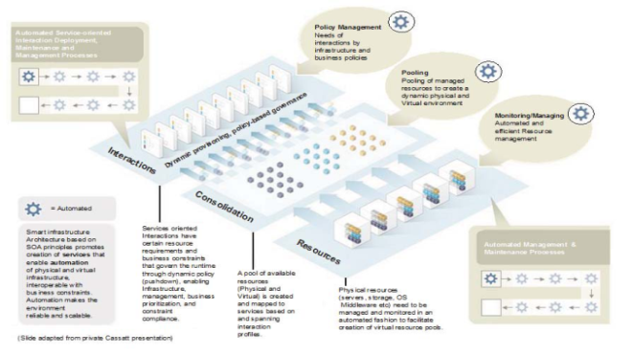
Treading back …
PaaS
SaaS
IaaS
BaaS
Cloud
Grid
Autonomic Computing – a set of architectural characteristics to manage systems where complexity is increasing but must be managed without increasing costs or the size of the management team, where a system must be quickly adaptable to new technologies integrated to it, and where a system must be extensible from within corporation out to the broader ecosystem and vice versa.

Slide 13
Cloud Computing is changing the sourcing and business models of IT companies and enterprise buyers
Significant industry changes are coming with cloud computing and adoption of alternate business models and types of information services
Enterprises are now buying Cloud Computing services which align with their needs and risk tolerance
For many IT vendors and services providers, Cloud Computing is the new focus of competition, putting great pressure on incumbents
Tech, Telecom, and Media companies are investing heavily, competing to establish cloud computing market share.
The IT industry is changing by the need to supply flexible cloud-based services to a both consumers and enterprises
Enterprises and service providers that adopt cloud computing delivery models have the potential to fundamentally re-shape the broader business landscape.

Slide 14
Enterprises are moving into the market for cloud services
Consumers and Enterprises are now both heavy users of Cloud services and blurring the distinction with enterprise usage patterns.
In 2008, Consumer use of the Internet overtook Business usage
Consumers
Enterprises
source: Cisco Systems, Global IP Traffic Forecast and Methodology; Mobility segment (0.1% of traffic in 2007)

Slide 15
Enterprises are adopting Cloud Computing service models following different paths of awareness and acceptance
Software as a Service and Infrastructure as a Service are the easiest to use and adopt, and are leading the market for enterprise services
Enterprise adoption path of cloud computing
SaaS
High
IaaS
Internalization
Institutionalization
PaaS
Adoption
Adoption
Positive Perception
Private Cloud
Understanding
Awareness
Low
Unaware
Time

Slide 16
Operational, Risk and Governance issues must be properly balanced for Enterprises Cloud Computing adoption:
Key operational and governance issues must be resolved – for both enterprises and services providers
Data controls | Who owns the data? How is it being used? Are controls in place?
Security and Privacy | How is security achieved? What is the level of privacy protection?
Audit & Assurance | Are there risk management controls to applications and data?
Tax and Legal | Can you meet needs for legal compliance and tax issues?
Backup and DR | Are data backup, retention, disaster recovery practices sufficient?
Vendor “lock-in” | Is the vendor limiting interoperability or access to your data?
IT Operations | What IT services and applications are best suited for the cloud?
IT Readiness | Are internal IT architecture and organization structures “ready”?
Alignment with Enterprise Risk and Governance strategy will help organizations address the operational hurdles to cloud adoption

Slide 17
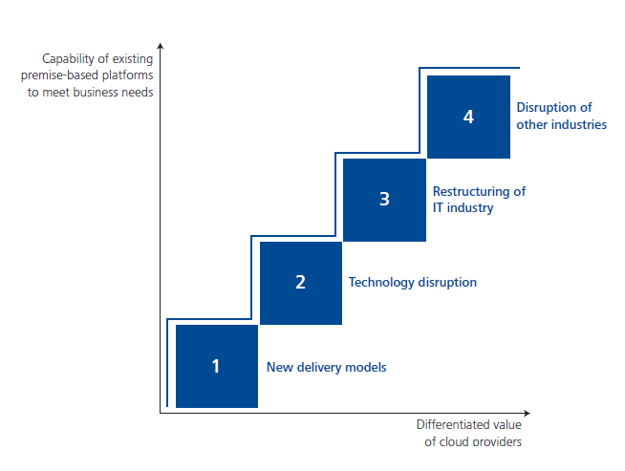
The longer-term impact of Cloud Computing will be felt in four waves of disruption in the IT marketplace
Notes:
The four disruptions catalyzed by cloud include 1) the growth of new technology delivery models; 2) the evolution of a new IT architecture to address unmet needs of business ecosystems; 3) rapid adoption leading to the restructuring of the IT industry; and 4) the disruption of other industries beyond high technology based on these new capabilities.

Slide 18
Case Study – G2C portal staging environment in Cloud
Staging environment setup in Amazon EC2 Cloud for the G2C portal of a Government Department in a neighbouring country
Driving factors
On the downside
Cost benefits
Low maintenance overhead
Easy backup and recovery
Developer training and learning curve to adopt cloud
High network bandwidth usage
Periodic backup of cloud image
What would be the impact if the production environment is not on cloud?

Slide 19
Q & A
Notes:
19

Slide 20
About Deloitte
Deloitte refers to one or more of Deloitte Touche Tohmatsu Limited, a UK private company limited by guarantee, and its network of member firms, each of which is a legally separate and independent entity. Please see www.deloitte.com/about for a detailed description of the legal structure of Deloitte Touche Tohmatsu Limited and its member firms Copyright © 2011 Deloitte & Touche Consulting India Pvt Ltd All rights reserved. Member of Deloitte Touche Tohmatsu
Notes:
20

