Slide 1
The Changing World of IT – Exciting new vistas for enterprise planning
Technology made Easy and Affordable for SMEs On Cloud
Manoj Sahai
Head Strategic Sales, iON
29th July 2011, Kolkata

Slide 2
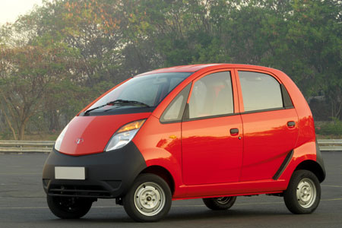
We want to do the same for Software
Car – Made Affordable by Tata

Slide 3
Challenges faced by SMBs in adopting ICT Solutions
Investments in ICT are depriving cash for Core Operations
Rapid Technology Obsolescence is leading to spiraling cost to run ICT operations
Inability to retain ICT Talent is disrupting effective ICT management
Lack of Technology expertise is depriving adoption of fit for purpose ICT systems
“Pay First – Use Later” models are forcing to pay for the cost of failed ICT implementations
Lengthy implementation cycle of traditional models resulting in loss of market share to new entrants leveraging ready to use technology
Lack of integration across ICT systems is preventing information driven business decisions
Lack of single accountable partner for ICT leading to poor service level commitments
Lack of credible ICT solutions is increasing the risk of non compliance to statutory needs
The Cost to Maintain IT consumes 65% to 75% of total ICT spend

Slide 4
Technology made Affordable for SMBs
Core Principles
Utility Model
1
Change the way I Pay into an Opex based model
Obsolescence
2
Reduce the cost to upgrade the technology due to obsolescence
Serviceability
3
Reduce the cost to get Serviced
Maintainability
4
Reduce the cost to get Maintained
Integration
5
Reduce the cost to get Integrated
Compliance
6
Reduce cost to Comply
Expandability
7
Reduce the cost to expand and Grow
Green
8
Reduce the cost to Run

Slide 5
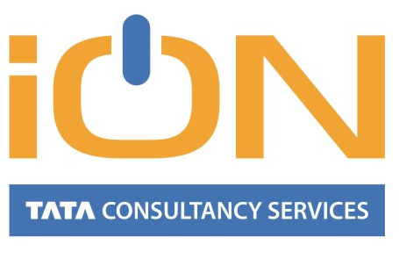
The Nano for the Software Industry

Slide 6
Technology made Affordable for SMBs
Core Principles
Affordable
1
Utility Model
TCS’ iON is a Per User Monthly Price (PUMP) model of pricing
Traditional Licensing Model
TCS’ IT-as-a-Service Model
Rs.
Benefit
Benefit
Cost
Cost
Rs.
Rs.
Rs.
Rs.
Rs.
Rs.
Rs.
Year 1
Year 2
Year 3
Year 4
Year 1
Year 2
Year 3
Year 4
Capex + Opex
Only Opex
PUMP Utility model also helps SMBs to scale the investment as they scale the number of users in the organization

Slide 7
Technology made Affordable for SMBs
Core Principles
Affordable
2
Obsolescence
TCS’ iON is a perpetual beta service
Continuous release cycle ensures responsiveness to changing business dynamics
SMBs do not own any IT assets and hence are not subject to obsolescence
Affordable
3
Serviceability
Robust serviceability model for service activation & provisioning and service assurance
Automation technical provisioning and pre-configured solutions reduces costs
24 x 7 Toll Free Helpdesk with remote tools for effective management
Affordable
4
Maintainability
Automatic and seamless upgrades
Reduced cost as no local IT infrastructure runs on premise
Reduced costs associated with maintaining physical and logical security of a data center

Slide 8
Technology made Affordable for SMBs
Core Principles
Affordable
5
Integration
Optimized IT cost allocation decisions due to integrated and holistic solution with single partner
Traditional Licensing Model
TCS’ iON Model
Buy Hardware
From Vendor 1
Hardware
Software
Networks
Customize Software
Integration
Maintenance & Support
Customer
Customize
Software
From Vendor 4
Customer
Buy Software
From Vendor 2
Deploy and
Integrate
From Vendor 5
Continuous
Improvement
by TCS
Buy Networks
From Vendor 3
Time taken is months
Time taken is few weeks
Reduced cost to manage multi-vendors
Reduced effort to manage solution deployment
Reduced cost to integrate with procured solutions

Slide 9
Technology made Affordable for SMBs
Core Principles
Affordable
6
Compliance
TCS iON Data Center is compliant to the TCS Security Audit based on BS7799 / SAS 70
Solutions with requisite Audit Trials and the necessary controls
Infrastructure and Solutions have been internally verified for corporate Security Compliance requirements
Solutions support statutory Central and State Compliance requirements
Affordable
7
Expandability
TCS iON is a catalogue based service model
SMBs have the option to decide on the key applications that is relevant to them in the beginning and then expand slowly
SMBs have the ability to scale down or up the number of users based on the business growth
SMBs have the option to expand the services to other regions or countries with no additional effort

Slide 10
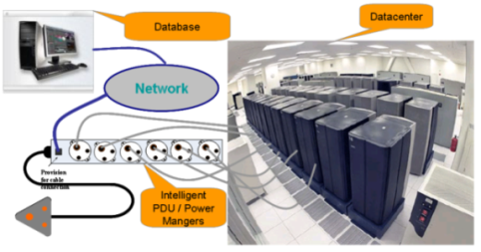
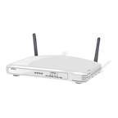
Technology made Affordable for SMBs
Core Principles
Affordable
8
Green
TCS iON reduces the overall cost to run the IT operations by nearly 40% of the traditional model
iON
Cloud Services
i PDUs
Virtual machines
High Server side Computation
Dynamic Provisioning
Active Power Management
Power consumption of a Zero client is 4W as against 100W for a normal Desktop.
Storage utilization of Zero clients is 100% as against 50% for normal desktops
Server in an office environment is utilized about 8-10%
By virtualization or multi-tenanted solution, the effective usage can be enhanced up to 70-80%
Power Aware computing can go to low usage mode and quickly turn-on when required
A tiered consumption and storage model can scale as per demand

Slide 11
TCS SMB Solutions
Solution Catalogue helps choose relevant solutions as they grow
L6
Business Analytics
Software Solution
Network Solution
Hardware Solution
L5P
Biz Services
Reward-Recognition
Assessments
Virtual Community
L5
Manufacturing
Retail
Wellness
Education
Prof. Services
L4
CRM
P & I
F&A
HRMS
Payroll
Projects
L3
Document Mgmt
Online Presence Mgmt
Enterprise Intranet Mgmt
Messaging Solution
Office Mgmt Solution
L2
Network Connectivity
Network Devices
Data Center Hosting
L1
Desktop/Laptops
Printers
On Premise Servers
All System Software

Slide 12
TCS SMB Solutions
Service Coverage
Applications
Software Subscription
System Software
Bundled Free Applications
Activation
Deployment
Data Load
Web based training
Enablers
On Premise Hardware
Last Mile Network
Forward Funding
Agility
Integration
Industry Business Process Defaults
Pre- Defined Industry Data Defaults
Hosting
Data Center Network
Data Center Compute
Data Center Storage
Management
AMC
Support (16*7)
Upgrade
System Administration
Vendor management
BCP
Security
Disaster Recovery

Slide 13
Thank You
Visit us on www.tcsion.com
Contact : m.sahai@tcs.com

