Slide 1
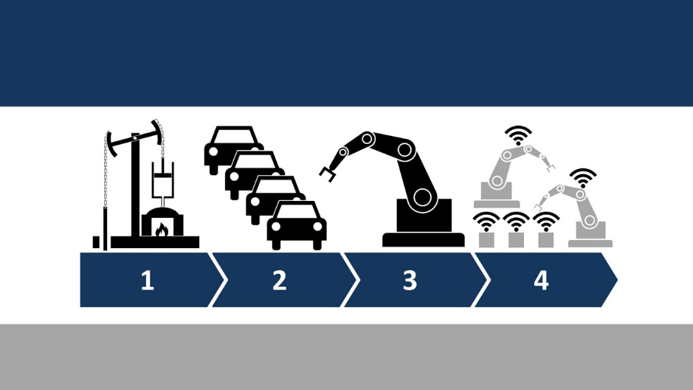
Role of Government in Driving Manufacturing Resurgence
Follow us on

Slide 2
EEPC India: Catering to the Indian Engineering Sector since 1955
Established on September 21, 1955
Over 12, 000 members; 60% of the total membership of the Council constitutes MSMEs;
An ISO 9001:2013 Certified Organization
Played instrumental role in promoting India’s engineering exports from US$ 10 million in 1955-56 to over US$ 58 billion in 2015-16
Started with a few hundred engineering units, EEPC INDIA has grown to be the largest trade and investment promotion body with a membership of more than 12,000 from amongst large Corporate Houses, Star Trading Houses, Small & Medium Scale Units (SME), Trading House

Slide 3
Manufacturing Sector in India
Follow us on

Slide 4
Manufacturing sector in India
Manufacturing Industry in India has gone through various phases of development over the period of time.
Since independence in 1947, the Indian manufacturing sector has traveled from the initial phase of building the industrial foundation in 1950’s and early 1960’s, to the license–permit Raj in the period of 1965–1980, to a phase of liberalization of 1990’s,.
Indian Manufacturing sector currently contributes ~15-16% to GDP (2015) and gives employment to ~12% (2014) of the country’s workforce.
Studies have estimated that every job created in manufacturing has a multiplier effect, creating 2–3 jobs in the services sector.
In a country like India, where employment generation is one of the key policy issues, this makes this sector a critical sector to achieve inclusiveness in growth.

Slide 5
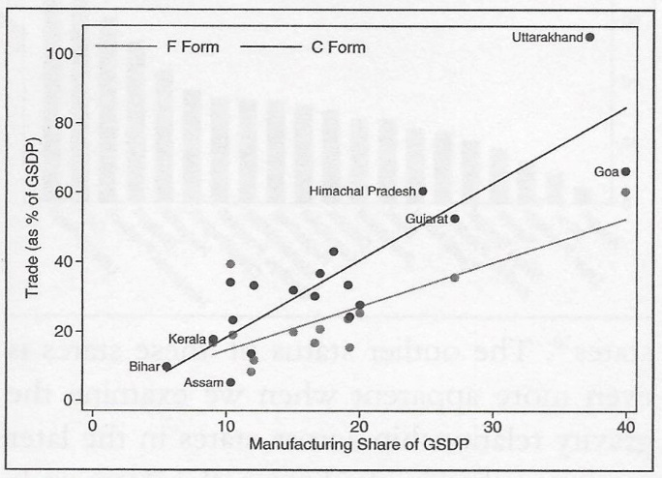
Relationship between Inter-state Trade and Manufacturing Output

Slide 6
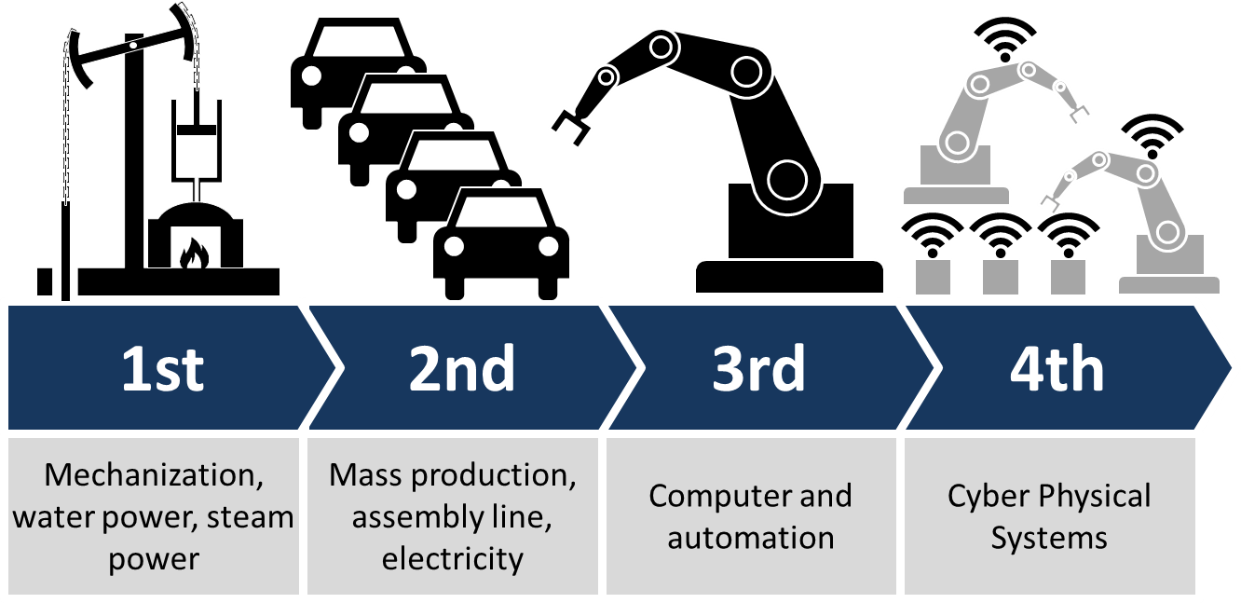
Next Gen Manufacturing: Industry 4.0
The fourth industrial revolution is already on its way. Is India prepared for the change?
This is a new area where public and private partners have to collaborate closely. Industrial bodies need to and already have started promoting innovation by providing avenues for all stakeholders to come to a common forum.
On behalf of EEPC India, we are in the process of developing a technology incubation centre in Bangalore and we have plan to develop similar facility in Kolkata too.
Notes:
Industry 4.0
First came steam and the first machines that mechanized some of the work our ancestors did. Next was electricity, the assembly line and the birth of mass production. The third era of industry came about with the advent of computers and the beginnings of automation, when robots and machines began to replace human workers on those assembly lines.
And now we enter Industry 4.0, in which computers and automation will come together in an entirely new way, with robotics connected remotely to computer systems equipped with machine learning algorithms that can learn and control the robotics with very little input from human operators.
Industry 4.0 introduces what has been called the “smart factory,” in which cyber-physical systems monitor the physical processes of the factory and make decentralized decisions. The physical systems become Internet of Things, communicating and cooperating both with each other and with humans in real time via the wireless web.

Slide 7
Major policy directions
Trade Policy: complete more trade-opening agreements, such as the current negotiations with Asia and Europe; combat “competitive currency devaluations”; and work to achieve global macroeconomic stability.
Energy Policy: develop energy policy for the future; improve electric grid to allow development of new sources of power generation, such as wind and solar; support more efficient use of energy through conservation efforts.
Regulatory Policy: reduce overlapping and layered regulations through regulatory forbearance, elimination of duplicative regulations, and more rigorous review of costs and impacts of new regulations; and use trade negotiations to reduce costs of and impediments to trade by converging or harmonizing regulations.
Manufacturing Labor Force: skill enhancement, including science, technology, engineering, and mathematics (STEM) education; develop nationally recognized skills certification programs and certificates; expand and improve apprenticeship and vocational education programs; encourage entry of non-traditional demographic groups to manufacturing positions and skills; reduce barriers to entry in professional fields related to manufacturing; and reform immigration to support permanent work status for skilled workers, engineers, and research personnel.
Tax Policy: Reduce corporate taxes to OECD average levels; adopt territorial tax regimes; expand and improve R&E tax credit and investment expensing options; and exercise care in any tax reform not to burden “pass-through” firms with new tax obligations on top of the personal income tax increases adopted in 2013.
Basic and Applied Research: Expand federal support for basic and applied research applied research in fields

Slide 8
Some of the major investments and developments in this sector
Huawei, the China-based smartphone manufacturer, has entered into an agreement to manufacture its smartphones in India.
LeEco, a Chinese technology company, has entered into a partnership to start manufacturing Le2 smartphones in India.
Zopo Mobile, a China-based smartphone manufacturer, plans to invest Rs 100 crore (US$ 15 million) to set up a manufacturing plant in Noida
Tata Power has partnered with US-based Javelin Joint Venture, which is a partnership between Raytheon Company and Lockheed Martin, for its Strategic Engineering Division (SED), in order to create a strategy to co-develop and produce the Javelin missile system and integrate platform mounts to meet Indian requirements.
Honda Motorcycle & Scooter India plans to invest around Rs 600 crore (US$ 88.94 million) to add a new line at its Narsapura facility at Karnataka, and launch at least 10-15 products during FY 2016-17 in the country.
Force Motors, a utility and commercial vehicles manufacturer, inaugurated its Rs 100 crore (US$ 14.82 million) manufacturing facility in Pune, which will supply engines and axles to the Germany-based automobile manufacturer Mercedes-Benz.
Boeing Company, an American plane maker, and Tata Advanced Systems Ltd (TASL), a fully owned subsidiary of Tata Sons, have entered into a joint venture to set up a new facility in Hyderabad to manufacture Boeing AH-64 Apache helicopter fuselages.

Slide 9
Some of the recent investments and developments in this sector
Panasonic Corporation plans to set up a new manufacturing plant for refrigerators in India with an investment of Rs 250 crore (US$ 37 million), and also invest around Rs 20 crore (US$ 3 million) on an assembly unit for lithium ion batteries at its existing facility in Jhajjar in the next 8-10 months.
Isuzu Motors, the Japan-based utility vehicle manufacturer, has inaugurated its greenfield manufacturing unit in Sri City, Andhra Pradesh
Airbus has procured more than US$ 500 million worth of supplies from India in 2015, registering a growth of 15 per cent annually and has targeted a cumulative procurement of more than US$ 2 billion over a period of five years up to 2020.
Havells India Limited, one of the top Indian consumer electrical equipment producer, plans to set up a new manufacturing unit near Bengaluru by making an investment of Rs 1,059 crore (US$ 156.99 million), which would be its twelfth plant in India and its first outside north India.
Global beverage company Pepsi plans to invest Rs 500 crore (US$ 74 million) to set up another unit in Maharashtra to make mango, pomegranate and orange-based citrus juices, while biotechnology giant Monsanto plans to set up a seed plant in Buldhana district of Maharashtra.
Hindustan Coca-Cola Beverages plans to set up a bottling plant with an investment of Rs 750 crore (US$ 111.2 million) in phases at the first industrial area being developed by Government of Madhya Pradesh under the public private partnership in Babai village of Hoshangabad, Bhopal.
Canada’s Magna International Incorporated has started production at two facilities in Gujarat’s Sanand, which will supply auto parts to Ford Motor Co in India and will employ around 600 people at both units.

Slide 10
Government initiatives
To boost manufacturing sector in India
Follow us on

Slide 11
Government’s Make in India initiative
Government of India has launched ‘Make in India’ program to place India on the world map as a manufacturing hub and give global recognition to the Indian economy.
Vision of the Make in India initiative
An increase in manufacturing sector growth to 12-14% per annum over the medium term;
An increase in the share of manufacturing in the country’s Gross Domestic Product from 6% to 25% by 2022;
To create 100 million additional jobs by 2022 in manufacturing sector;
Creation of appropriate skill sets among rural migrants and the urban poor for inclusive growth;
An increase in domestic value addition and technological depth in manufacturing;
Enhancing the global competitiveness of the Indian manufacturing sector;
Ensuring sustainability of growth, particularly with regard to environment.

Slide 12
Make in India: 25 Focus Sectors
Automobiles
Automobile Components
Aviation
Biotechnology
Chemicals
Construction
Defence manufacturing
Electrical Machinery
Electronic systems
Food Processing
Information Technology and Business Process Management
Leather
Media and Entertainment
Mining
Oil and Gas
Pharmaceuticals
Ports and Shipping
Railways
Renewable Energy
Roads and Highways
Space and astronomy
Textiles and Garments
Thermal Power
Tourism and Hospitality
Wellness
As per the new Govt. Policy 100% FDI is permitted in all the above sectors, except for space (74%), defence (49%) and news media (26%).

Slide 13
Upgradation of technology: initiatives by Government and EEPC India
Upgradation of technology is the need of hour for Indian manufacturing sector;
In collaboration with Department of Commerce, MoCI, EEPC India has already adopted a new initiative in order to ensure upgradation of technology in the Indian engineering sector;
Under the initiative, the Technology Meets are being organized to establish a common platform among Industry, R&D Labs and the Government Ministries and discuss industrial technological requirements and available expertise of the R&D Labs to introduce adoption of latest technologies in the cluster.
Once the technological requirements and relevant expertise of R&D Labs are identified, the Government initiates the Project (by inviting DPR). Besides, the platform also sensitizes available technological developments being undertaken across premier R&D Labs of the country.
Over the past one year, over 15 Technology meets have already been organized.
Currently such initiatives are being pursued for engineering clusters in association with regional and local industry bodies such as in Ghaziabad, Jaipur, Belgaum, Bangalore, Chennai, Rajkot, Kolkata, Bhilai and Raipur.

Slide 14
Other major initiatives by the Government of India
The Ministry of Labour and Employment plans to relax compliance measures for MSMEs by exempting them from inspections related to key labour laws.
The Government of India plans to give a big boost to local manufacturing by introducing the new 'Make in India green channel', which will reduce the time taken for cargo clearance at ports from about a week to a few hours without any upfront payment of duties.
Gujarat government is planning to set up an electronics products manufacturing hub in the state
The Ministry of Heavy industries and Public Enterprises, in partnership with industry associations, has announced creation of a start-up centre and a technology fund for the capital goods sector to provide technical, business and financial resources and services to start-ups in the field of manufacturing and services.
Government has recently launched the Technology Acquisition and Development Fund (TADF) under the National Manufacturing Policy (NMP) to facilitate acquisition of Clean, Green and Energy Efficient Technologies, by Micro, Small & Medium Enterprises (MSMEs).
The Government of Uttar Pradesh has secured investment deals valued at Rs 5,000 crore (US$ 741.2 million) for setting up mobile manufacturing units in the state.
Government of India has planned to invest US$ 10 billion in two semiconductor plants in order to facilitate electronics manufacturing in the country.
Entrepreneurs of small-scale businesses in India will soon be able to avail loans under Pradhan Mantri MUDRA Yojana (PMMY). The three products available under the PMMY include: Shishu - covering loans up to Rs 50,000 (US$ 735), Kishor - covering loans between Rs 50,000 (US$ 735) to Rs 0.5 million (US$ 7,340), and Tarun - covering loans between Rs 0.5 million (US$ 7,340) and Rs 1 million (US$ 14,700).

Slide 15
Some of the Schemes for MSMEs in India
Technology Up-gradation Fund Scheme (TUFS) (Ministry of Textiles)
Ministry of Textiles introduced the Technology Up-gradation Fund Scheme (TUFS) for textiles and jute industry to facilitate induction of state-of-the-art technology by the textile units.
Scheme for Technology Up-gradation/ Establishment/ Modernization for Food Processing Industries (Ministry of Food Processing Industries, Govt. of India)
This Scheme covers activities like setting up/expansion/modernization of food processing industries covering all segments, viz. fruits & vegetable, milk product, meat, poultry, fishery, oil seeds and such other agri-horticultural sectors leading to value addition and shelf life enhancement including food flavours and colours, oleoresins, spices, coconut, mushroom, hops.
Integrated Development of Leather Sector (IDLS) (Ministry of Industries & Commerce, Govt. of India)
The scheme is aimed at enabling existing tanneries, footwear, footwear components and leather products units to upgrade leading to productivity gains,right-sizing of capacity, cost-cutting, design and development simultaneously encouraging entrepreneurs to diversify and set up new units
Technology & Quality Upgradation Support for MSMEs (TEQUP) (Ministry of MSME, Govt. of India)
The TEQUP scheme focusses on enhancing competitiveness of MSMEs through Energy Efficiency and Product Quality Certification, reduction in emission of Green House Gases (GHGs). A grant assistance to the extent of 25% of the project cost for implementation of Energy Efficient Technologies (EET) subject to maximum of`10 lakh is provided.
Credit Linked Capital Subsidy Scheme for Technology Up-gradation (CLCSS) (Ministry of MSME, Govt. of India
The Scheme aims at facilitating Technology Up-gradation of MSME by providing 15% capital subsidy [ceiling of `15 lakh] on institutional finance availed by them for induction of well established and improved technology in approved sub-sectors/products. The admissible capital subsidy is calculated with reference to purchase price of plant and machinery. Maximum limit of eligible loan for calculation of subsidy is `100 lakh. Operational Procedure under CLCSS is now online and a paperless claim process.

Slide 16
Benefits in exporting the manufactured products
MAI (Market Access Initiative) scheme;
MDA (Market Development Assistance) Scheme;
MEIS (Merchandise Exports from India) Scheme;
Duty exemption & remission schemes
Advance Authorization Scheme
Advance Authorization for annual requirement
Duty Free Import Authorization (DFIA) Scheme
Duty Drawback of Customs/Central Excise Duties/Service Tax
EPCG SCHEME
Zero duty EPCG scheme
Post Export EPCG Duty Credit Scrip Scheme

Slide 17
Free Trade Agreements (FTA)
Free Trade Agreement (FTAs) is one of the best ways to provide access to foreign markets;
According to the WTO more than 50% of world trade today is on account of Regional Trade Agreements (RTAs).
Slow progress of the WTO Doha round of trade negotiations led to mushrooming of FTAs. India also follows FTA route in its endeavour to integrate with the global economy;
Except USA and China, India has engaged all major continents and trading blocs;
Trends in new FTAs
India’s earlier FTAs were South-South FTAs;
The latest trend is towards North-South FTAs (e.g., Japan and EU)
Earlier FTAs were restricted to trade in goods with a gradual elimination of tariffs (e.g., India-Sri Lanka FTA)
India’s new FTAs include immediate elimination of tariffs rather than a gradual approach.

Slide 18
India’s FTA engagement and Challenges
RTA: India-ASEAN Trade in Goods Agreement, APTA (Asia Pacific Trade Agreement), SAFTA (South Asia Free Trade Agreement), BIMSTEC (Bangladesh, India, Myanmar, Sri Lanka, Thailand Economic Cooperation)
Bilateral: India-Sri Lanka FTA, Indo Malaysia CECA, India Singapore CECA, Japan India CEPA, India Korea CEPA among others
Challenges
Rules of Origin;
Overlap of FTAs;
Inverted Duty;
Awareness.

Slide 19
Major Challenges
Faced by Indian manufacturing industry
Follow us on

Slide 20
Major Challenges
High price and unavailability of raw materials;
High Oil/ energy prices;
Complex Taxation policies;
Legislative or regulatory issues;
High cost of borrowing;
Working capital constraints;
Lack of skilled manpower;
Lack of R&D;
Stiff competition from China;
Inverted duty

